Slide 1

9th IAA International Planetary Defense Conference
Planetary Defense Activities in JAXA
IAA-PDC-25-02-153
May 6, 2025
Stellenbosch, Cape Town, South Africa
JAXA Planetary Defense Team
M. Yoshikawa, M. Kasahara, A. Iwaki, R. Yoshida,
T. Miyoshi, H. Shinomiya, Y. Muto, M. Abe,
T. Okada, N. Ozaki, T. Saiki, Y. Shimaki,
H. Takeuchi, S. Tanaka, Y. Tsuda, K. Nishiyama,
N. Higashio, Y. Mimasu, T. Ikenaga, K. Kamiya,
H. Kurosaki, T. Yanagisawa, K. Nitta, Y. Sakurai,
S. Nakamura, S. Ohkawa, T. Iori, M. Fujimoto (JAXA)

Slide 2
Contents
JAXA's activities for planetary defense
2024 YR4:
Collision probability analysis
Deflection by Hayabusa2
2

Slide 3
JAXA's activities for planetary defense
Observations
NEO observation at Bisei Spaceguard Center (BSGC)
Discovery of high-speed moving objects by new NEO search method
Space Missions
Orbit analysis
Past & current : Hayabusa, Hayabusa2, Hayabusa2 extended mission
Future : DESTINY⁺, Next Generation Sample Return mission, etc.
Participation in ESA's Hera mission
Cooperating with ESA on RAMSES
Orbit propagation
Orbit estimation
Collision analysis
International activities
Domestic activities
SMPAG, IAWN, PDC, Asteroid Day
Symposiums/meetings/sessions related PD
Outreach
Asteroid observation for citizen science (ex. APAON, Occultation obs., etc.)
Public events

Slide 4
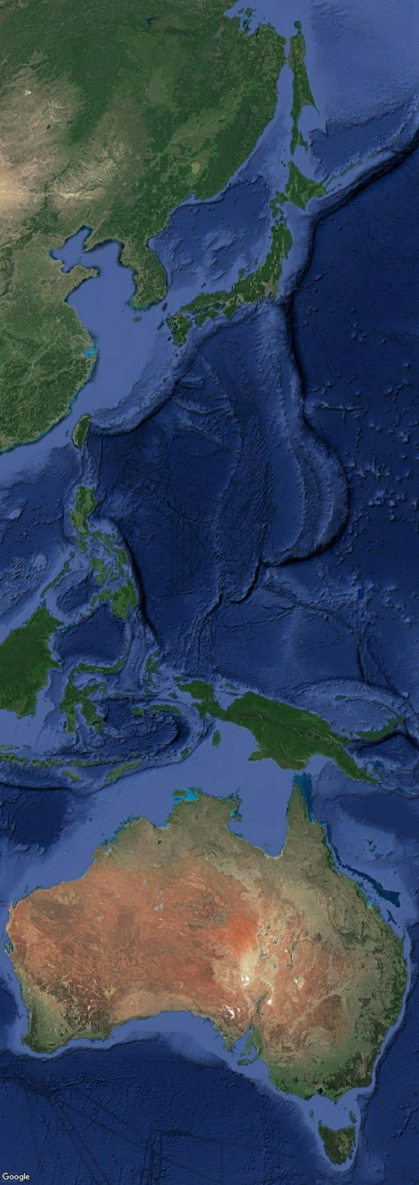
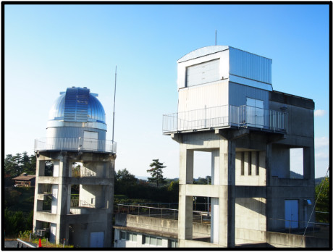
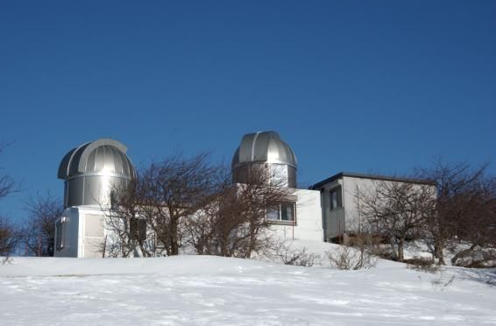
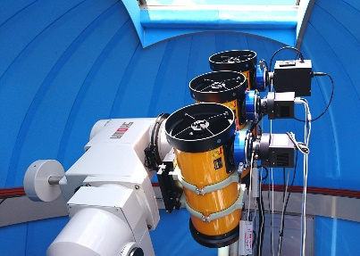
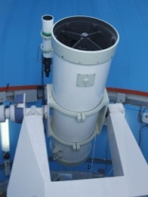
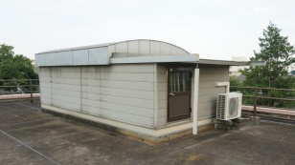
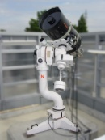
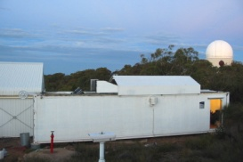
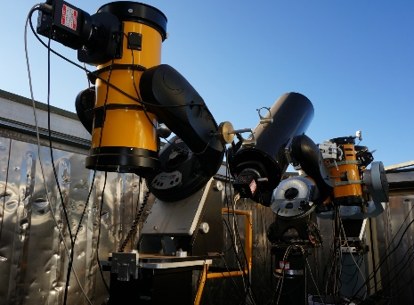
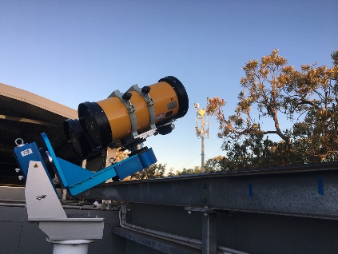
Asteroid observations in JAXA
Bisei Spacegurad Center (BSGC)
(Space Tracking and Communications Center)
Observation facility
(Research and Development Directorate)
0.5m telescope
Mt.Nyukasa Observational facility
1m telescope
Chofu LEO Observational facility
Remote observation site at Siding Spring Observatory
・Built in 2000 and owned by the Japan Space Forum, it was transferred to JAXA in April 2017.
・The observation work is carried out by the Japan Spaceguard Association (NPO).
・Observation targets: Space debris, NEO (asteroids)
Remote observation site at Zadko Observatory
2025/5/6
PDC2025
4

Slide 5
Discovery of fast moving small objects
Experimental observation:
We developed a stacking method to find fast moving small objects.
Discovered NEOs by the stacking method
by using small telescopes (~20cm)
Provisional designation | Mag. at discovery | e | a (au) | i (deg) | Distance at discovery (au) | Abs. Mag.
2017 BK | 17.5 | 0.489 | 1.909 | 6.6359 | 0.051 | 24.0
2017 BN92 | 17.1 | 0.483 | 1.921 | 1.0734 | 0.014 | 25.6
2018 EZ2 | 18.2 | 0.510 | 1.951 | 4.9718 | 0.01 | 26.6
2018 FH1 | 18.7 | 0.177 | 0.938 | 3.5468 | 0.013 | 26.6
2018 PM10 | 18.3 | 0.427 | 1.780 | 9.2065 | 0.001 | 27.0
2018 RR4 | 18.0 | 0.621 | 2.637 | 3.1793 | 0.015 | 27.1
2018 UG3 | 19.4 | 0.423 | 1.662 | 6.1673 | 0.03 | 24.5
2019 GW1 | 17.5 | 0.114 | 0.934 | 13.2945 | 0.009 | 26.1
2019 GT19 | 18.2 | 0.370 | 1.273 | 7.7488 | 0.01 | 27.5
2019 QU4 | 18.1 | 0.332 | 1.426 | 10.1313 | 0.017 | 24.8
2020 FC2 | 18.5 | 0.398 | 1.644 | 6.8153 | 0.006 | 28.0
We assume various movements of a faint object and overlap the images to find it.

Slide 6
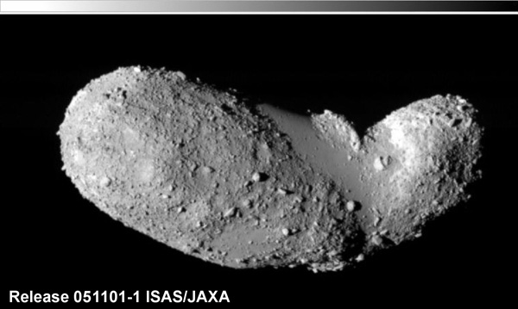
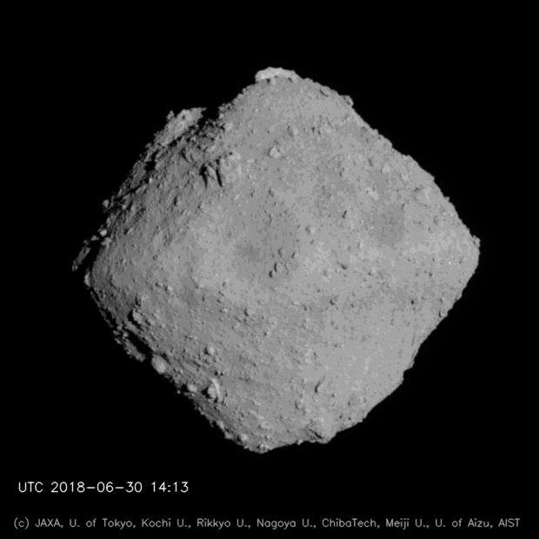
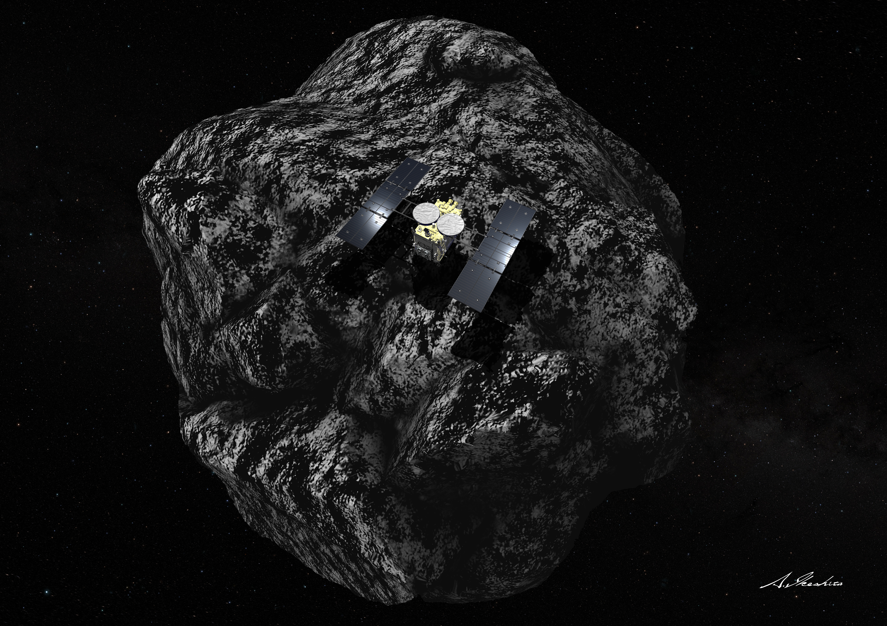
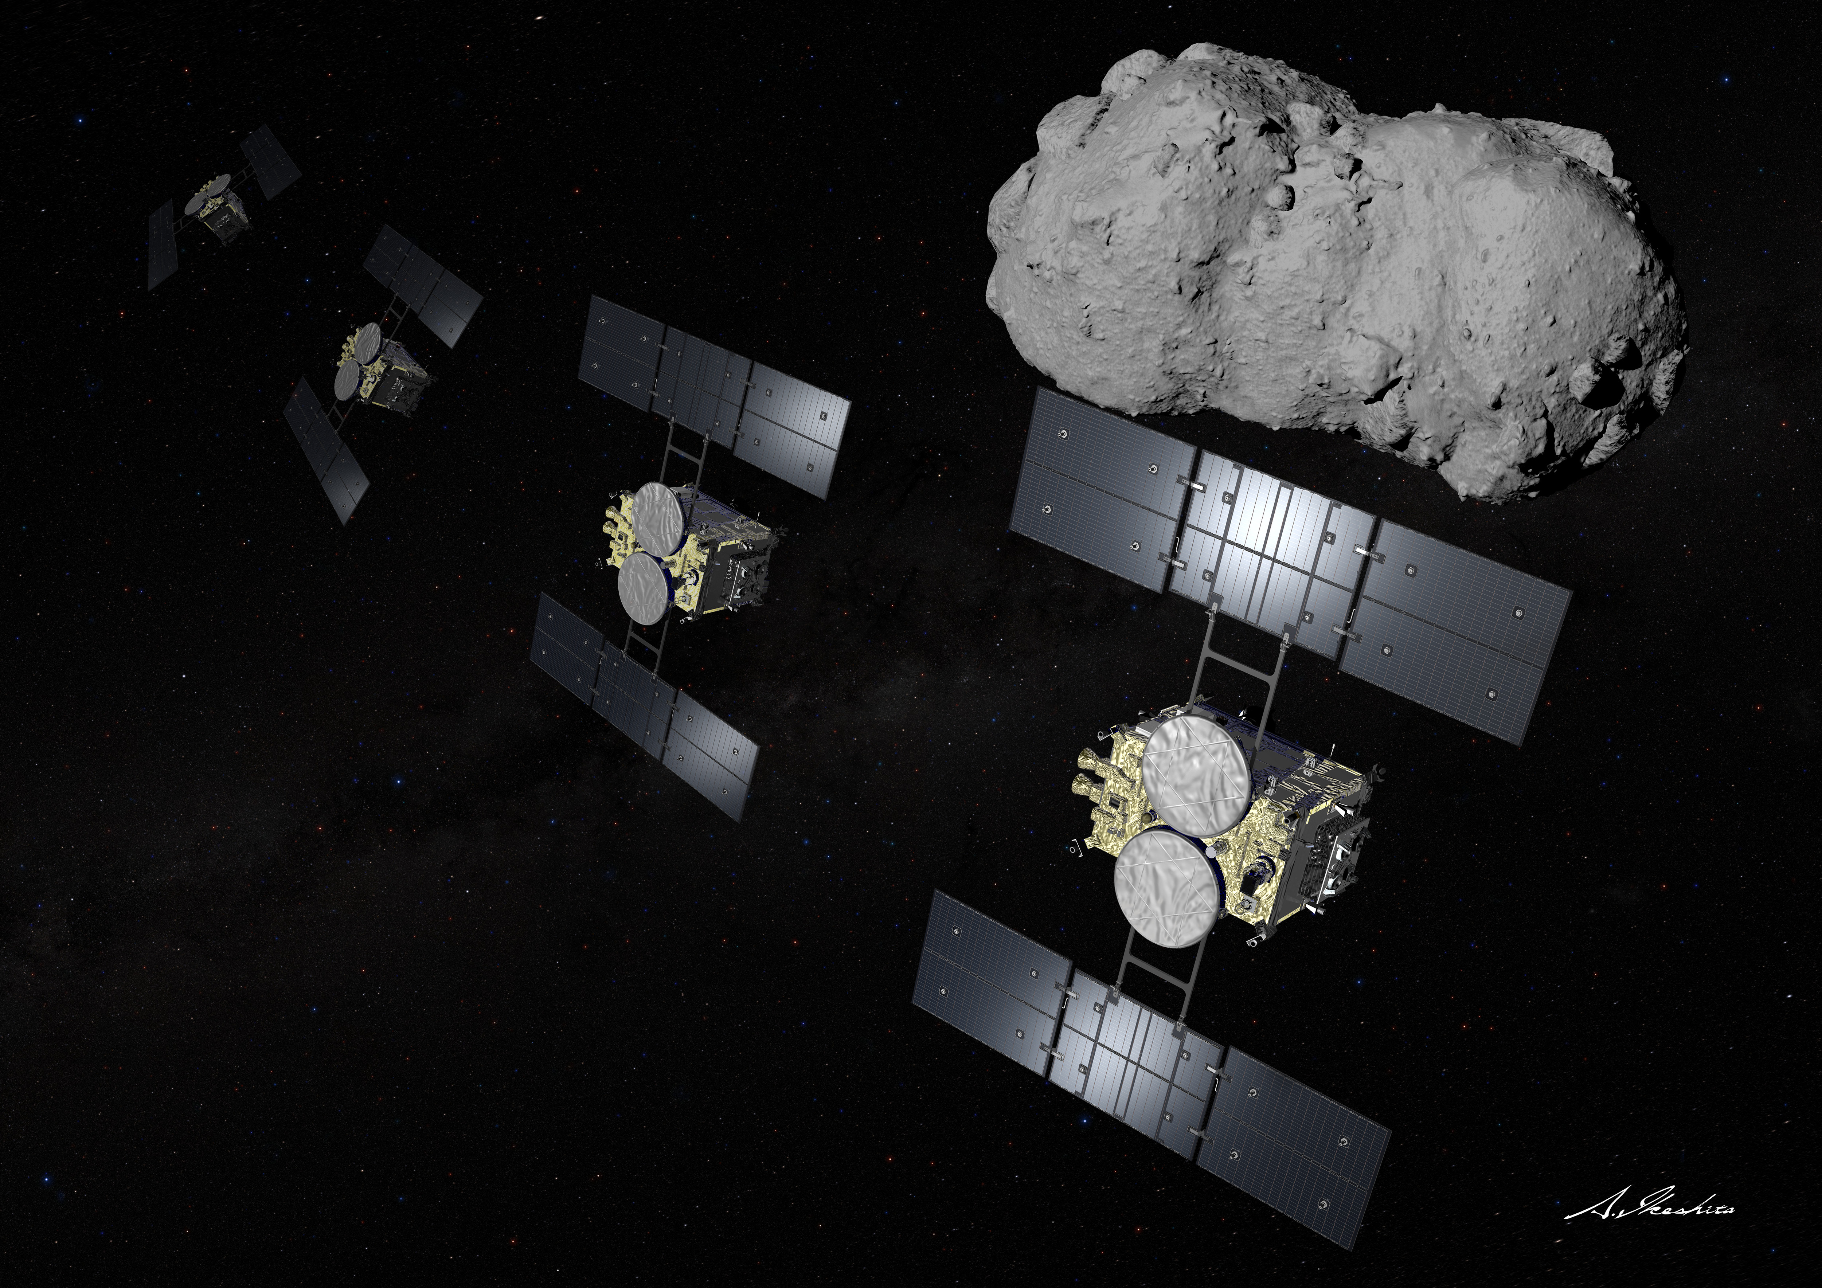
NEO missions related to JAXA
JAXA's mission
JAXA collaboration
Hayabusa (2003-2010)
Hayabusa2 (2014-2020)
Hayabusa2# (2020 ~ )
arrived in 2005
arrived in 2018
flyby in 2026
Rendezvous in 2031
?
?
Itokawa
S-type, 530m
Ryugu
C-type, 1000m
Torifune
S-type, 500m ?
1998 KY26
30m ? smaller?
DESTINY＋
Target : Phaethon
Launch 2028, flyby 2030
NGSR
Next Generation small body Sample Return mission
Target : comets
Launch 2030'
Hera (ESA)
Target : Didymos, Dimorphos
Launch 2024, arrival 2026
JAXA provided TIRI.
RAMSES (ESA)
JAXA collaboration
Target : Apophis
（Image credit：JAXA / A. Ikeshita）
6

Slide 7
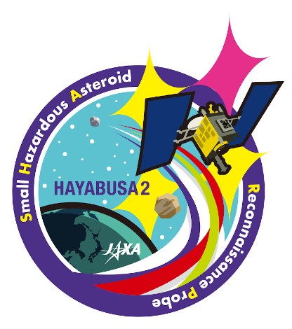
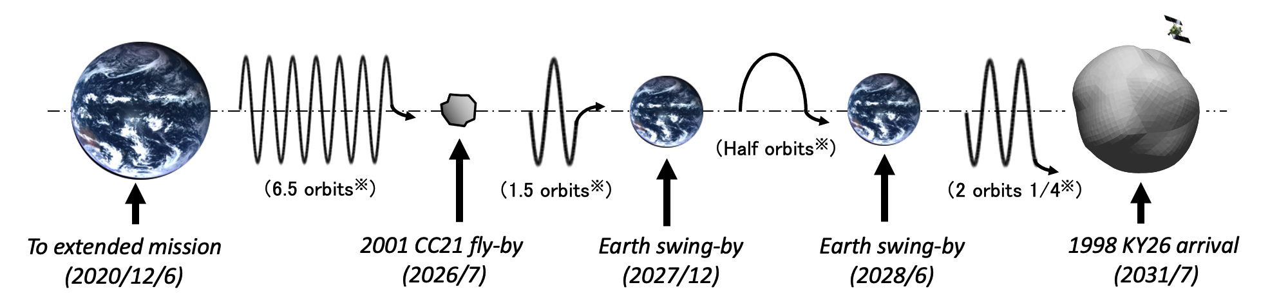
Hayabusa2 Extended mission : Hayabusa2#
# (SHARP) : Small Hazardous Asteroid Reconnaissance Probe
After Hayabusa2 returned the sample of Ryugu in Dec. 2020, we extended the mission for two more targets, (98943) Torifune (2001 CC21) and 1998 KY26.
now
※ indicates the number of orbits around the Sun.
Torifune
（Image credit：JAXA）
Relative velocity : 5km/s
High accuracy navigation is necessary.
Asteroid size : ~30m or 11m?
(spin period : ~11 or 5min?)
The collision probability of such asteroids with the Earth is once in 100~200 years.
Next presentation by T. Hirabayashi
Artist's illustration (by A. Ikeshita)
7

Slide 8
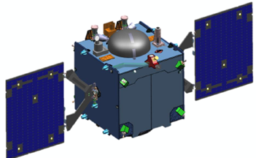
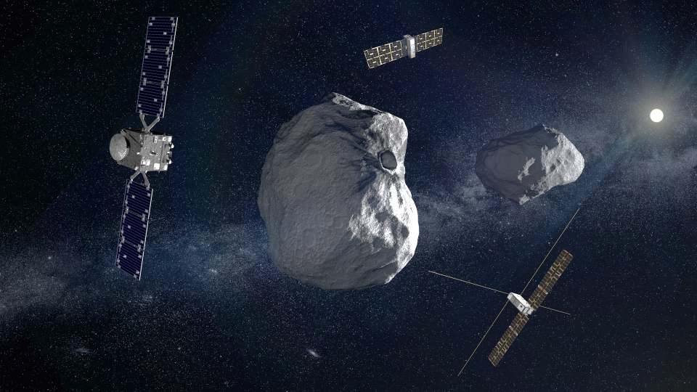
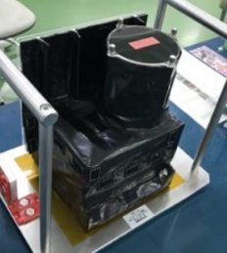
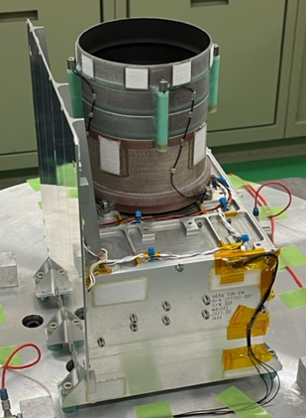
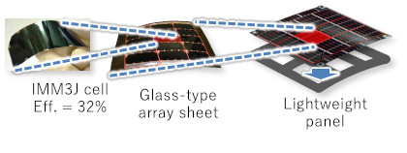
Hera / RAMSES collaborations
Hera
RAMSES
©ESA
JAXA is considering to provide followings:
Thermal infrared camera (TIRI)
Lightweight Solar Array Wing
Possible launch opportunities
© ESA
JAXA provided the thermal infrared camera (TIRI).
・ Broadband (8-14 µm) and six narrow band (1µm width)
・FOV：13 x 10 deg
・Measurement of temperature and physical properties of the asteroid surface layer
© JAXA
Flight spare of TIRI for Hera
© JAXA
Lightweight Solar Array Wing
TIRI
See the poster by T. Okada (IAA-PDC-25-02-176)
8

Slide 9
Apophis observation from satellites
JAXA currently has no plans to launch a new satellite/spacecraft to the asteroid Apophis.
We are investigating the possibility of observing Apophis using existing satellites.
This is currently under consideration and no conclusion has been reached yet.
See the poster of T. Ikenaga (IAA-PDC-25-07-95)
9

Slide 10
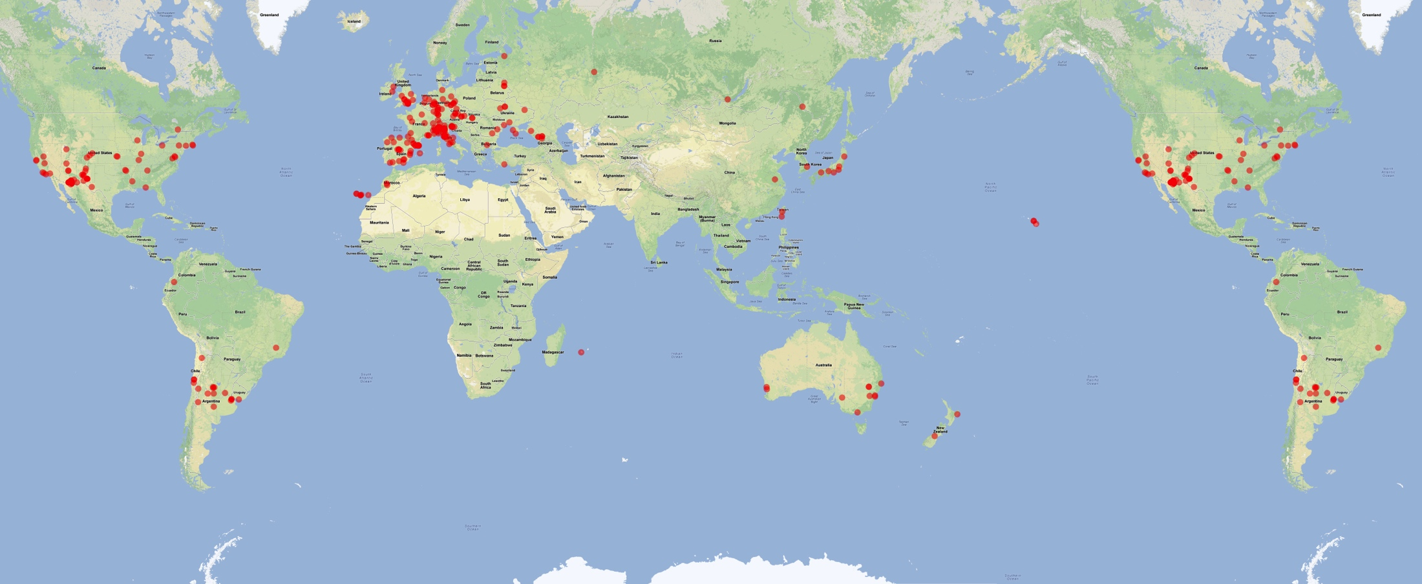
Asia-Pacific Asteroid Observation Network (APAON)
JAXA organized the "Asia-Pacific Asteroid Observation Network (APAON)" to effectively utilize telescopes in the Asia-Pacific region and contribute to planetary defense.
Asteroid observers in Japan are also organized into Japanese teams.
Dec. 2013 APAON was proposed at APRSAF※ and called for participation
2014 Introduced at IAWN and SMPAG meetings
Jan. 2015 Started observation campaign as test observation. Eleven countries and regions participated.
2018 Activity suspended.
2025 Attempting to restart
※:Asia-Pacific Regional Space Agency Forum
★
★
Promoting asteroid observation in this area
Distribution of ground observation networks.
Original illustration： by Timothy Spahr.

Slide 11
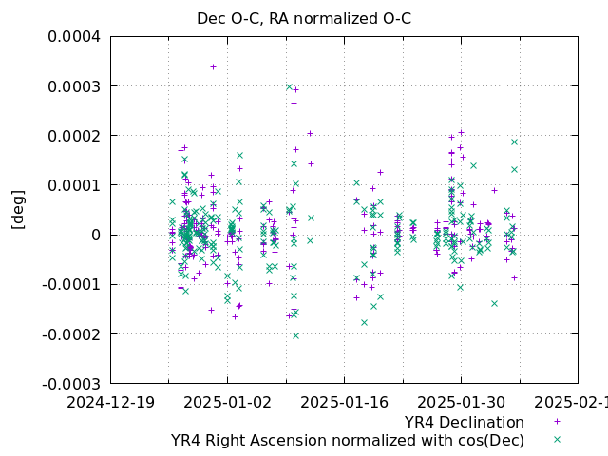
Deep-space multi-object orbit determination system (DMOODS) = JAXA's software for the orbit determination of deep space mission
Collision probability analysis for 2024 YR4
This system has the ability to simultaneously estimate the orbits of deep space probes and target celestial bodies:
For Hayabusa2 mission:
The final approach phase to Ryugu
The estimation of the gravity field of Ryugu
The final guidance phase returning to the Earth
Precise estimation of Ryugu's orbit
We used the data published by the Minor Planet Center (MPC), and the orbit of 2024 YR4 was estimated.
Developed a function to directly import asteroid observation data of ground-based telescopes.
O-C rms: 9.404e-05 deg = 0.33 arcsec
11

Slide 12
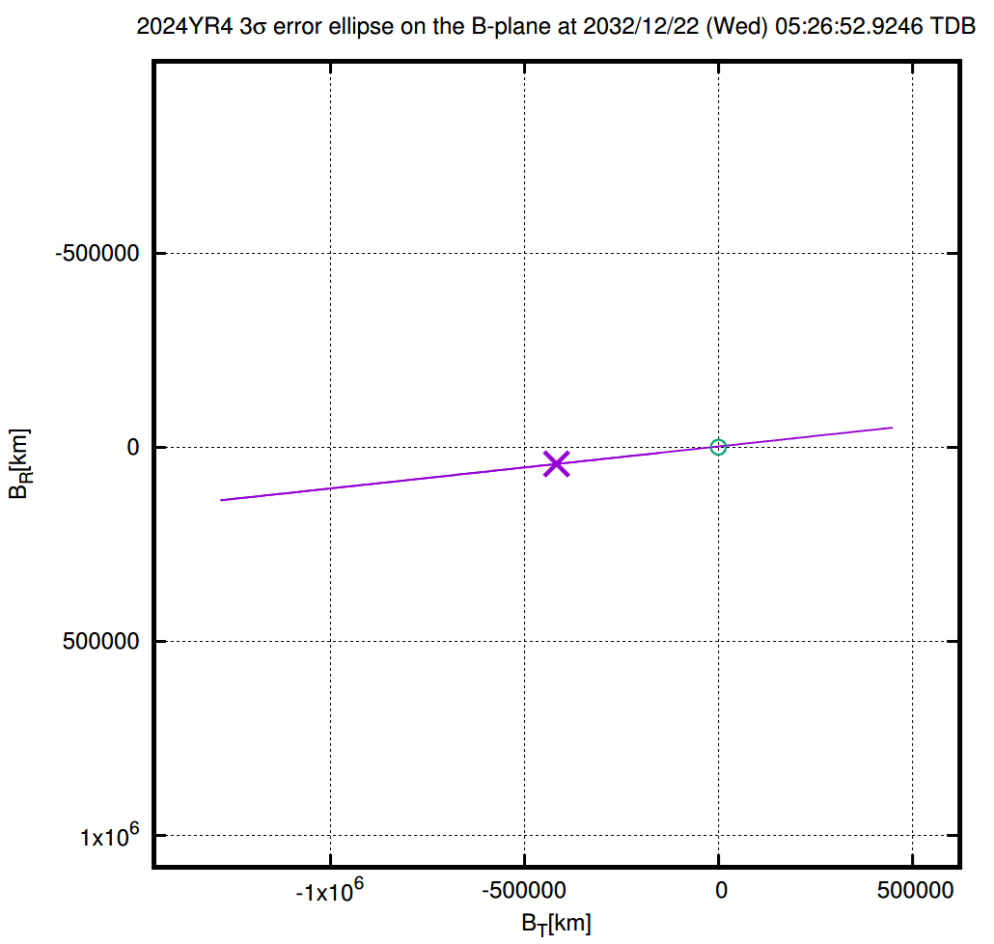
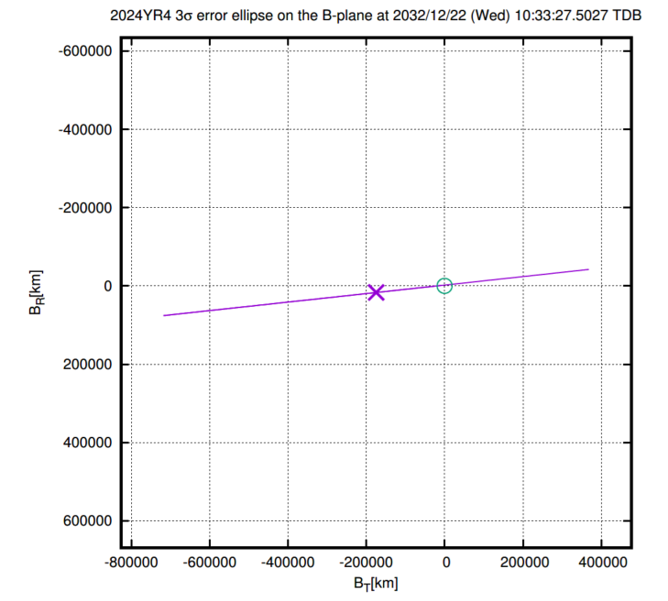
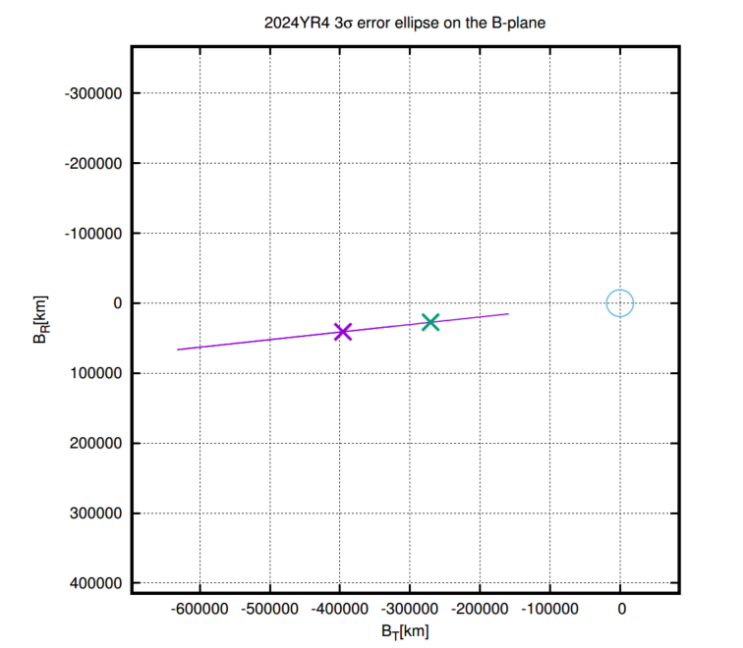
Collision probability analysis for 2024 YR4
JAXA's solution
Feb. 6, 2025
Col. prob. : 0.82%
Feb. 16, 2025
Col. prob. : 2.04%
Feb. 27, 2025
Col. prob. : 0.0%
The estimated probabilities were consistnet with those of by JPL and ESA.
12

Slide 13
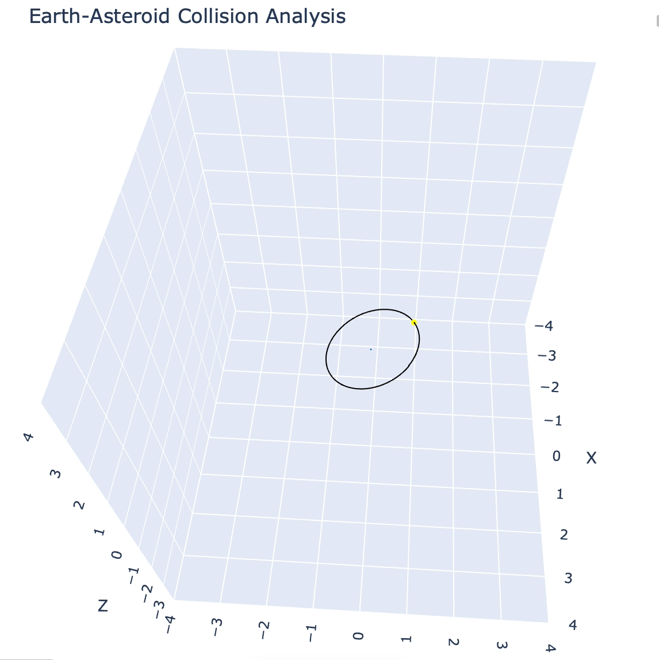
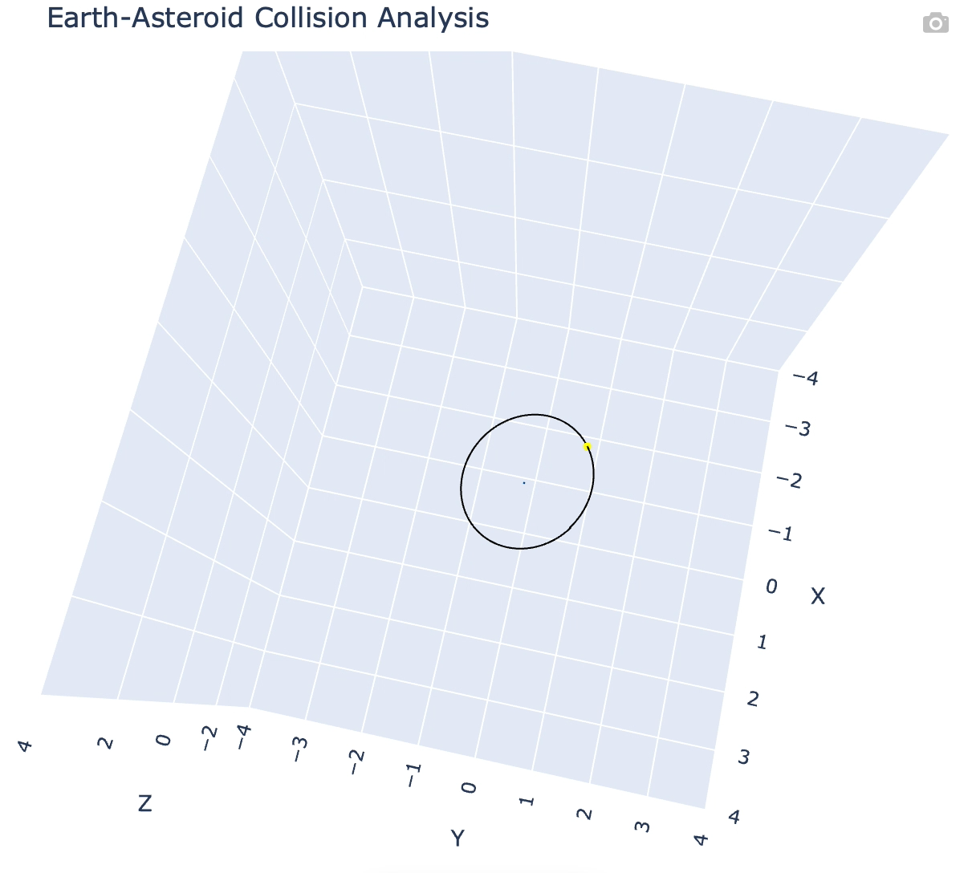
Collision probability analysis for 2024 YR4
JAXA's solution
Feb. 6, 2025
Col. prob. : 0.82%
Feb. 16, 2025
Col. prob. : 2.04%
In these simulations, the particles that collide with the Earth are not deleted after the collision.
13

Slide 14
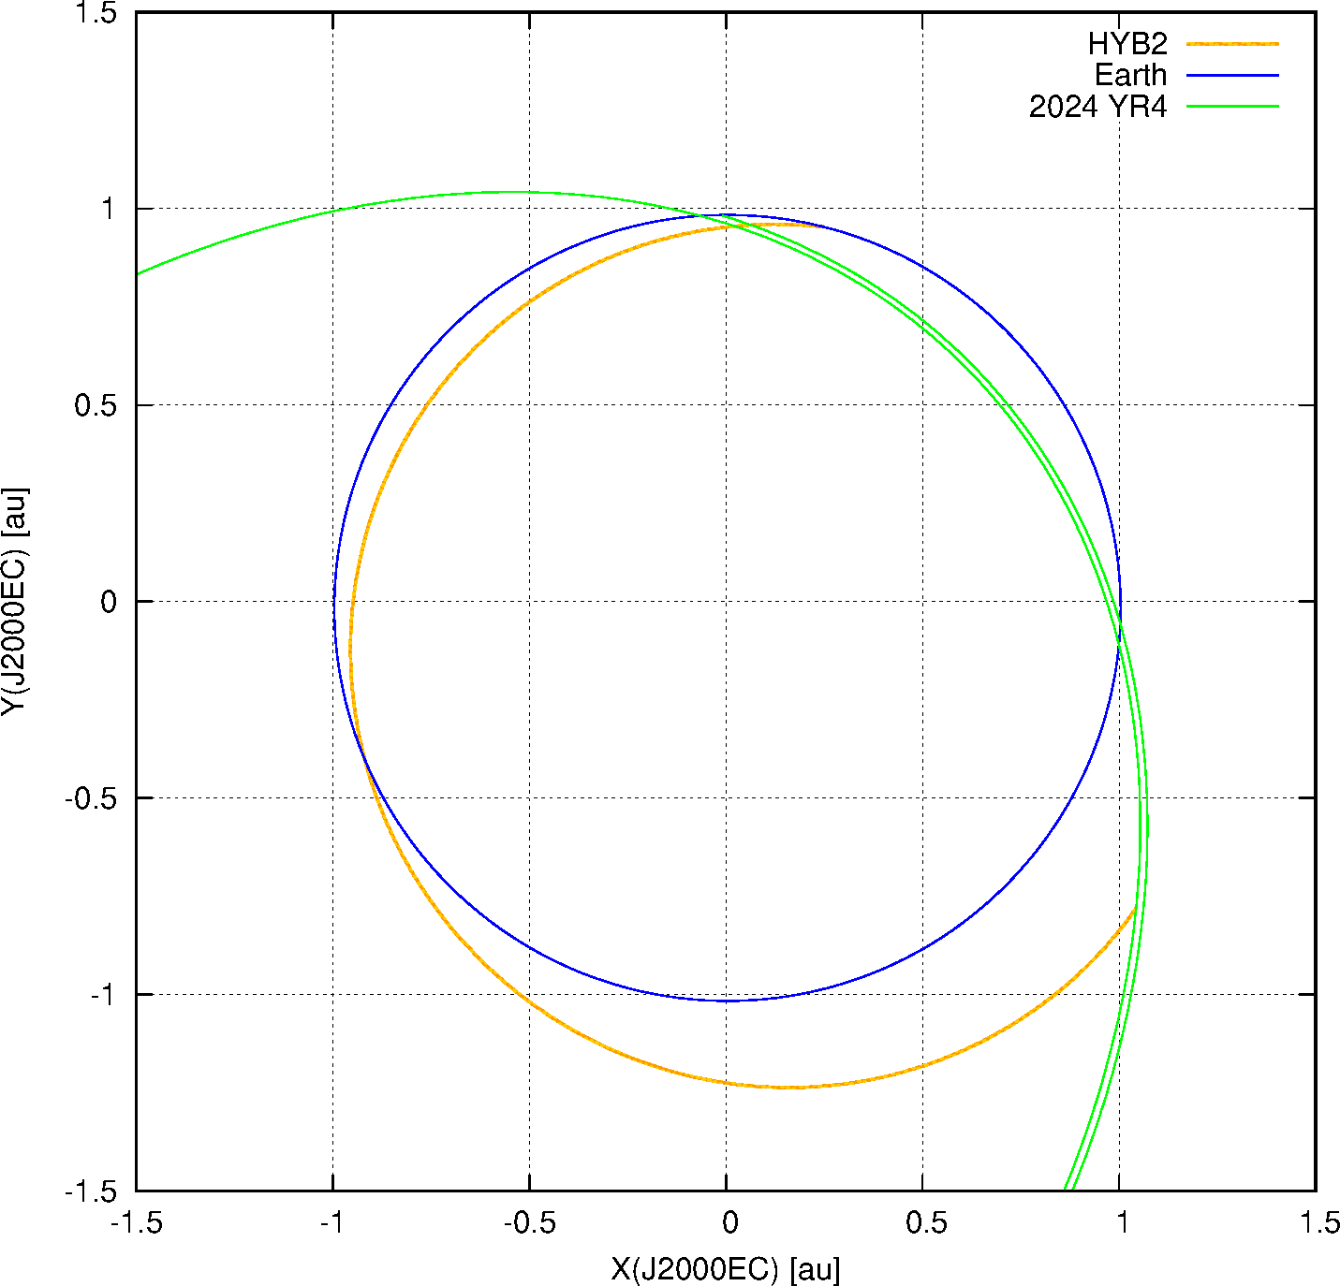
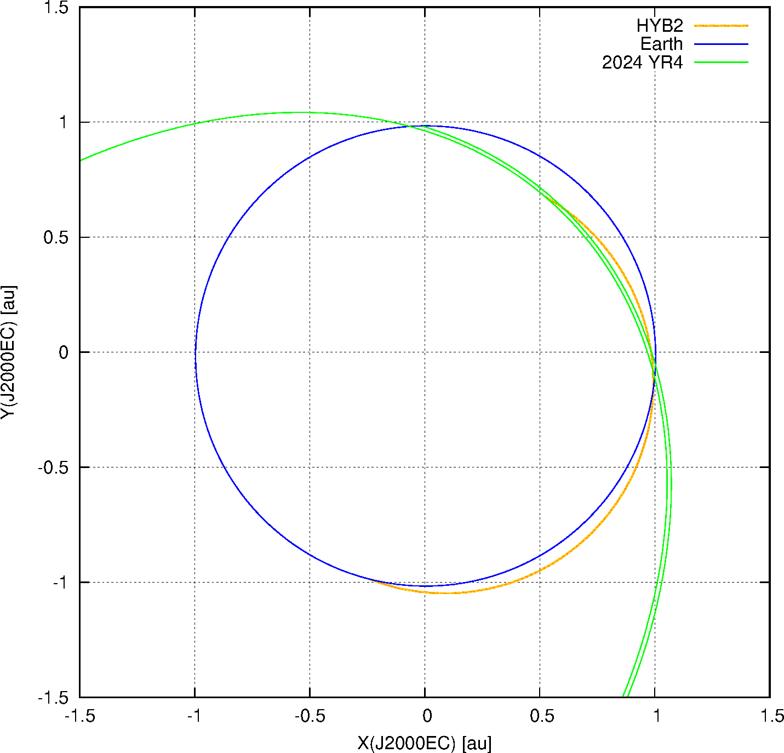
Deflection of 2024 YR4 by Hayabusa2
We investigated whether it would be possible to change the orbit of YR4 using Hayabusa2, which is currently in flight.
If we give up arriving at 1998 KY26, it is possible to direct Hayabusa2 to 2024 YR4 by changing the conditions of the two Earth swing-bys.
Case1
▶Earth Swing-by : 2027/12/07.0 UT
▶YR4 intercept : 2028/09/10.0 UT
▶Intercept Velocity: 16.14km/s
▶YR4 sun-lit phase : 12.8deg
(Near full-moon)
[Case1]
[Case2]
YR4’s Earth encounter (2032/12/22)
YR4’s Earth encounter (2032/12/22)
HYB2’s Earth swing-by (2027/12/7)
HYB2’s YR4 Impact (2028/11/23)
Case2
▶Earth Swing-by : 2028/06/07.0 UT
▶YR4 intercept : 2028/11/23.0 UT
▶Intercept Velocity: 10.80km/s
▶YR4 sun-lit phase : 128.0deg
(Crescent-moon)
HYB2’s YR4 Impact (2028/9/10)
HYB2’s Earth swing-by (2028/6/7)

Slide 15
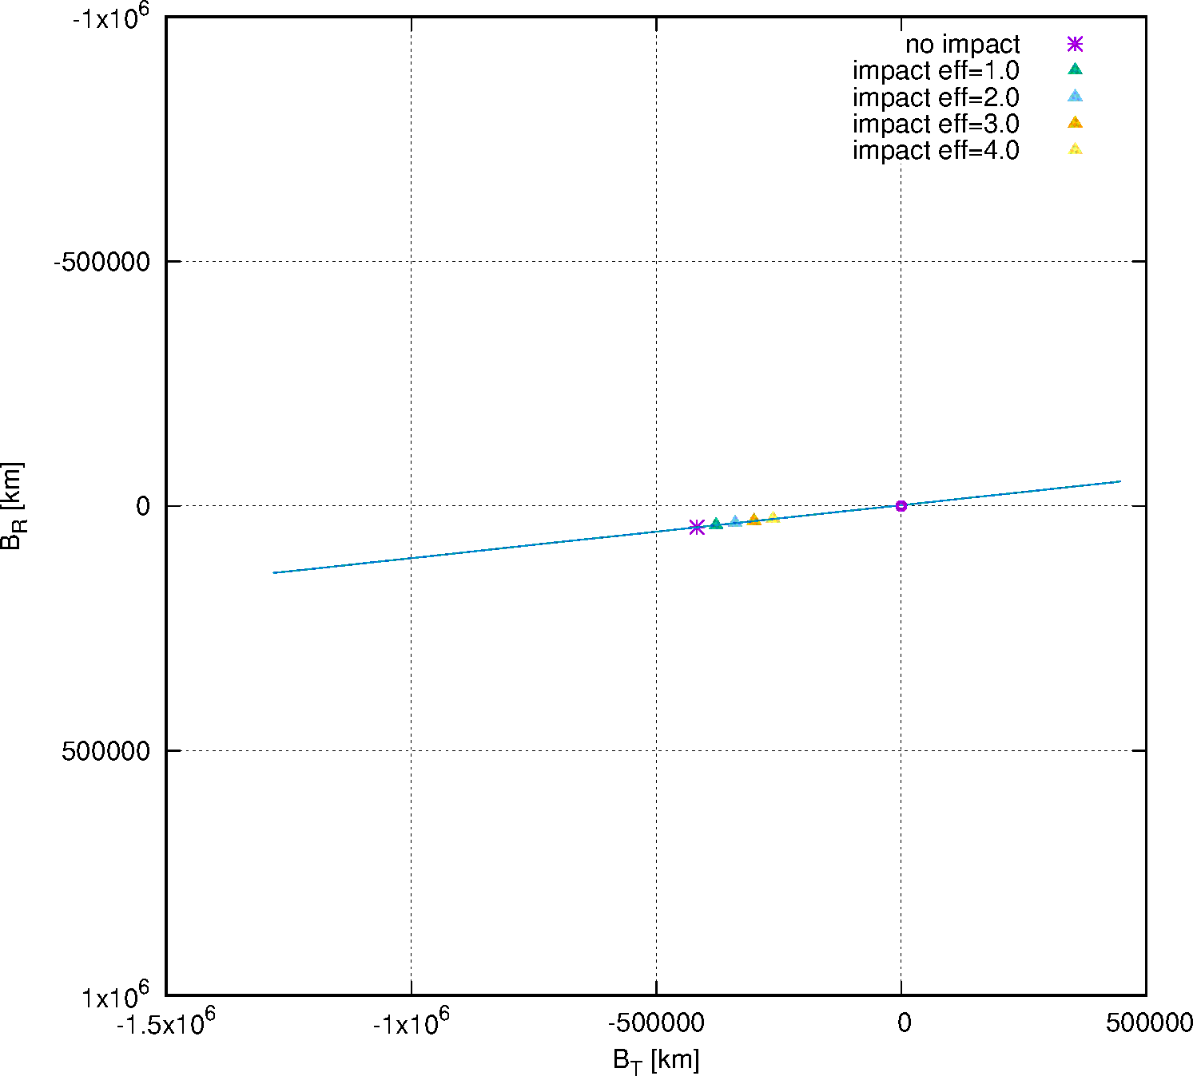

Deflection of 2024 YR4 by Hayabusa2
We investigated the changes in the velocity and the position of 2024 YR4, when Hayabusa 2 is collided with YR4.
The impact of Hayabusa2 to 2024 YR4 has the effect of shifting the YR4 orbit largely to the right on the B-plane.
This calculation is based on the JAXA's solution on Feb. 6, 2025
[Case1]
B-plane Passage for Impact with ε=1.0,2.0,3.0,4.0
Assumptions：
YR4: d~50m, ρ~2g/cm³
Hayabusa2: mass~500kg
Impact efficiency(ε) : 1 ~ 4
(DART : ε= 2.2 ~ 4.9)
Case1
ε=1.0, deflection ΔV= 61.6mm/s
ε=2.0, deflection ΔV=123.3mm/s
ε=3.0, deflection ΔV=184.9mm/s
ε=4.0, deflection ΔV=246.6mm/s
Earth
Case2
ε=1.0, deflection ΔV= 41.2mm/s
ε=2.0, deflection ΔV= 82.5mm/s
ε=3.0, deflection ΔV=123.7mm/s
ε=4.0, deflection ΔV=164.9mm/s
3σ ellipse of nominal YR4 traj.

Slide 16
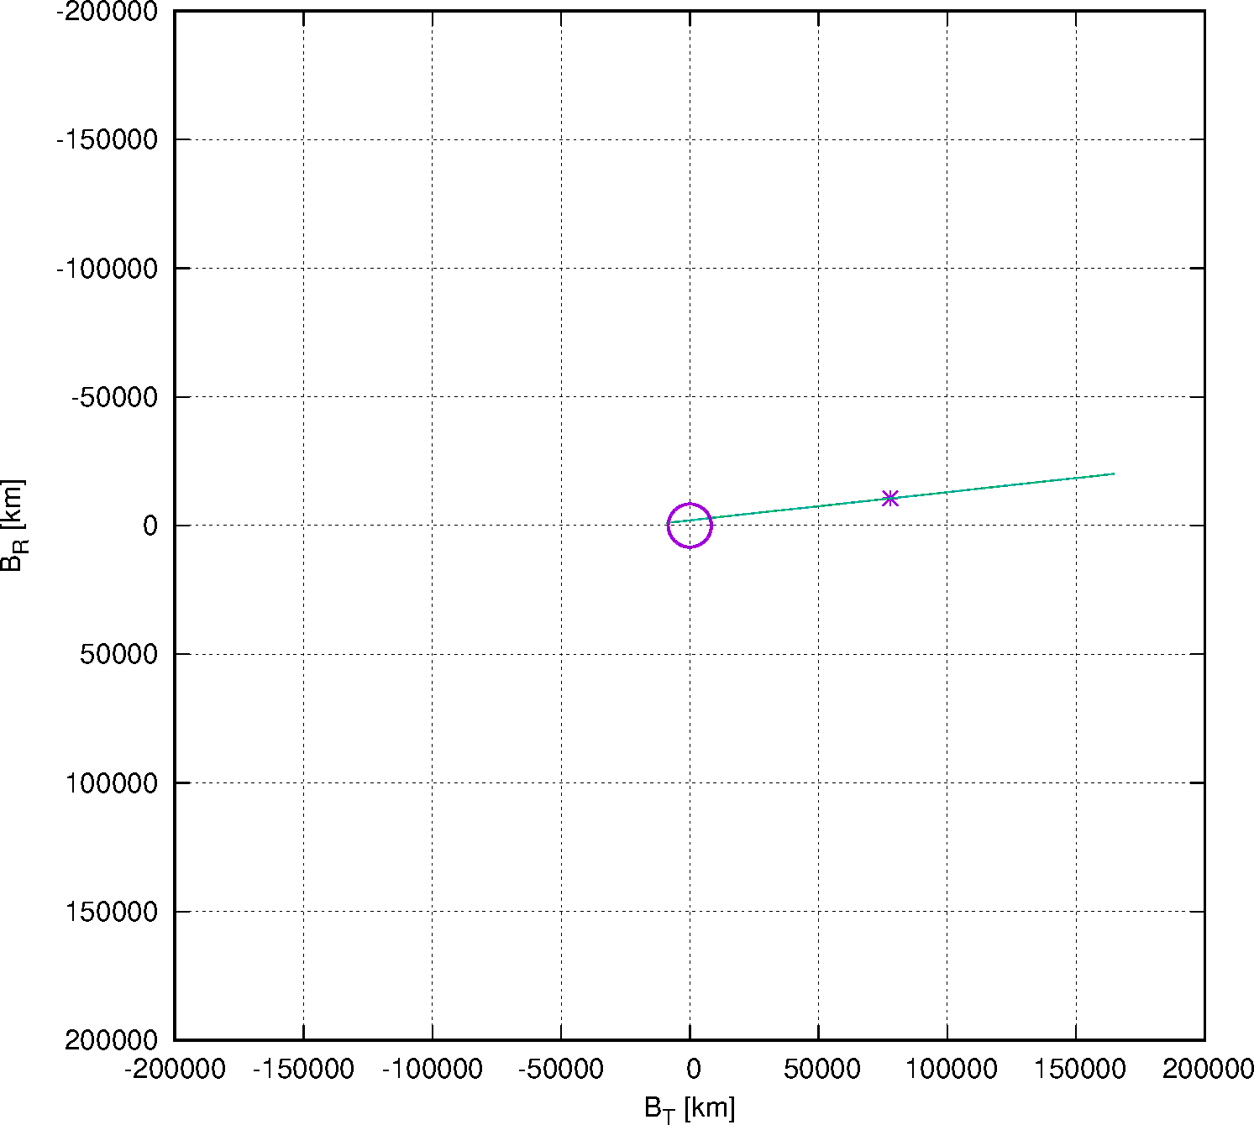
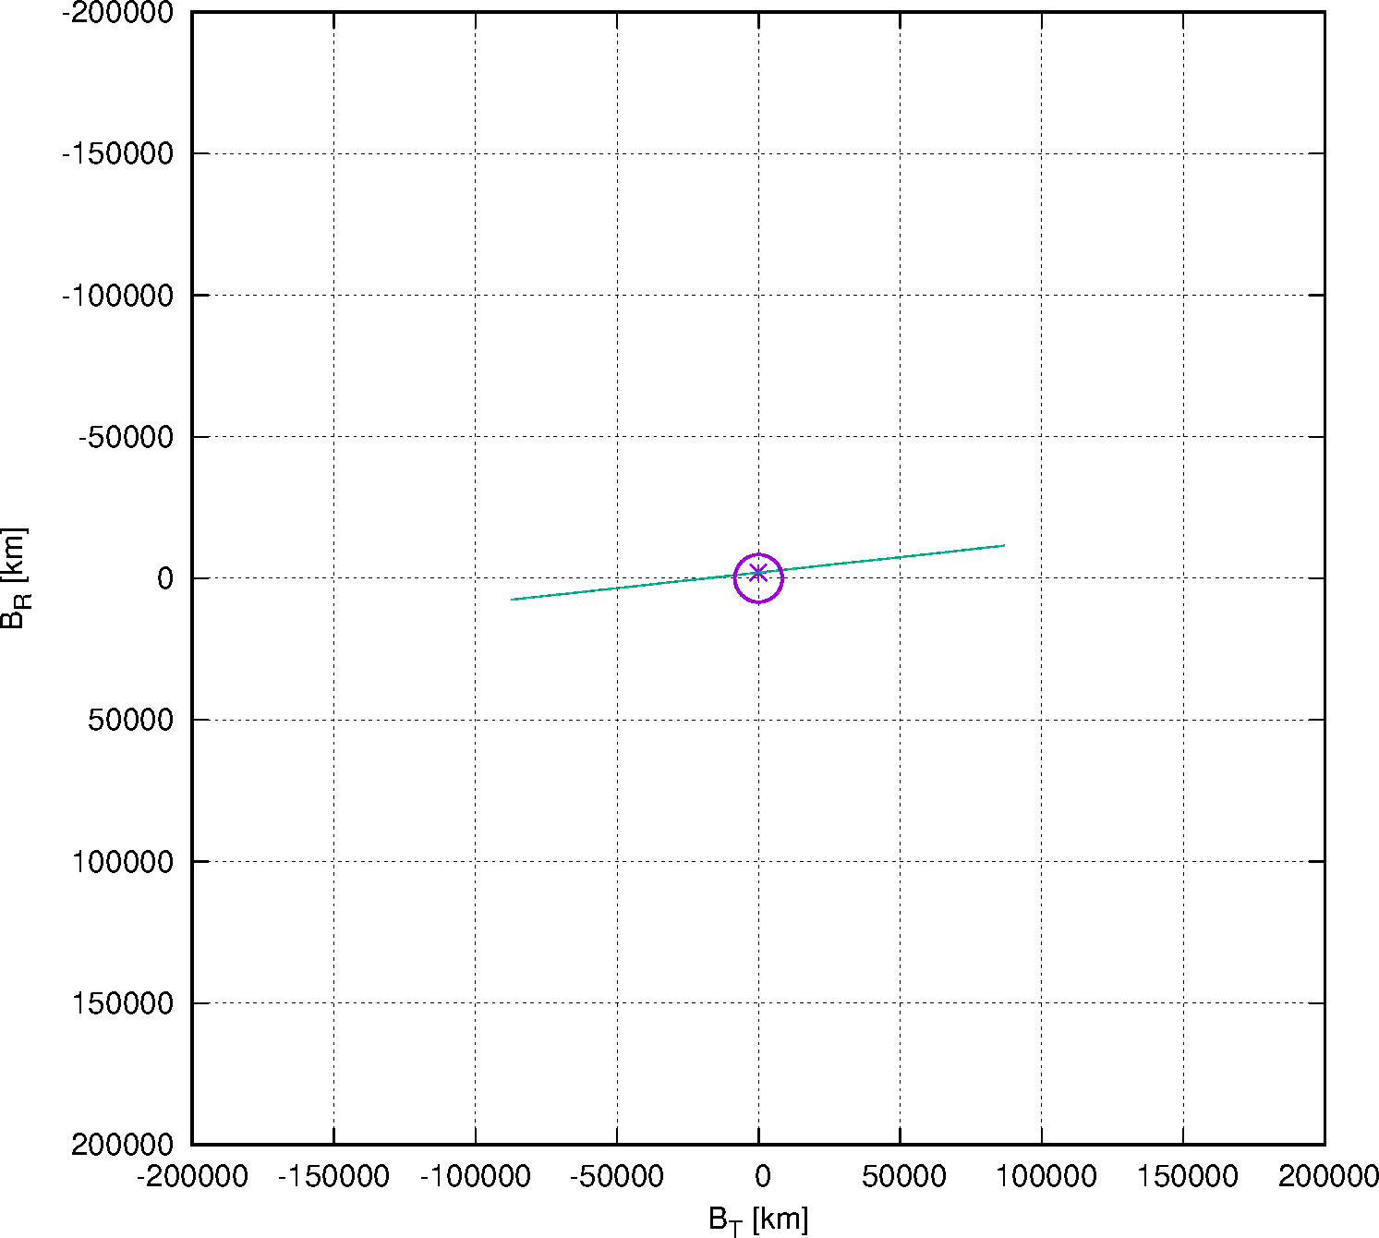
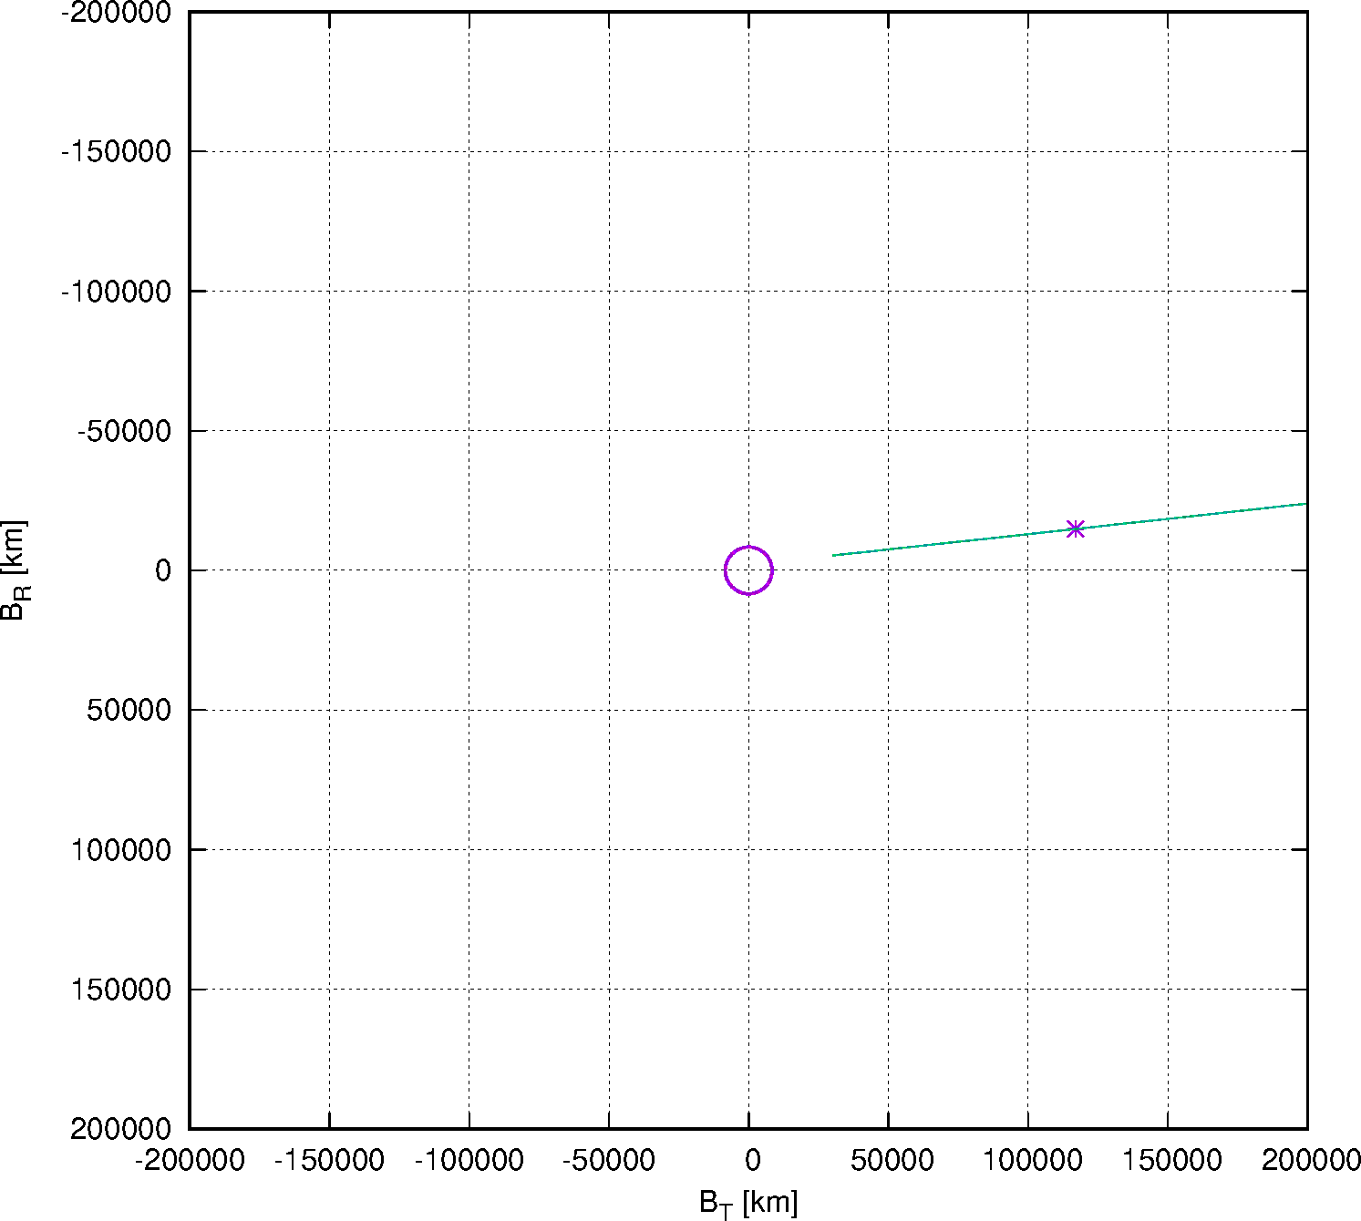
Deflection of 2024 YR4 by Hayabusa2
We assumed a fictitious case, where 2024 YR4 collides with the Earth.
Hayabusa2 can avoid the collision of 2024 YR4 with the Earth!
[Case1]
Assumptions：
YR4: d~50m, ρ~2g/cm³
Hayabusa2: mass~500kg
Impact efficiency(ε) : 2 or 3
YR4 orbit error becomes 1/10
ε=2.0
▶ YR4’s Earth Impact Probability : 0.58%
3σ ellipse of nominal YR4 traj.
Earth and YR4
▶ YR4’s Earth Impact Probability : 22.0%
ε=3.0
However, because Hayabusa2 is spacecraft for rendezvous, it is difficult to collide it with a small target object at high speed.
▶ YR4’s Earth Impact Probability : 0.01%

Slide 17
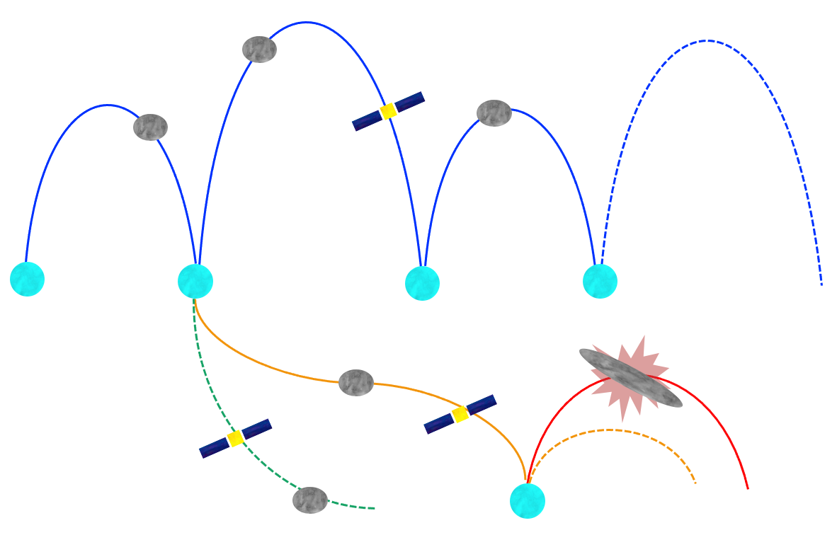
Deep Space Constellation Concept
New idea!
Many (for example, 12) spacecraft are put in an asteroid flyby cycler orbit (alternating asteroid flyby and Earth swing by).
Then, we can perform one NEO flyby per month (ΔV~10 m/s per year, which is feasible for micro/nano spacecraft) .
We can also visit to such a newly discovered asteroid like 2024 YR4!
Asteroid #2
Multiple asteroid flybys
(in the loitering orbit)
Asteroid #1
Asteroid #3
Spacecraft 1
Earth Gravity Assist
Earth Gravity Assist
Earth Departure
(Rideshare/
Dedicated launch)
Rapid response flyby
Asteroid #4
Spacecraft 2
Spacecraft 3
Asteroid #5
（©JAXA）

Slide 18
Summary
For the planetary defense, JAXA carries out a variety of activities, including observation, exploration, calculations, international and domestic responses, and outreach.
Orbit determination and Earth impact analysis for 2024 YR4 were carried out, and the obtained collision probability were almost consistent of those by NASA/ESA.
Using the currently operated Hayabusa2 spacecraft, we investigated the possibility of changing the orbit of 2024 YR4. The results showed that orbital change was theoretically possible. (However, since Hayabusa 2 is a rendezvous probe, it would be technically difficult to actually carry this out.)

Slide 19
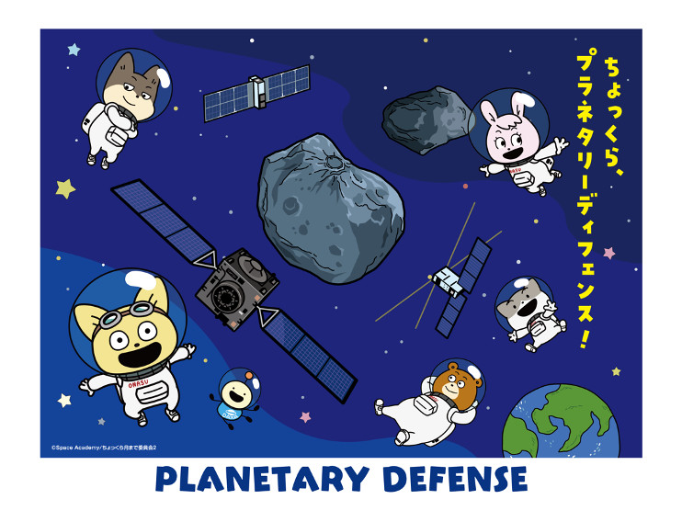
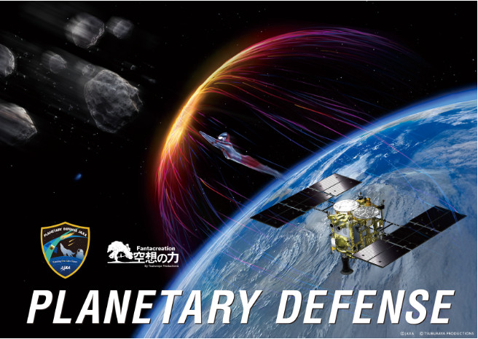
Thank you!

