Slide 1
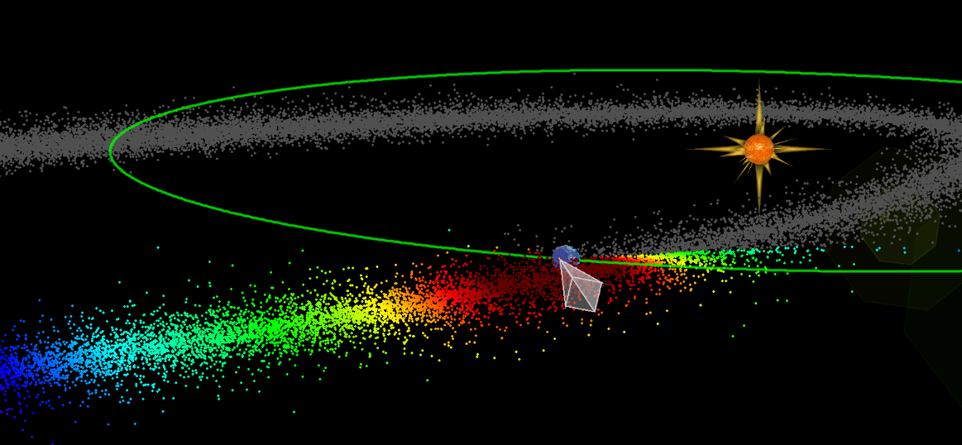
2032 and 2036 Risk Enhancement from NEOs in the Taurid Stream:
Is there a Significant Coherent Component to Impact Risk?
Mark Boslough^{1,2}, Peter Brown³, David Clark³, Paul Wiegert⁴, and Quanzhi Ye¹⁴
¹Los Alamos National Laboratory, ²University of New Mexico, ³University of Western Ontario, ⁴University of Maryland
IAA Planetary Defense Conference, 5-9 May 2025, Stellenbosch, Cape Town, South Africa
LANL work was supported by the US Department of Energy through the Los Alamos National Laboratory. Los Alamos National Laboratory is operated by Triad National Security, LLC, for the National Nuclear Security Administration of U.S. Department of Energy (Contract No. 89233218CNA000001).

Slide 2
Assumptions: Stochastic vs Coherent Risk
Risk assessment for planetary defense implicitly assumes impacts are random
Risk is the integrated product of probability and consequences over all sizes
If events are truly random, then probability is constant (stochastic risk)
If events are not random, then probability can change with time (coherent risk)
Actual risk can be a combination of stochastic and coherent risk
The stochastic/coherent ratio can depend on object size and change with time
Notes:
2
2
Axioms

Slide 3
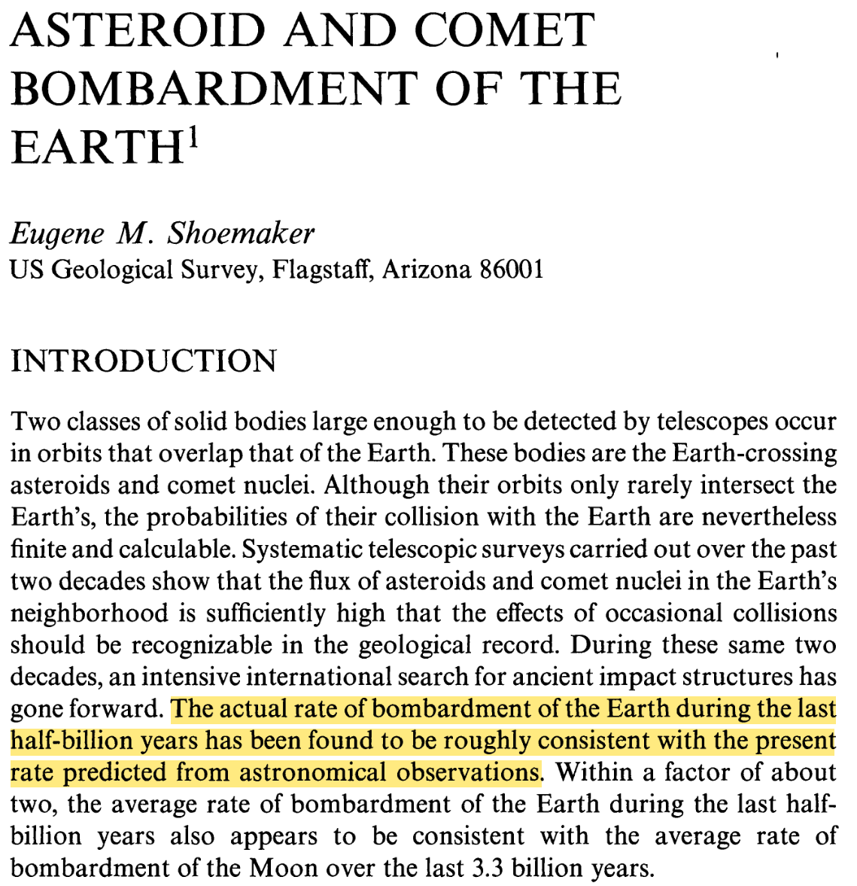
Shoemaker (1983)
Astronomical survey data are consistent with stochastic impacts for large objects over geological time

Slide 4
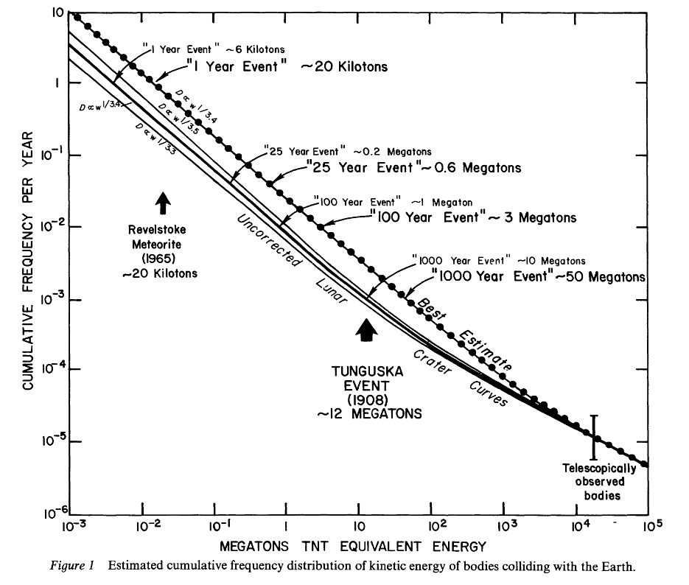
Shoemaker (1983)
Stochastic impact rate assumption is extrapolated beyond size and time ranges over which it was supported by data
Notes:
Baked in as a planetary defense risk assessment assumption

Slide 5
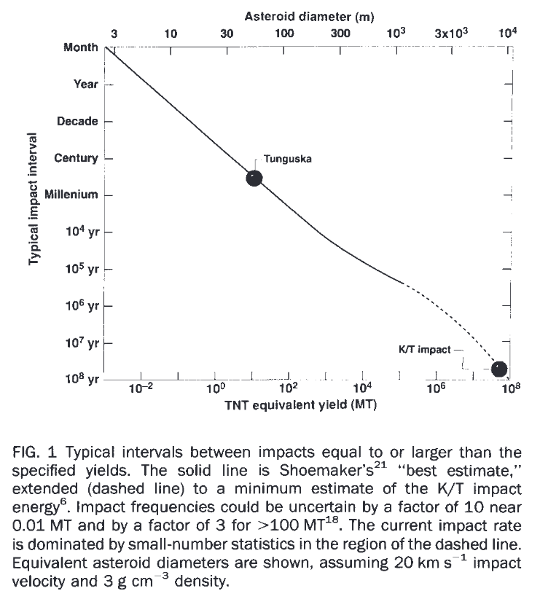
Chapman & Morrison (1994)
Adopted Shoemaker’s stochastic assumption in the first planetary defense risk assessment paper. This frequentist approach is now baked into our methodology but does not necessarily apply to size range with incomplete and biased observational statistics (Tunguska size range).
Notes:
Baked in as a planetary defense risk assessment assumption

Slide 6
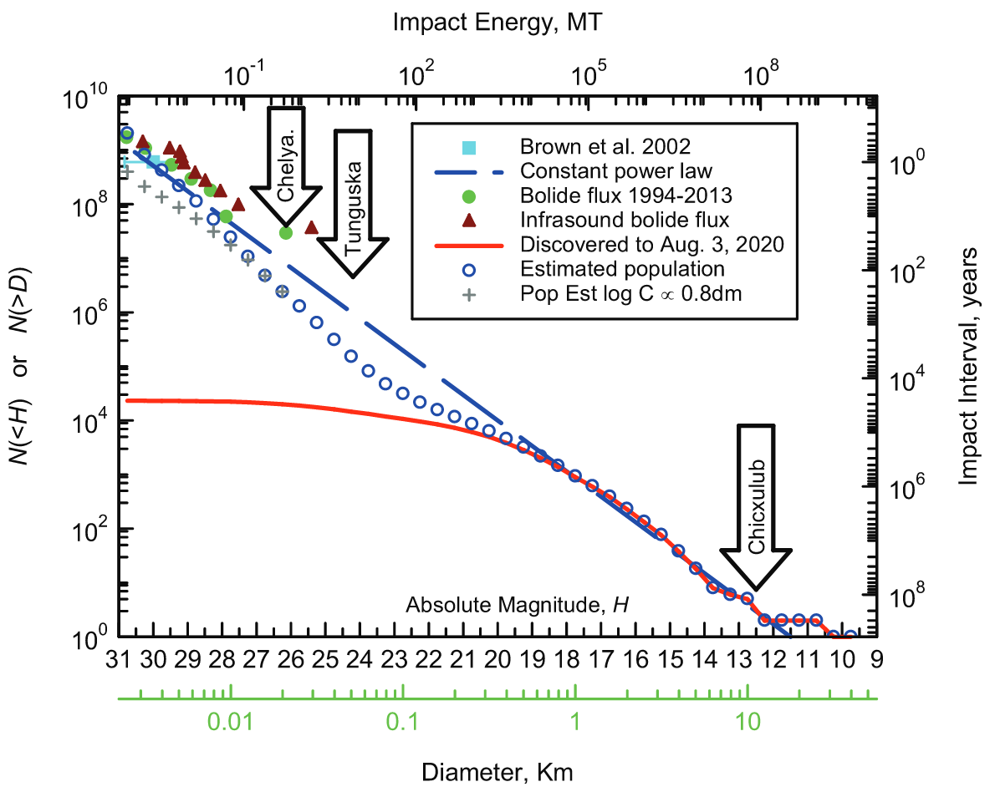
Harris & Chodas (2021)
Stochastic risk is implicit. 12 Mt impact should only happen once every 7000 years. Lowest published estimate range of 3-5 Mt for Tunguska should take place no more frequently than once every ~4000 years. Chelyabinsk corresponds to a ~250-year event. Suggests existence of unobserved coherent source.

Slide 7
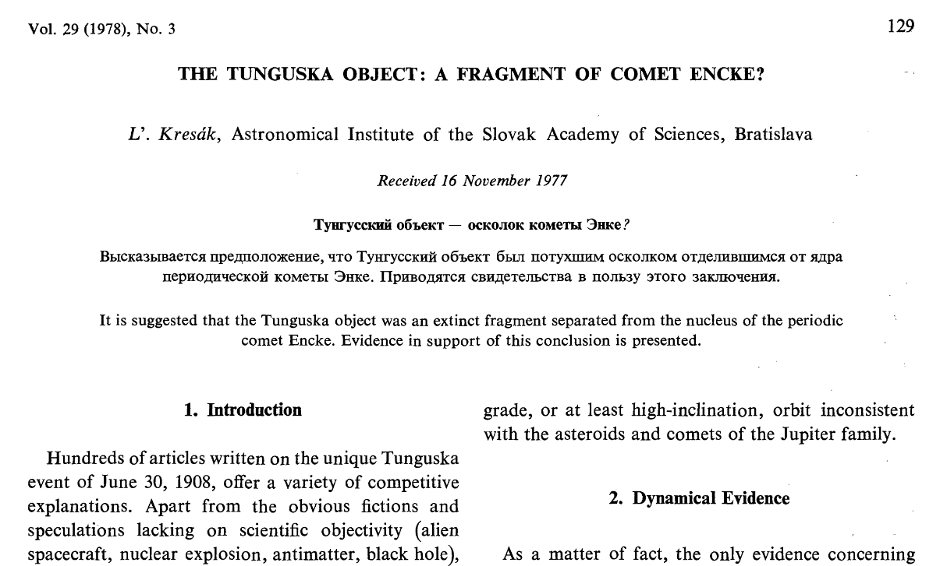
Kresák (1978)

Slide 8
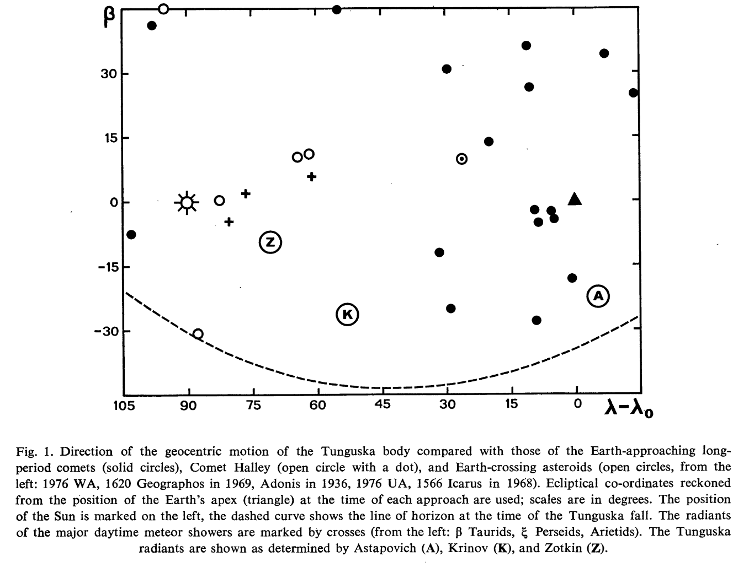
Kresák (1978)

Slide 9
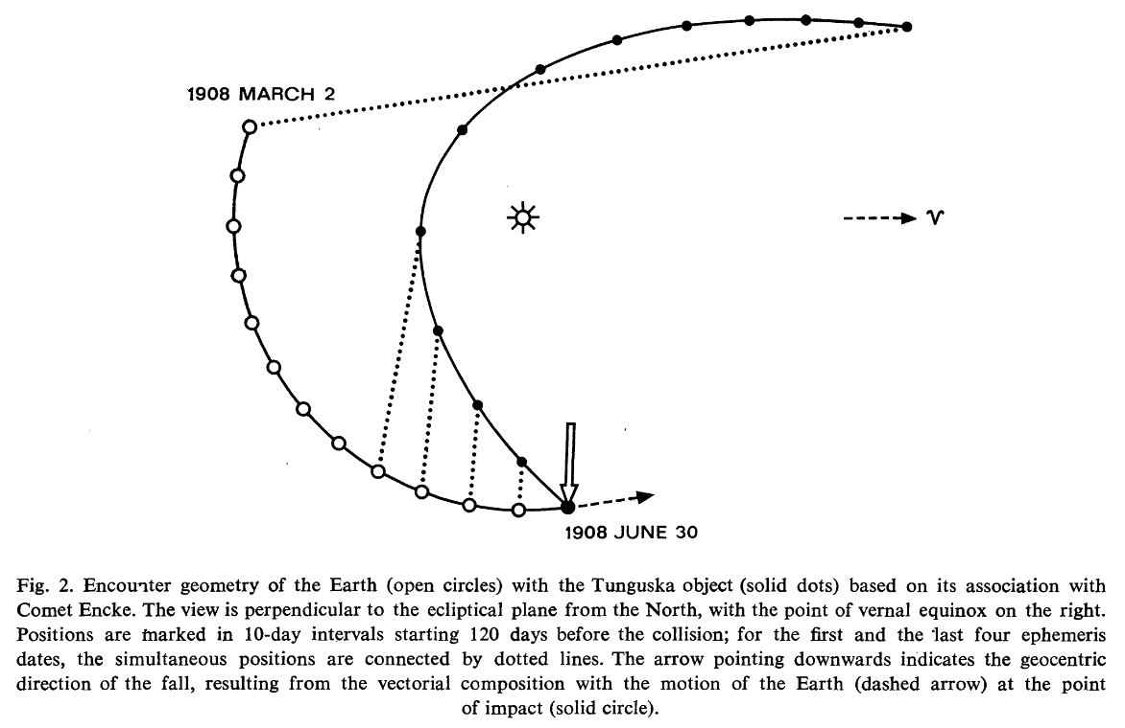
Kresák (1978)

Slide 10
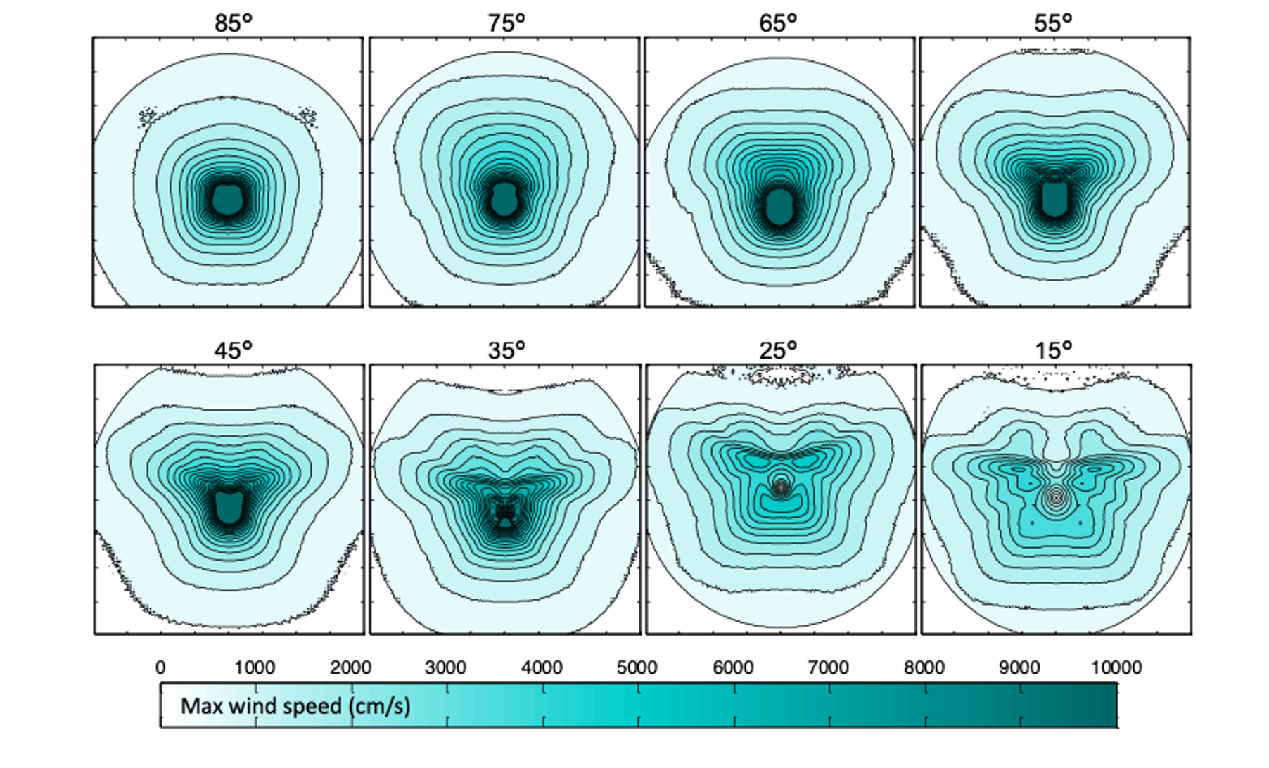
Tunguska tree fall pattern depends on entry angle

Slide 11
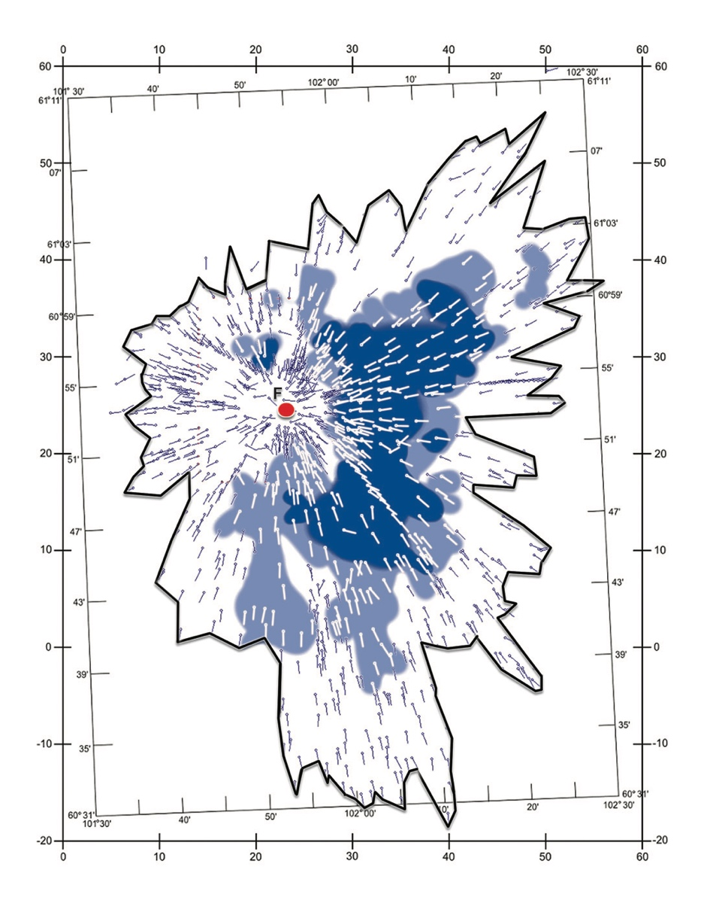

Tunguska tree fall pattern is consistent with Taurid
104°
Wind (m/s)
60
50
40
30
20
10

Slide 12
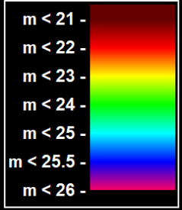
Wiegert et al (2025)

Slide 13
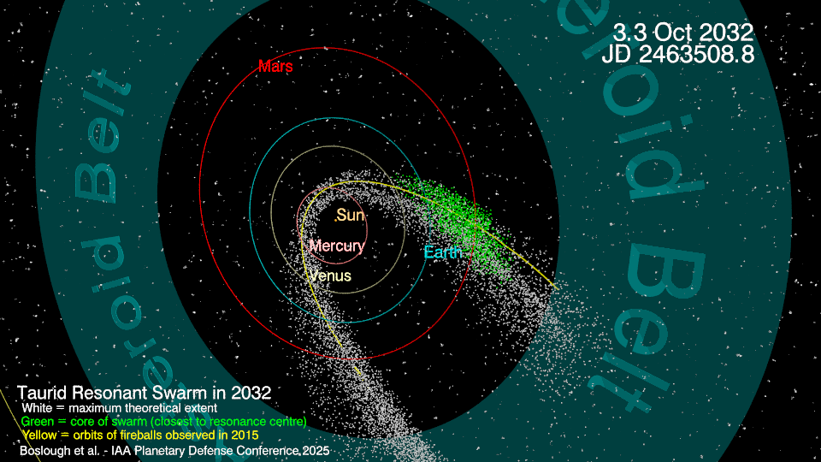
Title

Slide 14
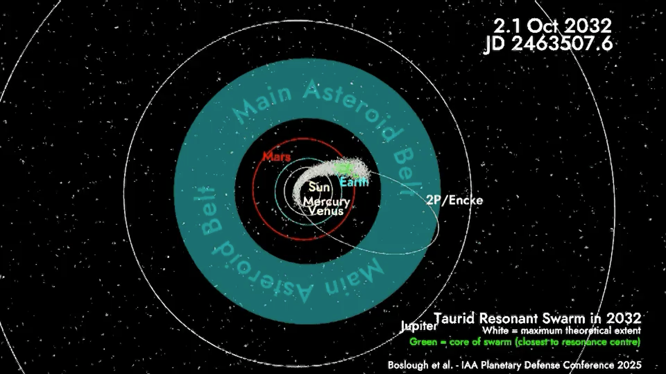
Title
Notes:
Insert movie

Slide 15
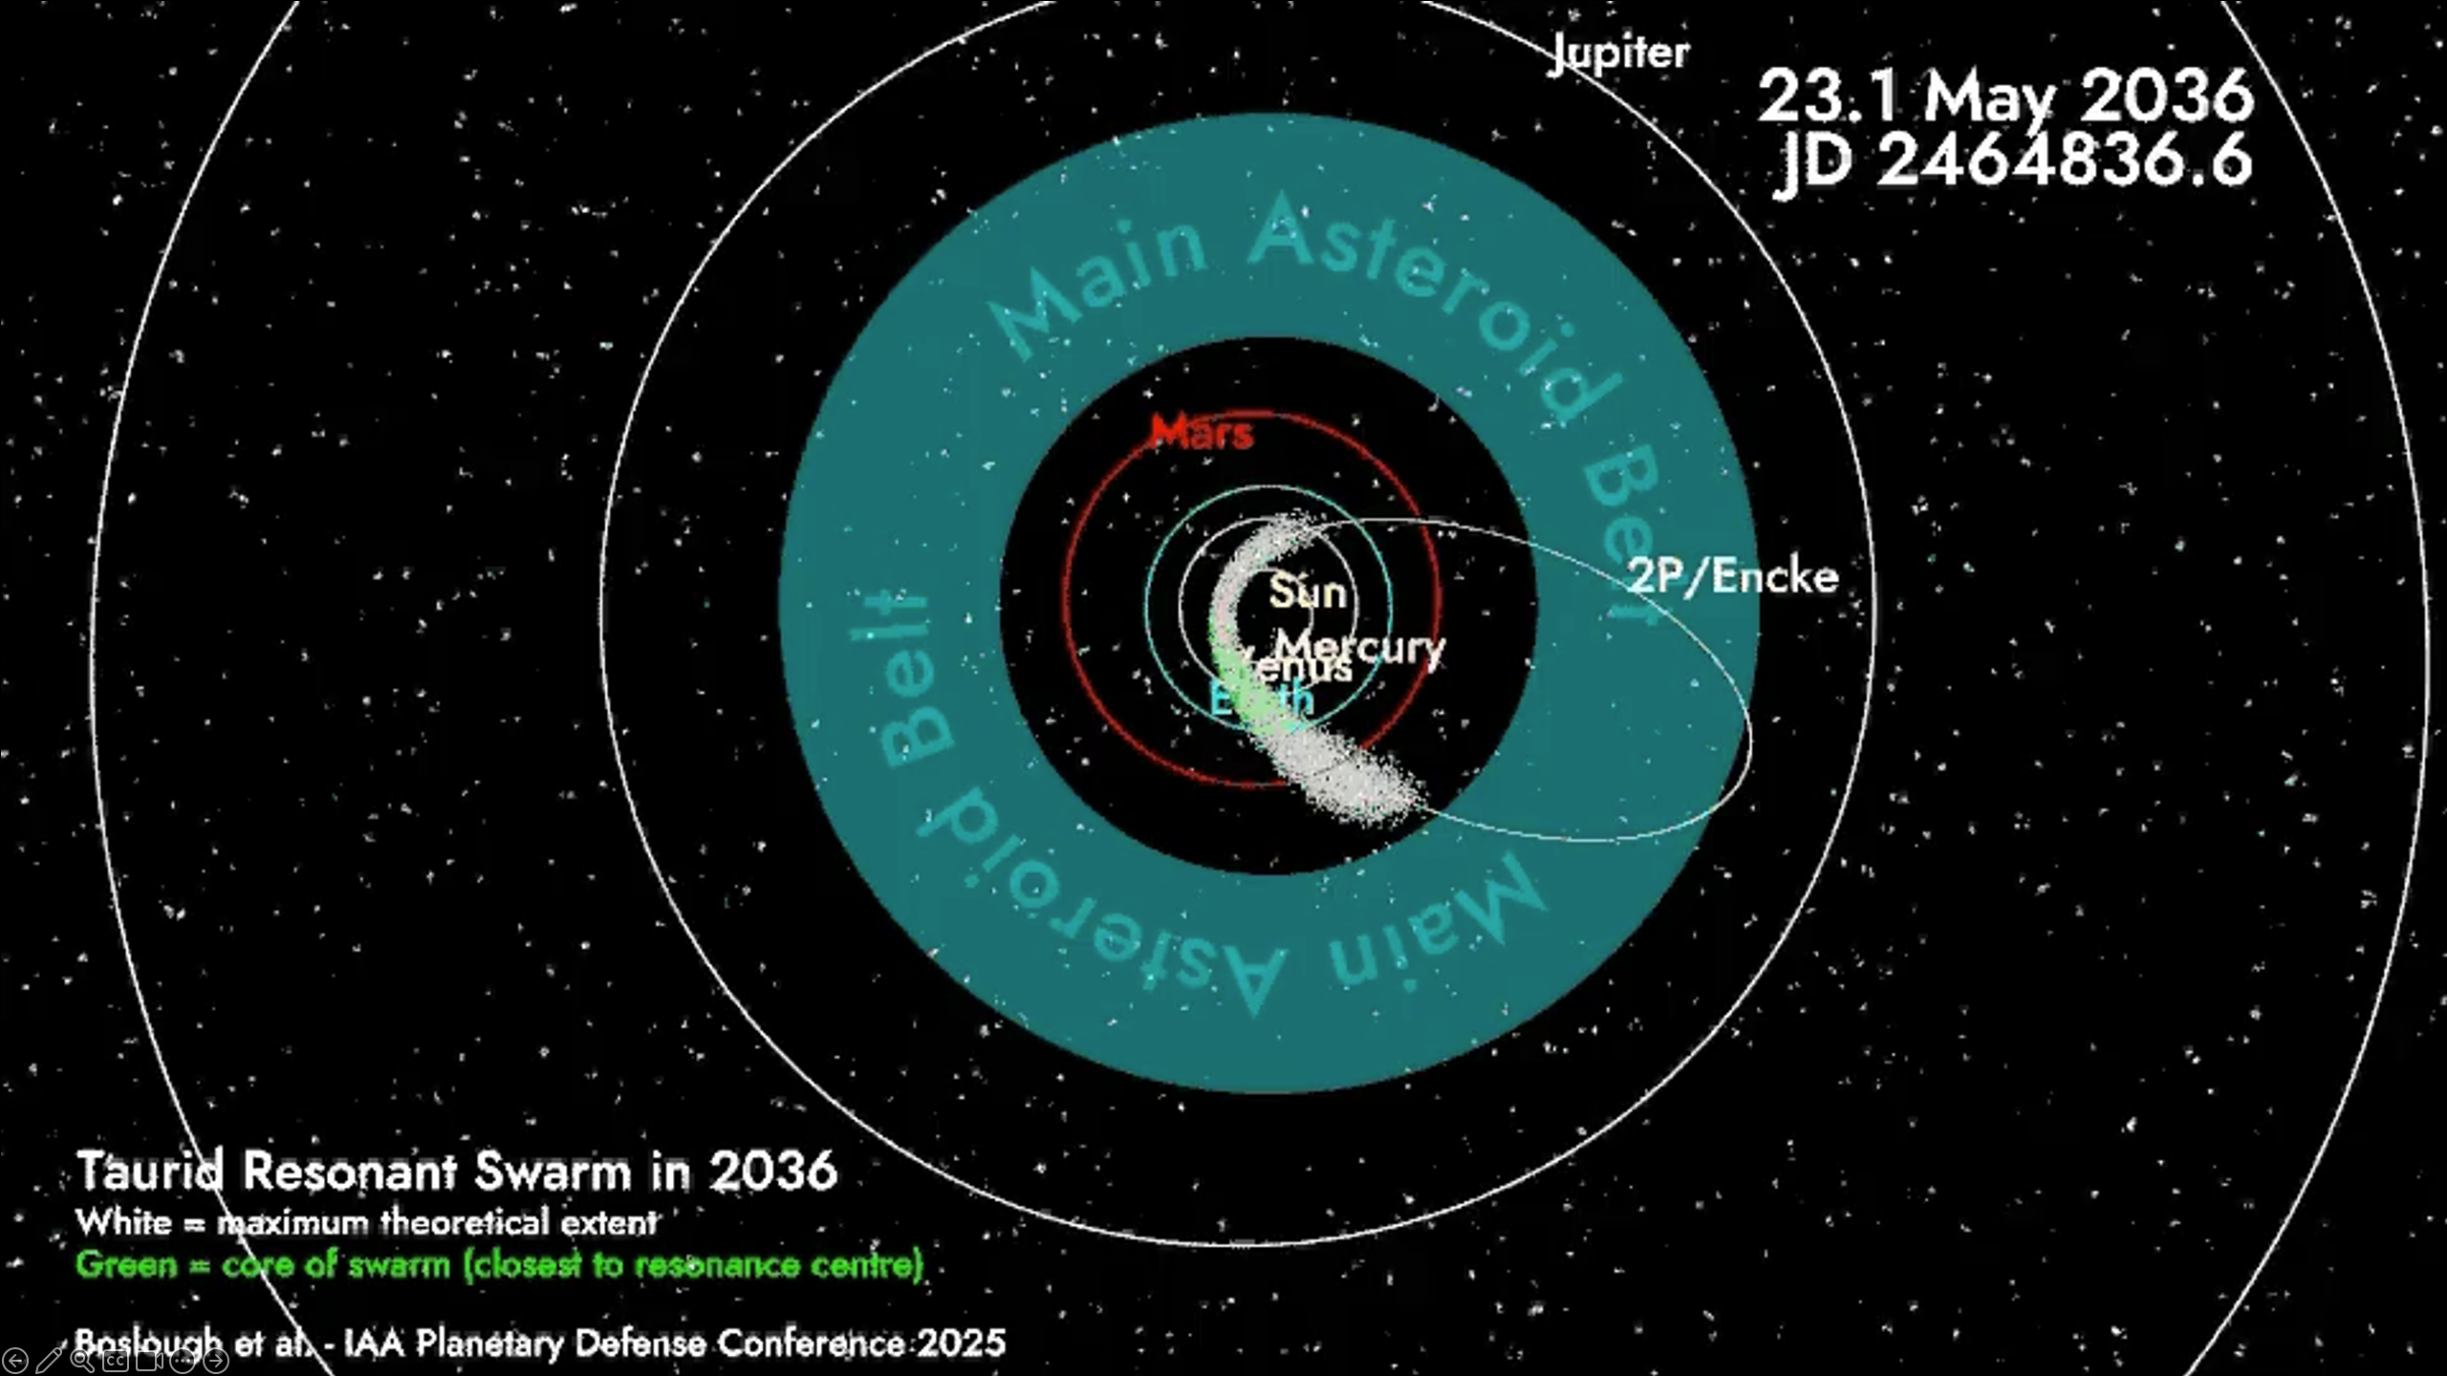
Title
Notes:
Insert movie

Slide 16
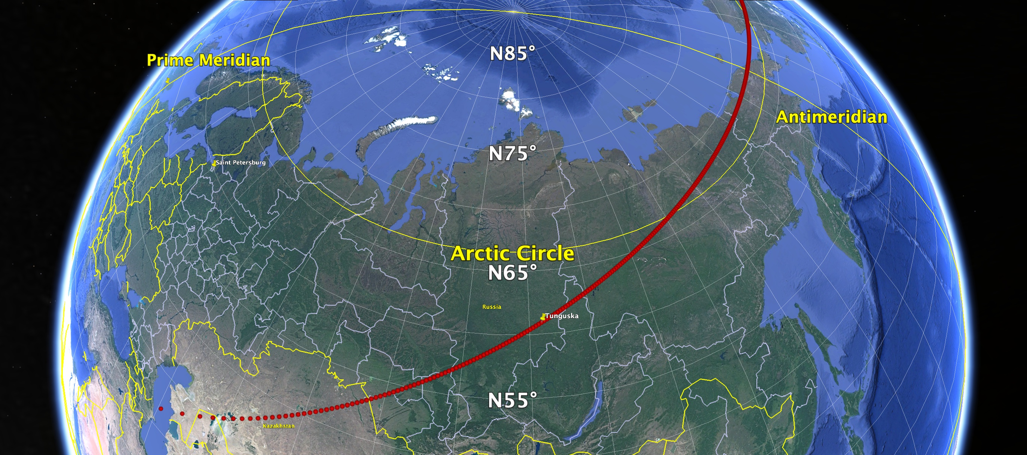
Boslough, Chodas, & Brown (2023)
St. Petersburg
Tunguska
Notes:
16
16
From Boslough et al, AGU poster (2023)

Slide 17
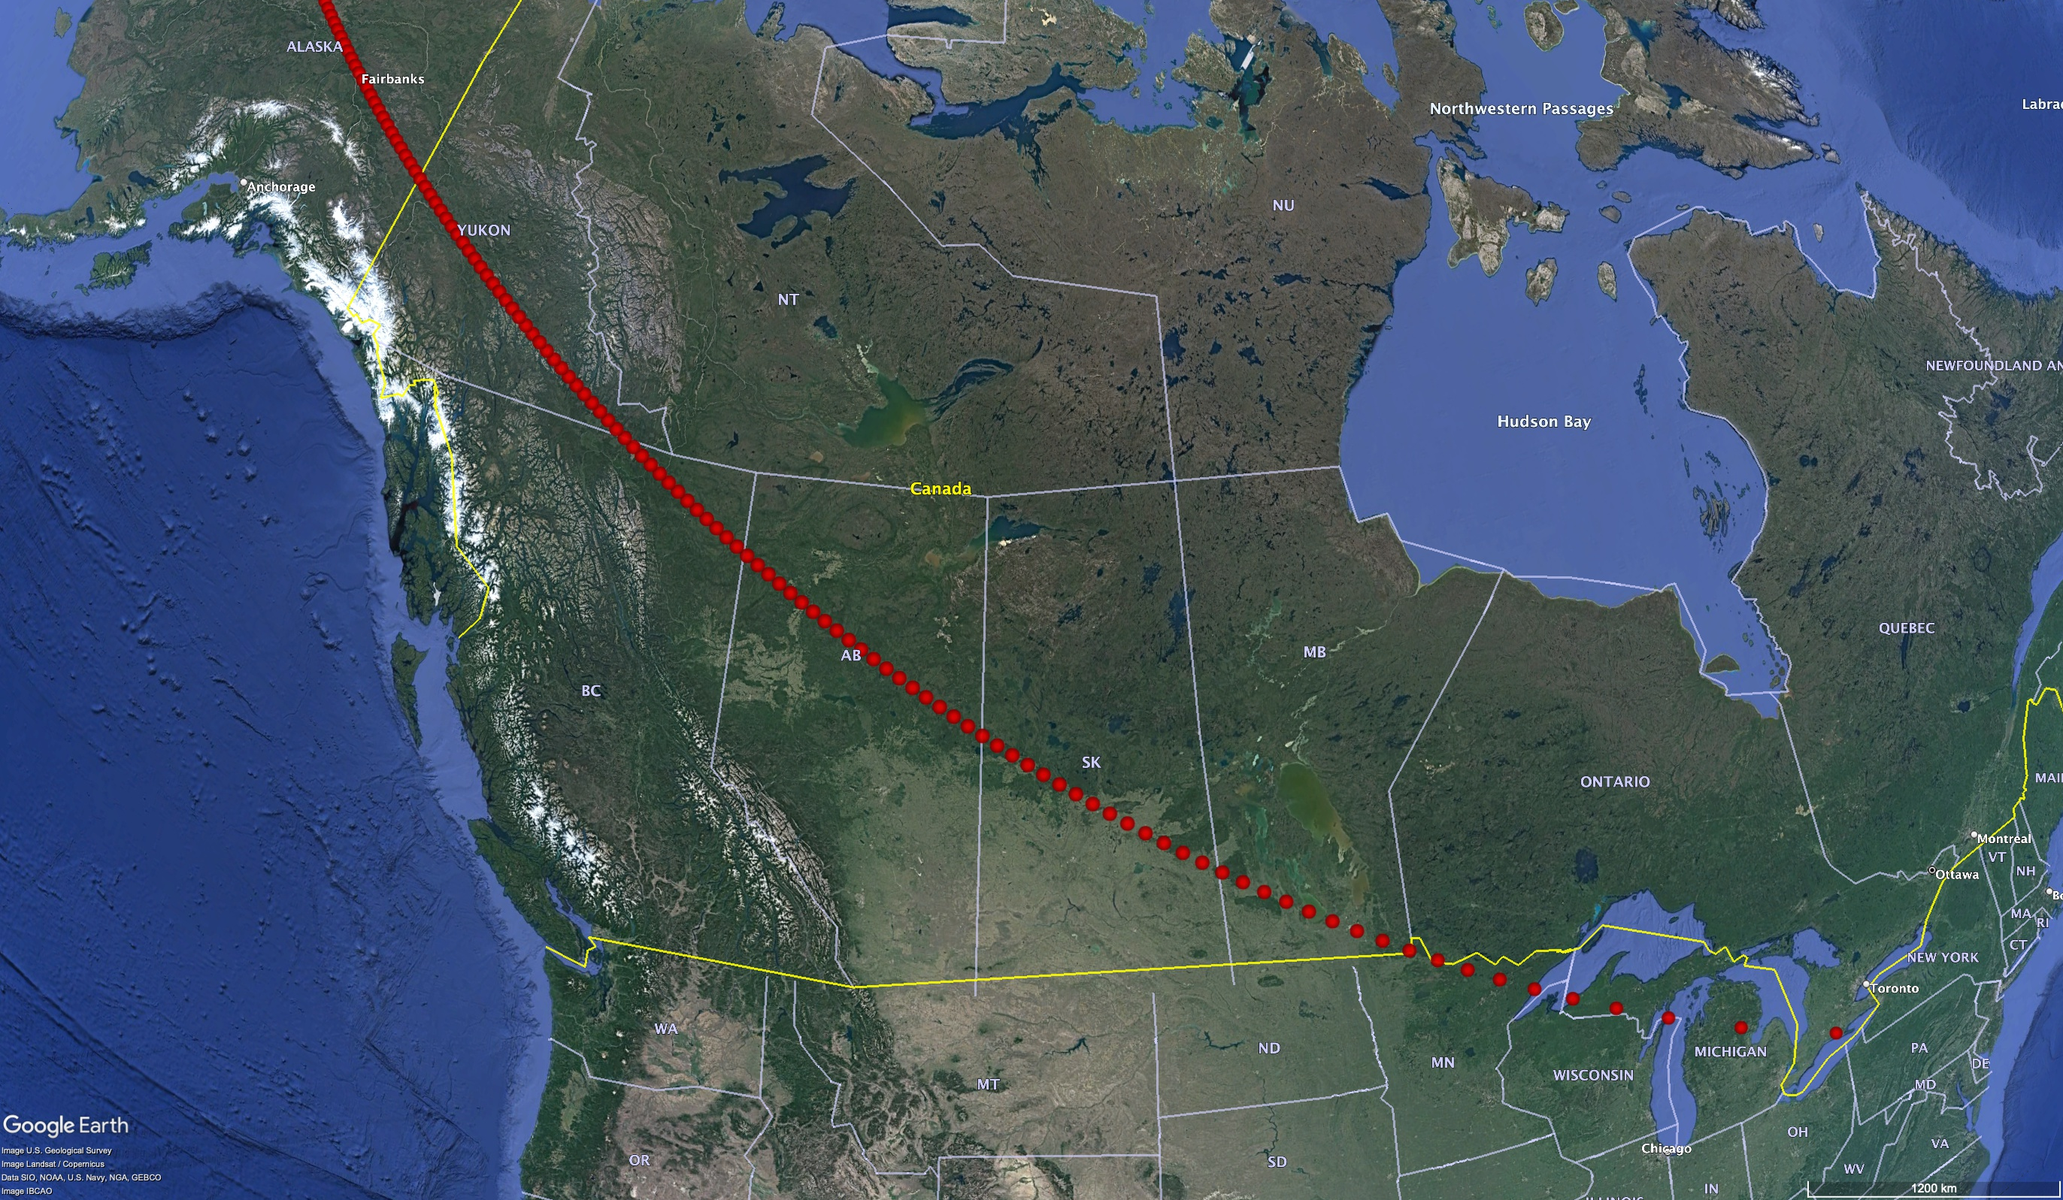
Boslough, Chodas, & Brown (2023)
Fairbanks
Winnipeg
Duluth
Notes:
17
17
From Boslough et al, AGU poster (2023)

Slide 18
Conclusions: Stochastic vs Coherent Risk
There is evidence for a possible coherent risk associated with the Taurids
The coherent risk does not extend above the global catastrophe threshold
There is no evidence for “coherent catastrophism” at this time in Earth history
The coherent component of risk from Taurids will peak in 2032 and 2036
Notes:
18
18

Slide 19
Recommendations: Stochastic vs Coherent Risk
Surveys should…
be used to quantify coherent risk
be optimized for Taurid stream objects in the Tunguska size range
focus on advance discovery of objects with potential impacts in 2032 and 2036
focus on imminent impactors in the higher-risk years
Notes:
19
19

