Slide 1


Machine learning improvement of the Near-Earth Object discovery process
Peter Vereš, Richard Cloete, Abraham Loeb, Matthew J. Payne
Planetary Defense Conference 2025

Slide 2
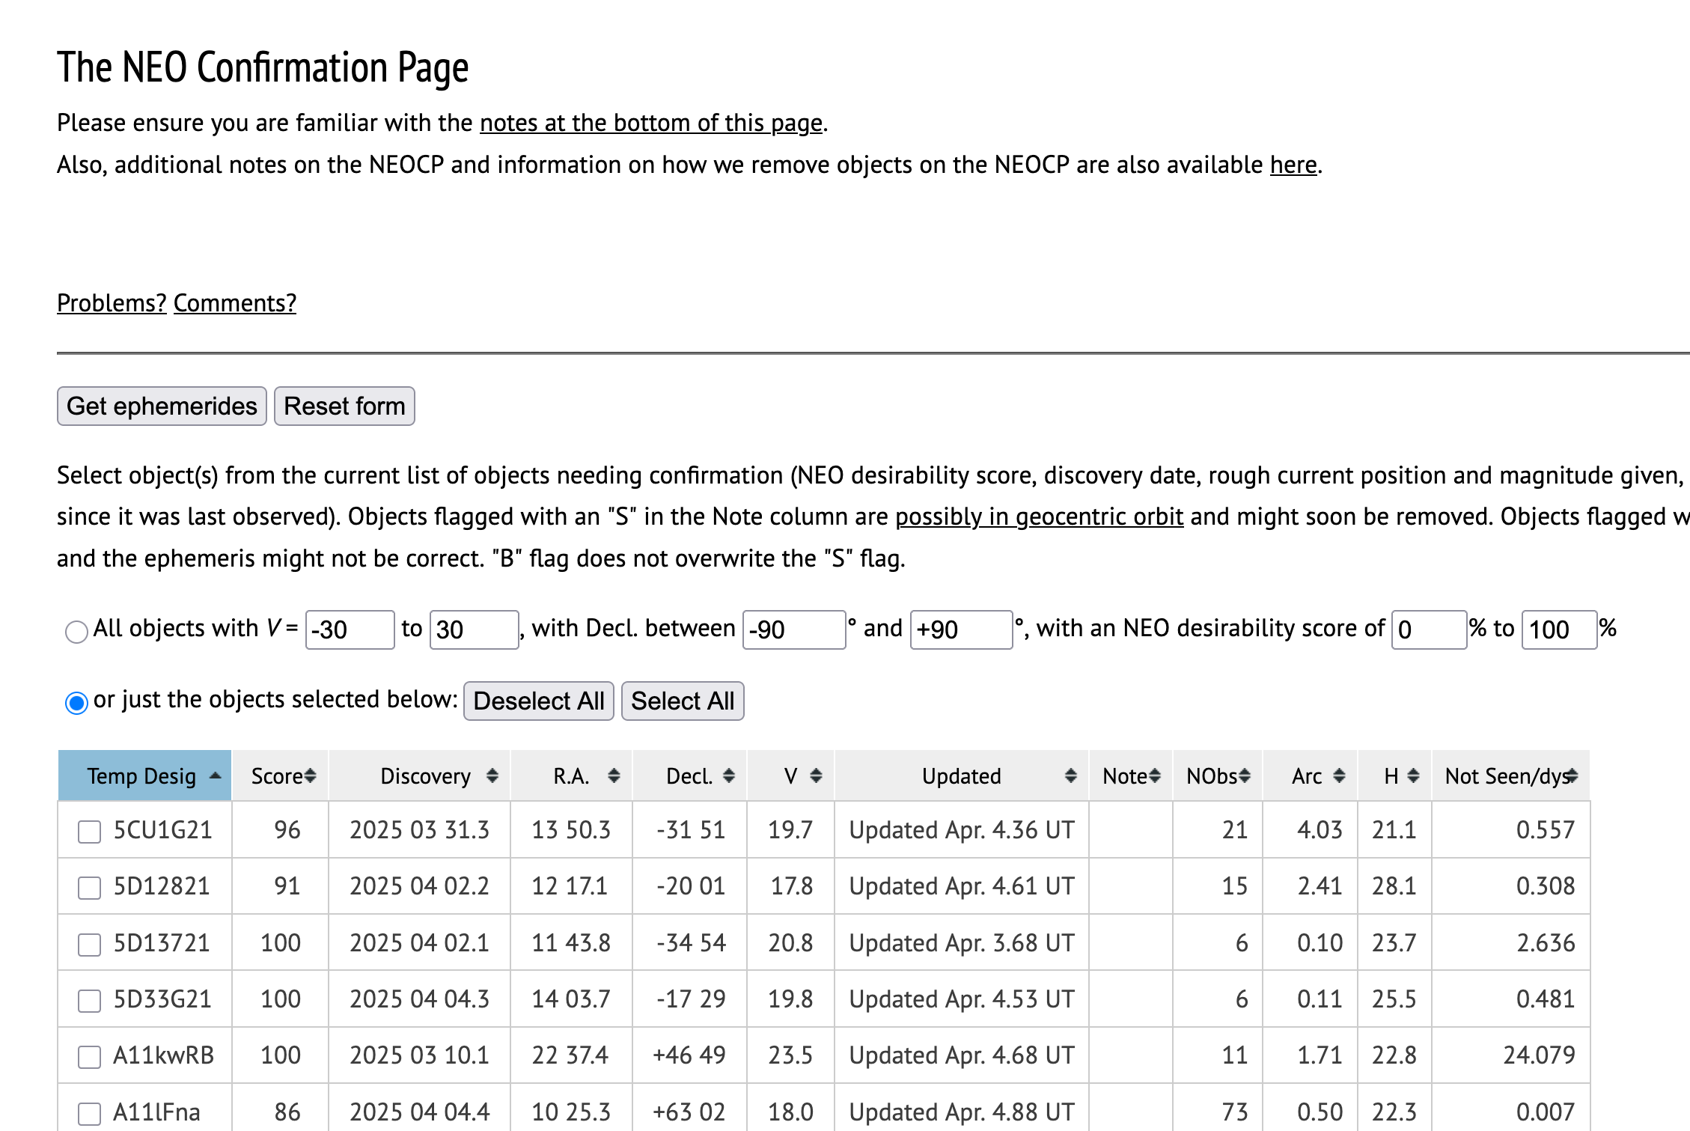
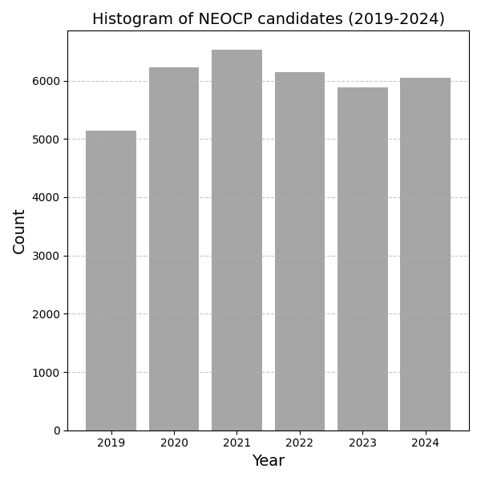

NEO discovery process
Near-Earth object confirmation page + digest2 screening of NEO candidates
digest2 > 65

Slide 3
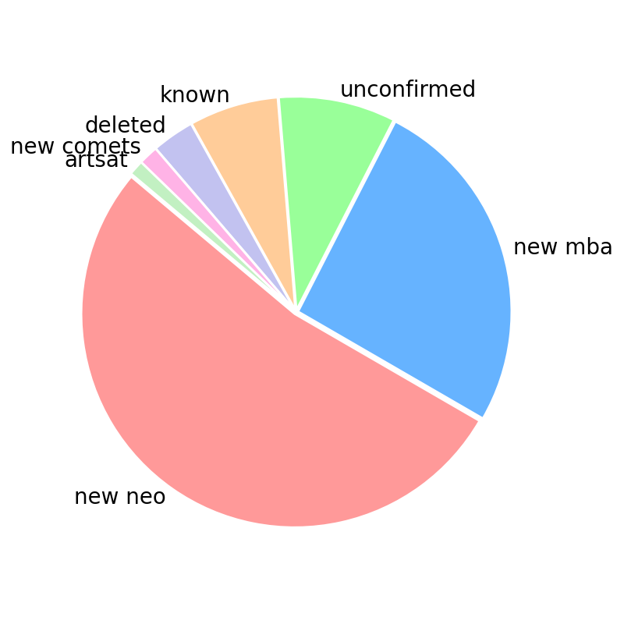
NEOCP since 2019 – final NEOCP disposition
MOTIVATION
Decrease unconfirmed rate (~11 %)
Decrease MBA count on NEOCP
INSPIRATION
Cloete, R., Veres, P., Loeb, A. : 2024. Machine learning methods for automated interstellar object classification with LSST. A & A 691.

Slide 4
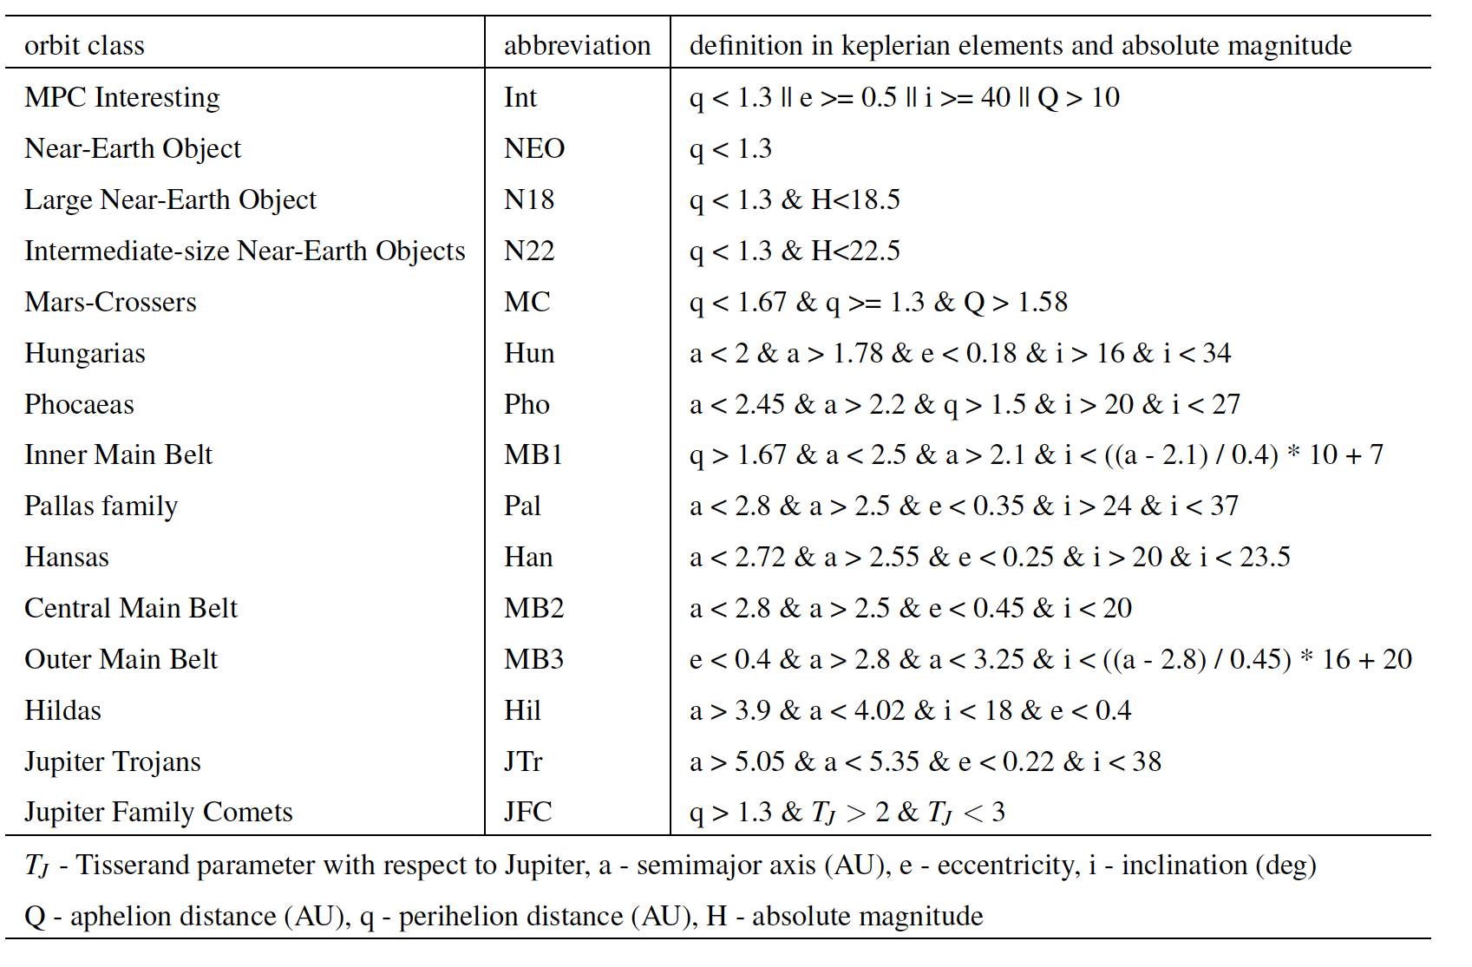
digest2
scores:
For different
orbit type

Slide 5
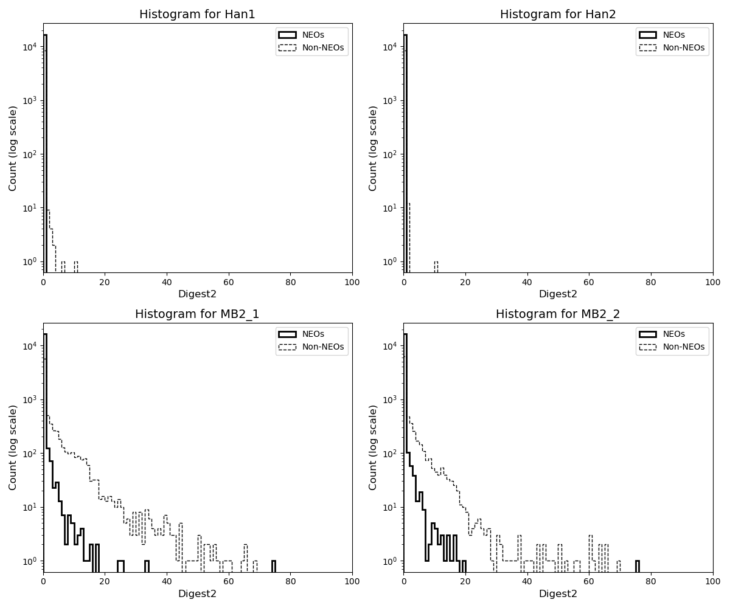
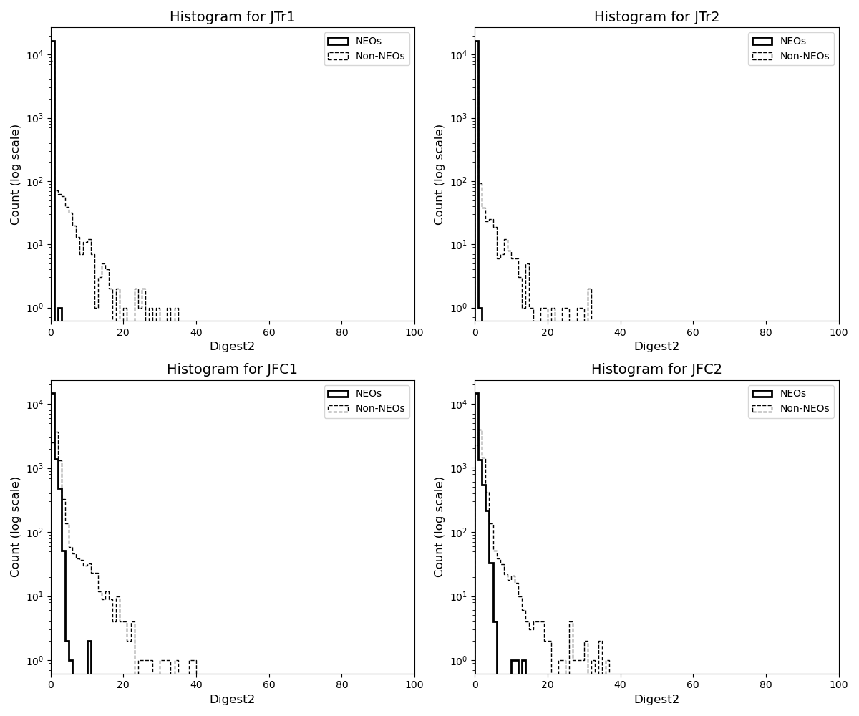
Basic filter

Slide 6
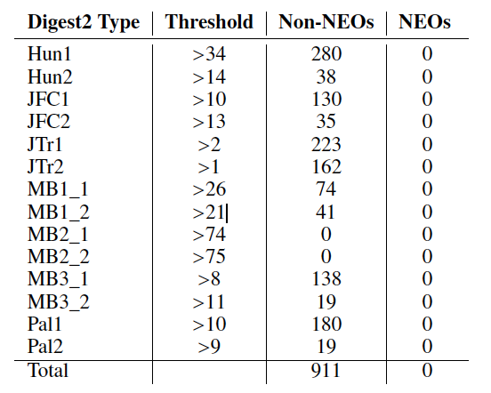
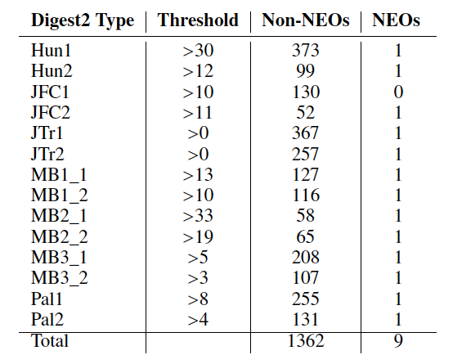
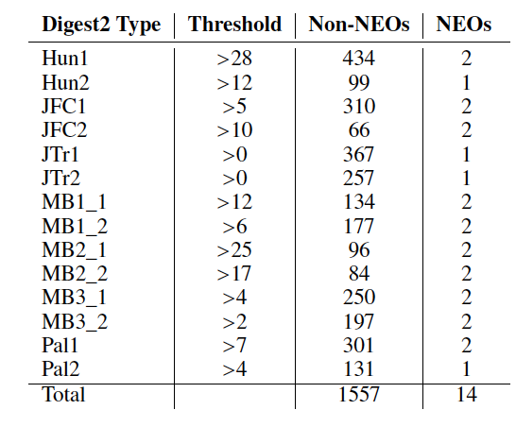
Basic filter
Lost
NEO
Filtered
Non-NEO
5-years on NEOCP
Filter | NEOs | Non-NEOs
0 | 0 | 12%
1 | 9 | 19%
2 | 14 | 21%

Slide 7
Machine learning (ML)
Gradient Boosting Machine (GBM)
Random Forest (RF)
Stochastic Gradient Descent (SGD)
Neural Networks (NN)
Learning on 2019-2023 NEOCP data
Validation set: 2024 NEOCP data

Slide 8
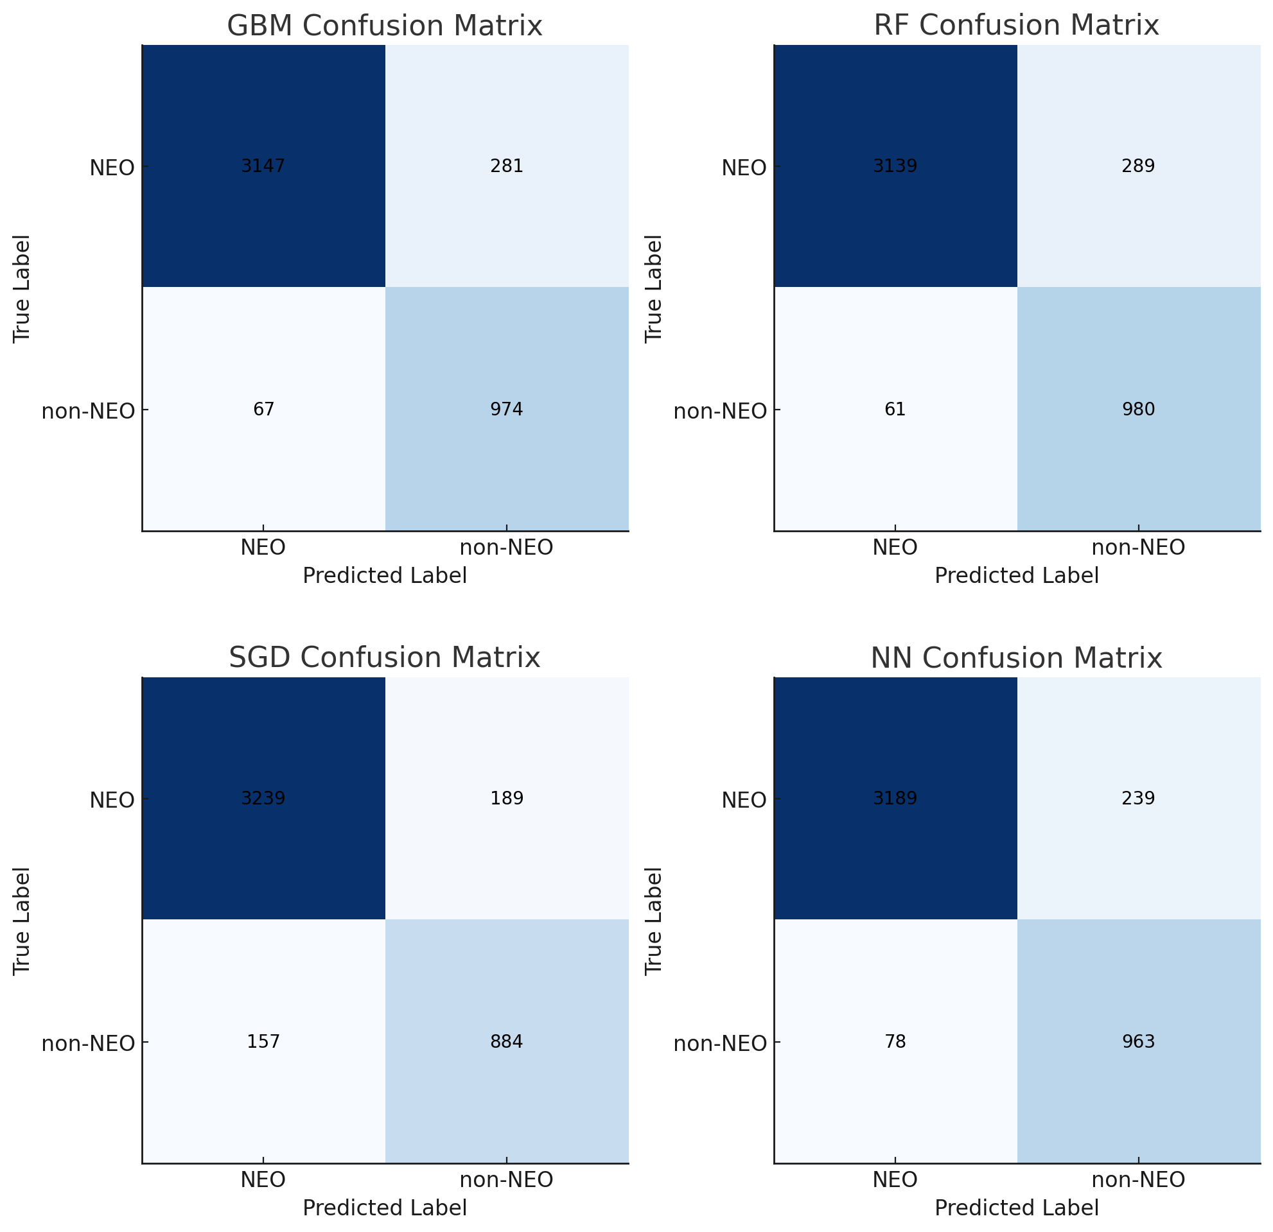
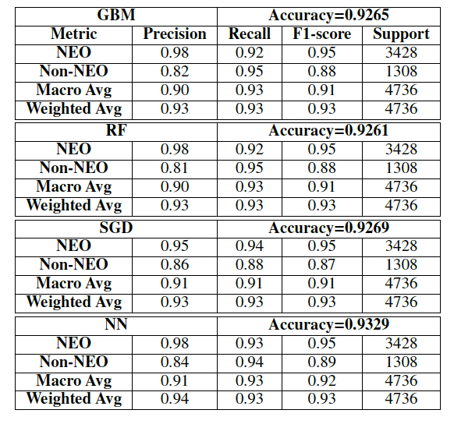
ML results
2024 NEOCP data

Slide 9
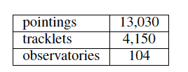
Results
Basic filter – removes 20% of non-NEOs
ML – correctly 95% NEOs, 85% non-NEOs
ML: 189 NEOs misclassified – 140 correctly in follow-ups
Saved follow-up time:
Find balance: sacrificing NEOs vs. elimination of non-NEOs

