Slide 1
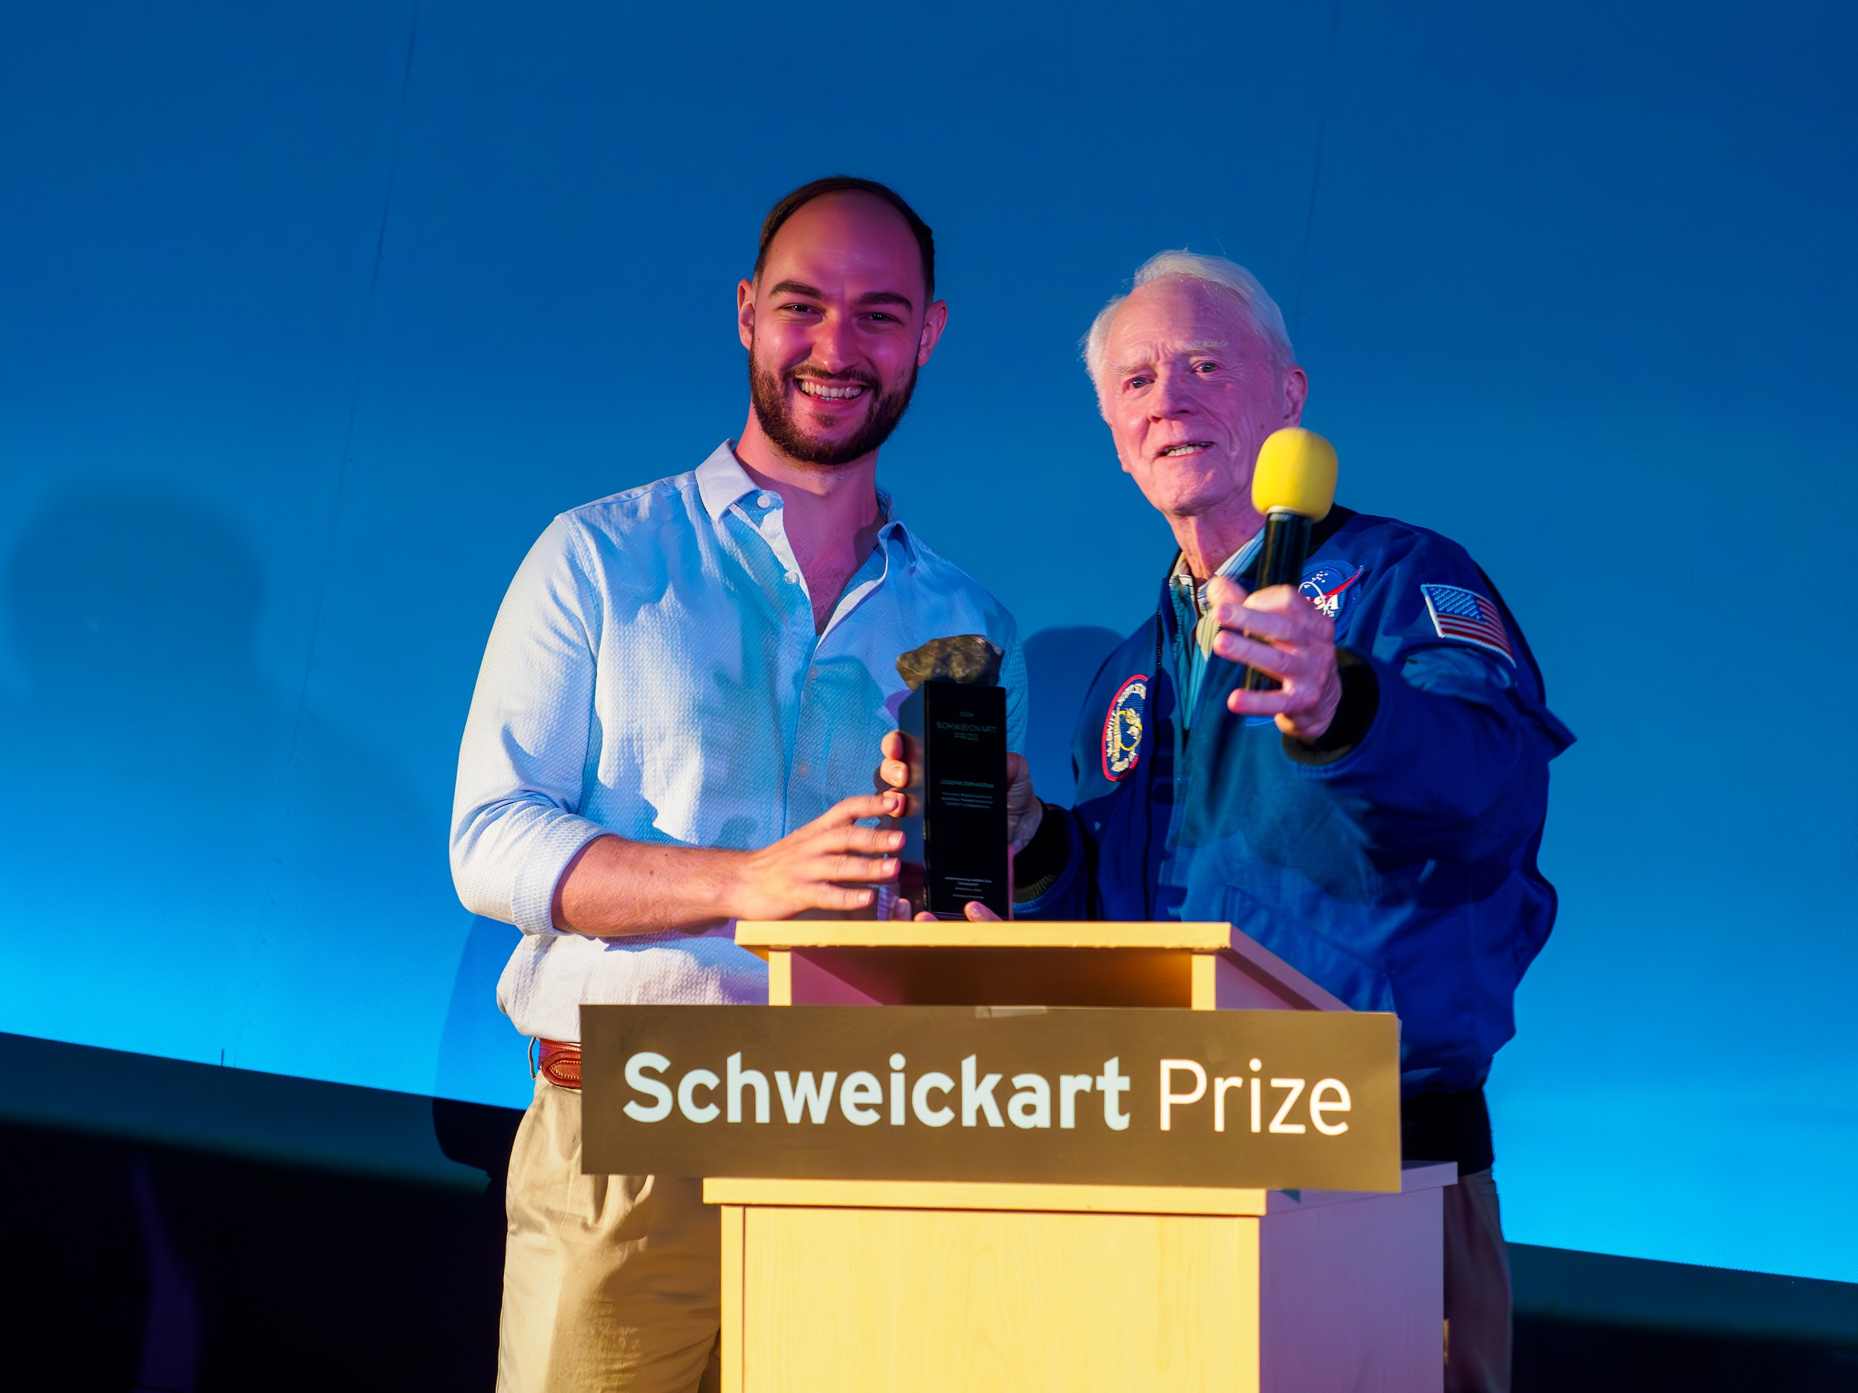
Photo by Hugo Wagner Photography
2024 Schweickart
Prize for Planetary
Defense
Winning Proposal:
SUnward NEO Surveillance and Early Twilight detection (SUNSET) Collaboration
Winner:
Joe DeMartini

Slide 2
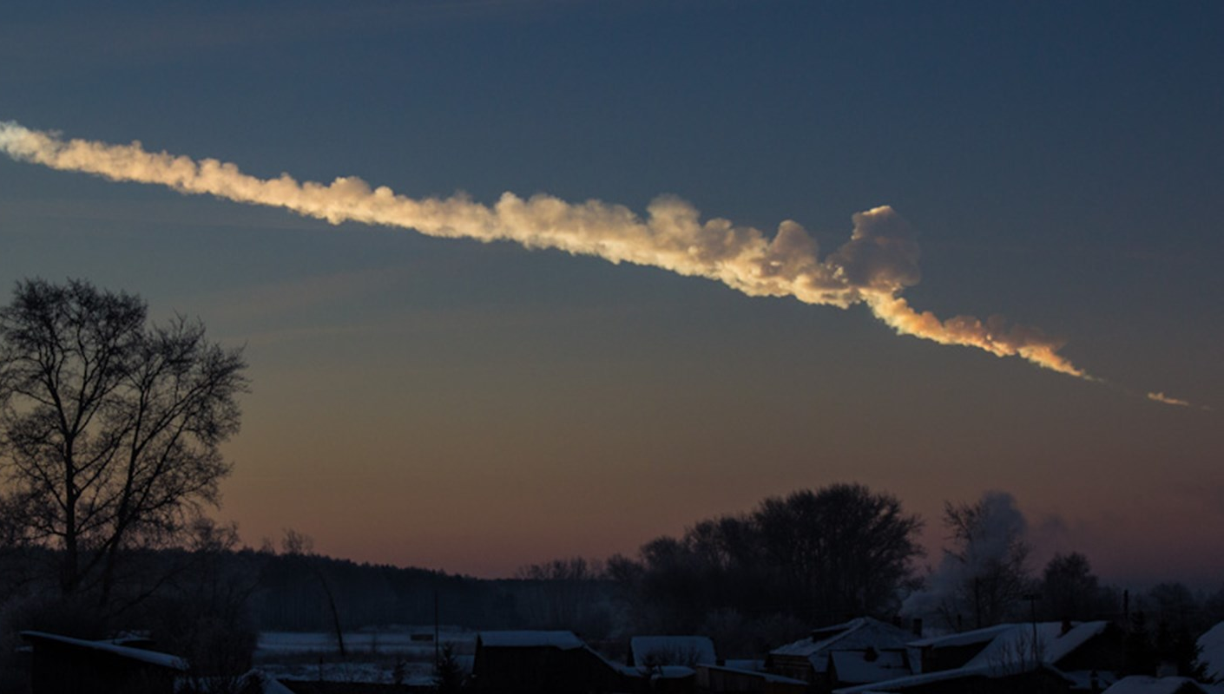
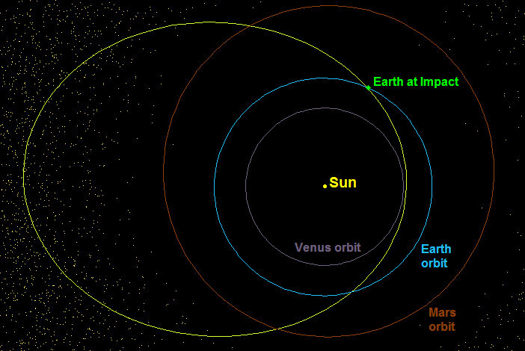
SUnward NEO Surveillance and Early Twilight detection (SUNSET) Collaboration
Increase discoveries and improve tracking of near-Earth objects (NEO) approaching from the sunward direction.
GOAL
METHOD
Ground-based twilight observations
Chelyabinsk orbit
Main Asteroid Belt
Chelyabinsk Meteorite Sky Trail. Credit Alex Alishevskikh
Chelyabinsk Orbit Diagram; Credit. Paul Chodas, CNEOS, NASA/JPL
2024
Notes:
Getting into the highlights of the proposal

Slide 3
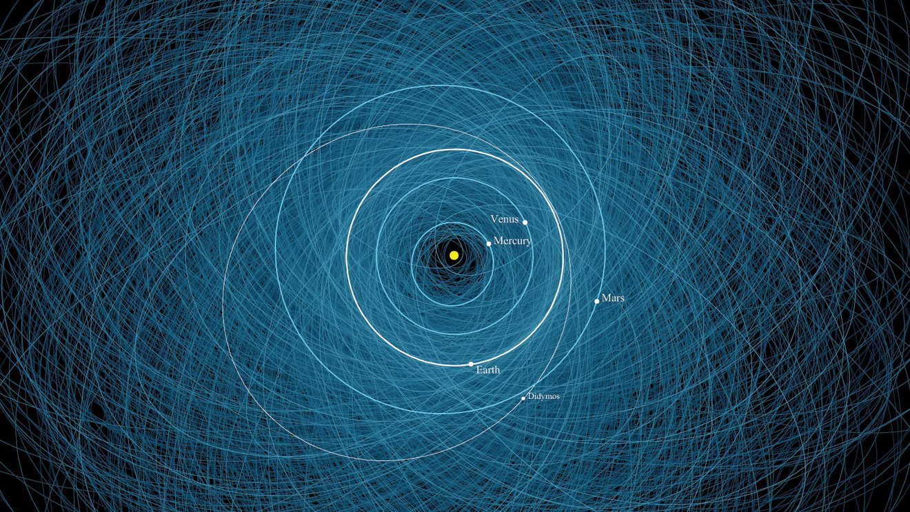
This schematic is not representative of true observable regions in the sky
NEO orbits are shown in blue. The yellow region is not observed due to solar brightness.
Credit NASA, DART
2024
Notes:
Joe
Introduce the idea of twilight observations.
“This is a schematic of how much of the sky astronomers are looking at on a given night….”
We don’t look toward the sun bc: it’s bright (physical constraint), not all telescopes can point that low (mechanical constraint),

Slide 4
This schematic is not representative of true observable regions in the sky
The pink region represents the newly visible twilight observation zones.
Credit NASA, DART
2024
Notes:
Joe
“THIS is a schematic of the visible fraction of the sky when we add twilight observations…”
What is meant by “twilight observations”: the ~10’s of min after sunset or before sunrise
The pink area is where all the NEO in the 3 categories live
Some details on Twilight NEA/PHA discoveries from: Sheppard+22 https://iopscience.iop.org/article/10.3847/1538-3881/ac8cff

Slide 5
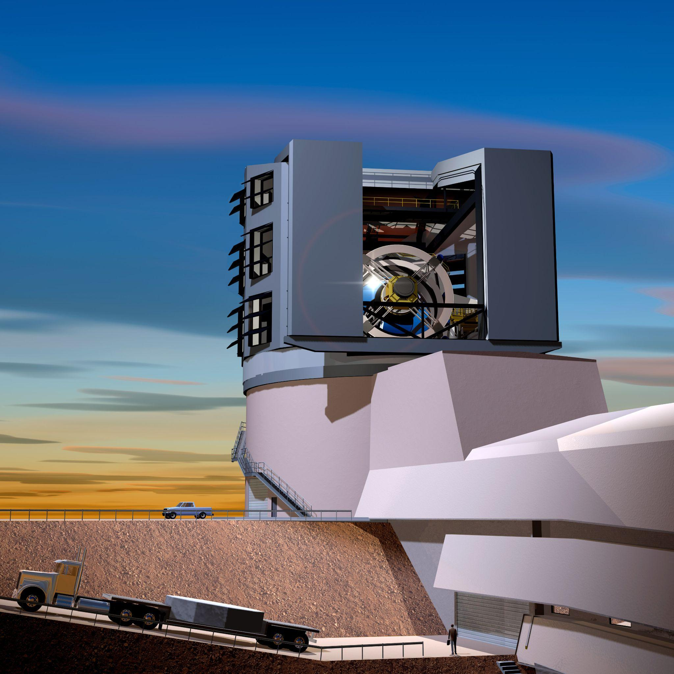
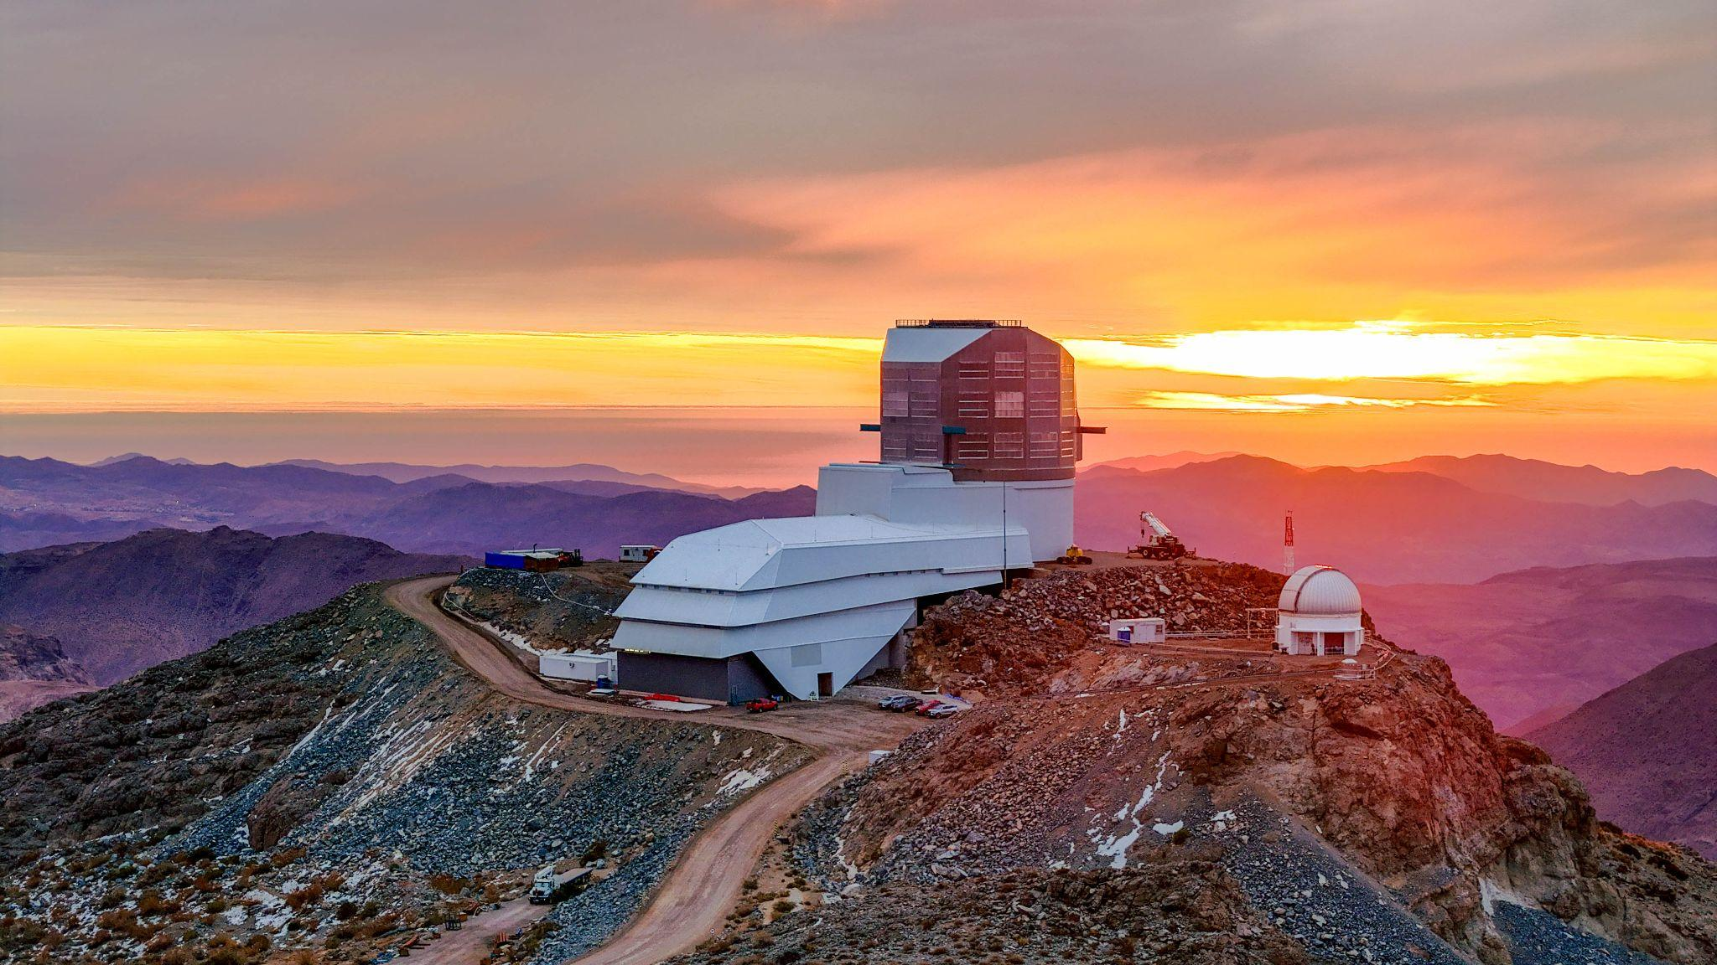

Who Would Participate in SUNSET?
DISCOVERY
VERA C. RUBIN OBSERVATORY
“Low Solar Elongation Twilight Microsurvey”
2024
Notes:
Getting into the highlights of the proposal
Why Rubin?
Large field of view (good for searching!), large aperture (easier to see dim objects)
Community-suggested plans for the twilight microsurvey

Slide 6
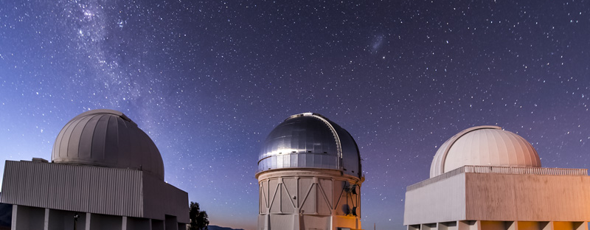
Who Would Participate in SUNSET?
FOLLOW-UP CHARACTERIZATION
OTHER TWILIGHT-CAPABLE OBSERVATORIES
Dark Energy Camera; Credit: Dark Energy Survey
2024
Notes:
Follow up: Once we know where to look, it should be easier for other telescopes to see SNEOs
This is also where we can make use of new “observer-independent” orbit-constraining software to more quickly confirm discoveries

Slide 7
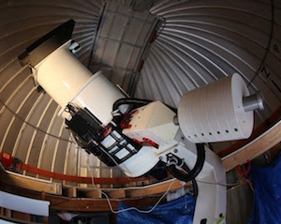
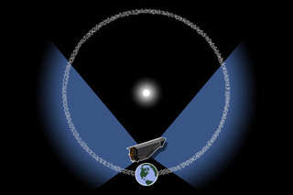
Next Steps
ATLAS 2 Telescope. Credit: ATLAS Observatory Network
NEO Surveyor Orbit. Credit: ASU, NEOS
Involve ATLAS for “close approach” discovery and warning.
Link the SUNSET follow-up network with NEO Surveyor (space-based).
2024

Slide 8
Proposal summary
SUnward NEO Surveillance and Early Twilight detection (SUNSET) Collaboration
Increase discoveries and improve tracking of near-Earth objects (NEO) approaching from the sunward direction.
GOAL
METHOD
Ground-based twilight observations
DISCOVERY
Vera C. Rubin Observatory
Other Twilight-Capable Observatories
Novel orbit refinement software to facilitate discovery confirmation
FOLLOW-UP CHARACTERIZATION
Contact: jdema@umd.edu
2024
Notes:
(Quickly) Summarize SUNSET once more

Slide 9
THANKS TO ALL OF YOU!
Contact: jdema@umd.edu
Derek Richardson
Naomi Murdoch
Jess Sunshine
Nick Schmerr
Quanzhi Ye
Carrie Holt
Rusty Schweickart Sr.
Randy Schweickart
Rusty Schweickart Jr.
Danica Remy
Colleen Fiaschetti
Delphine Veronese-Milin
Rachel Momperousse
Hugo Wagner
Lauren Miles
Andy Harris
Olivia Dent
Melissa Hayes-Gehrke
Barbara Hansborough
Kevin Rauch
Susan Lehr
Dorinda Kimbrell
Natalie Rowe
Patrick Michel
Kevin Walsh
Ron Ballouz
Cecily Sunday
Olivier Barnouin
Christine Hartzell
Raphael Garcia
David Mimoun
Alice Amsili
Alex, Jules, Jeanne, Arnau, Alexia, Colas, Arnaud, Solene, Martin Alexandre, Anthony, Melanie, Hai
Cole Miller
Eliza Kempton
Benedikt, Stuart, Tad, Alberto, Massimo, Chris, Doug, Sylvain, Megan, Richard, Lee
Harrison Agrusa
Julian Marohnic
Teal
Ben, Erica, Ramsey, Milena, Sara, Jegug, Liz, Becca, Gabe, Alex, Vicente, Rye, JP
Esteban, Sharkey, Yaeji
Calvin, Serena, Emma, Emeline, Yash, Ell, Arjun, Katya, Jordan, Giannina, Erika, Isiah, Eric, Antoine, Sander, Gokul, Zuzanna, Michaela, Sander, Kylie, Jonathan, Johnny, Amanda, Brian, Mark, Sid, Matt, Lacey, Enrico
Max, Cole, Shaniya, Sophie, Keaton, Keyi, Marshall, Charles
… and all of my other family, friends, peers, colleagues, nemeses, acquaintances, archrivals, and students

