Slide 1


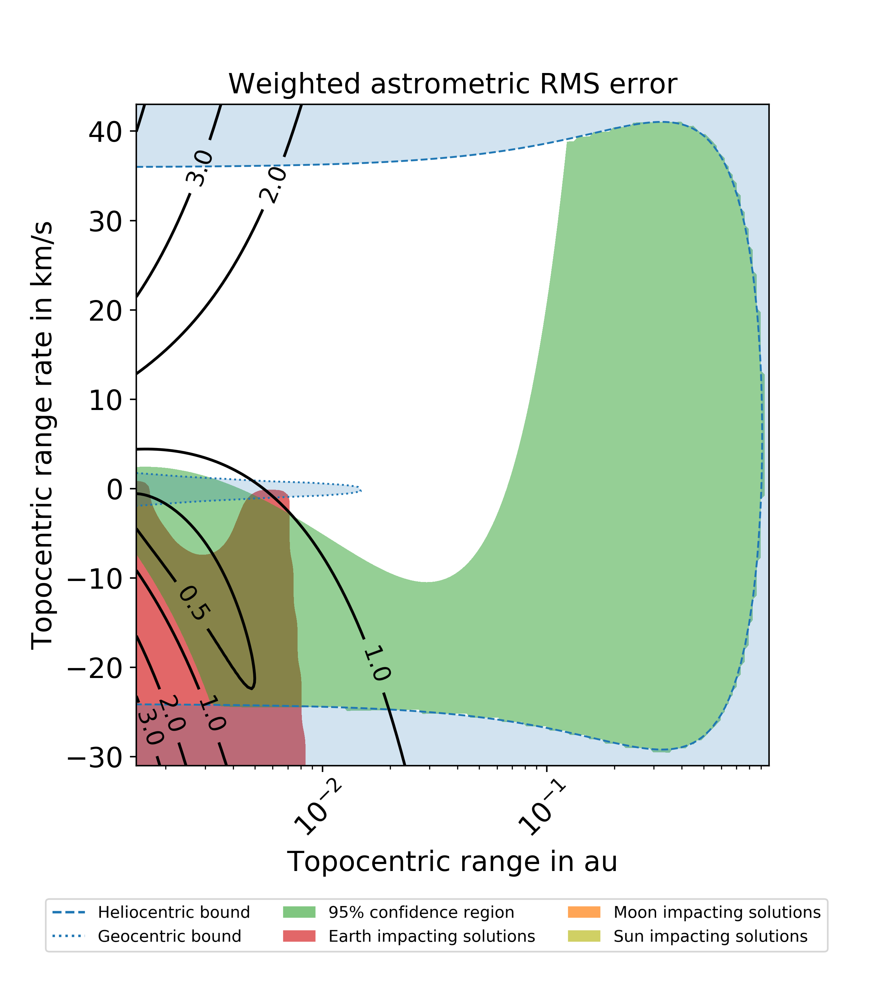
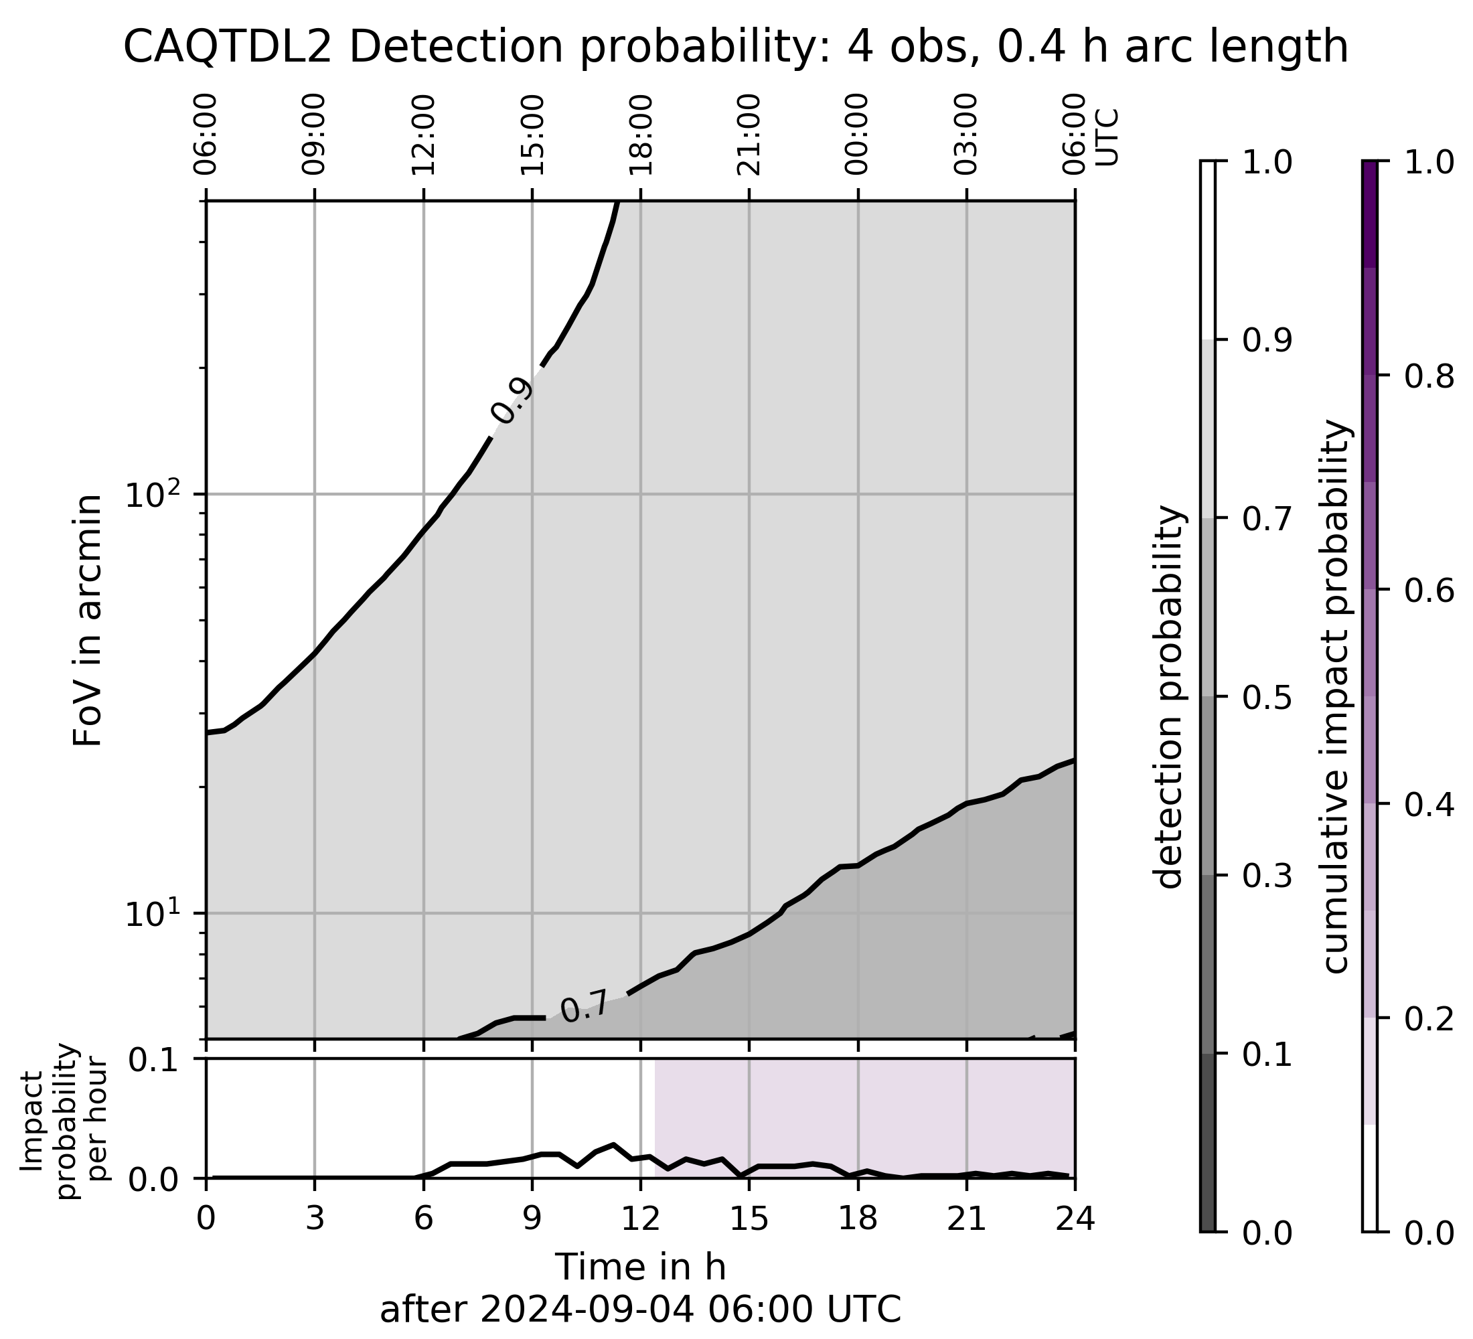
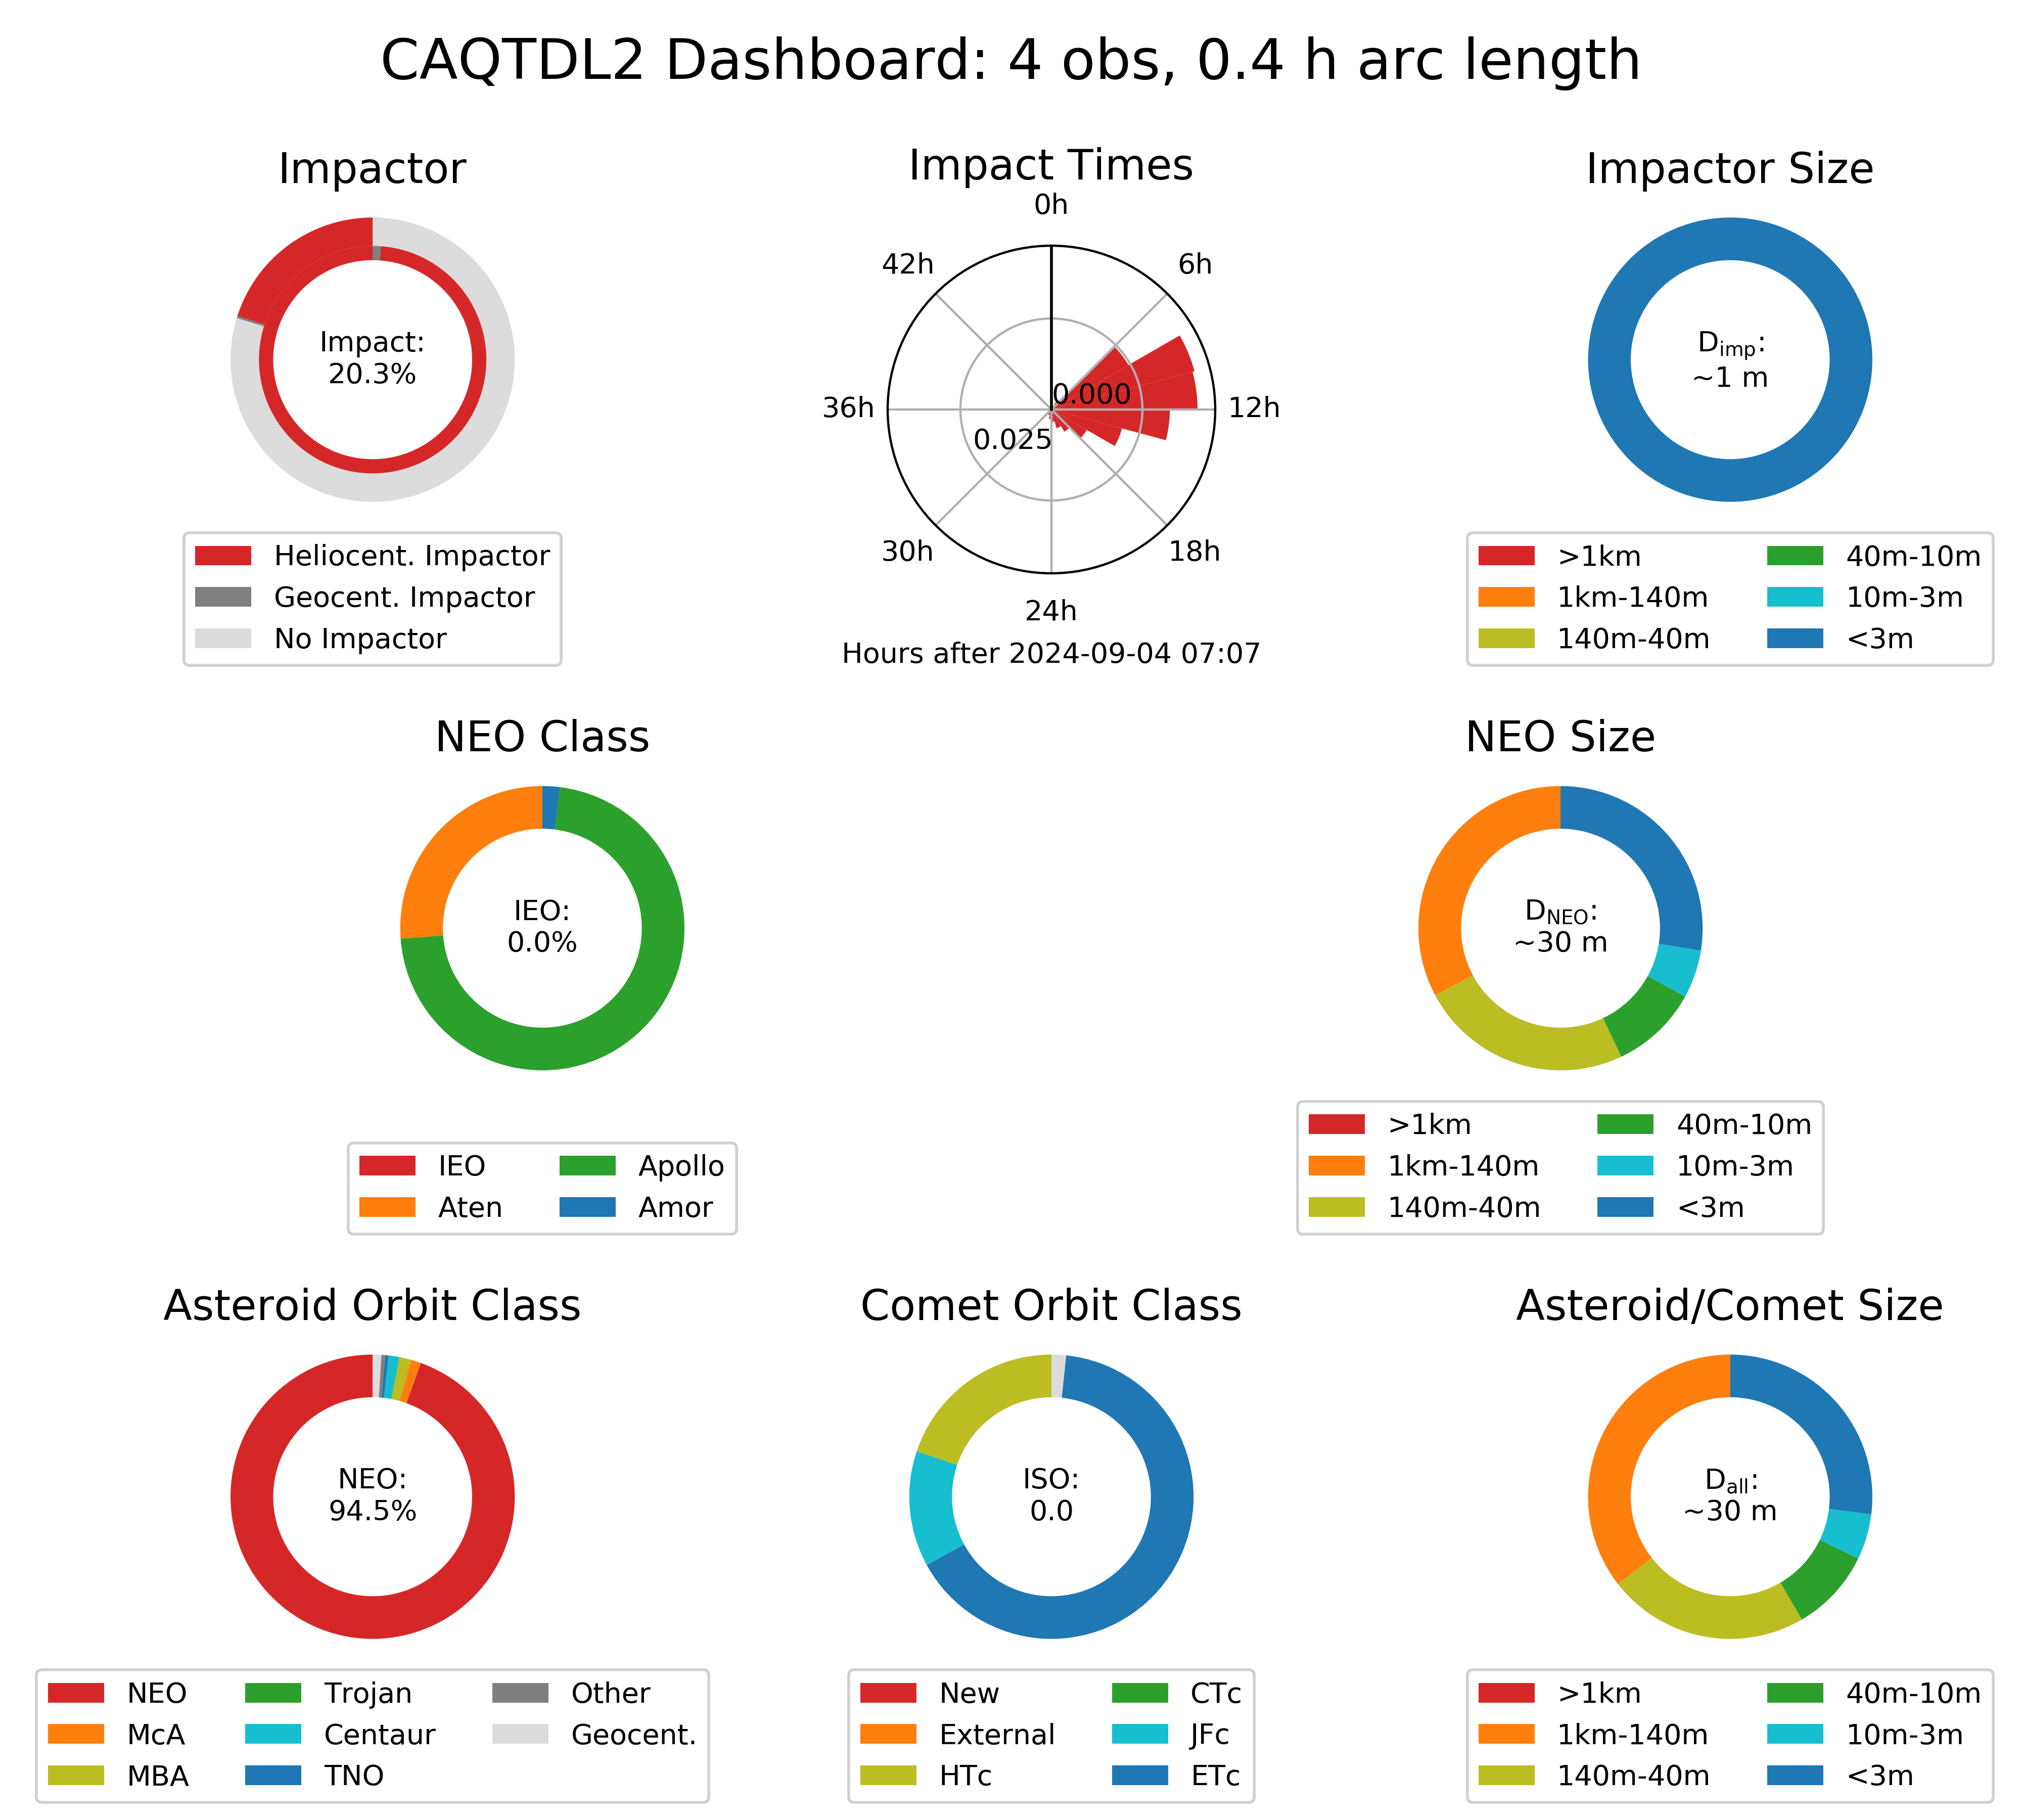
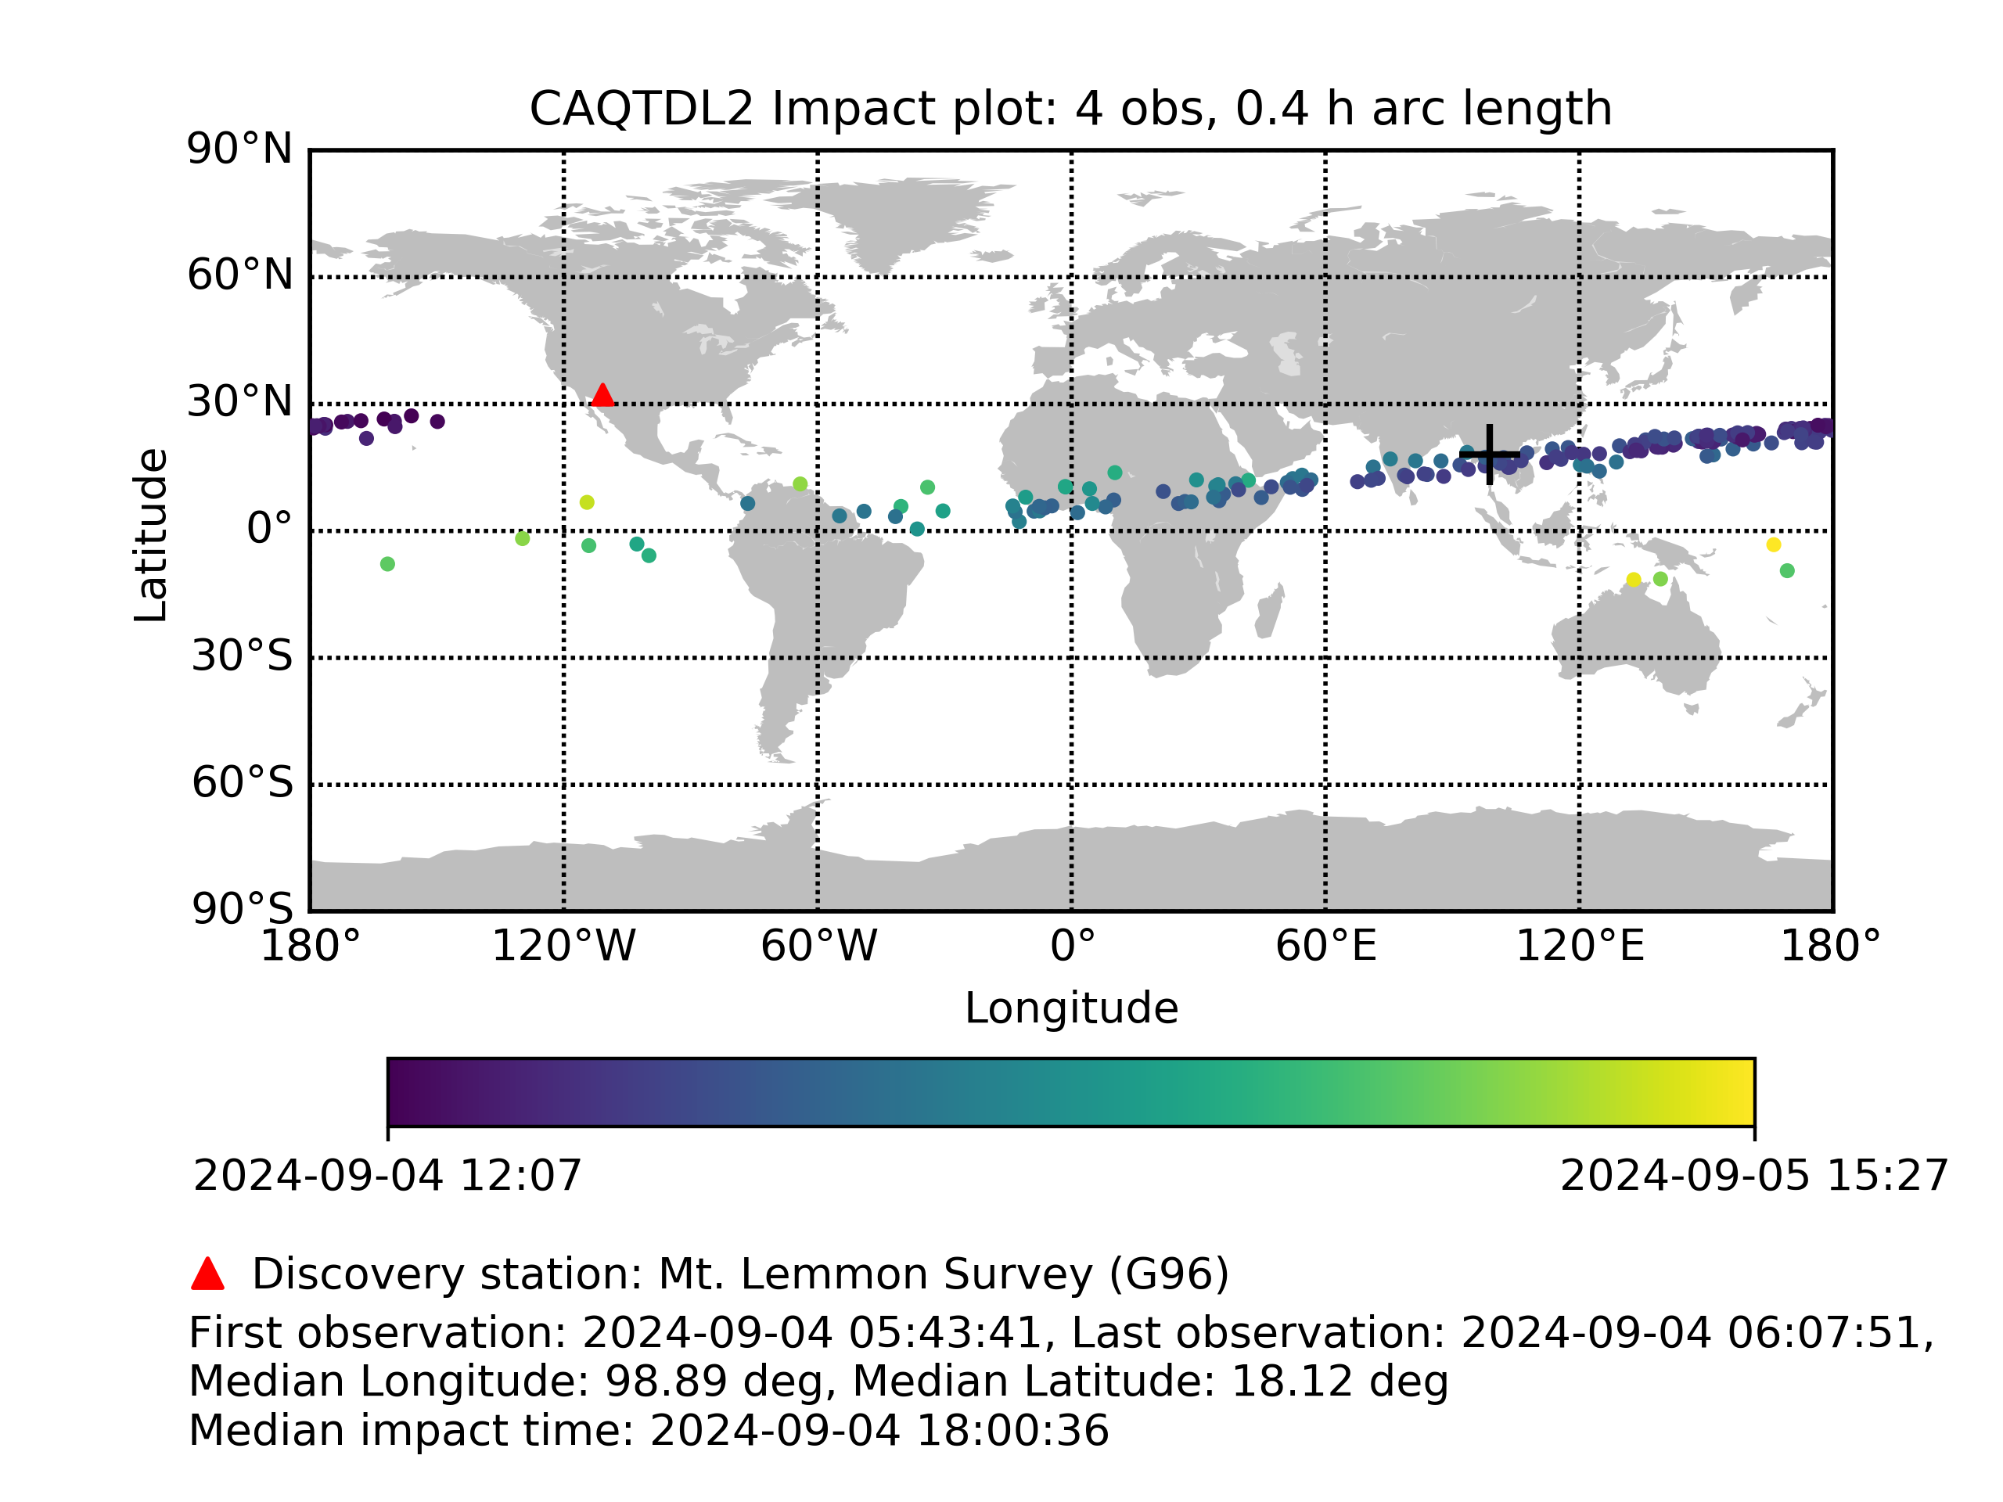
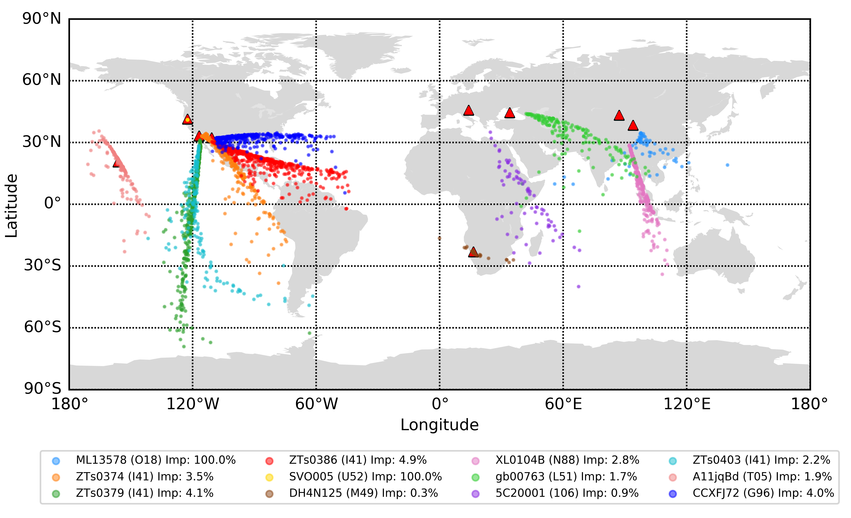
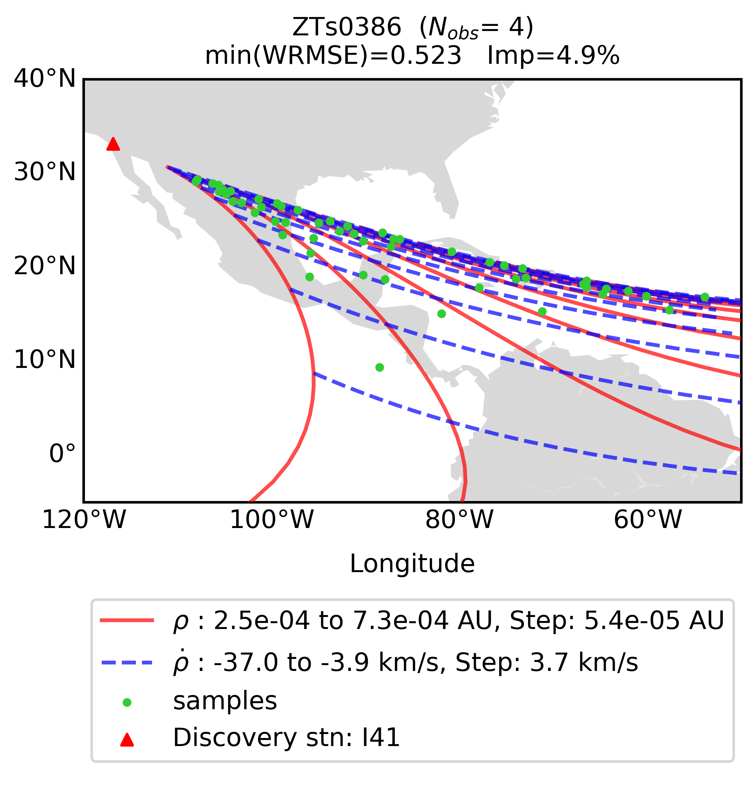

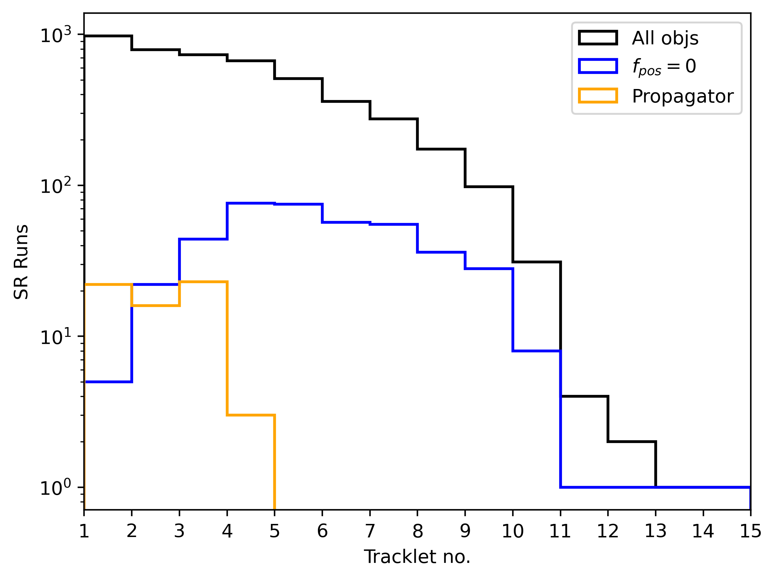
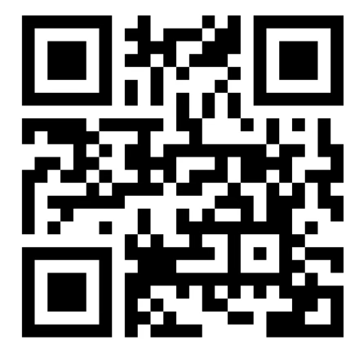
Assessing the Vulnerabilities of the
Meerkat Asteroid Guard
Background: Meerkat is ESA’s imminent impactor warning service [1]. It operates autonomously 24/7, processing tracklets from the NEOCP to deliver warnings for potential impactors. Newly-discovered objects often have short observational arcs, leading to errors with traditional orbit determination methods. To overcome this, Meerkat employs the method of systematic ranging (SR) [2] [3], whereby the object attributable 𝒜 (RA, Dec, RA rate, Dec rate at time t₀) is fitted to a grid of topocentric range and range rates (𝜌, 𝜌̇). From the fit error and prior probability distribution we derive a posterior distribution - a statistical description of the orbital and physical characteristics.
Meerkat Processing
Meerkat runs continually in a loop, following the process outlined in Fig 1. Issued alerts will include Figs. 2-4, with Fig. 5 included if impacting Monte Carlo solutions are drawn. Meerkat delivered timely alerts for the past 7 imminent impactors, as highlighted in Table 1.
NEOCP download
Impact Monitoring
Propagate fitted grid points forward 30 days
Alert issued
Email and phone alerts
Each subscriber group has custom thresholds to trigger alerts
Monte Carlo (MC) samples drawn from posterior distribution. Impacting samples plotted as in Fig. 5.
Systematic Ranging
NEOCP scanned autonomously 24/7
Orbit Determination: Object attributable 𝒜 fitted to (𝜌, 𝜌̇) grid, as in Fig. 1.
Fitting performed using Least Squares Differential Corrections
Magnitude Fitting: Absolute magnitude fitted to best-fit attributable 𝒜*
Observations weighted by bespoke station weighting scheme
New observations
Fig. 2 Ranging plot for object CAQTDL2 (N_{obs} = 4). The contours show the weighted RMSE from the orbit determination. All points outside the heliocentric bound are given a posterior probability of zero.
Fig. 3 Basic station selector plot for object CAQTDL2 (N_{obs} = 4). The detection probability from the geocenter as a function of instrument FoV and observation time is plotted in the top panel. The bottom panel indicates the impact probability per hour with cumulative impact probability shaded behind.
Impact score above threshold
Fig 1. Flow chart showing stages of Meerkat processing
Asteroid | Time between detection and impact (hrs)
2022 EB5 | 1
2022 WJ1 | 3
2023 CX1 | 7
2024 BX1 | 3
2024 RW1 | 11
2024 XA1 | 10
Table 1. List of impacting asteroids with successful Meerkat alerts issued. It is worth noting that 2024 UQ would also have had a successful alert, had the observations been submitted before the impact event.
Fig. 4 Dashboard plot for object CAQTDL2 (N_{obs} = 4). The rows indicate scores for impacting solutions, NEO solutions and all solutions respectively.
Fig. 5 Impact plot for object CAQTDL2 (N_{obs} = 4). Impacting Monte Carlo samples drawn from the grid posterior distribution are plotted with an indicated impact time. The median impact location is plotted as a cross.
False positive alerts
Error rate
New development features
Of the 1045 objects and 4626 SR runs between 6th Jan and 7th Mar 2025:
10.7% of all SR runs failed
27.5% of objects had ≥1 failed SR runs
2.2% of objects had only failed SR runs
Of the errors, two causes were most prominent:
Propagator reaches max number of steps (13% of total errors):
Occurs most frequently for very close approaches, who experience a deep dynamical encounter with Earth
Proposed solution: Zero-weighting of grid points exceeding 1e7 max propagator steps threshold
Posterior probability zero everywhere (82.5% of total errors):
Meerkat v2.0 is being developed in Python 3 with ESA’s astrodynamics library GODOT. This package is highly flexible, allowing users to develop custom solutions to virtually any flight dynamics problem.
Meerkat v2.0 will be live in September. There are several exciting features in development for this release:
Data handling:
Integration of MPC PostgreSQL database for reading NEOCP observations, allowing 80 col + observer submitted observation error
Ability to read any of 80-col, ADES v2022 and ADES v2017
Error reduction:
Re-computation of failed objects in Meerkat downtime, with option to use batch SRIF orbit determination method
Observation outlier identification and rejection upon failed grid fitting
Recall of last used grid limits for each object, reducing computation time and allowing more highly converged solutions at high N_{obs} to be reached.
Refined propagator error handling using zero-weighting scheme
Impactor analysis:
Prioritisation queue for high-risk objects
Estimated entry angle, impact velocity and time until object enters Earth’s shadow
Fig. 6. Left panel: 500 heliocentric impacting MC samples for specific false positive alert objects. The discovery stations and impact scores are indicated. Right panel: The impact region of ZTs0386 in (𝜌,𝜌̇)-space is mapped into longitude-latitude space, highlighting the correlation of sample impact location with range-rate.
Between May 2024 and Apr 2025, Meerkat issued ∽15 discovery alerts (N_{obs} ≤ 5) where the MC impact locations appeared to point towards the discovery station, as shown in Fig. 6. The mechanism behind this is hypothesised as:
Poor observations inject artificial curvature to the observation arc
Consequently, all fitted orbits within admissible region equally likely
Monte Carlo samples are drawn from a uniform distribution; 𝑠 ∽ 𝒰(𝜌,𝜌̇)
Impact locations cluster correlating to range-rate.
The clustering is thought to be due to the natural dispersion that occurs with changing velocity. This effect is worsened by slower range rate samples having more time to be perturbed by Earth’s gravity, and typically being fitted with less eccentric orbits. It is envisaged to devise a metric based on the flatness of the posterior distribution to indicate when this false positive will occur.
Orbit fitting yields high residuals at every grid point
This can occur when the solution in (𝜌,𝜌̇)-space is so converged that the confidence region is small enough to be missed by the grid step size.
More frequently, occurs due to poor observations
Proposed solution: apply observation outlier identification and rejection upon failed grid fitting
Fig. 7. The distribution of all SR runs over tracklet number compared to those with errors.
References:
Authors Information:
[1] F. Gianotto, J. Cano, L. Conversi, L. Faggioli, M. Fenucci, D. Föhring, M. Frühauf, D. Koschny, R. Kresken, M. Micheli, et al., Meerkat Asteroid Guard - ESA’s Imminent Impactor Warning Service, in: 2nd NEO and Debris Detection Conference, p. 49.
[2] S. Chesley, Very short arc orbit determination: the case of asteroid 2004 FU162, Proceedings of the International Astronomical Union 2004 (2004) 255–258.
[3] D. Farnocchia, S. Chesley, M. Micheli, Systematic ranging and late warning asteroid impacts, Icarus 258 (2015) 18–27
C. Drury ⁽¹⁾, M. Frühauf ⁽²⁾ , J.L. Cano ⁽³⁾ , F. Gianotto ⁽¹⁾, M. Fenucci ⁽¹⁾, L. Faggioli ⁽¹⁾
Additional thanks to F. Ocaña ⁽¹⁾ , M. Micheli ⁽¹⁾ and M. Revellino ⁽¹⁾ for their guidance and input
¹ ESA ESRIN / PDO / NEO Coordination Centre, Via Galileo Galilei, 1, 00044 Frascati (RM), Italy
² Technical University of Munich, Lunar and Planetary Exploration, Lise-Meitner-Str. 9, Ottobrunn, 85521, Germany ³ ESA ESOC / Planetary Defence Office, Robert-Bosch-Straße 5, 64293, Darmstadt, Germany
To subscribe to Meerkat automatic mailing list, please send an email to neocc@esa.int
NEOCC portal

