Slide 1
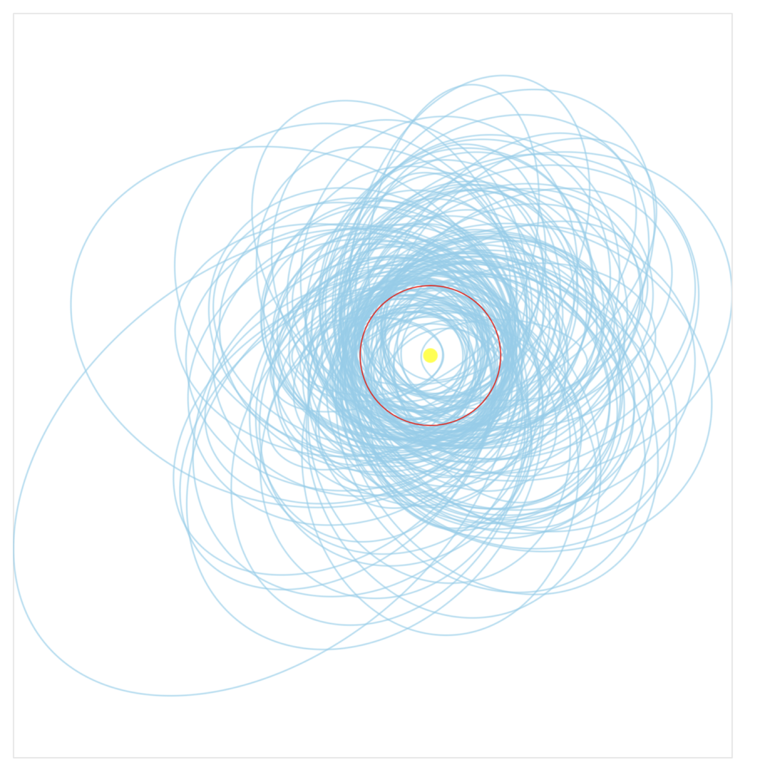
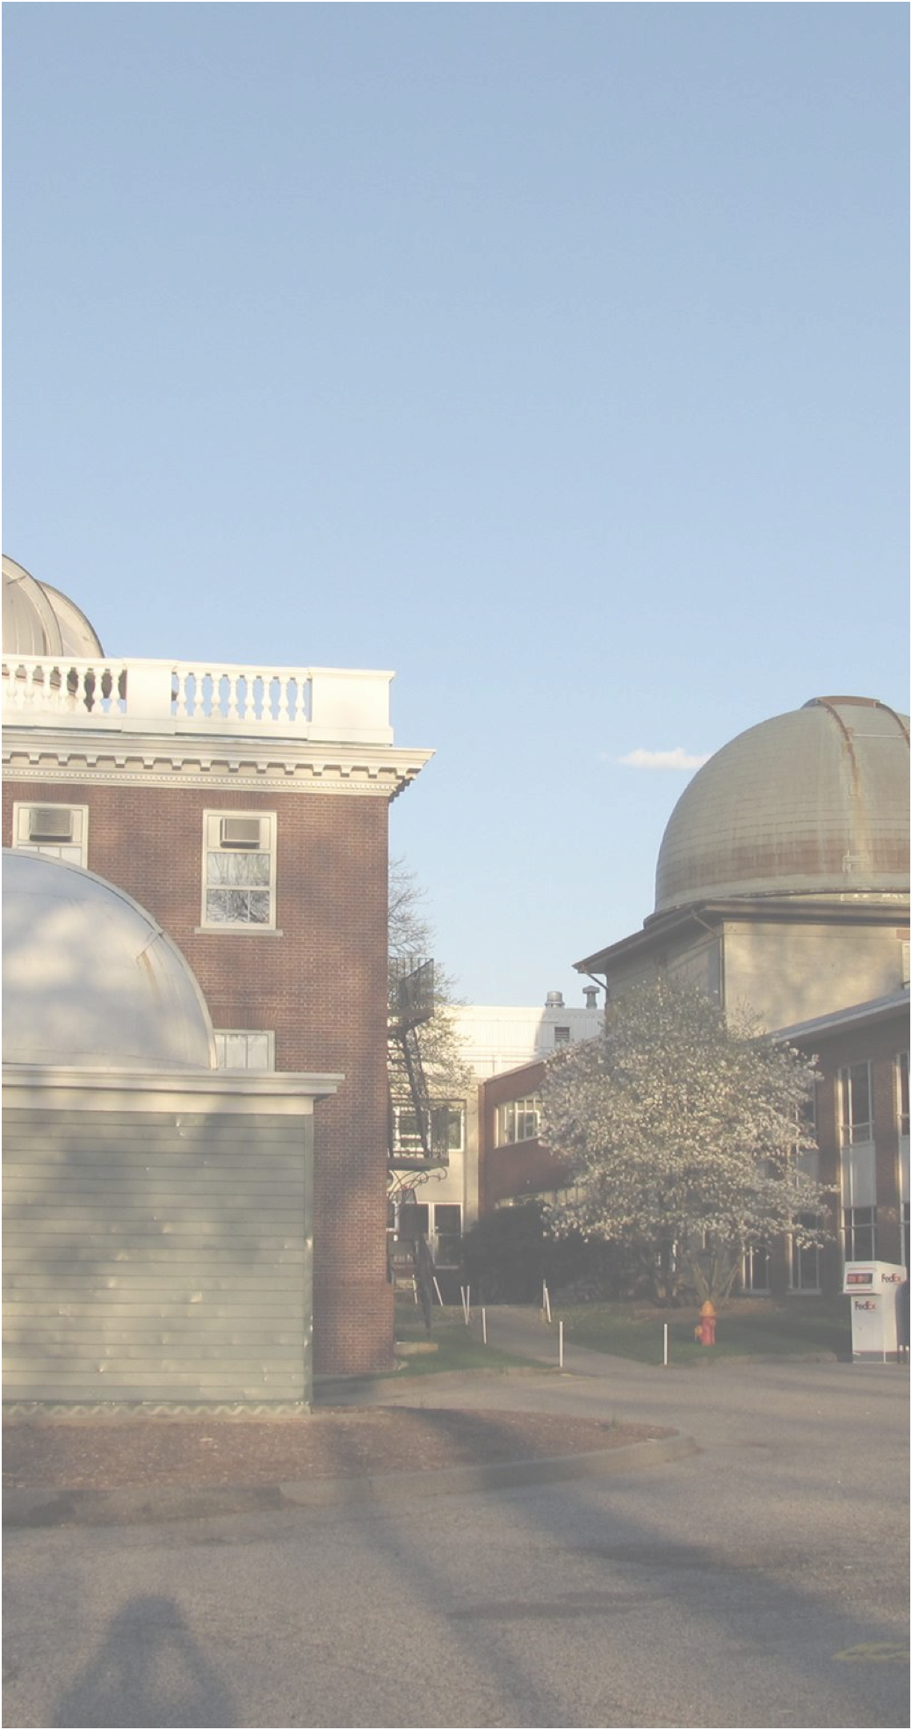


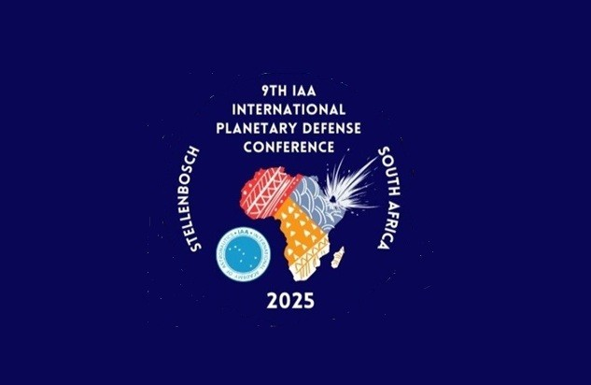
Minor Planet Center
Updates & new Developments
Federica Spoto, Matthew Payne & the MPC team
Center for Astrophysics | Harvard & Smithsonian
May 7, 2025
9th IAA Planetary Defense Conference 2025

Slide 2
The MPC
The Minor Planet Center (MPC) serves as the single worldwide location for tracking and cataloging asteroids, natural irregular satellites of the major planets, and comets, making it central to planetary defense efforts
The MPC is located in Cambridge (MA) at the Center for Astrophysics.
It operates as part of the Smithsonian Astrophysical Observatory under the auspices of the Division F of the IAU
The MPC is responsible for:
Announcing the discovery of new objects
Maintaining a consistent catalog of observations and orbits of minor planets, comets and natural satellites
Announce identifications
Numbering (assign numbers to objects that have good enough orbits)

Slide 3
The MPC
Name | FTE | Role
Matthew Payne | 1.00 | Director
Federica Spoto | 1.00 | Project Scientist
Mike Alexandersen | 0.90 | Astronomer
Dave Bell | 1.00 | Software developer
Nora Casale | ~0.80 | Software Developer
Margaret Pan | ~0.80 | Astronomer
Rosemary Pike | ~0.25 | Astronomer
Peter Veres | 1.00 | Astronomer
Radiy Matveev | 1.00 | Software Developer
Mike Rudenko | 1.00 | Software Developer & Sys-Admin
Brian Burt | 1.00 | Software Developer
Michael Lackner | 1.00 | Contractor: Database Development & AWS Migration
Peter Williams | 1.00 | Technical Lead
The MPC staff has expanded to 16 team members (5 astronomers & 7 software developers). New additions to the team are: Paul Di Re (project manager ~25%); Yatrik Solanki (software developer) - started in March 2025; Jorge Hernandez (astronomer) - starting in June 2025

Slide 4


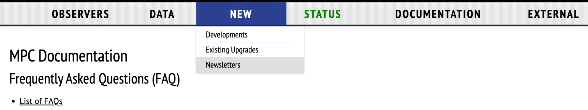
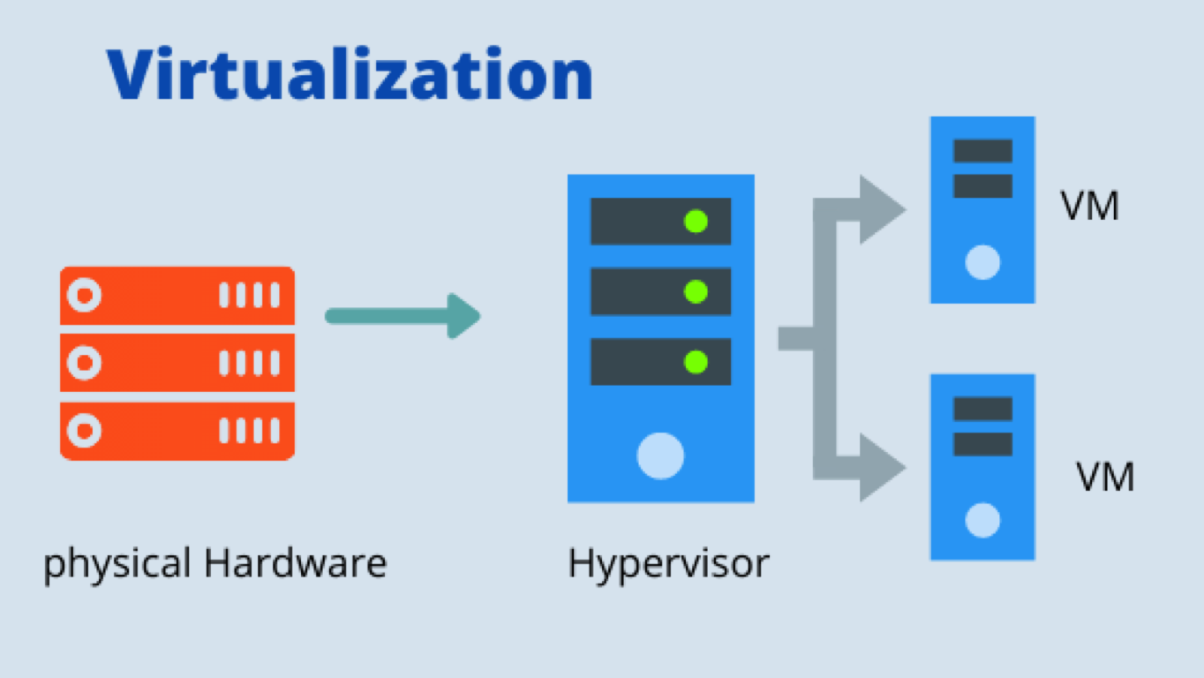
What have we been up to?
The MPC has spent the last years improving its current systems and working towards getting ready for the incoming surveys.
Improving the reliability and access to our data : website, replication of database tables, APIs, documentation
Virtualization : creating a new hardware infrastructure for easier disaster recovery and faster processing times (use of multiple virtual machines)
Moving towards a database-centric system : ensuring consistency between flat files and database tables for a smooth transition
Parts of the new system are already operational and others currently run as part of testing phases with the Vera Rubin/LSST and NEO Surveyor Teams

Slide 5
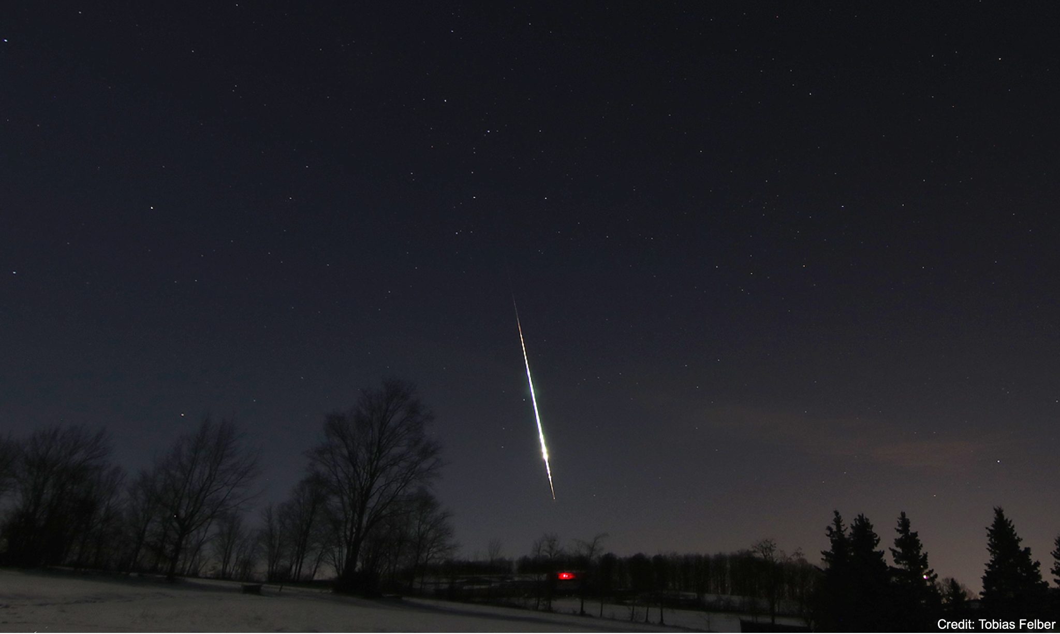
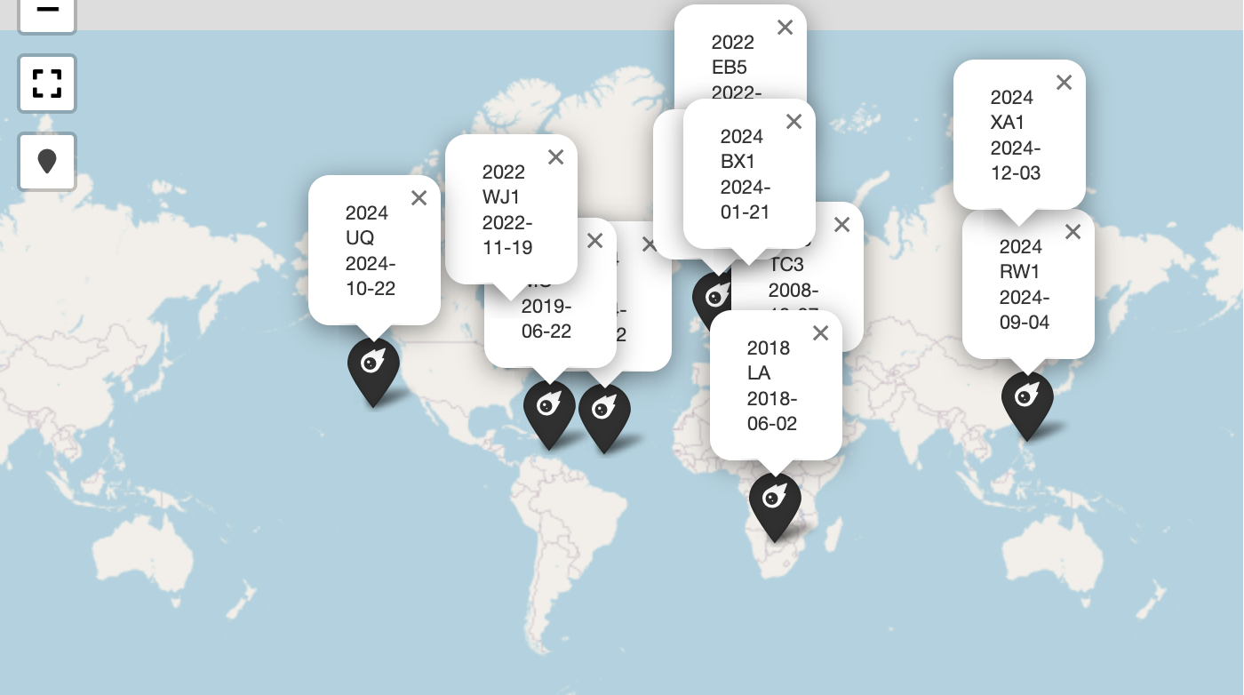
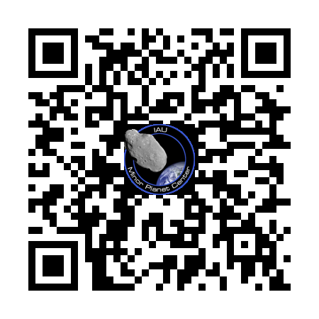
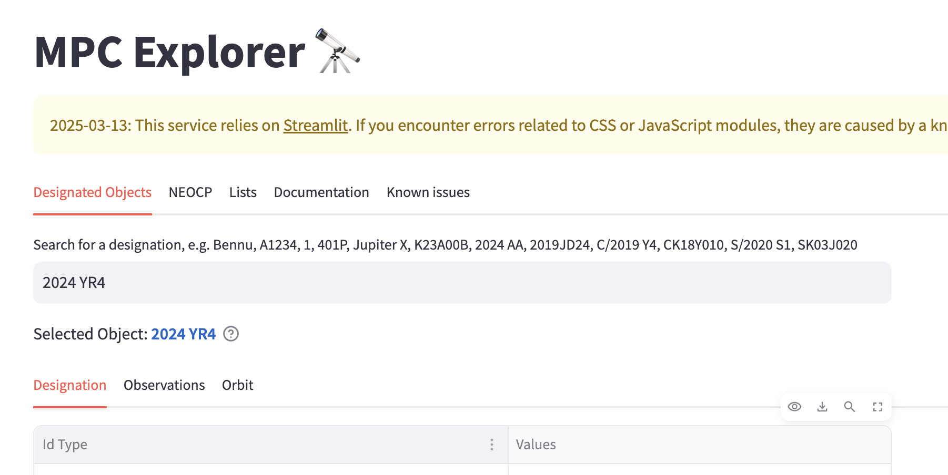
Past impactors
List of past impactors and their impact locations (object that have been discovered before entering Earth’s atmosphere):
2008 TC3: Sudan
2014 AA : Atlantic Ocean
2018 LA : Botswana
2019 MO : Caribbean
2022 EB5: North of Iceland
2022 WJ1: Ontario
2023 CX1: North of France
2024 BX1: Berlin
2024 RW1: Island of Luzon (Philippines)
2024 UQ: Pacific Ocean
2024 XA1: Eastern Siberia
MPC Explorer - Past Impactors list

Slide 6
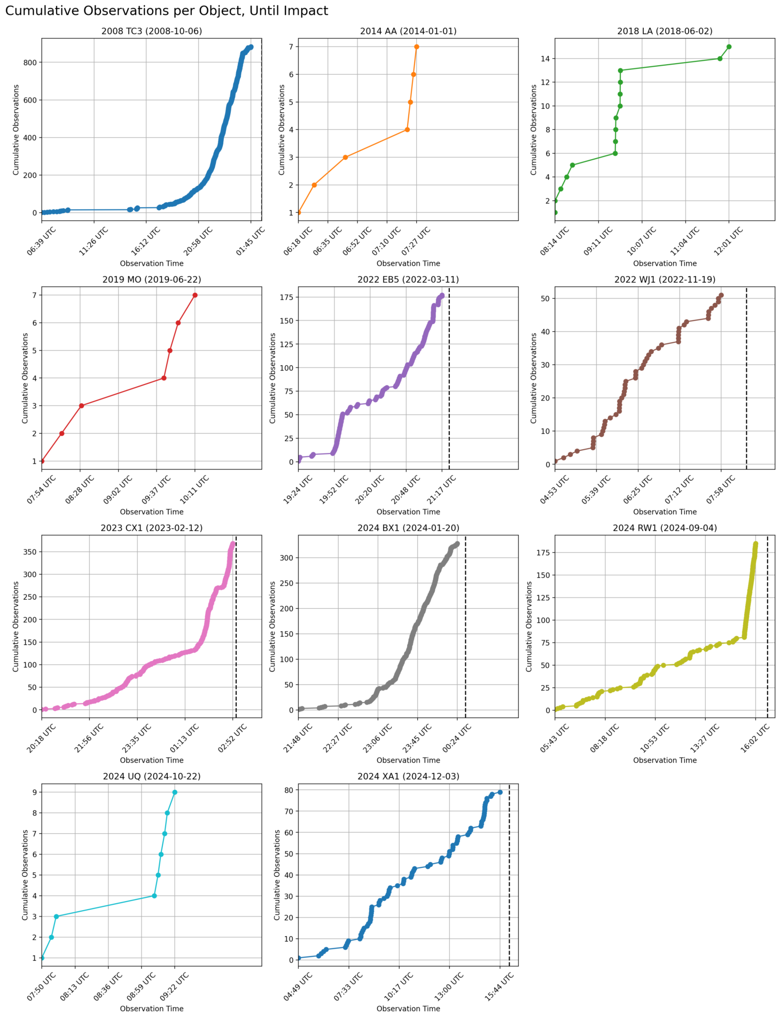
When to designate an impactor?
Open question: when is the right time to designate an impactor?
The MPC has tried two different approaches:
Keeping the object on the NEOCP until the impact
Removing the object from the NEOCP before the impact (once the orbit and the impact location were already well determined)
PROs of keeping the object on the NEOCP
Recent monitoring systems, like JPL Scout or ESA Meerkat relies on the objects being on the NEOCP
Continuous update of observations and ephemerides
Easier follow-up from part of the community
CONs of keeping the object on the NEOCP
The object doesn’t have an official designation from the MPC
More difficult follow-up for the part of the community that has tools set up to work with Horizons and not Scout (or the ephemeris service and not the NEOCP)
We are working towards finding the best combination.
Plot from the list of past impactors page from the MPC Explorer: Cumulative distribution of the number of observations per past impactors.

Slide 7
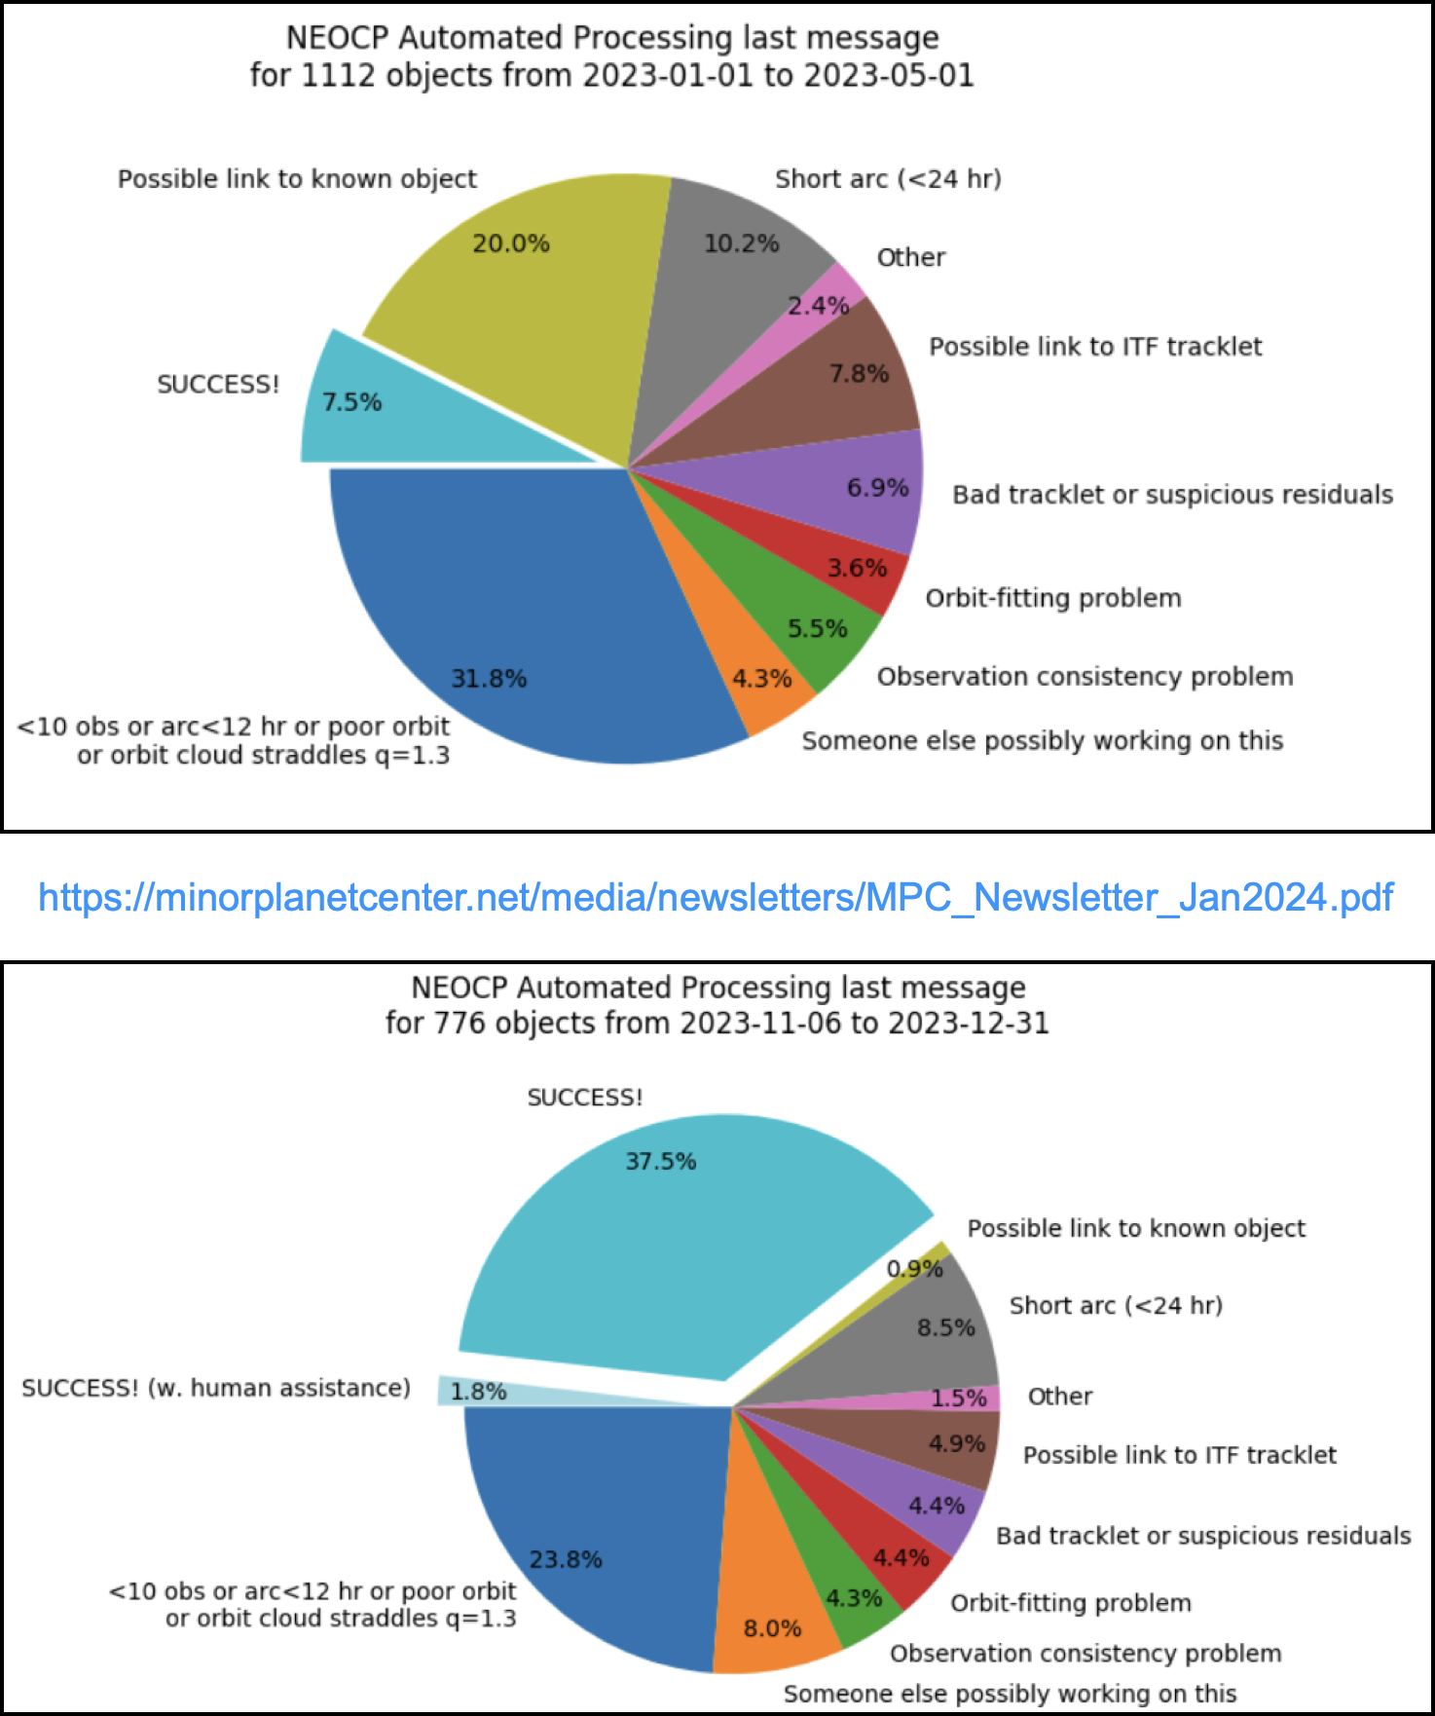
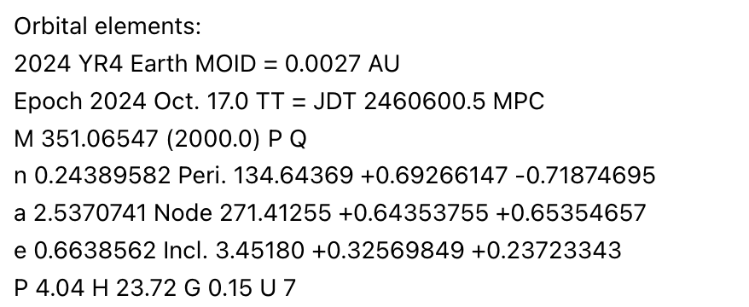
MPEC Automation
NEOCP Automatic Processing (NAP)
NEOs or very distant objects (q>5.6 au) are usually MPEC’ed when we have sufficient astrometry to determine a well constrained orbit
Check out our April newsletter for new criteria on MPECs for distant objects
NAP is an automated script that is able to automatically process and designate NEOCP objects
Before being automatically designated, the objects go through a very thorough verification process
Work in progress: automating the designation of very-short arc (less than 24 hours?)
Fun fact: 2024 YR4 was automatically designated by NAP on Dec 27, 2024

Slide 8
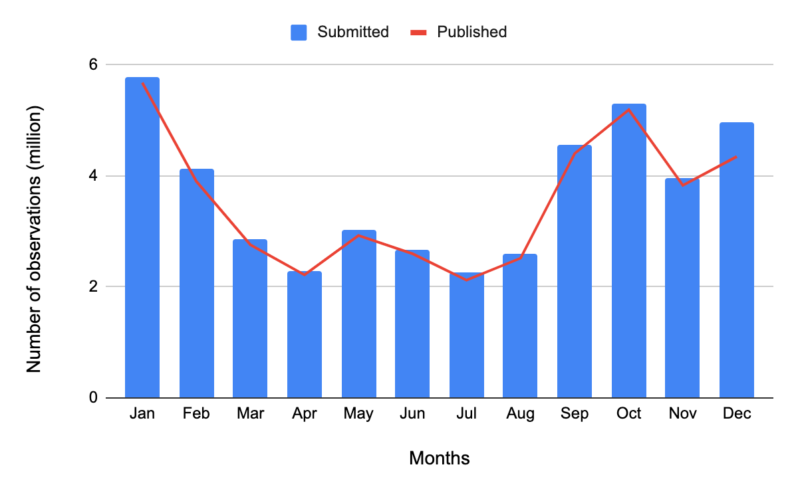
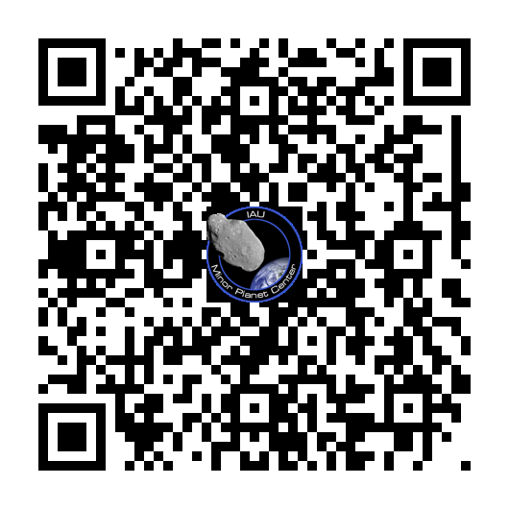
Thank you.
More than 44 million observations have been submitted to the MPC in 2024
For any questions, suggestions, requests, please don’t hesitate to contact us using Jira
Data from Dec 30, 2024
https://data.minorplanetcenter.net/mpcops/new/newsletters/

