Slide 1
How many NEAs are there?
Gonzalo Tancredi
Departamento de Astronomía – Facultad de Ciencias
Udelar
URUGUAY

Slide 2
Question from the public: How many dangerous asteroids could potentially hit the Earth?
The number is size-dependent.
The community agreed in two limits:
1km objects for global catastrophes.
140m objects for regional events.

Slide 3
Estimates in the last 25 years
# | Authors | Pub. yr | H Limit | Diameter | p_{V} | # | + | -
1 | Bottke et al. | 2000 | 18 | * 1 | 0.155 | 910 | 100 | 120
2 | D’Abramo et al., | 2001 | 18 | * 1 |  | 855 | 101 | 101
3 | Stuart | 2001 | 18 | * 1 | 0.11 | 1227 | 170 | 90
4 | Bottke et al. | 2002 | 18 | * 1 | 0.098 | 960 | 120 | 120
5 | Stuart & Binzel | 2004 | 17.8 | 1 | 0.14 | 1090 | 180 | 180
6 | Mainzer et al. | 2011 |  | 1 |  | 981 | 19 | 19
7 | Harris & D’Abramo | 2015 | 17.75 | * 1 | 0.14 | 990 | 20 | 20
8 | Tricarico | 2017 | 17.75 | * 1 |  | 920 | 10 | 10
9 | Granvik et al. | 2018 | 17.75 | 1 |  | 962 | 52 | 56
10 | Morbidelli et al. | 2020 | 17.75 | 1 | 0.147 | 1000 | 100 | 200
11 | Harris & Chodas | 2021 | 17.75 | * 1 |  | 940 | 10 | 10
12 | Harris & Chodas | 2023 |  |  |  | idem
13 | Nesvorný et al. | 2023 | 17.75 | * 1 | 0.14 | 931 | 30 | 30
14 | Nesvorný et al. | 2024a | 17.75 | * 1 | 0.14 | 936 | 29 | 29
15 | Nesvorný et al. | 2024b |  | 1 |  | 830 | 60 | 60
* - Diameter estimated assuming a mean p_{V}
p_{V}=0.14 - Stuart & Binzel (2004)

Slide 4
Consensus
There are roughly 1000 NEAs larger tan 1km.
Estimates range from 770 to 1400, but most recent estimates concentrate in the range 800-1000.
Let’s do a critical revision of this consensus!

Slide 5
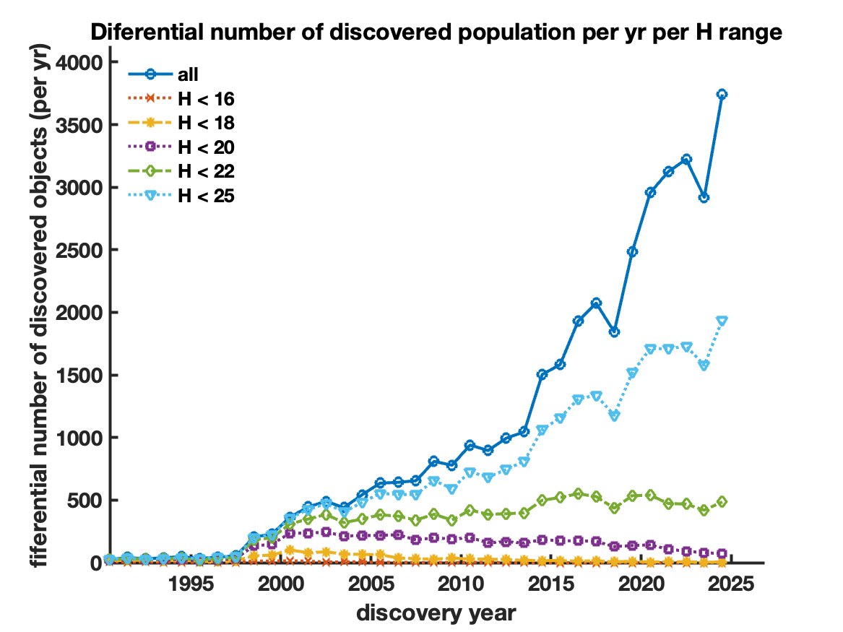
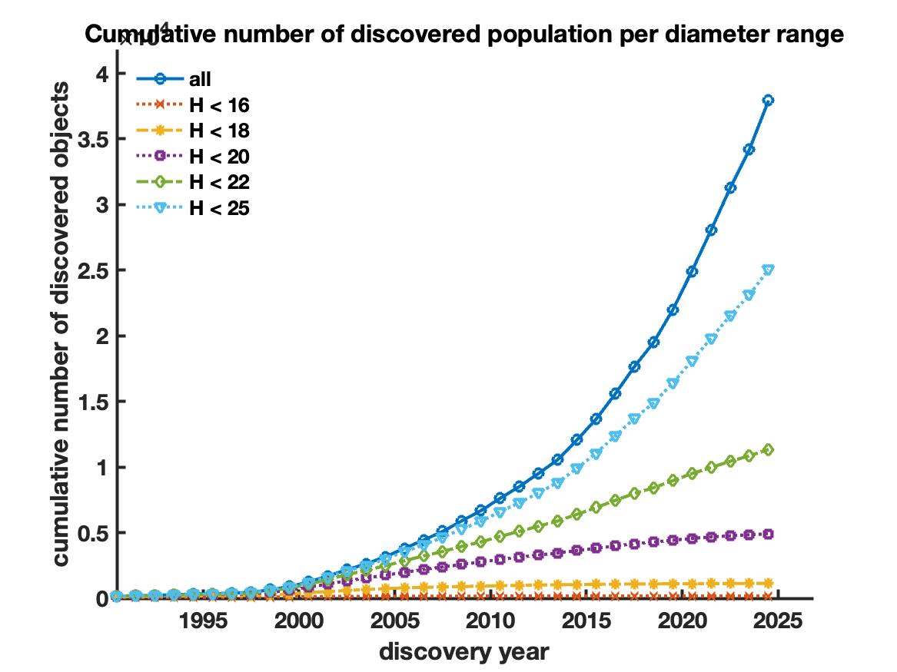
Discoveries per H range

Slide 6
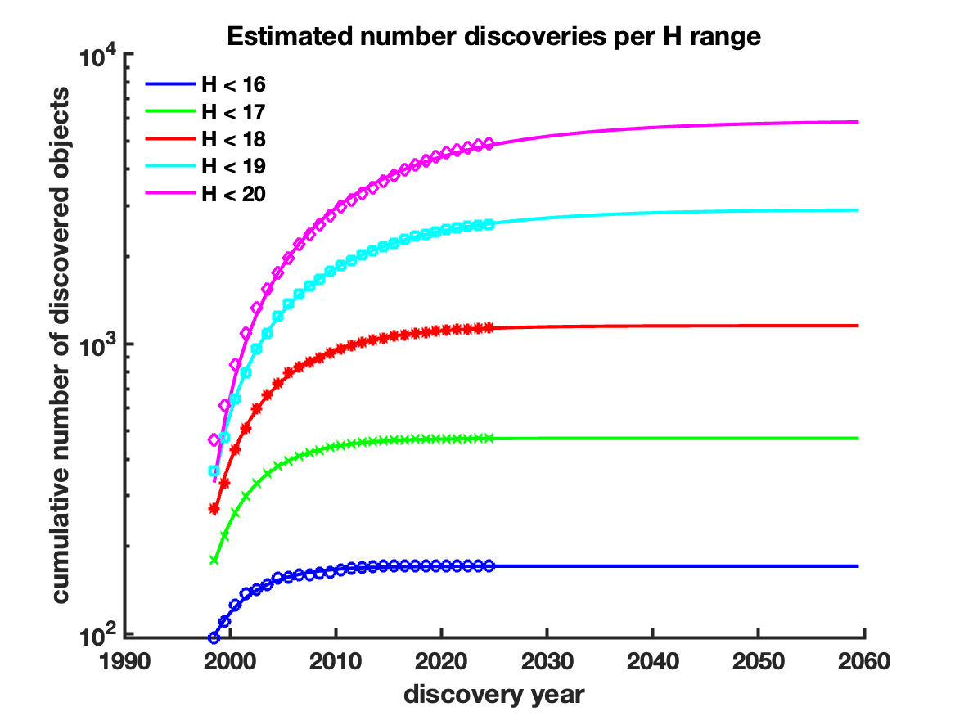
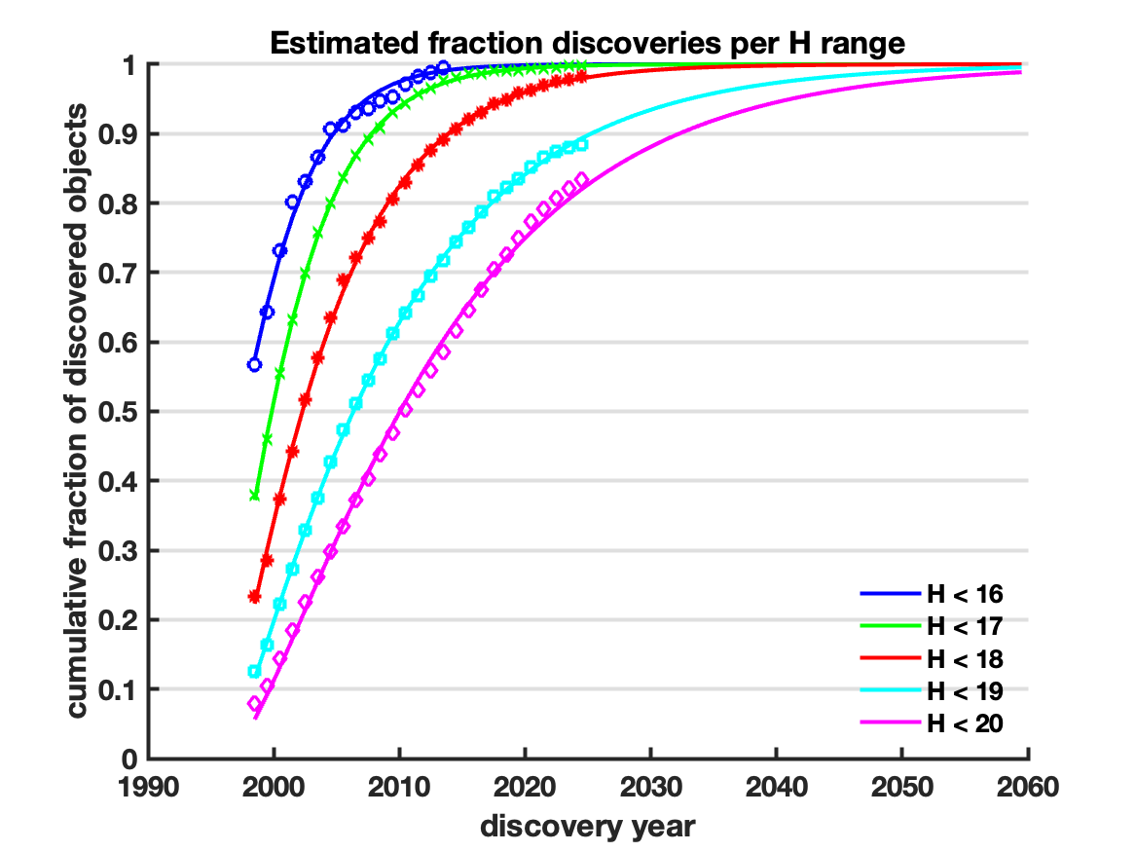
Numbers per H range
Extrapolations were done by fitting a Cumulative Gamma Distribution to the already discovered population.

Slide 7
Numbers for H<17.75
According to our numbers:
Number already discovered for H<17.75: 868
Estimated number for H<17.75: 874
Estimated fraction discovered for H<17.75: 99 %
Latest estimates:
Harris & Chodas (2021): 940 ±10 - 92% of completeness
Nesvorný et al. (2024a): 936 ± 29 - 93% of completeness
If those estimates are correct, it would be difficult to reach total completeness at the present discovery rate (~70 missing NEAs). The present discovery rate is 2 NEAs of H<17.75 per year.
Where are those missing objects?
Alternative: those estimates slightly overestimate the real number.

Slide 8
But from a Planetary Defense perspective, we are interested in limits based on size, not on H.

Slide 9
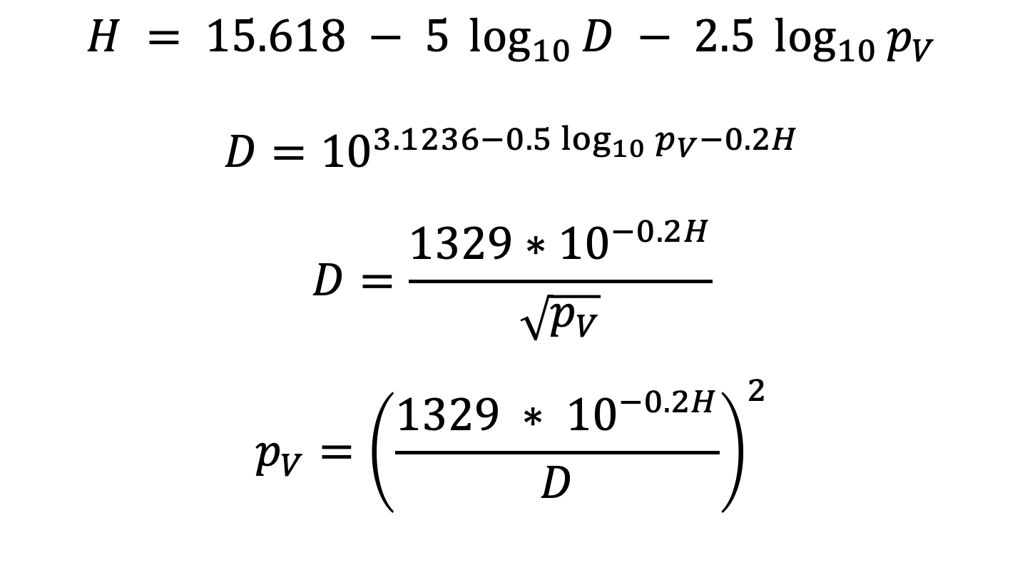
Relations between H – D - p_{v}
$$H = 15.618 − 5 \log_{10}{D} − 2.5 \log_{10}{p_{V}}$$
$$D={10}^{3.1236−0.5\log_{10}{p_{V}}−0.2H}$$
$$D=\frac{{1329∗10}^{−0.2H}}{\sqrt{p_{V}}}$$
$$p_{V}={\left(\frac{1329 ∗ {10}^{−0.2H}}{D}\right)}^{2}$$
Note that the equations relating H – D - p_{v} are highly non-linear.

Slide 10
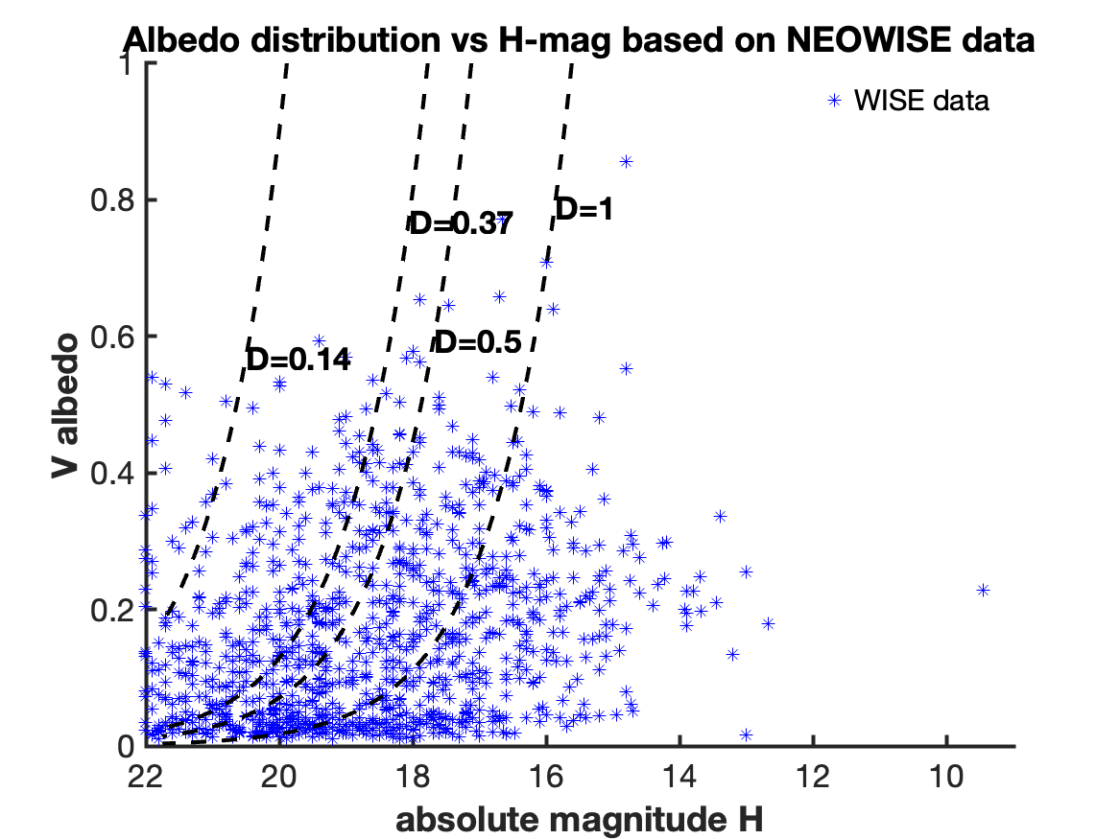
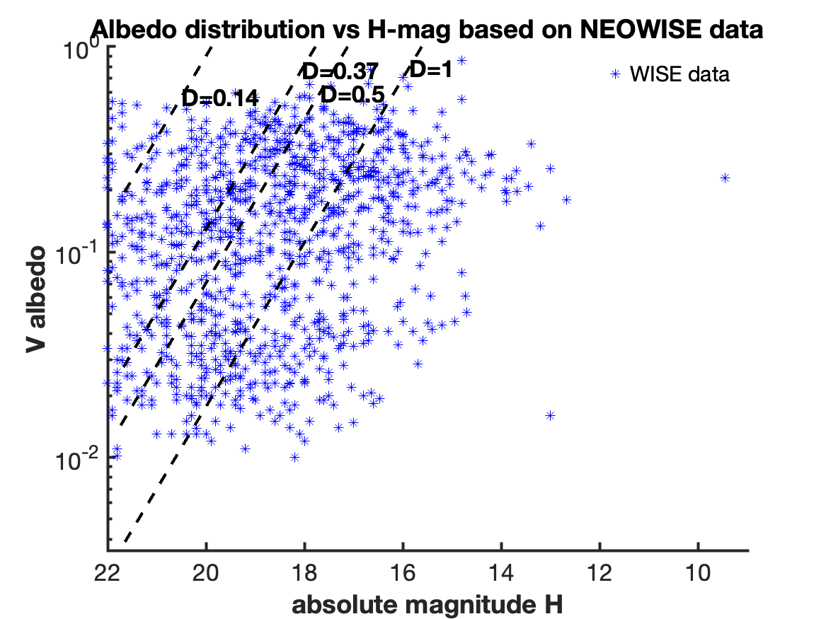
H vs p_{V} in the NEOWise database
NEOWise claimed that their albedo distribution represents the entire population.
“We don’t find any statistically significant evidence that the albedo distribution of NEOs depends on NEO size.” (Morbidelli et al. 2020)

Slide 11
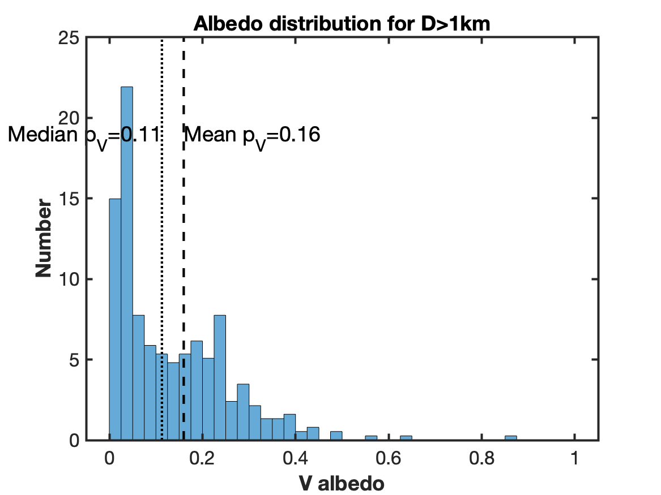
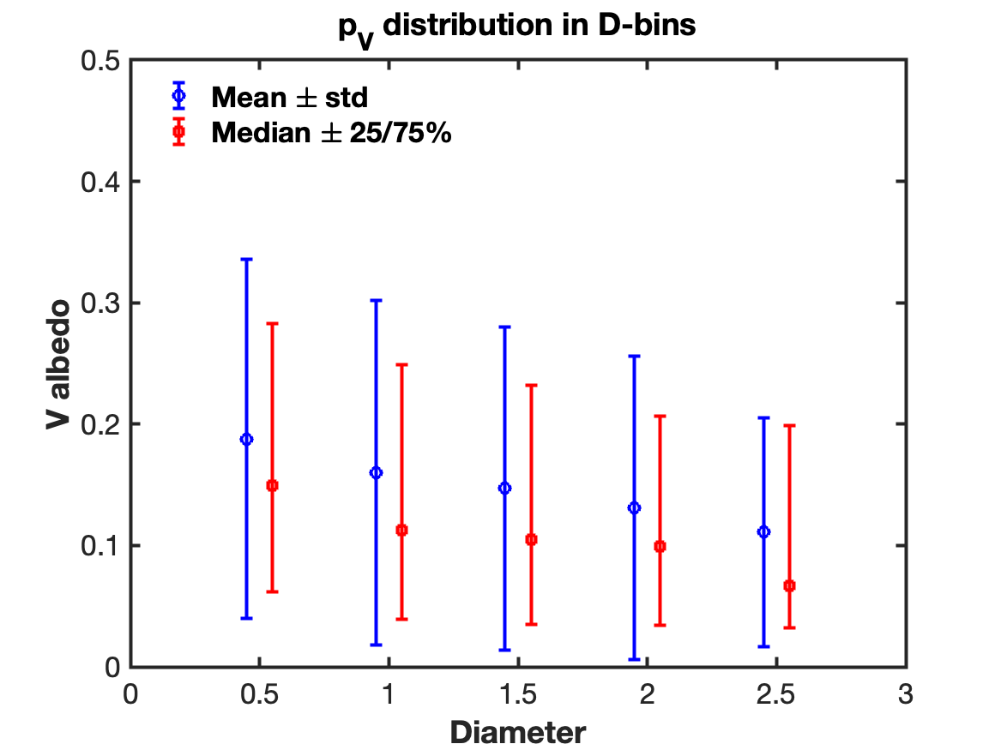
A squeezed & bimodal albedo distribution

Slide 12
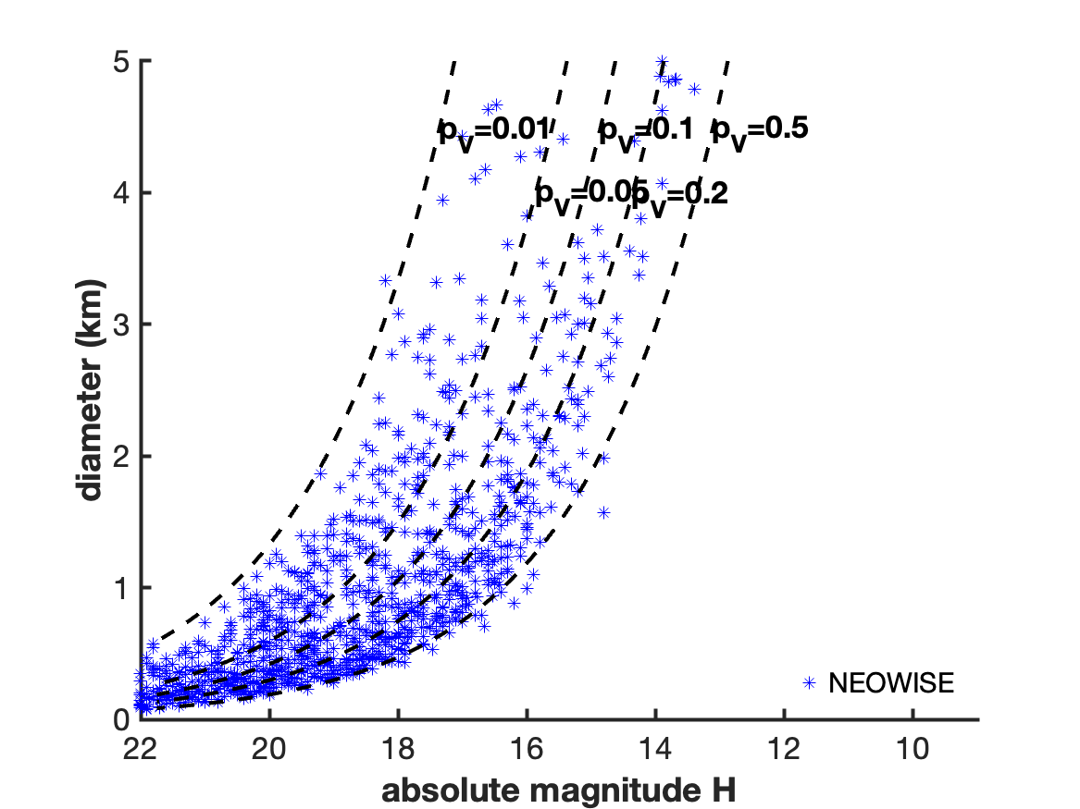
H vs D NEOWISE data

Slide 13
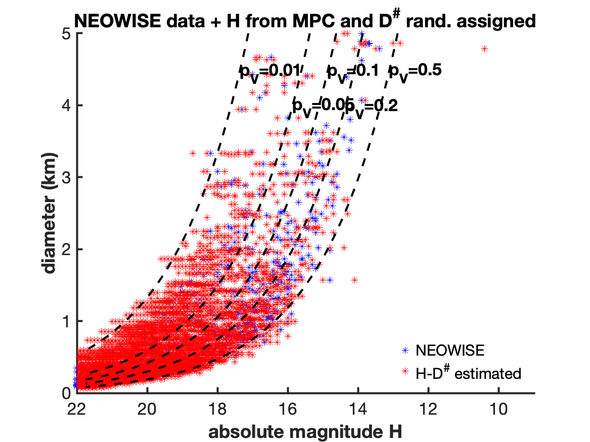
Guess D given a value of H compatible with the NEOWise data
NEOWISE data
Methods for conditional resampling
Generate D-values from MPC’s H using the Nearest Neighbors Resampling method.
Problem: The objective is to estimate values of y (D) for a
given set of x (H) values, using the distribution inferred from a subsample in which both x and y were measured.
Steps:
1. For a given x₀, find the k nearest neighbors (in terms of x) in the subsample.
2. Given the set of k y values, randomly select a y₀ value for the given x₀.
We note these guessed values of D as D#.

Slide 14
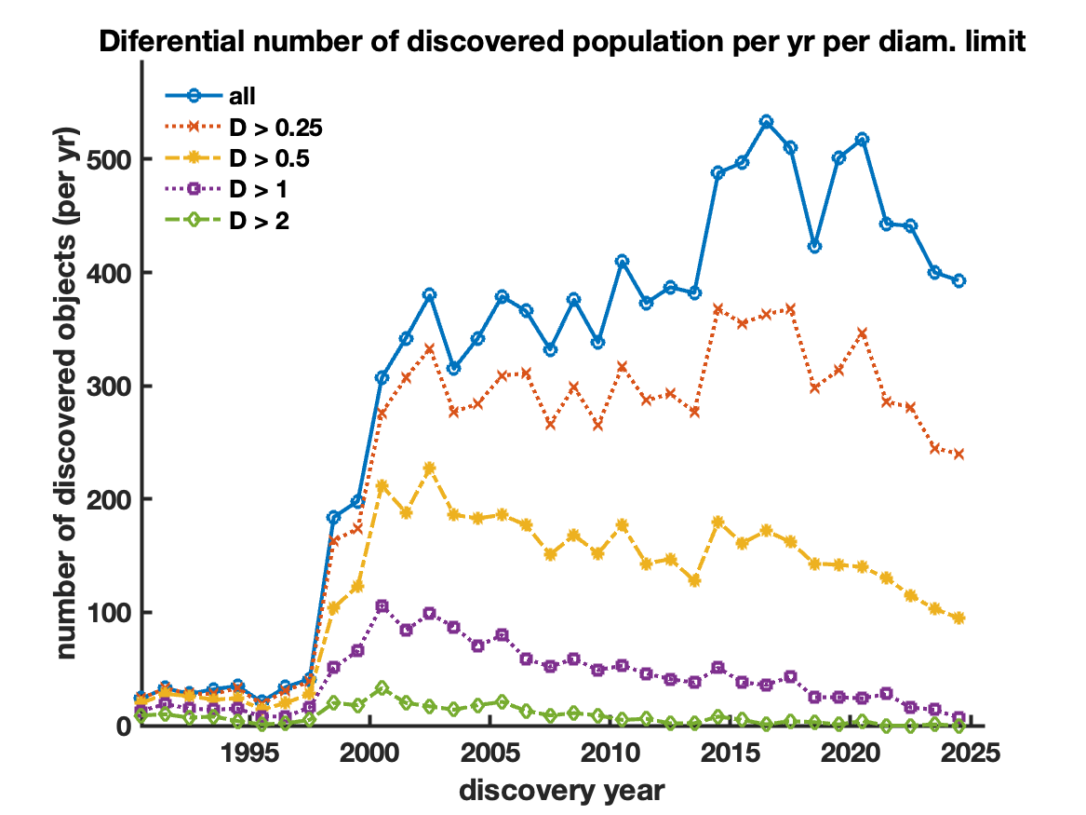
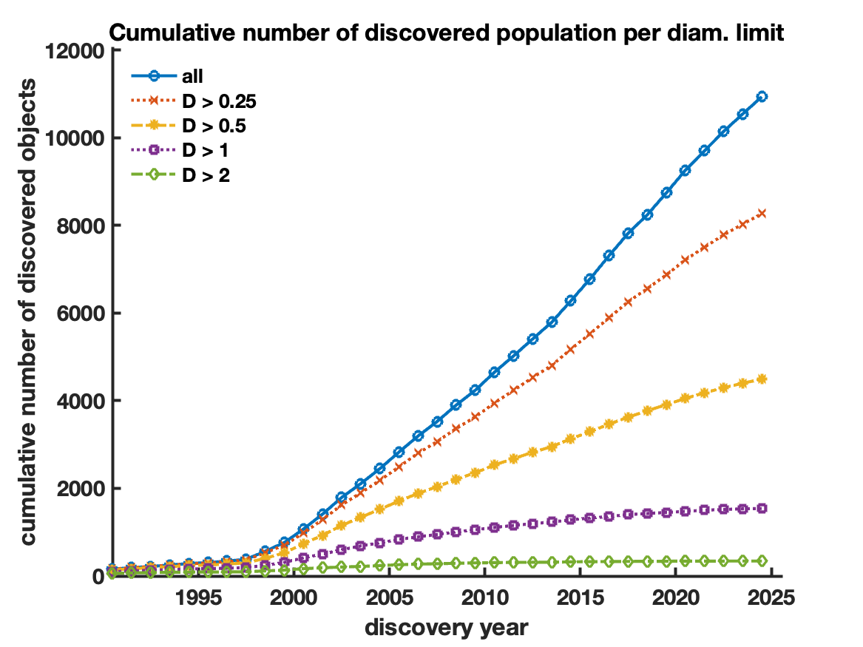
Discoveries per D# range
D#- guessed D using the Nearest Neighbors Resampling method
~1500 NEAs >1km
Note: According to the guessed values of D# , the numbers of NEAs larger than 1km already discovered is ~1500.

Slide 15
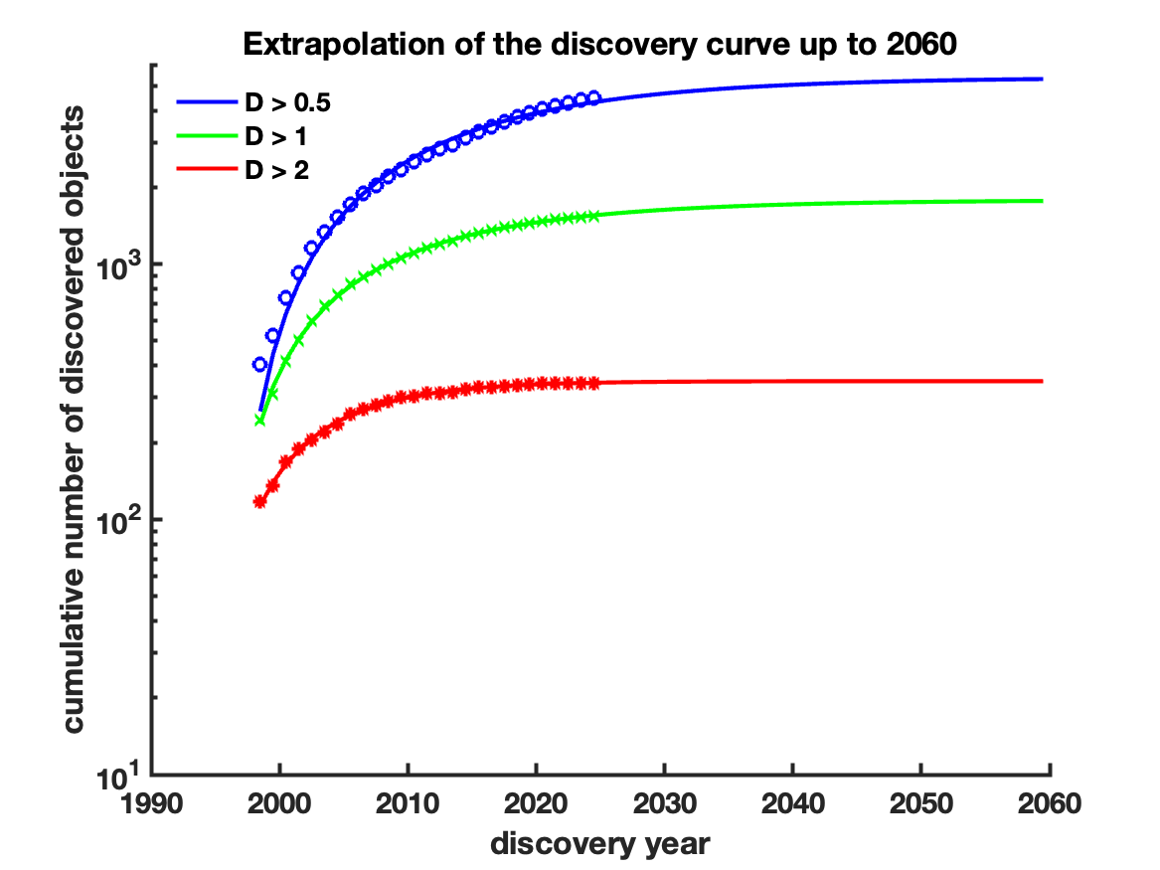
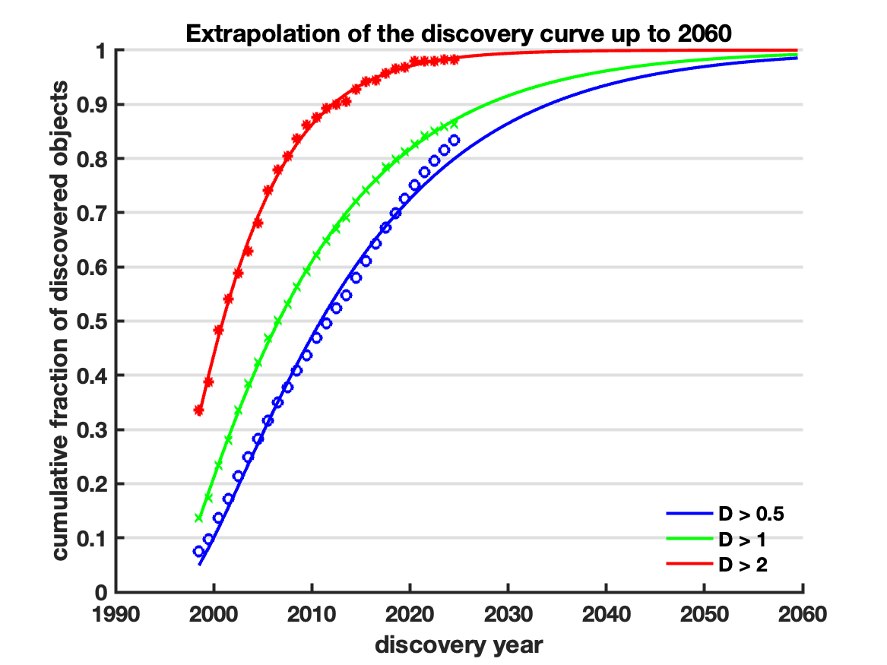
Numbers per D# range
Extrapolations were done by fitting a Cumulative Gamma Distribution to the discovered population.
~1750 NEAs >1km
~87% completeness for
NEAs >1km
Note: for D>1 km the discovery rate has already passed the peak, and it is decreasing at present.
The fitting of the Gamma distribution and the extrapolation to obtain the total number are more reliable in all the ranges of D larger than 1km

Slide 16
Estimates for various D#
 | # median discoveries | 25/75 % discoveries | # estimated | 25/75 % estimated | fraction discovered
D>2 | 350 | 340 | 355 | 345 | 99%
 |  | 358 |  | 365
D>1 | 1515 | 1496 | 1735 | 1703 | 87%
 |  | 1530 |  | 1773
D>0.5 | 4458 | 4430 | 5350 | 5316 | 84%
 |  | 4481 |  | 5377
D>0.34 | 6778 | 6749 | >8134 | >8099 | <83%
 |  | 6807 |  | >8168

Slide 17
Conclusions
Previous estimates of the number of NEAs were generally based on a value of the absolute magnitude H<17.75.
Assuming a unique value of albedo p_{V}=0.14 , this limit corresponds to D>1km.
Previous estimates were mostly in the range 800-1000.
By considering the albedo distribution, we obtain an estimate of NEAs D>1km ~ 1750, with a completeness of 87%.
For NEAs larger than Apophis (D>0.34km), the number is more uncertain, because the discovery rate has not stabilized yet; but it is expected to be > 8000 (completeness <83%).

Slide 18
The estimated number of NEAs larger than 1 km has doubled, implying that the impact frequency should be revised downward by a factor of two.
Stay tuned!!

Slide 19
Acknowledgements
To my son Bruno Tancredi, Graduated in Statistics, for discussions about the methods for conditional resampling.

Slide 21
The Discovery process
Questions:
What is the expected Probability Distribution for the discovery process?
What is the distribution of the discovery times?
Simulation:
Problem: Consider a set of particles moving inside a 3D cubic box, bouncing elastically off the walls.
Question: What is the probability distribution of the arrival times of the particles close to a point inside the box?

Slide 22
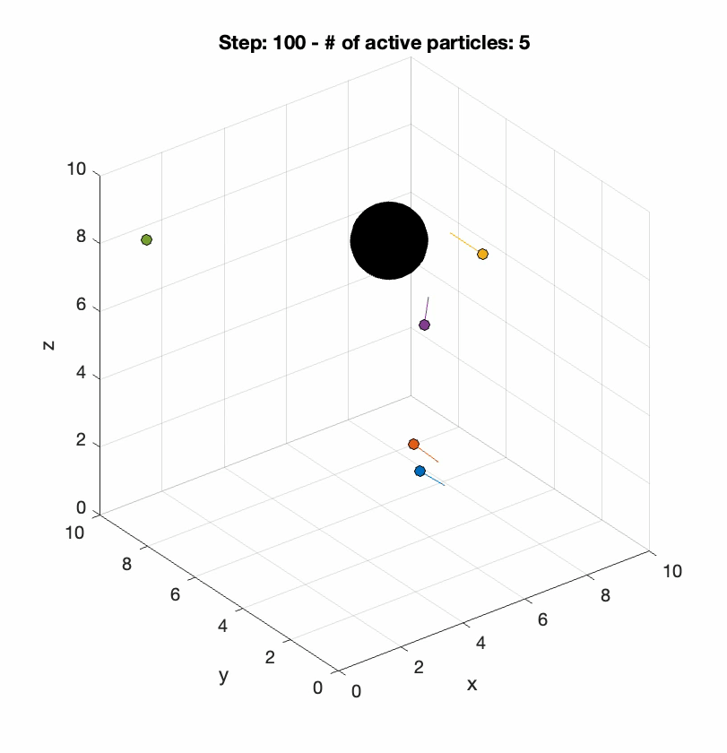
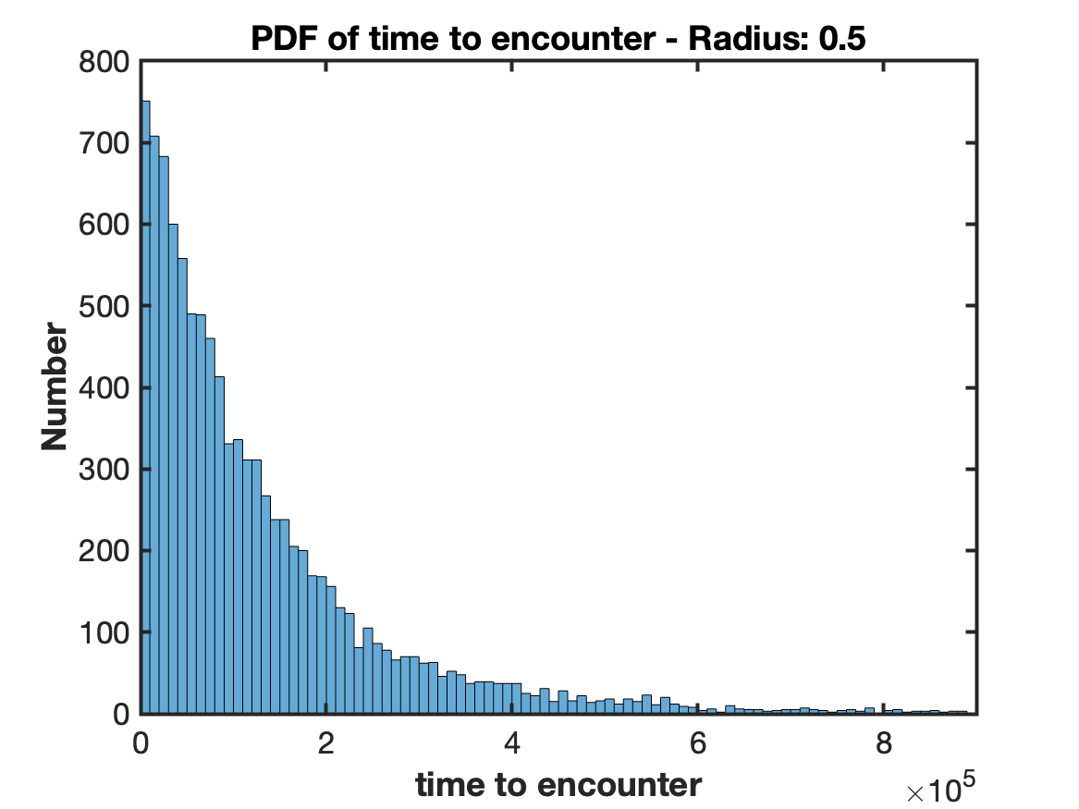
Simulation of the discovery process

Slide 23
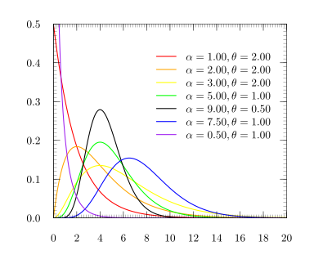
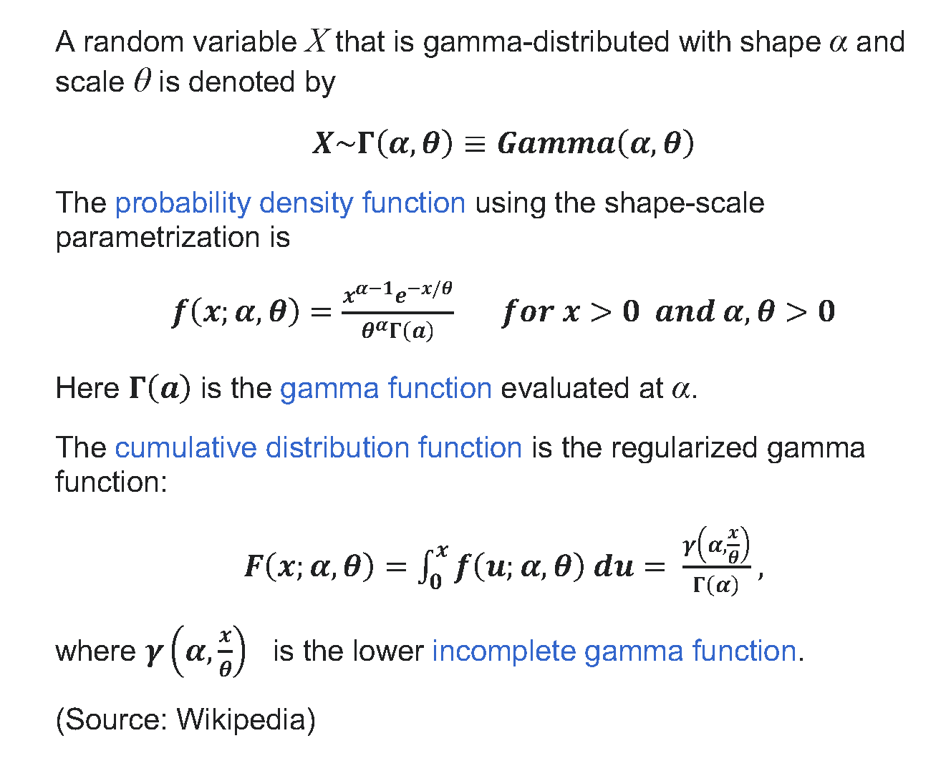
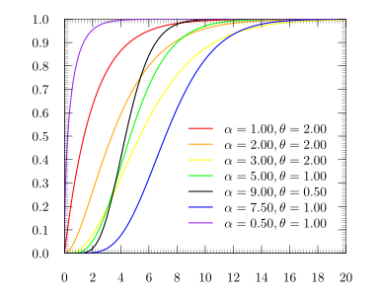
The Gamma distribution
PDF
CDF

Slide 24
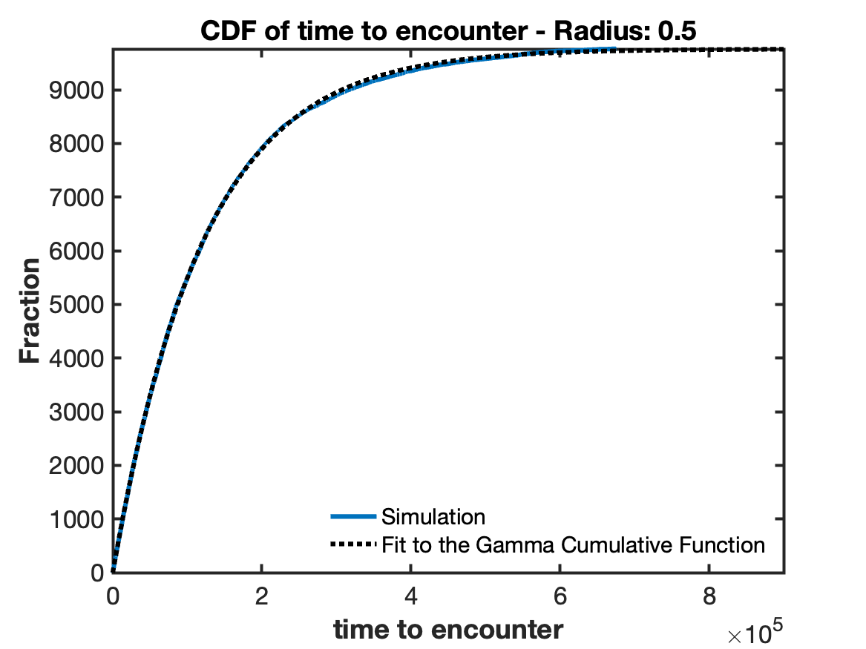
Fitting a Gamma distribution to the simulated discovery process
Consider a sequence of events, with the waiting time for each event being an exponential distribution with constant rate λ. Then the waiting time for the n-th event to occur is the gamma distribution.
Examples include the waiting time of cell-division events, number of compensatory mutations for a given mutation, waiting time until a repair is necessary for a hydraulic system, multi-path fading of signal power, the age distribution of cancer incidence, and so on.
The simulated discovery process can be well fitted to a Gamma distribution.

Slide 25
What is causing the large discrepancy with previous estimates? (almost 2X more NEAs > 1km)
For estimates based on a given value of H (e.g. 17.75), authors assumed a constant albedo to compute the corresponding limit in D (e.g. 1km). The problems are: i) the assumed mean albedo obscure the skewness of the p_{V} distribution; ii) the relation between H-p_{V}-D are non-linear.
Few estimates tried to correct for the albedo distribution, e.g.:
Mainzer et al. (2011) – NEOWISE
Nesvorný et al. (2024) – NEOMOD3
Detail analysis is in progress.

