Slide 1
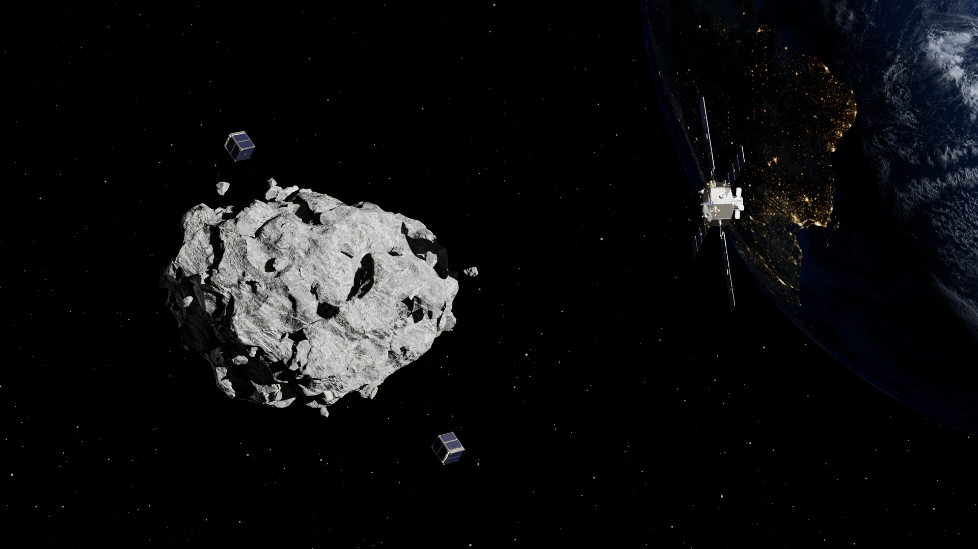


The Caltech Mission to Apophis
C. A. Raymond¹, J. E. Andrade², P. C. Adell¹,
R. B. Amini¹, S. Bhaskaran¹, A. B. Chmielewski¹,
A. E. Daca¹, C. Elachi², L. M. Fesq¹, M. Haynes¹,
A. Herique³
1. Jet Propulsion Laboratory, California Institute of Technology, 4800 Oak Grove Dr., Pasadena, CA 91109
2. California Institute of Technology, 1200 E California Blvd M/C 104-44, Pasadena, CA 91125
3. Univ. Grenoble Alpes, CNRS, CNES, IPAG, Grenoble, France
IAA Planetary Defense Conference, Stellenbosch, Capetown, South Africa, 5-9 May 2025
© 2025 California Institute of Technology.
Government sponsorship acknowledged.
Notes:
Hi I’m Lorraine Fesq, and today I’ll be talking about an Apophis mission that we’re working on at Caltech and JPL.

Slide 2
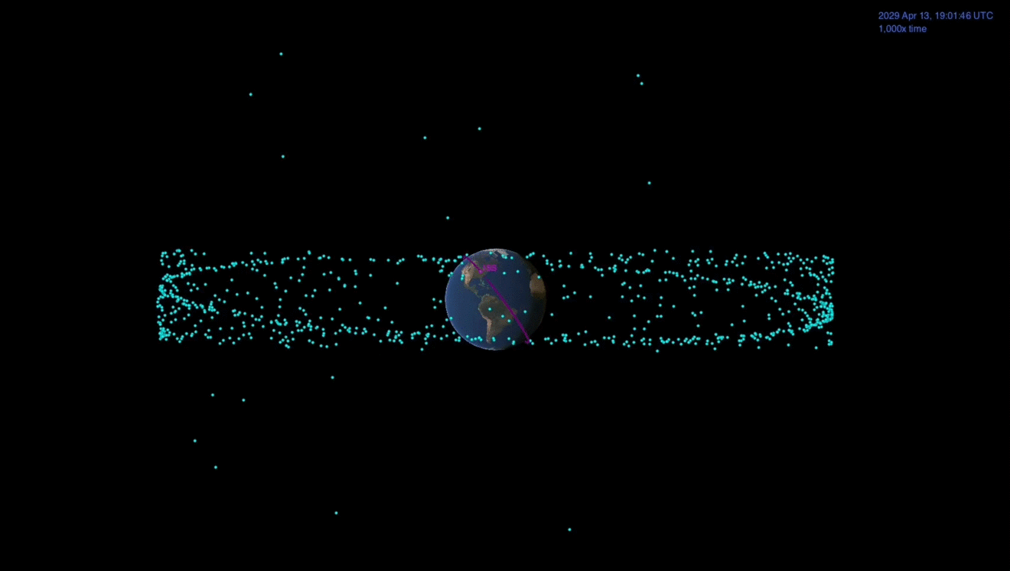
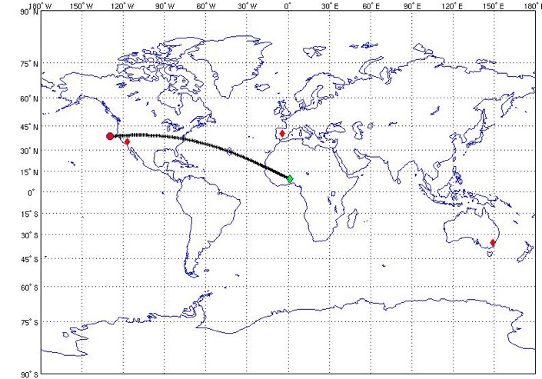

Why Apophis?
Apophis (~340m) will pass within GEO distance from Earth in 2029 – a once-in-7-millenia event
Credit: NASA/JPL-Caltech
The Apophis flyby creates unique opportunities:
Pre- and post-encounter observations yield unique insights into how a small body responds to tidal forces
Apophis ground track below GEO altitude
Pre-decisional Information – For Planning and Discussion Purposes Only
Notes:
- So, why do we want to go to Apophis?
- As most of you probably know, the asteroid Apophis will fly by the Earth within GEO distance in 2029.
- This will be a global event and offers a rare opportunity to observe the reaction of a small body to tidal forces.

Slide 3
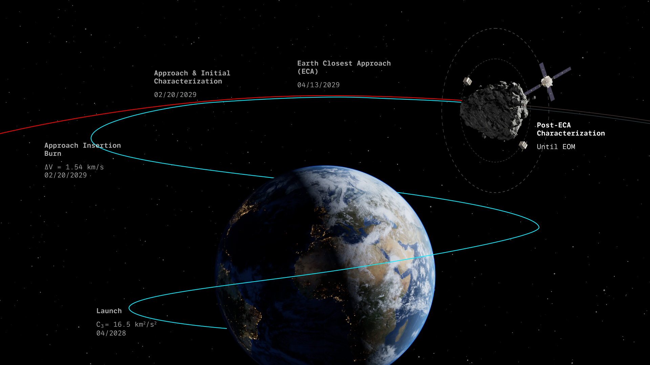

Caltech Mission to Apophis
Pre-decisional Information – For Planning and Discussion Purposes Only
3
Notes:
Caltech is leading a first-of-its-kind mission to escort Apophis through Earth Closest Approach or ECA, identifying surface changes and mapping its interior structure
You may have heard this mission referred to as “DROID” in the past. But now that Caltech is leading it, we’re calling it the Caltech Mission to Apophis.
It’s a rendezvous mission with a spacecraft constellation consisting of a mothership and 2 CubeSats equipped with radar

Slide 4
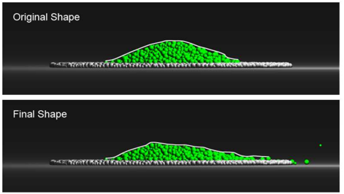
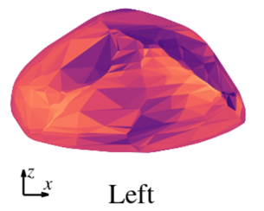

Characterizing Apophis
Schematic diagram of possible interior structures for small asteroid (Asphaug et al. 1999)
Goals: | Objectives: | Key Measurements:
Understand the interior structure of a rubble pile asteroid, and implications for its formation, evolution, and response to a mitigation attempt | Determine the shape, bulk density, and bulk porosity of Apophis to constrain its interior structure and mechanical properties. | Global shape and gravity models
 | Determine the internal block size distribution, composition, porosity, and geometric arrangement | Monostatic and bistatic radar observations
Understand how close planetary flybys affect asteroids, to understand how asteroids are resurfaced and respond to impulsive events (like deflection attempts) | Determine cohesive strength by observing material movement on the surface of Apophis during the Earth flyby | Images of the surface of Apophis before and after the Earth encounter
 | Determine how the spin-state of Apophis changes during the Earth flyby | Measurements of Apophis’s spin state before and after the Earth encounter
 | Put asteroids into human context by taking simultaneous resolved images of the Earth and Apophis | Images of Apophis during the Earth encounter
Simulations of regolith pile shapes on Apophis before and after the Earth encounter (Yu et al. 2014)
Predicted changes in Apophis’s surface slope during the Earth encounter (Valvano et al. 2021)
Model of surface stresses on Apophis during the Earth encounter (Hirabayashi et al. 2021)
Pre-decisional Information – For Planning and Discussion Purposes Only
Notes:
The first overarching goal for this mission is to understand the interior structure of a rubble pile asteroid, and implications for its formation, evolution, and response to a deflection attempt.
we want to determine the shape, bulk density and bulk porosity of apophis. This will help constrain its interior structure and mechanical properties. We would also like to determine the internal block size distribution, composition, porosity, and geometric arrangement of blocks and voids.
The second goal is to understand how close planetary flybys affect asteroids - including resurfacing and implications for response to a deflection attempt.
Observing material movement during ECA will help us constrain the cohesive strength. We also want to observe spin state changes as a result of ECA, and take a cool photo of apophis with earth in the background, which will be great for public outreach.

Slide 5

MISSON TO APOPHIS
PAGE 25
2025
Baseline Science Traceability Matrix
Science Goals
Science Objectives
Measurement Requirements
Instrument/Mission Requirements
1
Camera: 0.2 m/px res, Apophis full-frame (20482 CCD, IFOV 8-25 μrad px-1, FOV 0.9°-2.7°) ⇒ achieved at dist. 25-9 km or 150-50 body radii
Understand the interior structure of a rubble pile asteroid and implications for its formation, evolution, and response to a mitigation attempt
1.1. Determine the shape, bulk density, and bulk porosity of Apophis to constrain its interior structure and mechanical properties
Global shape model at <0.5 m spatial & elevation resolution
Global gravity model to spherical harmonic degree/order 4
Radio science: Doppler tracking
1.2. Determine the internal block size distribution, composition, porosity, and geometric arrangement
Distinguish interior ≥10 m monolithic objects / voids
Radar (monostatic mode): 3D SAR volumetric backscatter image (7m res, ≥10 MHz bandwidth, SNR ≥ 10 dB).
Measure interior dielectric constant at ∆ε=0.3 accuracy and 10% precision
Radar (bistatic mode): transmission radar echoes (100 ns timing accuracy / precision, SNR ≥ 10 dB)
2
Understand how close planetary encounters affect asteroid resurfacing and response to impulsive events (like deflection attempts)
2.1. Determine if material moves on the surface of Apophis during the Earth encounter
Measure albedo change
Camera: Phase angle 0°-90°, 5° res. At least two photometric filters (ideally matching OSIRIS-APEX). 0.01 m px-1 res from 1.3-0.4 km (7.5-2.5 body radii, with specs above)
Measure color change
Construct Digital Terrain Maps of select regions at 0.01 m px-1 res.
2.2. Determine how the spin-state of Apophis changes during the Earth encounter
Measure the spin state before and after encounter
Camera: imaging before, during, and after encounter
2.3. Put asteroids into human context: simultaneous resolved images of Earth and Apophis
Image Apophis while transiting Earth during the encounter
Pre-decisional Information – For Planning and Discussion Purposes Only

Slide 6
Caltech mission concept complements OSIRIS-APEX and RAMSES
Caltech Mission
Direct measurement of permittivity (composition and porosity)
Surface material properties through surface change
OSIRIS-APEX
RAMSES
Map surface morphology
Shape, bulk density, porosity
Mass
Interior heterogeneity
Map mineralogy
Spin change
Map elemental abundances
Ejected debris
Study Yarkovsky effect
Seismology

Slide 7
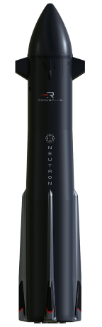
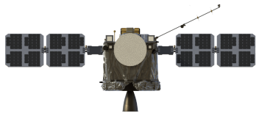
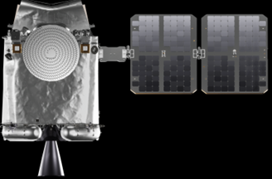





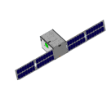
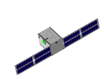



MISSON TO APOPHIS
7
2025
PAGE
Apophis Mission Hardware
Mothership
ROCKET LAB
ROCKET LAB
Collaboration of Caltech, JPL, and Rocket Lab
Mothership Payload
Launch
Jan-Feb 2028
TEKEVER: INTER-SATELLITE LINK (ISL)
JPL & SCANWAY: SCIENCE/PUBLICITY & NAV CAMERAS
RL: 2X CUBESAT DISPENSER
Rendezvous with Apophis
February 2029
2X CubeSat
Deliveries to CubeSat Vendor
Deploy CubeSats after closest approach
Q3 2029
TEKEVER: INTER-SATELLITE LINK (ISL) EMTRONIX: BI-STATIC RADAR SODERN: NAV CAMERA T4i: PROPULSION MODULE
Autonomous Formation Flying Experiment in the extended mission
ARGOTEC
ROCKET LAB
CONFIDENTIAL
JPL Proprietary Business Discreet
Not Reviewed for Export

Slide 8

























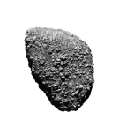



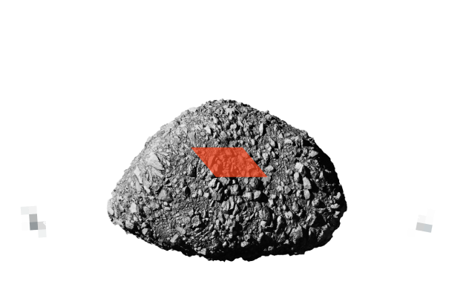






MISSON TO APOPHIS
PAGE 15
2025
Caltech Mission Operations
Legend
Caltech Mission
Apophis
CALTECH MISSION LAUNCH 04/2028
OSIRIS-APEX
EARTH CLOSE APPROACH
APOPHIS
APRIL 13, 2029
Caltech Mission
OSIRIS-APEX
Caltech Mission rendezvous with Apophis
OSIRIS-APEX rendezvous with Apophis
03
01
02
MOTHERSHIP
RADIO LINK
RADIO LINK
CUBESAT 1
BISTATIC RADAR
BISTATIC RADAR
CUBESAT 2
PHASE 01
PHASE 02
PHASE 03
PRE-APPROACH PHASE
CLOSE APPROACH PHASE
POST-APPROACH PHASE
Pre-decisional Information – For Planning and Discussion Purposes Only

Slide 9
Summary and Outlook
Caltech is leading a mission to Apophis in collaboration with JPL & Rocket Lab
Mission would monitor changes in Apophis resulting from encounter
Bistatic radar will probe the interior structure, providing a unique data set
Caltech mission will be complementary to OSIRIS-APEX and RAMSES
Fast development schedule addresses objectives of the Decadal Survey’s recommended planetary defense characterization mission
Key contracts in place
Team is funded for Phase A and pursuing private funding for an early 2028 launch
Pre-decisional Information – For Planning and Discussion Purposes Only
Notes:
In summary, bistatic radar would provide a unique data set, making our mission complementary to both RAMSES and APEX
We’re currently funded for Phase A and we’re working on long term funding.
Thank you, and I look forward to answering any questions!

Slide 11
References
Asphaug, Erik, et al. "Disruption of kilometre-sized asteroids by energetic collisions." Nature 393.6684 (1998): 437-440.
DeMartini, Joseph V., et al. "Using a discrete element method to investigate seismic response and spin change of 99942 Apophis during its 2029 tidal encounter with Earth." Icarus 328 (2019): 93-103.
Hirabayashi, M., Y. Kim, and M. Brozović. "Finite element modeling to characterize the stress evolution in asteroid (99942) Apophis during the 2029 Earth encounter." Icarus 365 (2021): 114493.
Kim, Yaeji, et al. "Tidal resurfacing model for (99942) Apophis during the 2029 close approach with Earth." Monthly Notices of the Royal Astronomical Society 520.3 (2023): 3405-3415.
Valvano, Giulia, et al. "APOPHIS–effects of the 2029 Earth’s encounter on the surface and nearby dynamics." Monthly Notices of the Royal Astronomical Society 510.1 (2022): 95-109.
Yu, Yang, et al. "Numerical predictions of surface effects during the 2029 close approach of asteroid 99942 Apophis." Icarus 242 (2014): 82-96.

