Slide 1
PREDICTED DISCOVERY OF LOW-DELTA V TARGETS AMONG THE NEO POPULATION BY NEAR-EARTH OBJECT SURVEYOR
Paul A. Abell, Timothy B. Spahr, Brent W. Barbee, Dar W. Dahlen,
Amy K. Mainzer, and Joseph R. Masiero
9th IAA Planetary Defense Conference
Stellenbosch, Cape Town, South Africa
May 7, 2025

Slide 2
NEO Surveyor: Finding NEOs Before They Find Us
NEO Surveyor is a mission designed to find, catalog, and characterize NEOs.
This mission responds to the 2005 George E. Brown NEO Survey Goal that requires NASA to find > 90% of NEOs larger than 140 m in diameter within 15 years (before end of 2020).
NEO Surveyor is an infrared space telescope with a design and survey strategy optimized for discovering the NEOs that are most likely to impact the Earth.
Why do this now?
  Because mitigation is most effective with years to decades warning before an impact.
  Only roughly ~40% of 140 m NEOs have been discovered to date.
  Current ground-based surveys (e.g., PanSTARRS and Catalina Sky Survey) & Vera C. Rubin LSST cannot reach high levels of completeness for decades (more than ~30 years).
Found
Not Found
Total Population NEOs larger than 140 m is estimated to be ~25,000
(NEO Survey Status as of Dec. 14, 2024), 2024

Slide 3
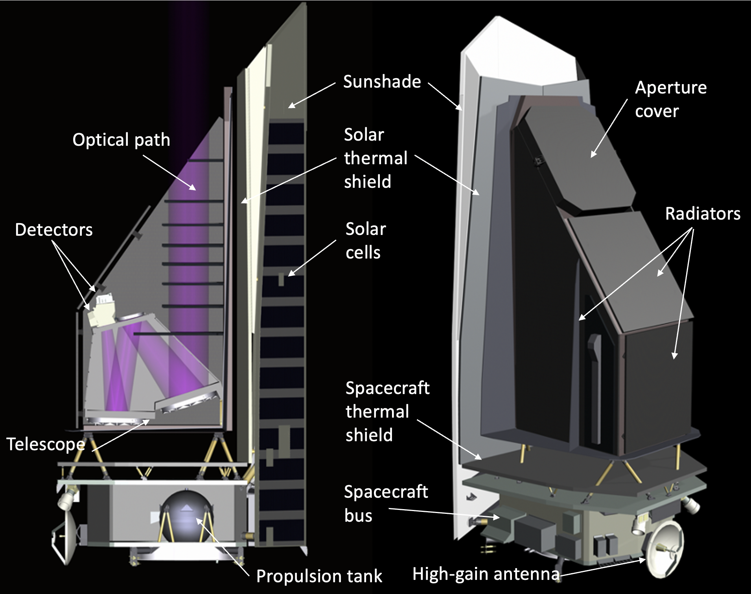
Mission Architecture
Observatory will survey from halo orbit at Sun-Earth L1
Instrument is passively cooled
  50-cm telescope
  2 IR channels imaging simultaneously
  4-5.2 um and 6-10 um
  Field of view 11 sq deg
Spacecraft is based on BAE (formally Ball Aerospace) heritage
  3-axis stabilized spacecraft
  The ejectable cover is the only deployment

Slide 4
NEO Surveyor Survey Simulator
We have created a survey simulator to predict how many asteroids and comets we will see with NEO Surveyor, the NEOS Survey Simulator (NSS).
It uses a reference model population of small bodies along with a model of the Observatory, the CONOPS, and detection capabilities to calculate how many asteroids & comets will appear in each Visit & how many objects will be detected.
  The model includes NEOs down to 30 m, comets, and background objects such as main belt asteroids and Jovian Trojans.
Expect to discover ~200,000 - 300,000 new NEOs, millions of MBAs, and thousands of comets, a significant improvement on the number known today.

Slide 5
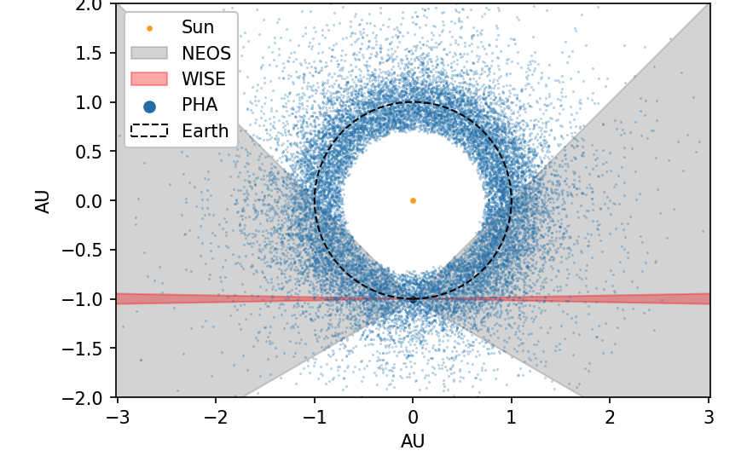
NEO Surveyor Field of Regard
Detected PHAs
NEO Surveyor field of regard
Detected PHAs are defined as having MOID ≤ 0.05 AU and diameters ≥ 50 m.
This plot is based on a simulated 5 yr survey.
Approx. NEOWISE field of regard
Ground-based surveys’ field of regard

Slide 6
NEOs in Earth-like Orbits
NEO Surveyor’s ability to observe regions close to the Sun increases the likelihood that it will detect objects in very Earth-like orbits.
These objects tend to have the lowest minimum orbit intersection distances (MOIDs) and thus pose the greatest risk of Earth impact.
NEOs on more Earth-like orbits are also more difficult to deflect, all else being equal.
This attribute of NEO Surveyor’s operation is not only important for planetary defense considerations, but it also provides an opportunity to identify low-delta V spacecraft mission targets.

Slide 7
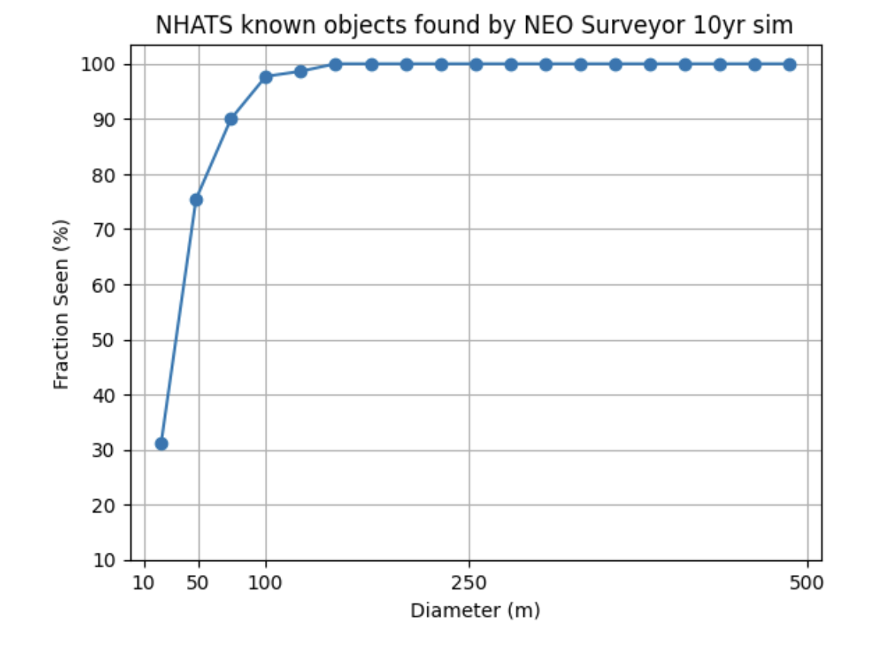
NHATS* simulation results (10-year sim vs known NHATS)
First simple test—just ran all NHATS targets (~6100 NEOs), assumed diameters based on albedo = 0.14 and computed completeness.
Results:
  98% complete down to ~100 m
  50% complete down to ~30 m
Note the simulation was cut off at ~20 m.
*Near-Earth Object Human Space Flight Accessible Targets Study (NHATS) https://cneos.jpl.nasa.gov/nhats/intro.html

Slide 8
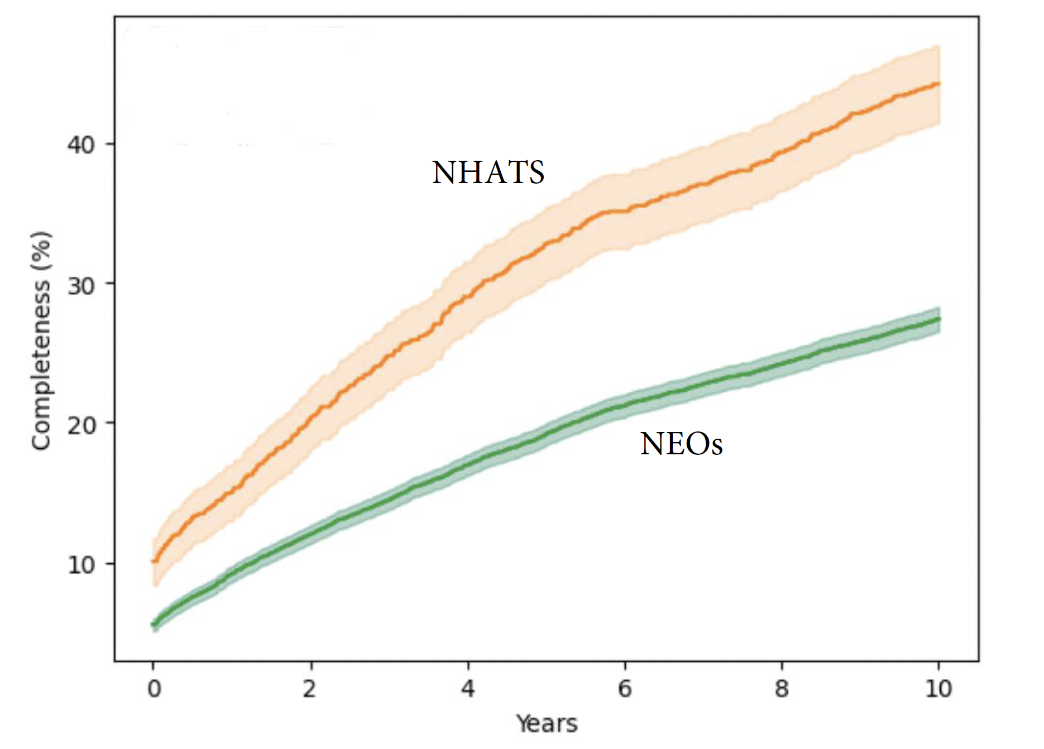
NEO Surveyor 50-140 m ”NHATS-Like”
Used 10000 small synthetic NEOs with 50-140 m diameters to match the NHATS population orbital elements and MOIDs.
Results:
  NHATS “like” ~45% complete
  NEOs ~28% complete
  Numbers jive with NHATS-only simulation
Note ~10% of NHATS 50-140 m targets expected to be found by other surveys.
NEO Surveyor results for 50-140 m NEOs

Slide 9
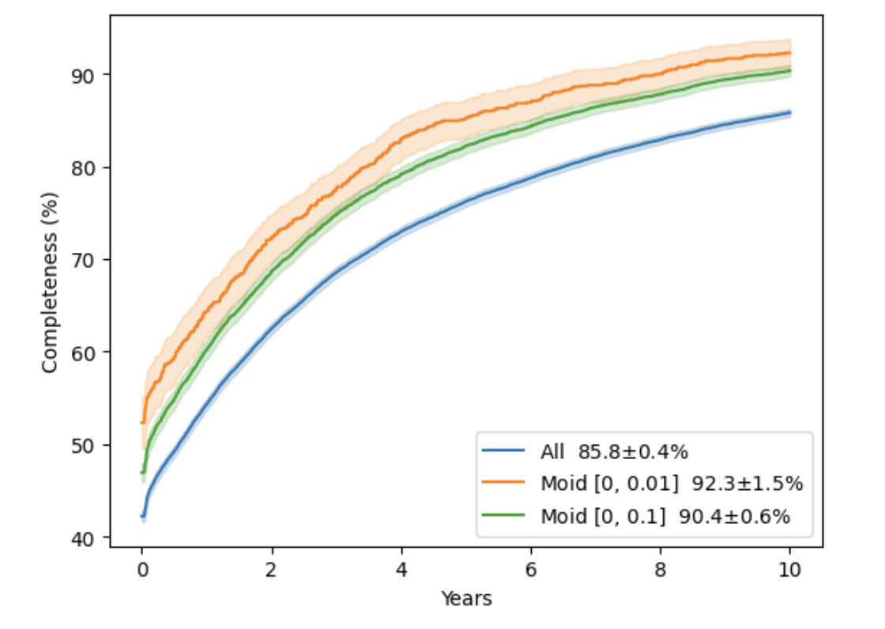
Why is Surveyor so good at NHATS targets?
Surveyor is designed to find PHAs—objects that must cross the orbit of the Earth.
Low MOID objects, but also low-inclination and low eccentricity objects spend more time near the orbit of the Earth.
Plot shows NEO Surveyor’s effectiveness for large NEOs ≥ 140 m by MOID.
NEO Surveyor results for 140 m
and larger NEOs

Slide 10
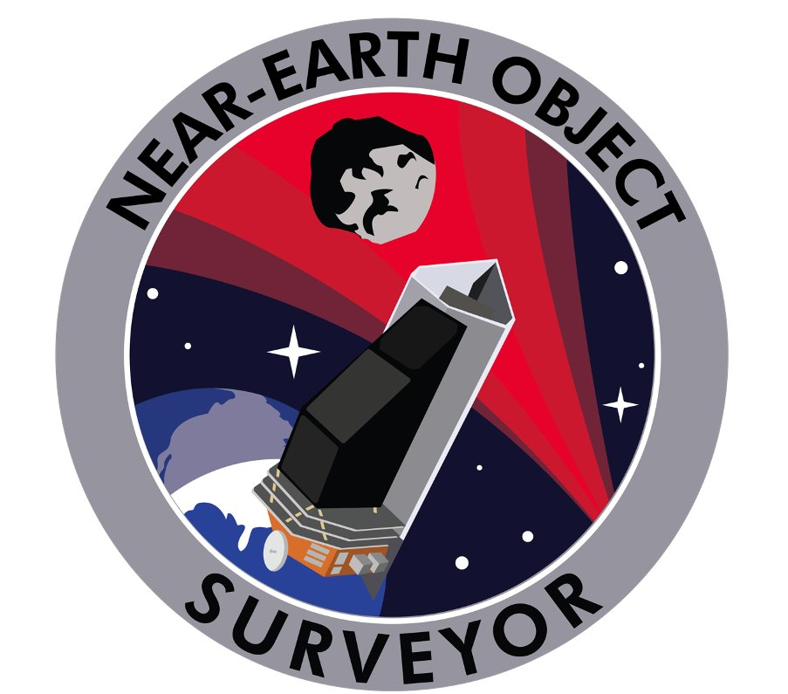
Conclusions
  NEO Surveyor is well-suited to detect NEOs in very Earth-like orbits.
  In addition to the planetary defense benefits, NEO Surveyor also provides an opportunity to identify low-delta V spacecraft mission targets.
  These targets are of interest to the science, in situ resource utilization, and exploration communities.

Slide 11
BACKUP

Slide 12
Survey Design – Visits
Observatory receives “Visit” commands and performs all actions within them
  Visits are the fundamental unit of the survey
  6 exposures of ~30 sec each (180 sec/Visit)
All Exposures are returned to ground for processing by Survey Data System
One Visit
Exp 4
Exp 5
Etc
Exp 3
Exp 6
10” dither
10” dither
Exp 2
Slew
Exp 1
Notes:
Reminder that a TFM is just extra visits out of the survey sequence. The spacecraft doesn’t do anything differently; just more of them.

