Slide 1


Modern Computational Techniques for Improving Moving Object Detection Pipelines with the Catalina Sky Survey
Carson Fuls – Director of CSS
IAA Planetary Defense Conference 2025
Stellenbosch, South Africa

Slide 2
Background - CSS Operations
For each field, the CSS pipeline produces a ranked list of NEO candidates.
On-site observers validate top results in real-time.
Transients (moving objects) are identified via source comparison using SExtractor.
IAA Planetary Defense Conference 2025
Stellenbosch, South Africa

Slide 3
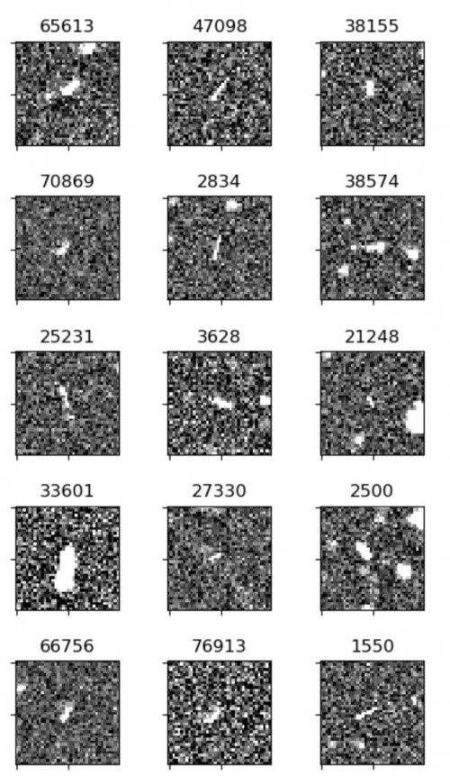
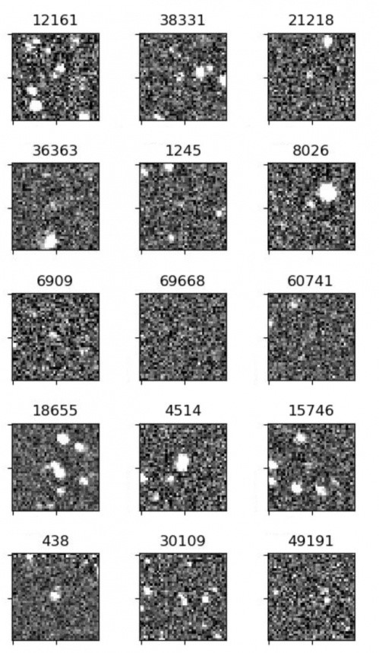
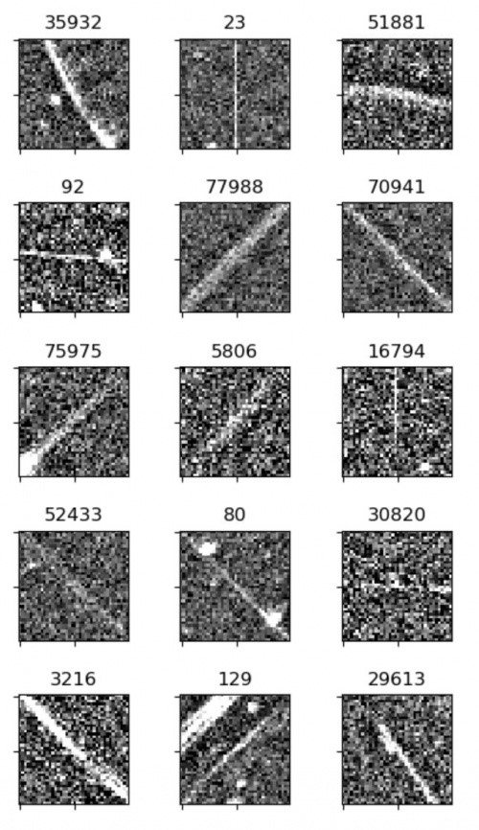
ML Classification of Transients
Inspired by work done by the ATLAS survey, CSS began developing convolutional neural network classification models for transients.
Models are trained on transients using 40 x 40 matrices of pixel values.
Initial classes for 703 were: Streak, Stellar, and Diffraction Spike.
IAA Planetary Defense Conference 2025
Stellenbosch, South Africa

Slide 4
ML Classification of Transients
This method provides additional data for forming tracklets.
Tests from 703 over 1.5 months showed a 5.2% increase in real detections over review threshold just by reducing diffraction spikes.
Working now on enhancing rank of “Streak” tracklets and building models for other survey telescopes.
IAA Planetary Defense Conference 2025
Stellenbosch, South Africa

Slide 5
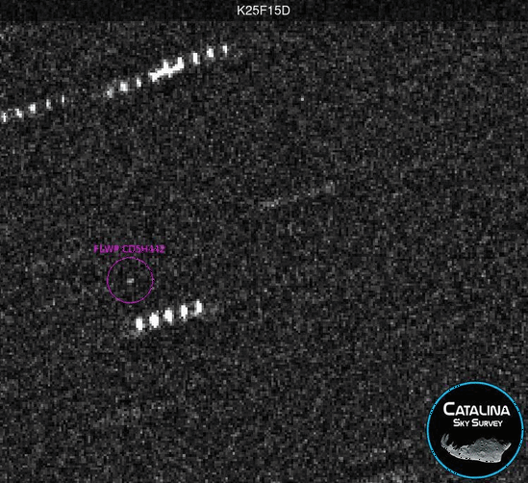
Second-chance follow-up reprocessing
CSS follow-up uses the same moving object detection as the survey.
However, most observations are preformed tracking at the object’s rate (non-sidereal).
If the required exposure time means that the field stars will be elongated more than 6 pixels, the exposures are split into multiple shorter exposures (track-and-stack).
IAA Planetary Defense Conference 2025
Stellenbosch, South Africa

Slide 6
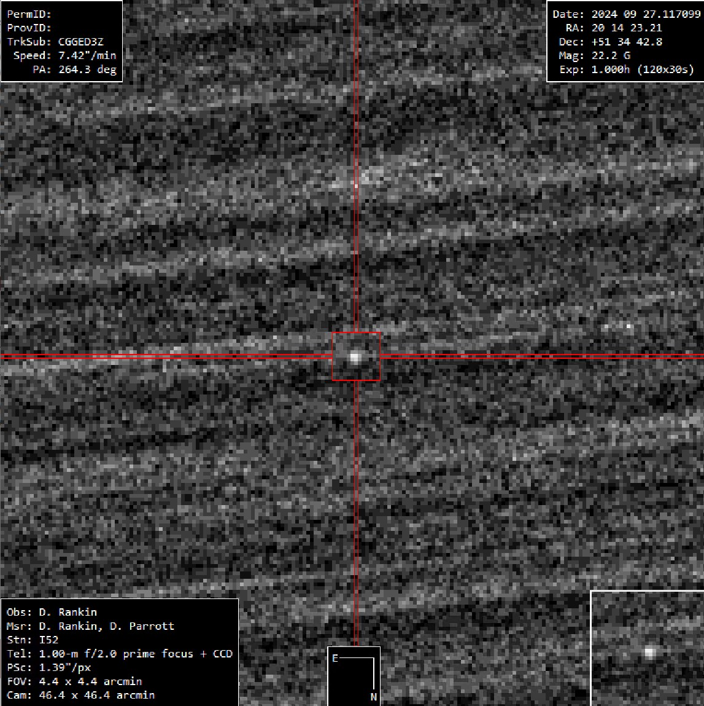
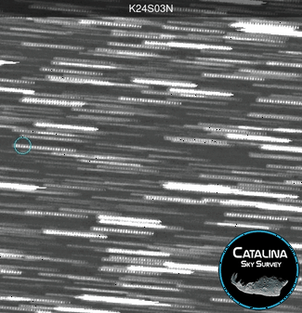
Second-chance follow-up reprocessing
Confusion with background stars and uncertainty in the rate of motion of the target can cause the target to be undetected by normal processing.
Working with Daniel Parrott, the developer of Tycho Tracker, we were able to implement second-chance reprocessing of these failed attempts using synthetic tracking.
To date, this has saved 157 follow-up attempts.
IAA Planetary Defense Conference 2025
Stellenbosch, South Africa
Notes:
Attempt was with sub-stacks of 24 images (120 images total)

Slide 7
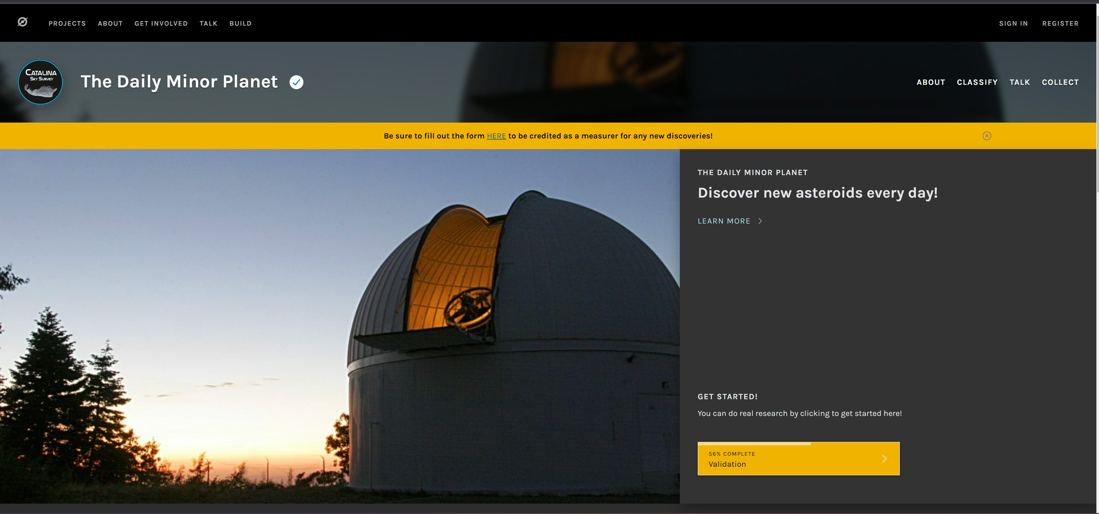
Citizen Science Candidate Review
Observers at G96 station review 22 candidates per field (~4,000 candidates per night).
Precovery review shows this threshold captures 98% of objects.
To review more candidates, we started “The Daily Minor Planet” hosted on the Zooniverse platform.
Candidate detections are uploaded the next day for volunteers to review. Bayesian statistics are used to determine consensus on individual subjects.
IAA Planetary Defense Conference 2025
Stellenbosch, South Africa

Slide 8
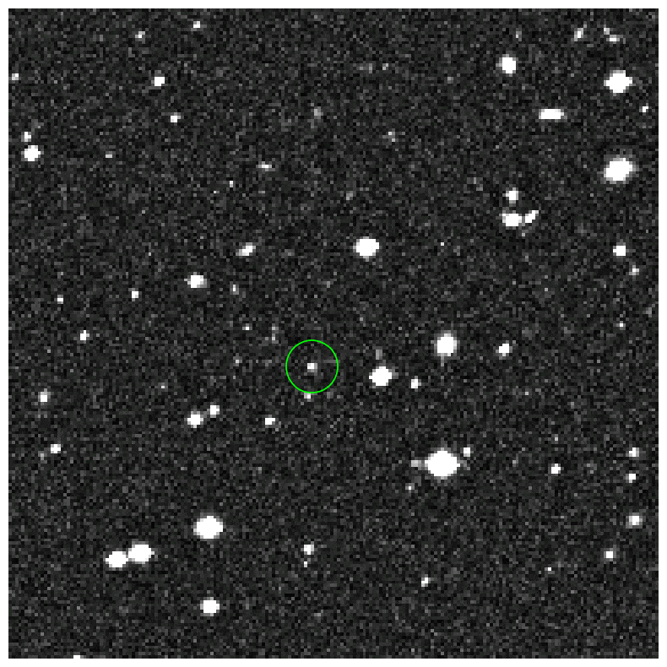
Citizen Science Candidate Review
To date, the project has submitted 4,593 observation of main-belt asteroids, 105 observations of NEOs, and received 4 discovery MPECs.
8,678 volunteers have made 16,000,000+ classifications so far.
Volunteers are also highly alert for anomalies such as active asteroids.
IAA Planetary Defense Conference 2025
Stellenbosch, South Africa

Slide 9
Takeaways
Collaboration!
Leverage modern processing to increase efficiency by deploying complimentary processes.
Citizen science adds both processing AND engagement.
IAA Planetary Defense Conference 2025
Stellenbosch, South Africa

