Slide 1

ESA’s Planetary Defence Office NEO Survey Strategy
Rainer Kresken
ESA NEOCC
CGI Germany
Rainer Kresken
Rainer Kresken
Rainer Kresken
Notes:
Leitfrage: “Was sind Asteroiden überhaupt, und wo kommen die her?”
Solar System formation ~4.6 billion years
Jupiter formed in ~10 Million years
Earth formed in ~100 million years
… how??

Slide 2
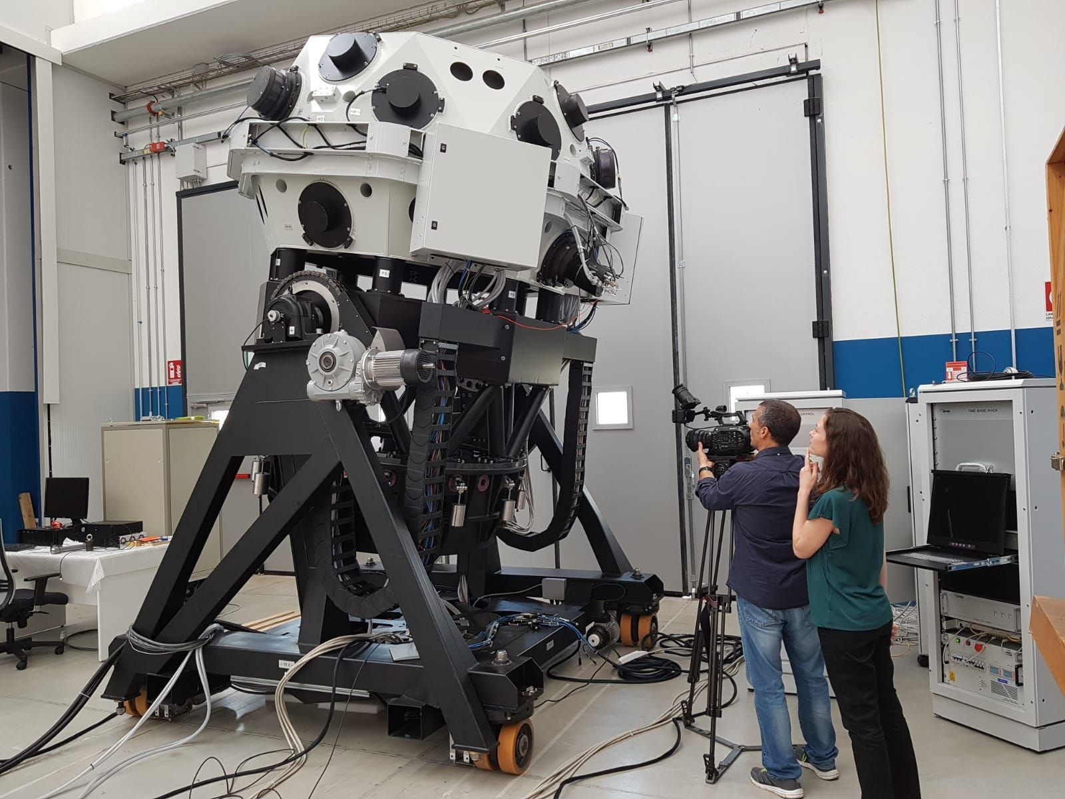

Slide 3
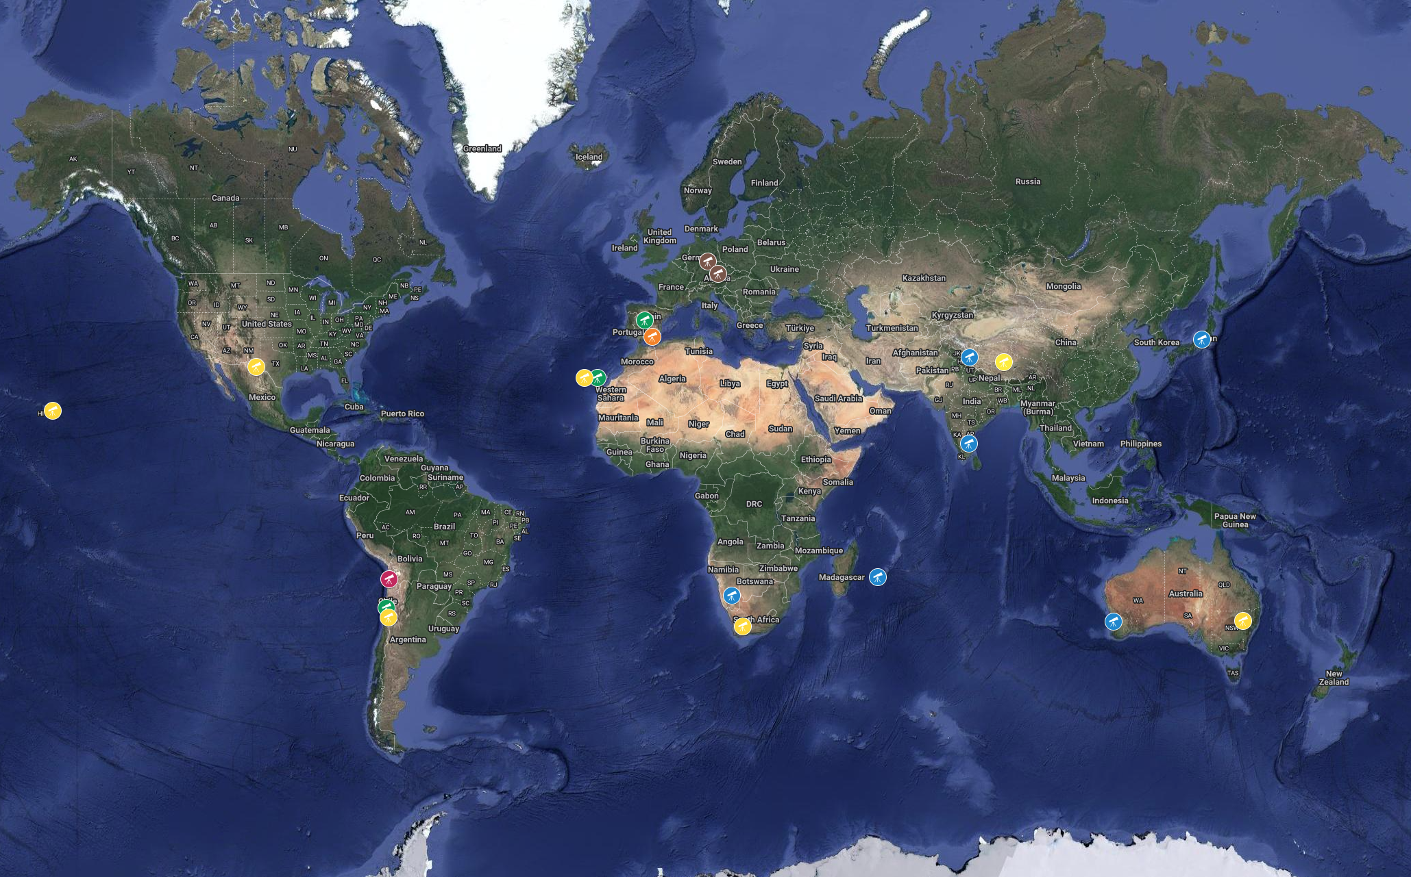
Notes:
Leitfrage: “Was sind Asteroiden überhaupt, und wo kommen die her?”
Solar System formation ~4.6 billion years
Jupiter formed in ~10 Million years
Earth formed in ~100 million years
… how??

Slide 4
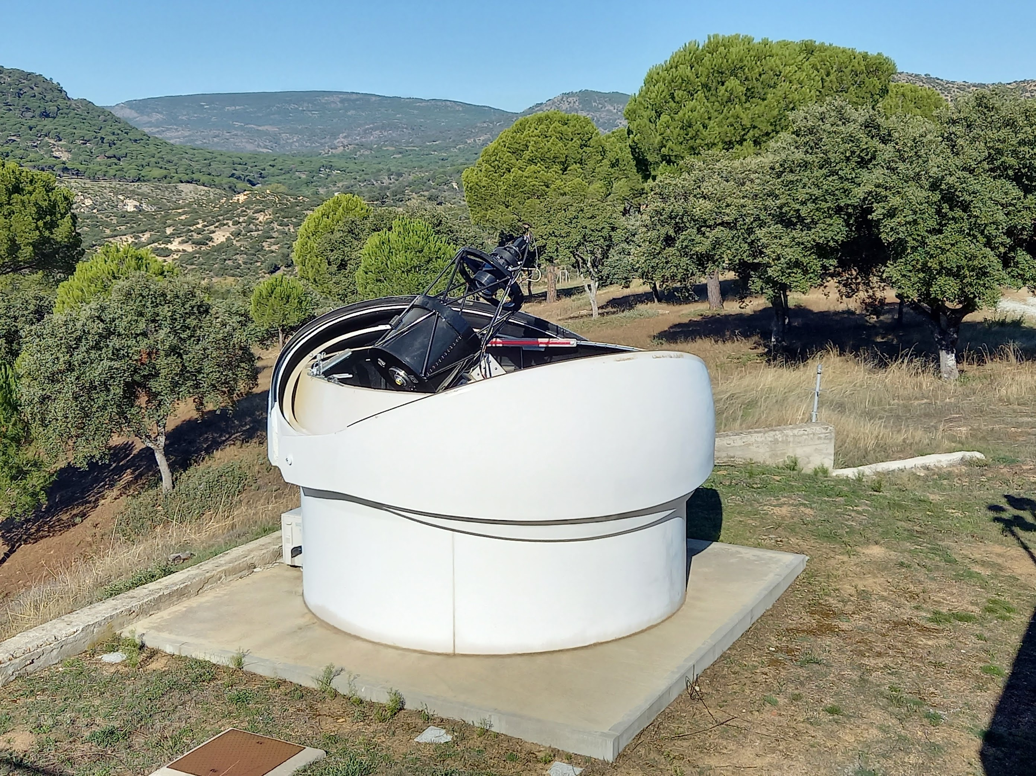

Slide 5
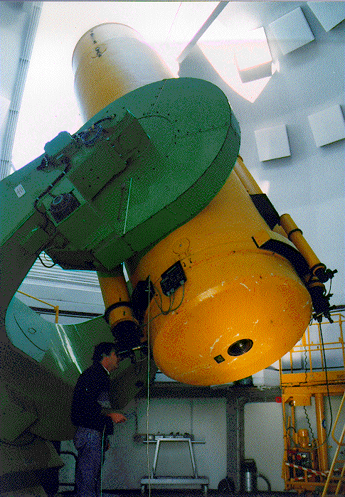
CAHA Schmidt Specs
MPC Code | Z84
Latitude | +37.22399°
Longitude | -2.54816°
Altitude | 2212 m
Aperture | 0.8 m
Focal ratio | f/3
Default passband | IR-cutting Schott KG3 clear glass
Altitude limit | ~15°
Typical PSF FWHM | ~3”
FoV | 44’×44’
Sensor | 2k×2k e2v CCD
Pixel scale (unbinned) | 1.29”
Download time | ~6 s
Notes:
Leitfrage: “Was sind Asteroiden überhaupt, und wo kommen die her?”
Solar System formation ~4.6 billion years
Jupiter formed in ~10 Million years
Earth formed in ~100 million years
… how??

Slide 6
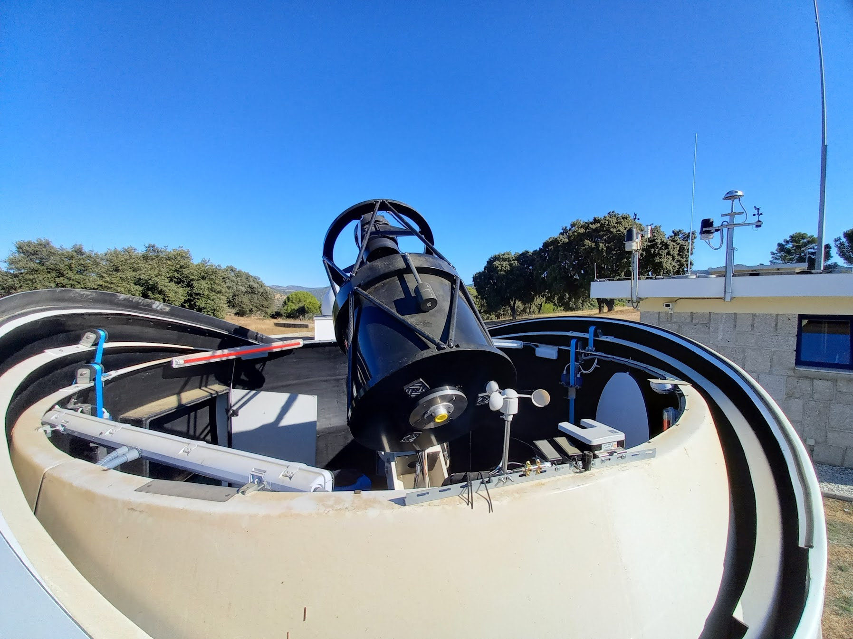
MPC Code | Z58
Latitude | +40.454075°
Longitude | -4.369319°
Altitude | 719 m
Aperture | 0.56 m
Focal ratio | f/2.52
Default passband | UV-cut glass
Altitude limit | ~10°
Typical PSF FWHM | ~4”
FoV | 150’×150’
Sensor | 4k×4k e2v CCD
Pixel scale (unbinned) | 2.19”
Download time | ~12 s
Notes:
Leitfrage: “Was sind Asteroiden überhaupt, und wo kommen die her?”
Solar System formation ~4.6 billion years
Jupiter formed in ~10 Million years
Earth formed in ~100 million years
… how??

Slide 7
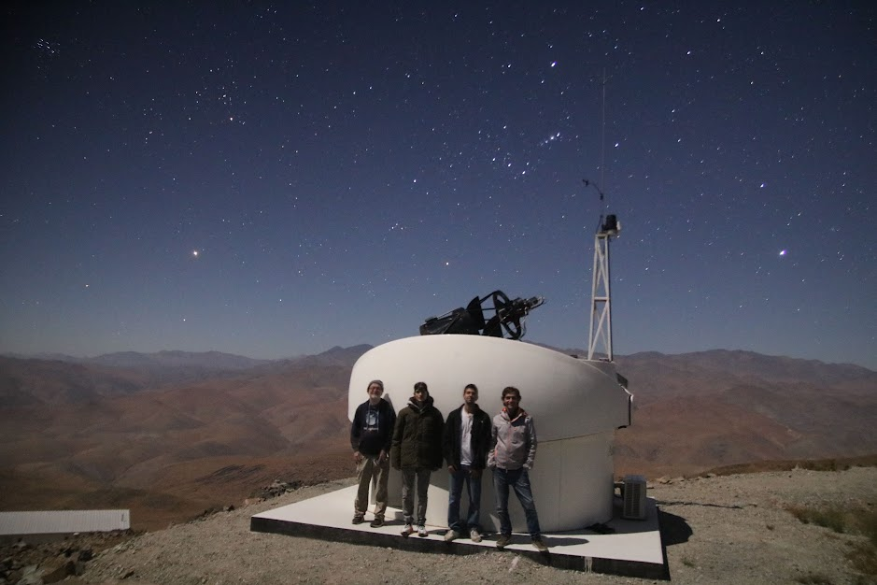

Slide 8
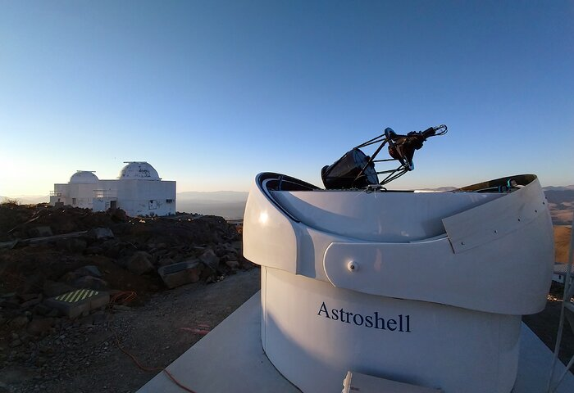
MPC Code | W57
Latitude | -29.255222°
Longitude | -70.739056°
Altitude | 2377 m
Aperture | 0.56 m
Focal ratio | f/2.52
Default passband | UV-cut glass
Altitude limit | ~5°
Typical PSF FWHM | ~4”
FoV | 150’×150’
Sensor | 4k×4k e2v CCD
Pixel scale (unbinned) | 2.19”
Download time | ~12 s
Notes:
Leitfrage: “Was sind Asteroiden überhaupt, und wo kommen die her?”
Solar System formation ~4.6 billion years
Jupiter formed in ~10 Million years
Earth formed in ~100 million years
… how??

Slide 9
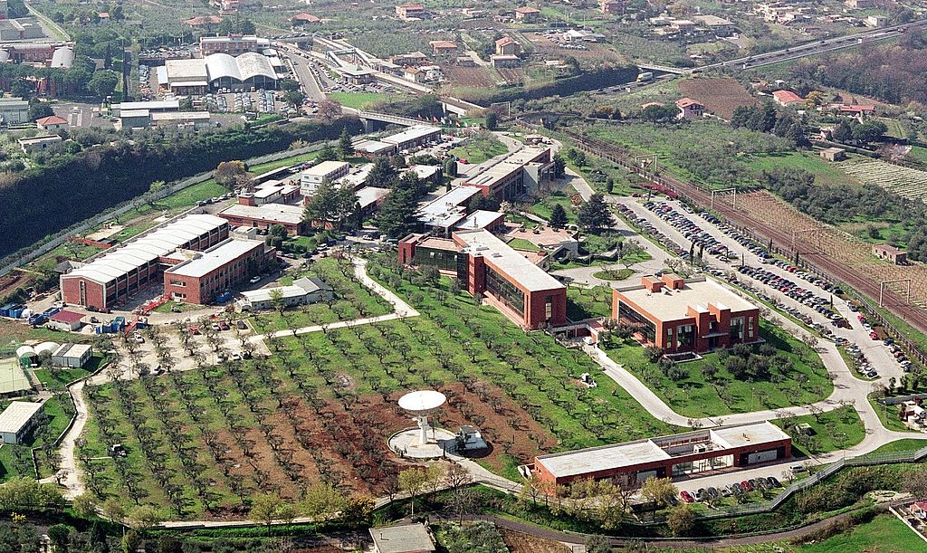
Notes:
Leitfrage: “Was sind Asteroiden überhaupt, und wo kommen die her?”
Solar System formation ~4.6 billion years
Jupiter formed in ~10 Million years
Earth formed in ~100 million years
… how??

Slide 10
Notes:
Leitfrage: “Was sind Asteroiden überhaupt, und wo kommen die her?”
Solar System formation ~4.6 billion years
Jupiter formed in ~10 Million years
Earth formed in ~100 million years
… how??

Slide 11
Notes:
Leitfrage: “Was sind Asteroiden überhaupt, und wo kommen die her?”
Solar System formation ~4.6 billion years
Jupiter formed in ~10 Million years
Earth formed in ~100 million years
… how??

