Slide 1
Tidal disruptions increase the number of asteroids on Earth-crossing orbits
Mikael Granvik
Luleå University of Technology, Sweden
University of Helsinki, Finland
In collaboration with
Kevin Walsh
Southwest Research Institute, Boulder, CO, USA

Slide 2
Models underestimate frequency of impacts and close encounters
An encounter similar to that by Apophis in 2029 should happen once every 7000 years. Yet it is happening just some decades after we started surveying for NEOs.
bug!
2x10⁵
Apophis
Harris & Chodas 2021
Nesvorny et al. 2023

Slide 3
State-of-the-art NEO models reveal disruption close to the Sun, but systematic trends also at q>0.6 au
Granvik+ 2016

Slide 4
Excess of NEOs with perihelion distances coinciding with the semimajor axes of the Earth and Venus
Adapted from Granvik+ (2016) for Granvik & Walsh (2024)
Apophis
Venus
Earth

Slide 5
Tidal disruptions of NEAs suggested already in 1998
Pole-on silhouette of (1620) Geographos based on delay-Doppler radar observations (Ostro+ 1995, 1996).
Numerical simulation of tidal disruption of rubble-pile asteroid shows all the same features as (1620) Geographos (Richardson+ 1998).

Slide 6
NEA binaries and families through tidal disruptions?
Walsh & Richardson 2008
Schunova+ 2014

Slide 7
e and i of excess detections agree with TDs
Venus
encounters
Earth
encounters
blue shows the orbit distributions corresponding to NEO detections of q ~ a_{planet}
gray shows the arbitrarily normalized orbit distribution of simulated tidal disruptions
low-to-moderate e and low i implies low encounter speeds, a prerequisite for tidal disruptions
eccentricity
Apophis
inclination
Apophis
Granvik & Walsh 2024

Slide 8
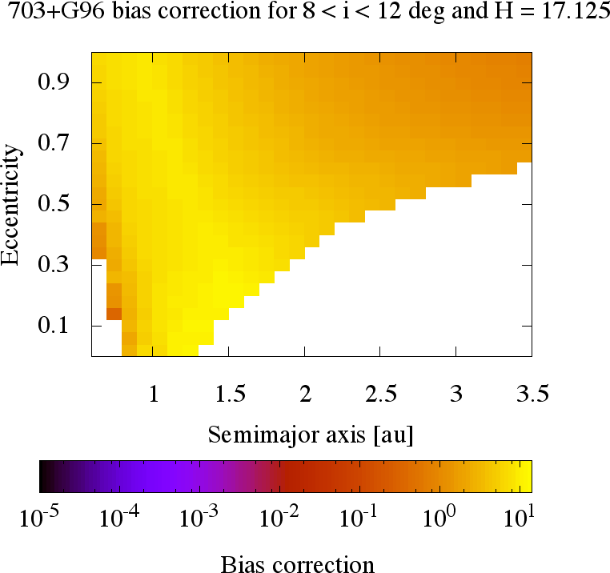

NEO population modeling 101
Fit these 4 parameters
per source
$$n\left(a,e,i,H\right)=ε\left(a,e,i,H\right)\sum_{s}{N(H;P_{s})}R_{s}(a,e,i)$$
observed population
(this is what we see)
observational bias
(this is estimated numerically for each survey)
true population
(this is what we
want to know)
Granvik+ 2016, 2017, 2018; Jedicke+ 2016

Slide 9
Examples of orbit distributions for fragments produced in tidal disruptions
Average 10kyr-old @ Earth
Average steady-state @ Earth
Granvik & Walsh 2024

Slide 10
Population fits improve when accounting for tidal disruption at Venus and at the Earth
Granvik & Walsh 2024
Apophis

Slide 11
Largest TD fragments could be several hundred meters in diameter
Granvik & Walsh (2024)
Apophis

Slide 12
Independent confirmation of tidal disruptions
Nesvorny et al. 2024

Slide 13
Conclusions
Current NEA orbit models predict too few asteroids with q or Q coinciding with the semimajor axes of Earth and Venus.
To the best of our knowledge this is the first piece of quantitative evidence on the population level presented in support of tidal disruption of NEAs as a result of close encounters with terrestrial planets.
Apophis orbit and H suggest it may be a fragment or re-accumulation of fragments from a tidal-disruption event with terrestrial planets.
Tidal disruptions may solve the discrepancy between the impact predictions based on small NEOs and the observed rate of impacts by meter-to-decameter scale objects.

