Slide 1










TREx: A Temporarily Captured Orbiter Rendezvous Explorer & In Situ Characterization Mission
9th IAA Planetary Defense Conference
Stellenbosch, South Africa
May 8th, 2025
Notes:
Adrienne

Slide 2
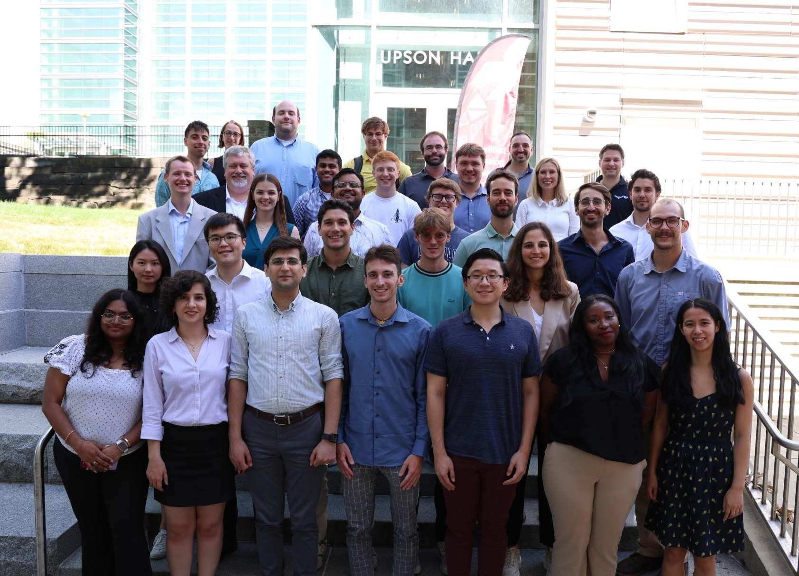





SmallSat Mission Design School
Notes:
Adrienne

Slide 3

A Temporarily Captured Orbiter (TCO) is a small(ish) asteroid temporarily captured in the Earth-Moon system for at least one geocentric orbit
TCO Criteria:
TCO kinetic energy is less than local Earth escape energy
Distance from Earth to TCO < 0.03 AU
TCO diameter between 1 and 100m
Notes:
Adrienne

Slide 4
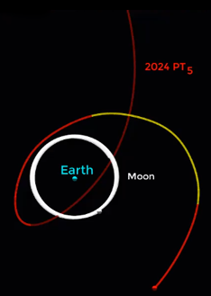
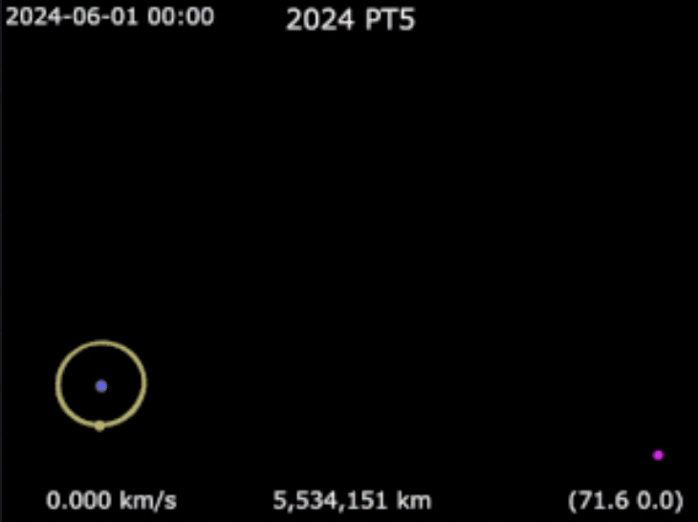
Recent TCO Example: 2024 PT5
Orbital simulation of Earth, the moon, and 2024 PT5. Credit: Daniel Papp, Telescope Live, and HORIZONS System, JPL, NASA
Notes:
Adrienne

Slide 5
Why TCOs Matter
The primordial composition of TCOs remains largely unstudied
They provide information on the early solar system and planetary formation
May contain organic or volatile compounds
Longer length of time for study
Provide opportunities for technology demos
Notes:
Adrienne

Slide 6
Why TCOs Matter
The primordial composition of TCOs remains largely unstudied
They provide information on the early solar system and planetary formation
May contain organic or volatile compounds
Longer length of time for study
Provide opportunities for technology demos
National Academy of Sciences, Engineering and Medicine Decadal Survey
Q4.1b How Has Collisional and Dynamical Evolution Affected Small Body Populations?
Q4.1c What Are the Life Cycles of Small Bodies in the Solar System and How Are They Affected by Collisions, Thermal Changes, and Non-gravitational Forces?
Notes:
Adrienne

Slide 7
Why TCOs Matter
The primordial composition of TCOs remains largely unstudied
They provide information on the early solar system and planetary formation
May contain organic or volatile compounds
Longer length of time for study
Provide opportunities for technology demos
National Academy of Sciences, Engineering and Medicine Decadal Survey
Q4.1b How Has Collisional and Dynamical Evolution Affected Small Body Populations?
Q4.1c What Are the Life Cycles of Small Bodies in the Solar System and How Are They Affected by Collisions, Thermal Changes, and Non-gravitational Forces?
SMDS wants to determine size, shape, rotation rate, and surface composition of a TCO
Notes:
Adrienne

Slide 8
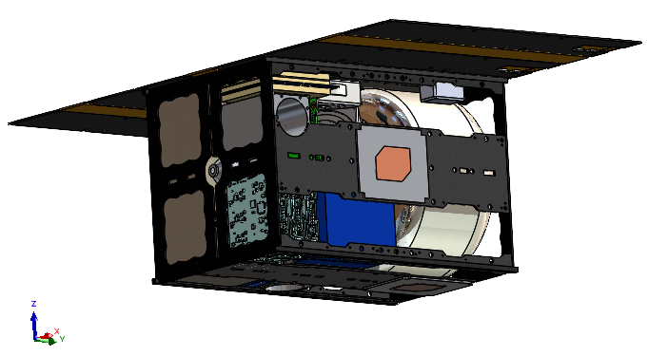
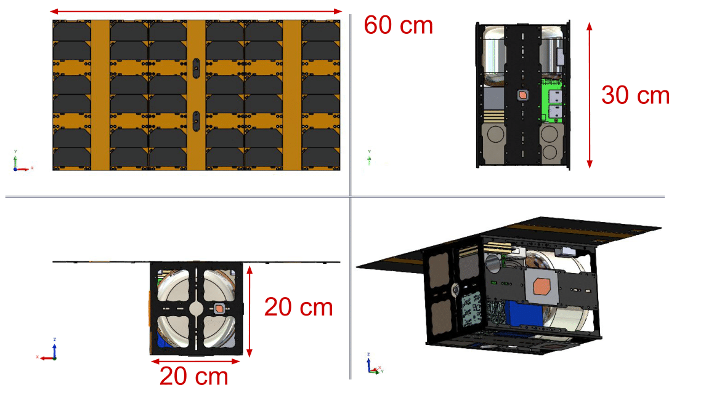
The Mini-Luna Mission & TREx Spacecraft
A rendezvous mission to collect data on a TCO asteroid in situ for the first time in 2028
12U volume
15 kg (33 lb)
Subsystem Single Fault Tolerance
Rapid Response Capability
20 x 20 cm
60 cm when solar panels fully deployed
30 cm
Notes:
Arthur
3.5 years from mission concept to mission completion
Description
CAD model
Highlight more important features
Our mission is called mini luna but
Our s/c name is trex

Slide 9
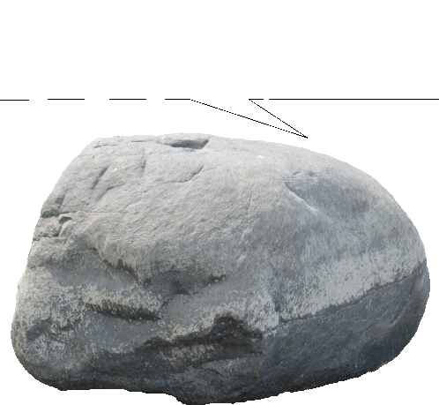




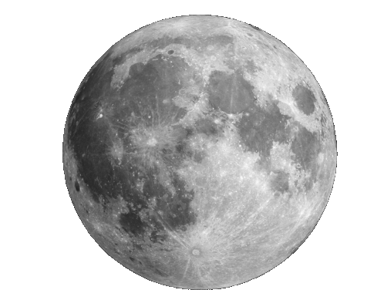
Mission Concept of Operations
(8)
Launch to Earth-Moon L2 point
Deploy solar panels and establish contact with ground
Stationkeep in L2 parking orbit
LSST searches for suitable TCO target
TREX receives TCO ephemeris and ‘go’ command
TREX thrusts to TCO intercept
Deploy antenna and collect measurements using hyperspectral imager
Transmit data to ground station
Stay on TCO trajectory as it leaves EM system (End-of-Life Operations)
(9)
(4)
(1)
(5)
(7)
(2)
L2
(6)
(3)
Notes:
Arthur

Slide 10
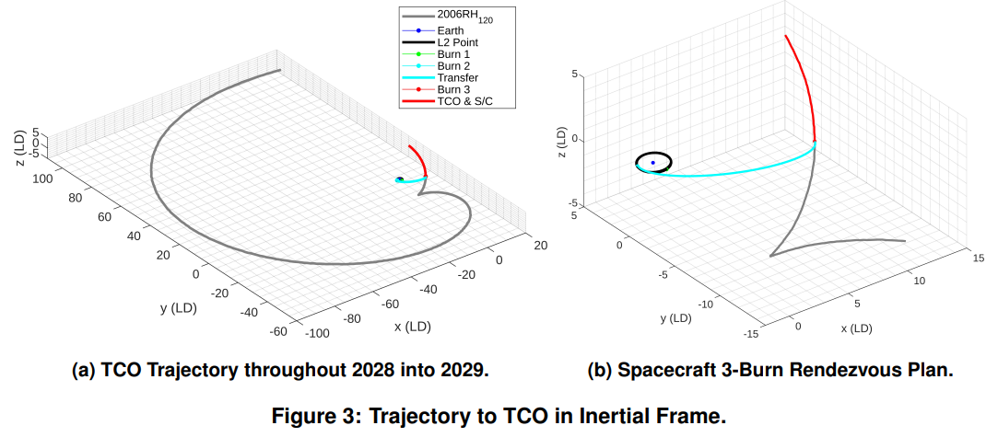
Trajectory Considerations
TREx + TCO
Burn 3
Burn 2
Burn 1
TCO Trajectory
Figure (a): TCO 2006 RH120 Trajectory between 2028 & 2029
Figure (b): Zoomed in - TREx 3-Burn Rendezvous Sequence
Notes:
Arthur - can you make the propulsion overview image bigger or make it fit a little better with the trajectory plots

Slide 11
Propulsion Needs
Propulsion Overview
Variable | Value |  |  |  |  | Units
Maneuver Type | Parking Orbit | Burn 1 | Burn 2 | Burn 3 | All/Total | -
Maneuver Date |  | 01/01/28 | 01/26/28 | 10/27/28 | - | -
Wet Mass Pre-Maneuver | 13.751 | 13.009 | 12.331 | 10.708 | - | kg
ΔV + 5% margin | 7.76 | 119.70 | 115.50 | 304.50 | 547.46 | m/s
Propellant Mass | 0.038 | 0.742 | 0.678 | 1.623 | 3.081 | kg
Total Firing Time | 0.097 | 1.866 | 1.705 | 4.081 | 7.749 | hours
Notes:
Arthur - can you make the propulsion overview image bigger or make it fit a little better with the trajectory plots

Slide 12
Inside the Spacecraft
Attitude Control
3-Axis stabilization
Comms
Near & Deep Space Network compatible
`
Data Processing
Triple Redundancy for Radiation
Flight Software fault management
Propulsion
More than 0.5 km/s ΔV
3 kg hydrazine fuel
Instrument
1-100 Meter size target sensing
4 Spectral imaging sensors
Power
3 6U solar panels generating 53 W
40 Wh battery capacity
Structure
Frame with thermal coating
Notes:
Arthur - Power, prop, rad shield, instruments, make look pretty and simple

Slide 13
Mission Logistics
Subsystem | Total Mass (kg) | Total Vol (U)
Ground System and Communications | 0.91 | 0.388
Data Processing | 0.24 | 0.489
ADCS | 2.83 | 1.34
Imaging System | 1.31 | 1.42
Propulsion | 5.56 | 6.05
Frame/Coatings | 2.92 | 0.36
Power | 1.58 | 1.66
Total | 15.34 | 11.71
Cost
Constraint: $55 M
Total: $9.7 M
Mass
Constraint: 24 kg
Total: 15.34 kg
Volume
Constraint: 12U
Total: 11.71U
Notes:
Arthur

Slide 14
Mission Timeline
2 Months
6 Months
9 Months
10 Months
< 2 years
2 months
Pre-phase A Concept Studies | Phase A Concept and Technology Development | Phase B Preliminary Design and Technology Completion | Phase C Final Design and Fabrication | Phase D System Assembly, Integration and Test, Launch | Phase E Operations and Sustainment | Phase F Closeout
MCR
JUL 2025
MDR
SEP 2025
PDR
MAR 2026
CDR
OCT 2026
SIR
DEC 2026
Launch
Q4 2027
Notes:
Arthur

Slide 15
Mini Luna + TREx spacecraft seek to rendezvous with a TCO and capture surface and tomographic imagery to analyze the target asteroid’s composition and structure.
Pave the way for capturing TCOs and inserting them into stable orbits
Potentially be repurposed for a mission to newly discovered 2024 YR4
Notes:
Adrienne

Slide 16

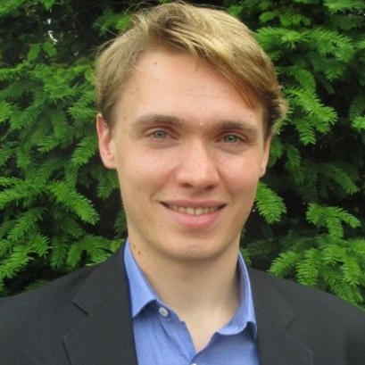
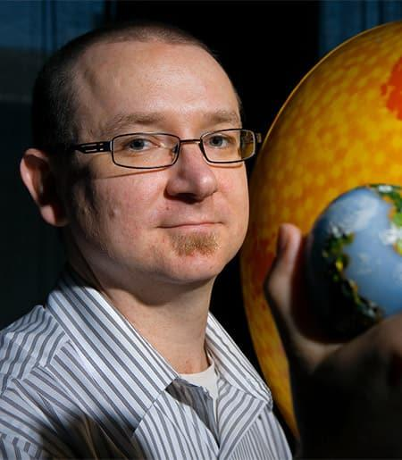

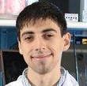
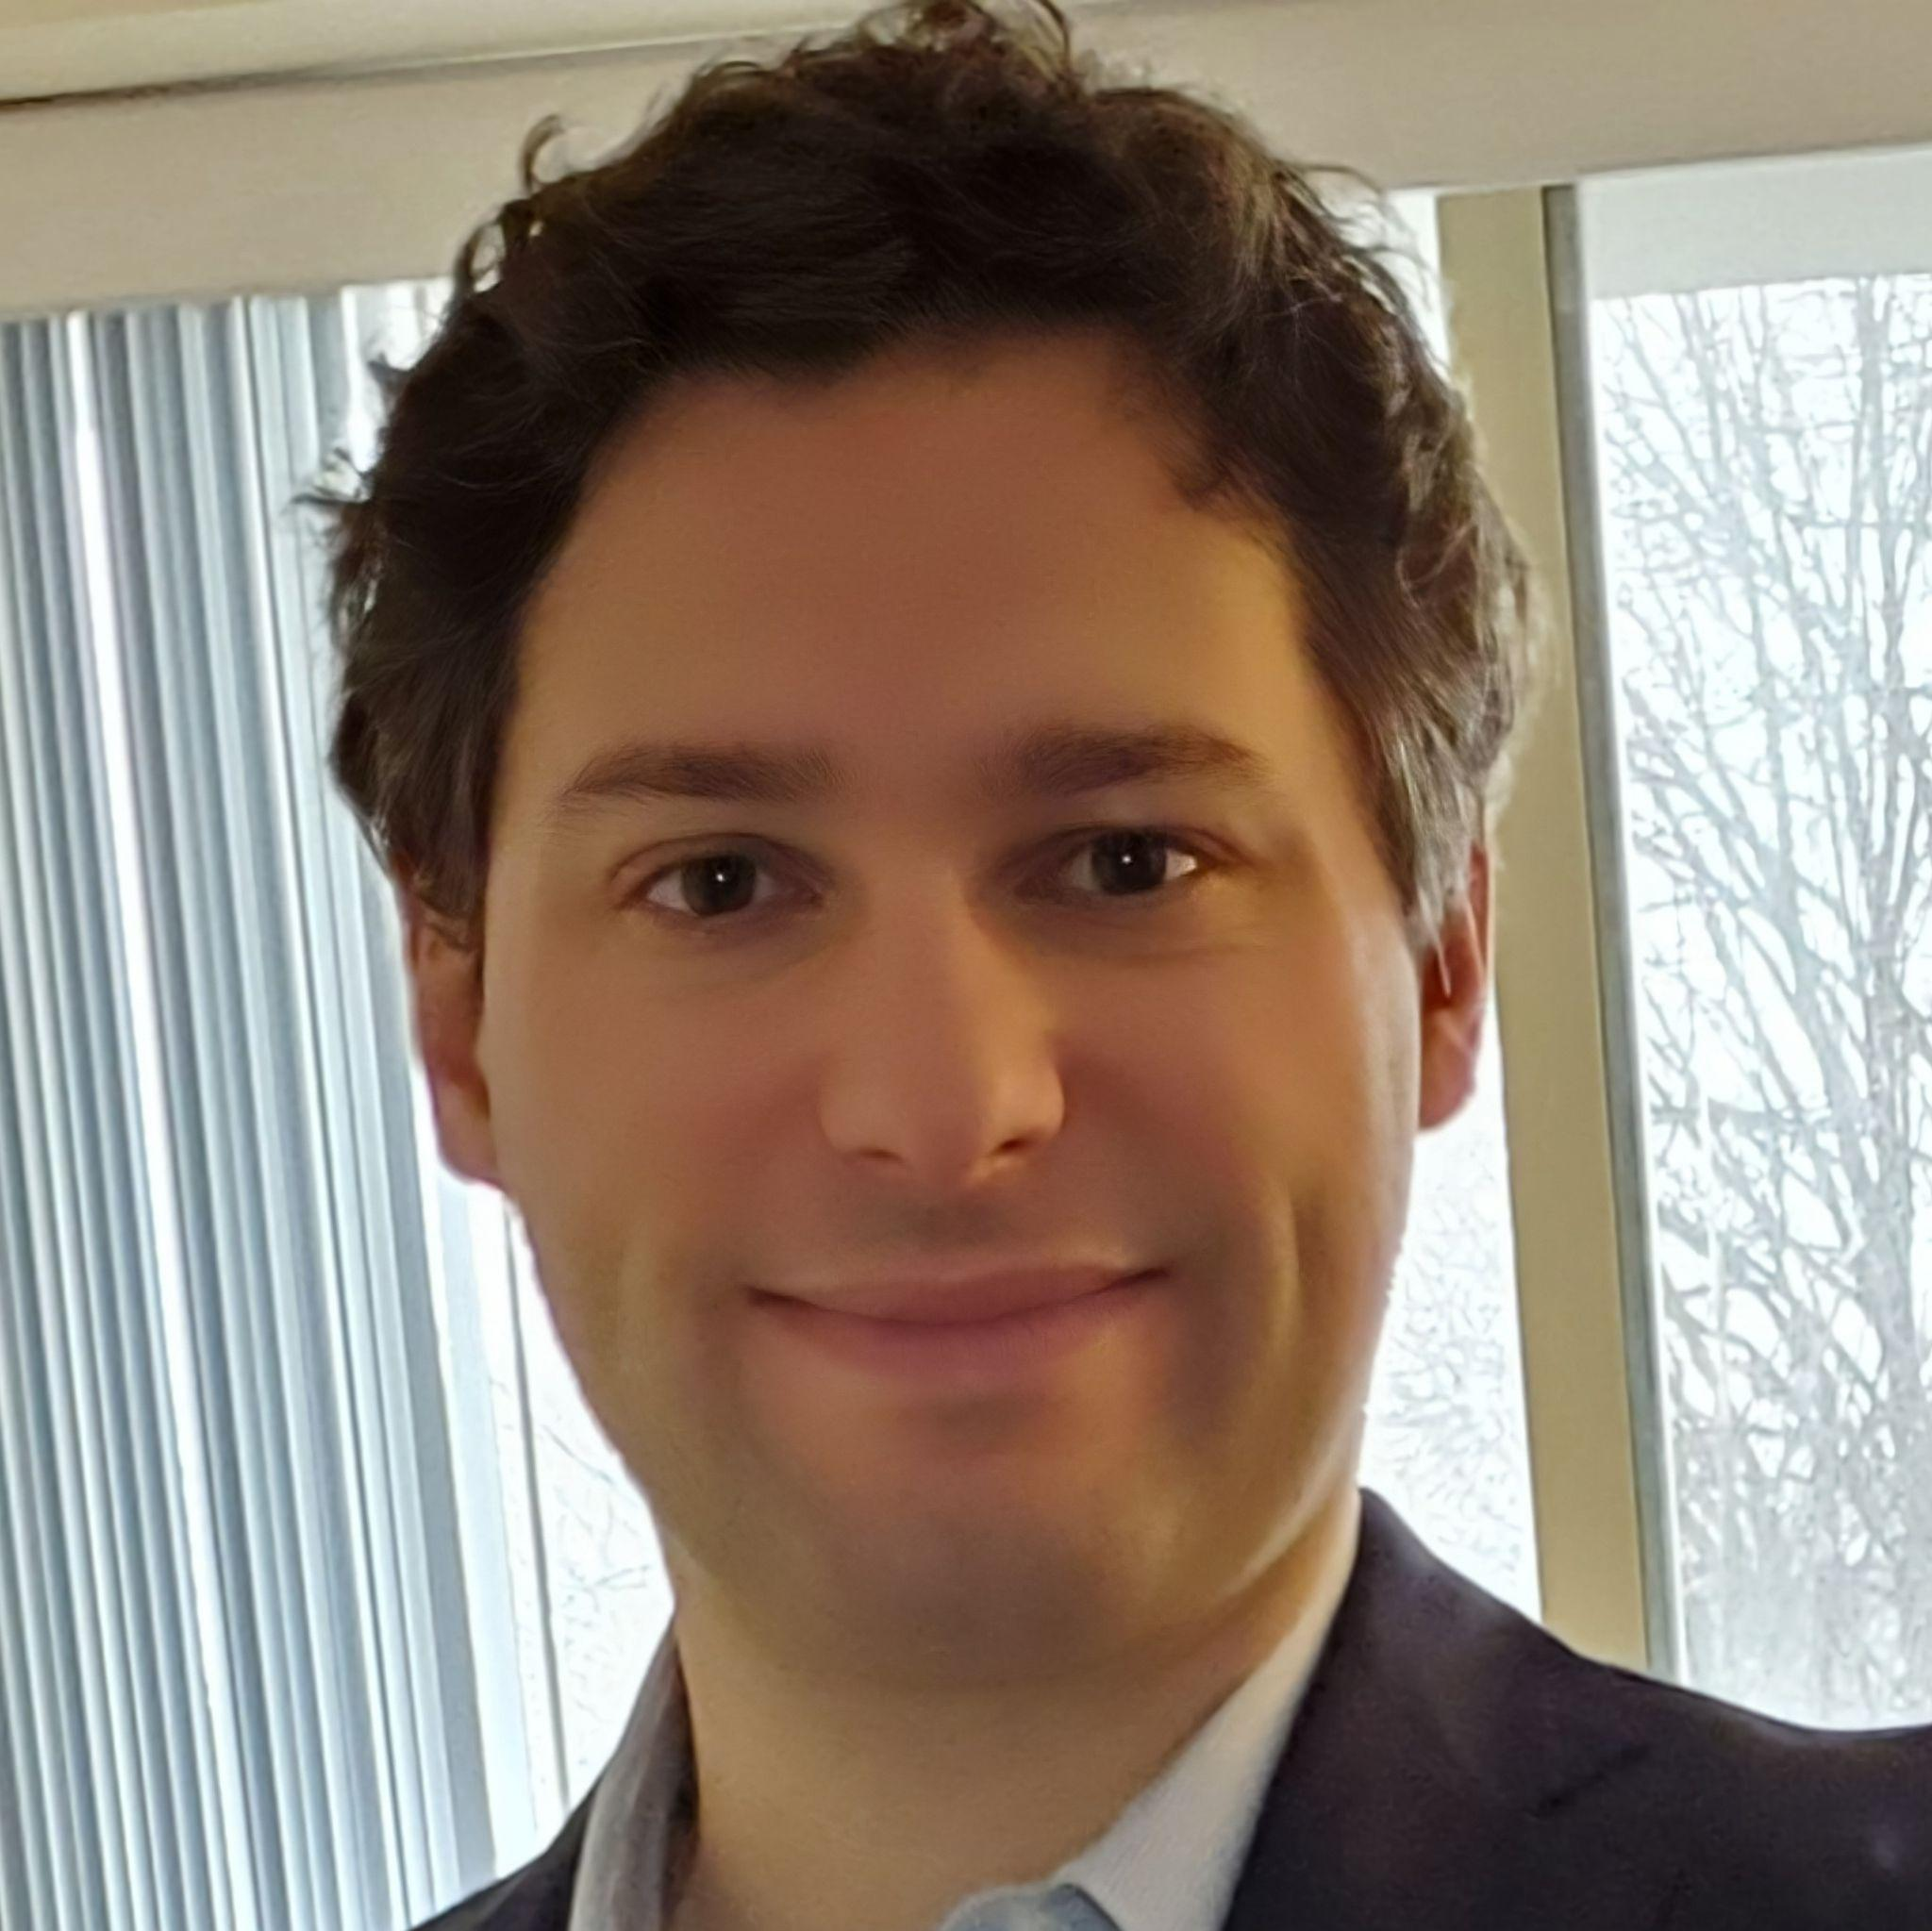
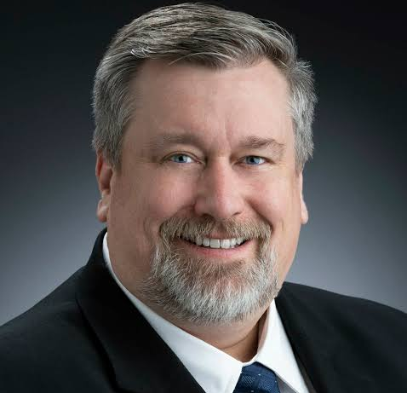
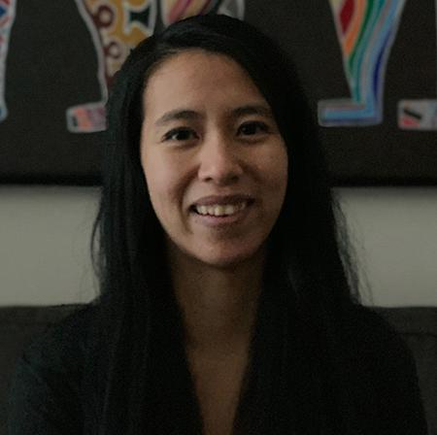
Mentors
Elaine Petro, PhD
Propulsion
Andrew van Paridon, PhD
SMDS
Jamie Lloyd, PhD
Science Instrument
Dmitry Savransky, PhD
Orbital Mechanics
Josh Umansky-Castro
SMDS TA
Fabien Royer, PhD
Space Structures
Mason Peck, PhD
Mission Design
Grace Genszler
SMDS TA
Notes:
Adrienne

Slide 17
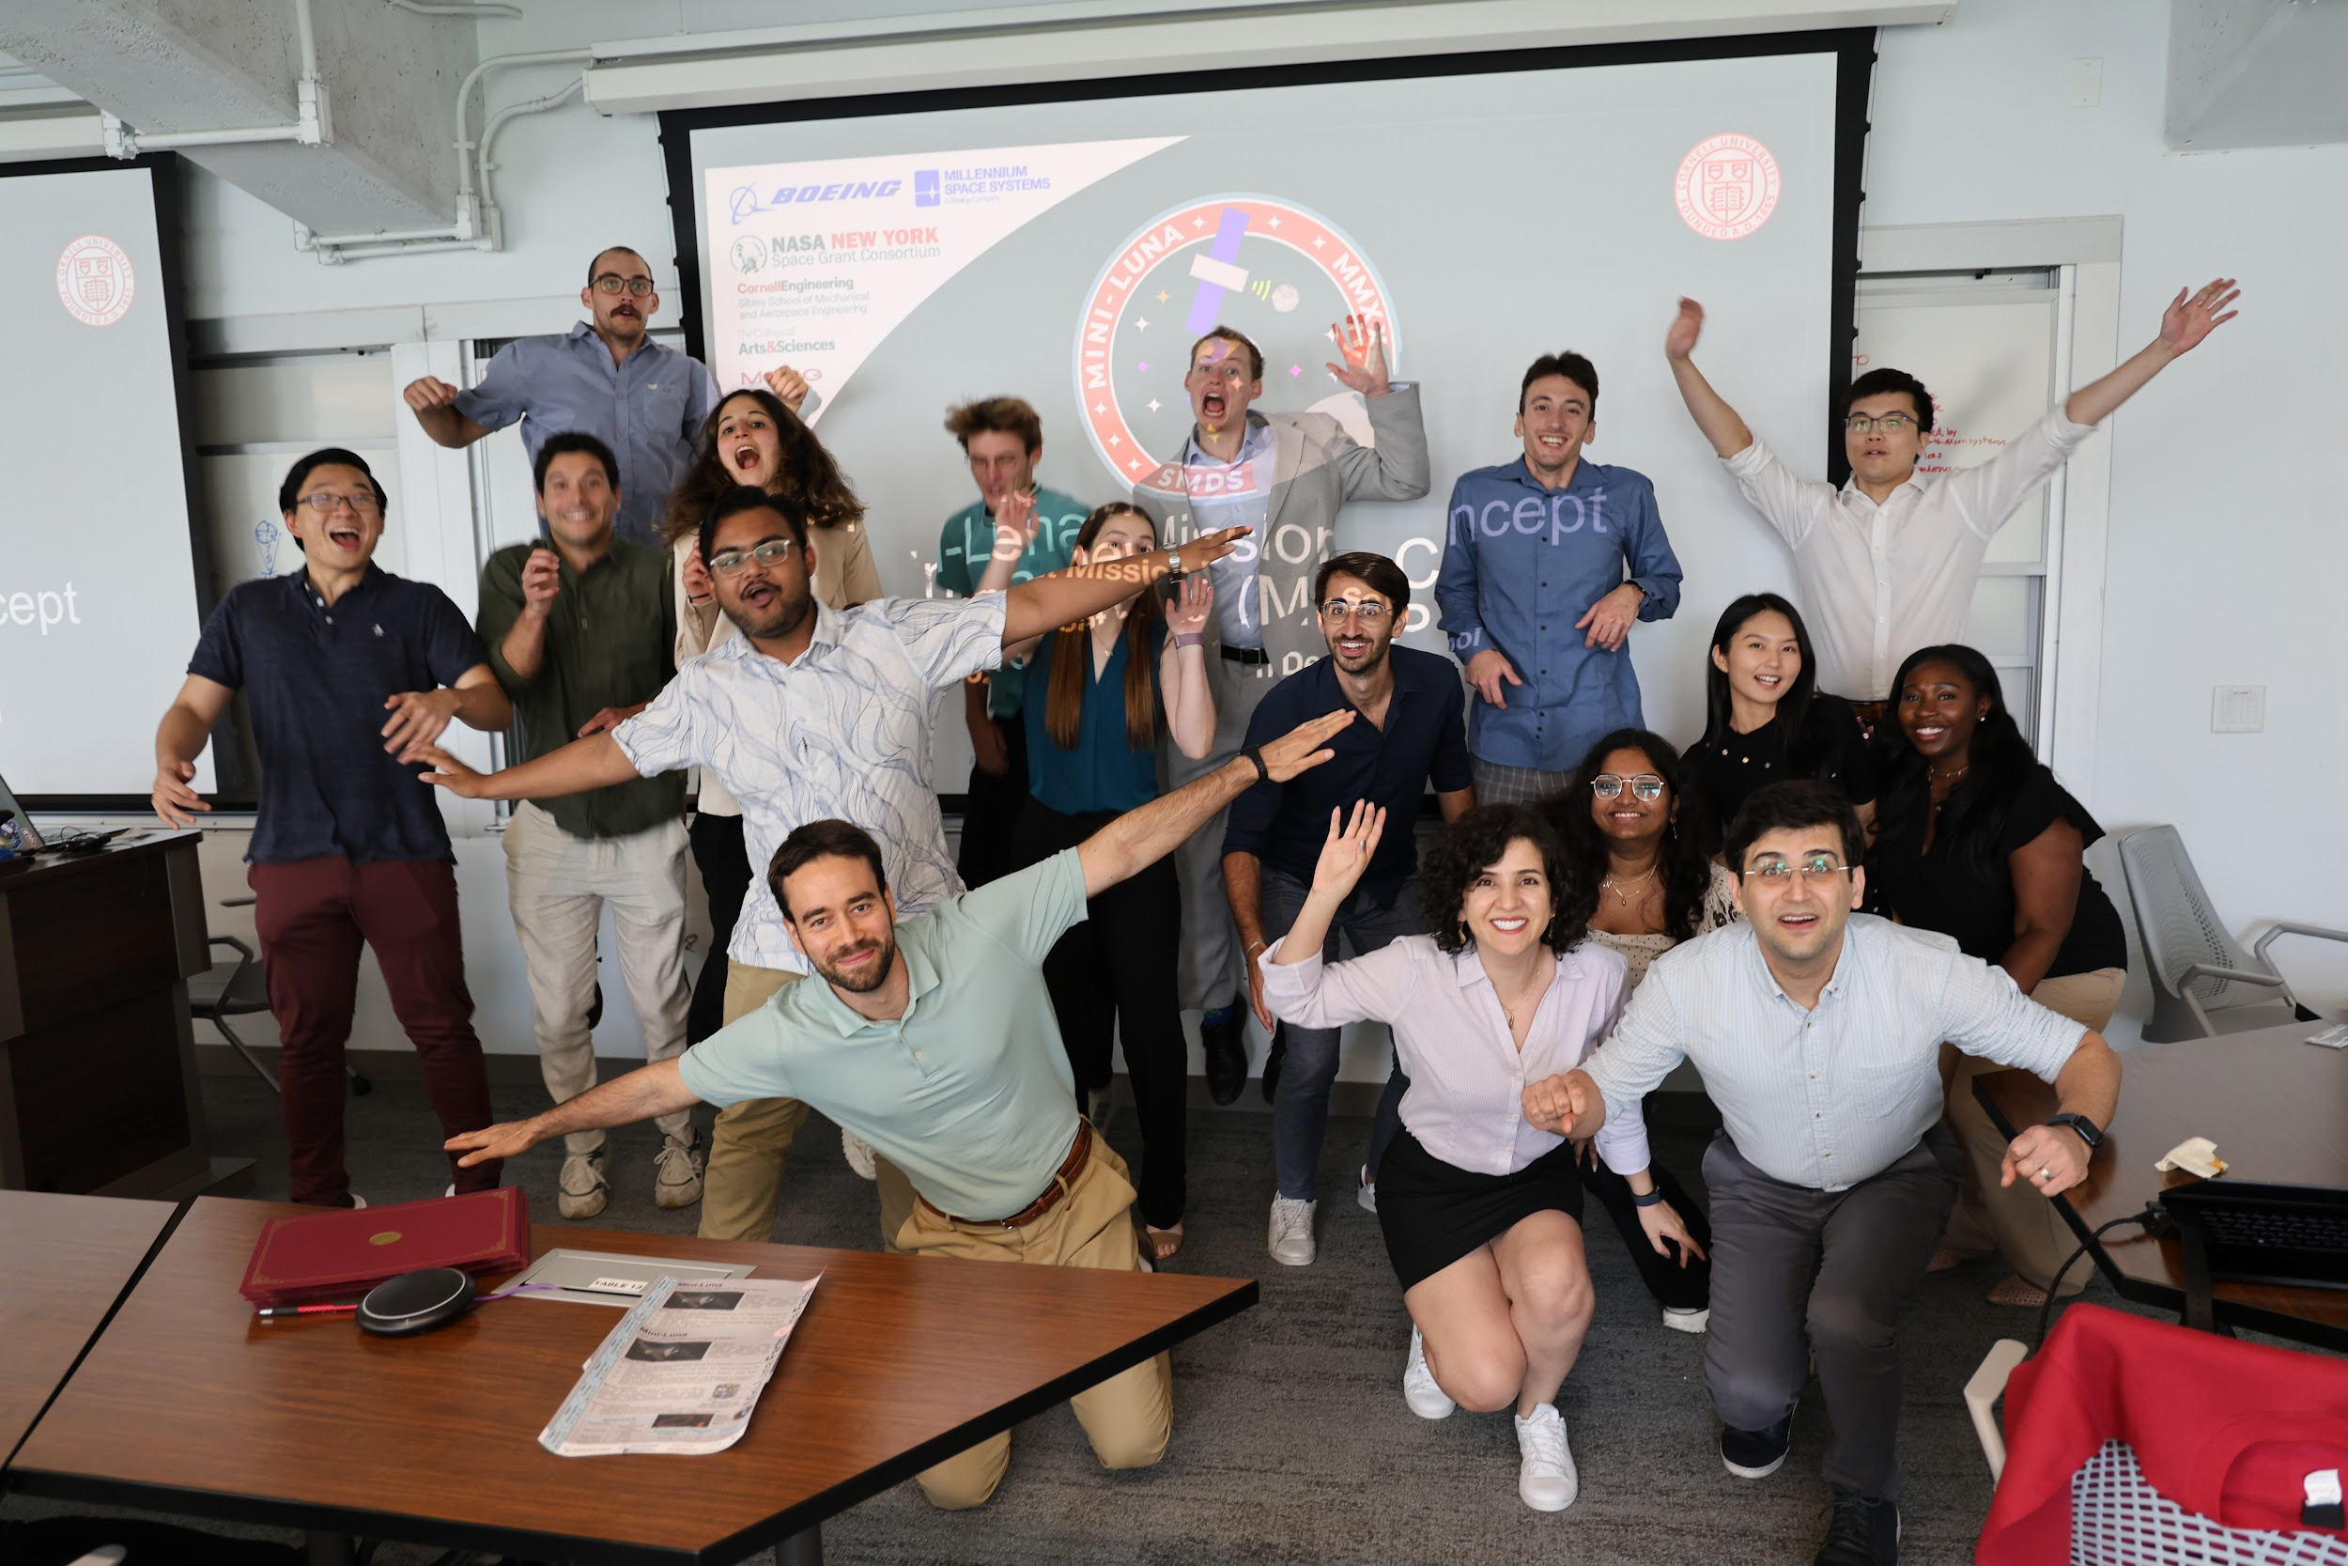
Thank You
2024 SmallSat Mission Design School
Notes:
Adrienne

