Slide 1
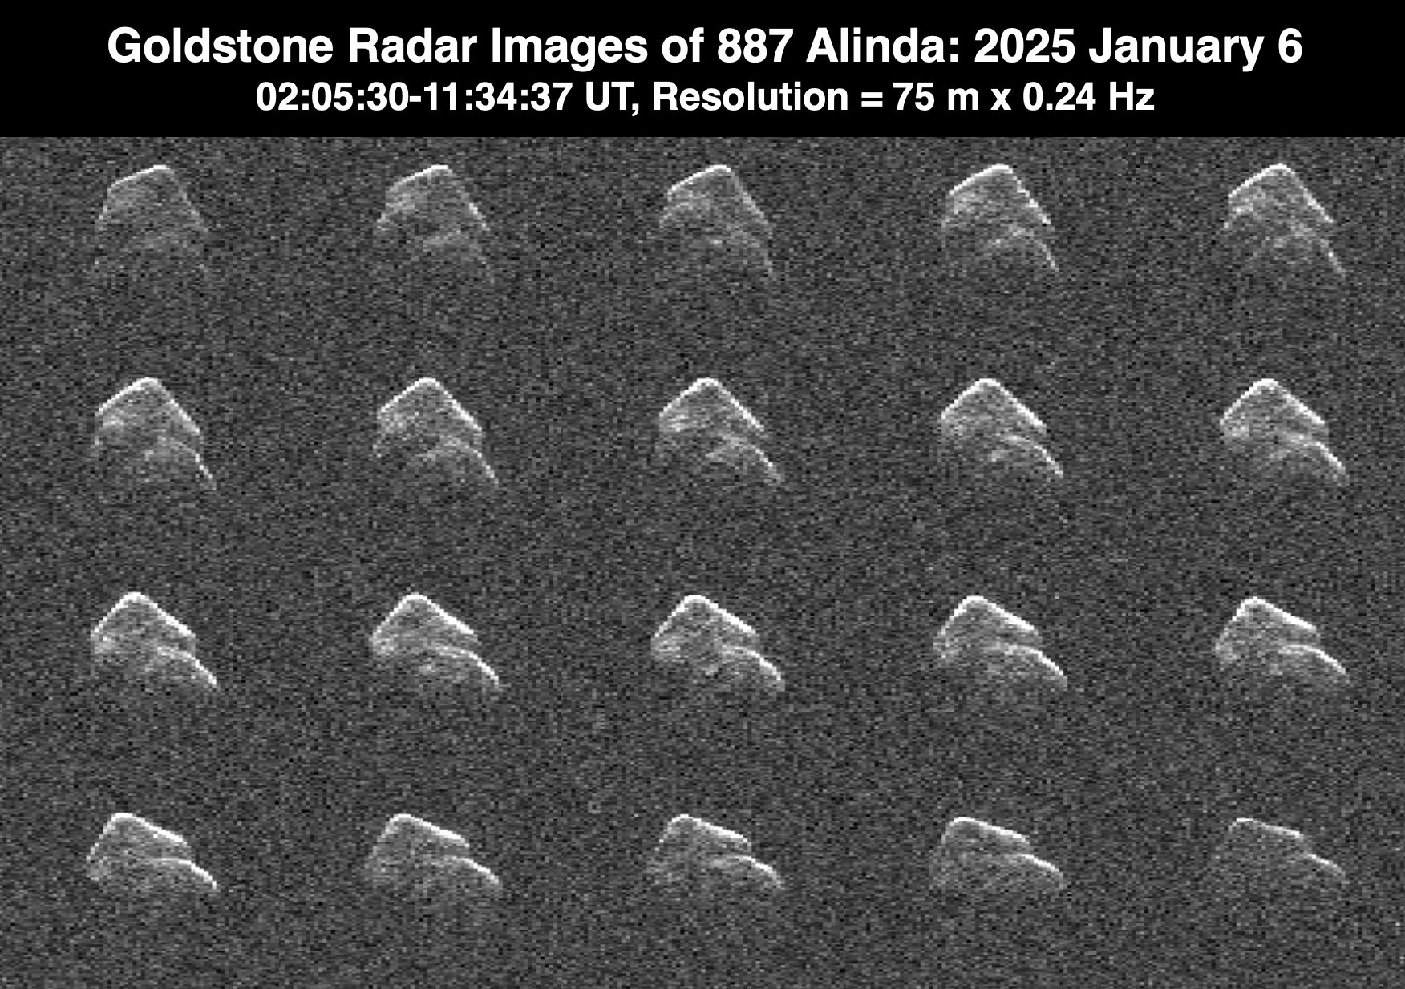
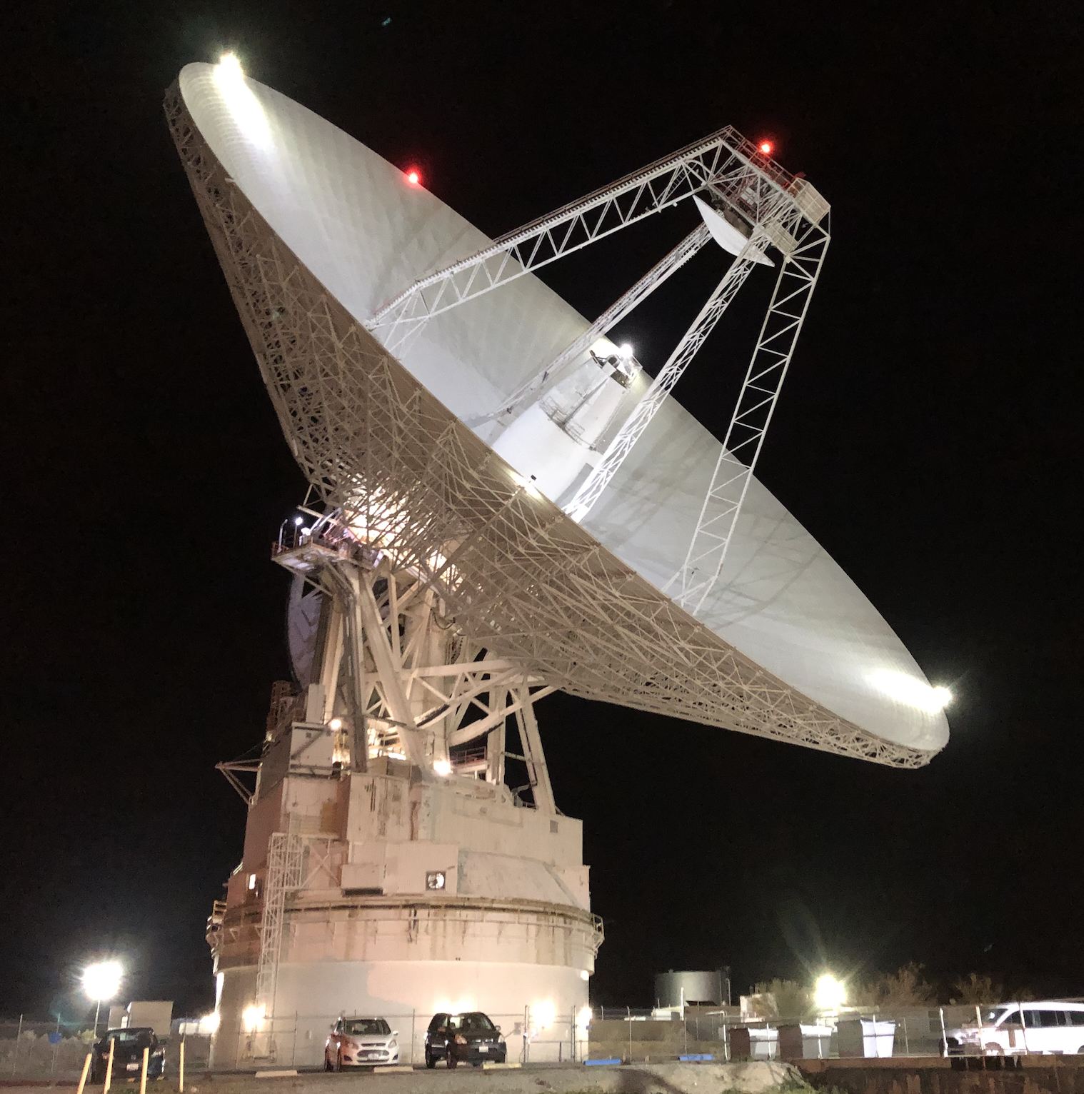

Status of Near-Earth Asteroid Radar Observations
at Goldstone
Lance Benner, Marina Brozovic, Shantanu Naidu, and Jon Giorgini
Jet Propulsion Laboratory, California Institute of Technology
© 2025. All rights reserved.

Slide 2
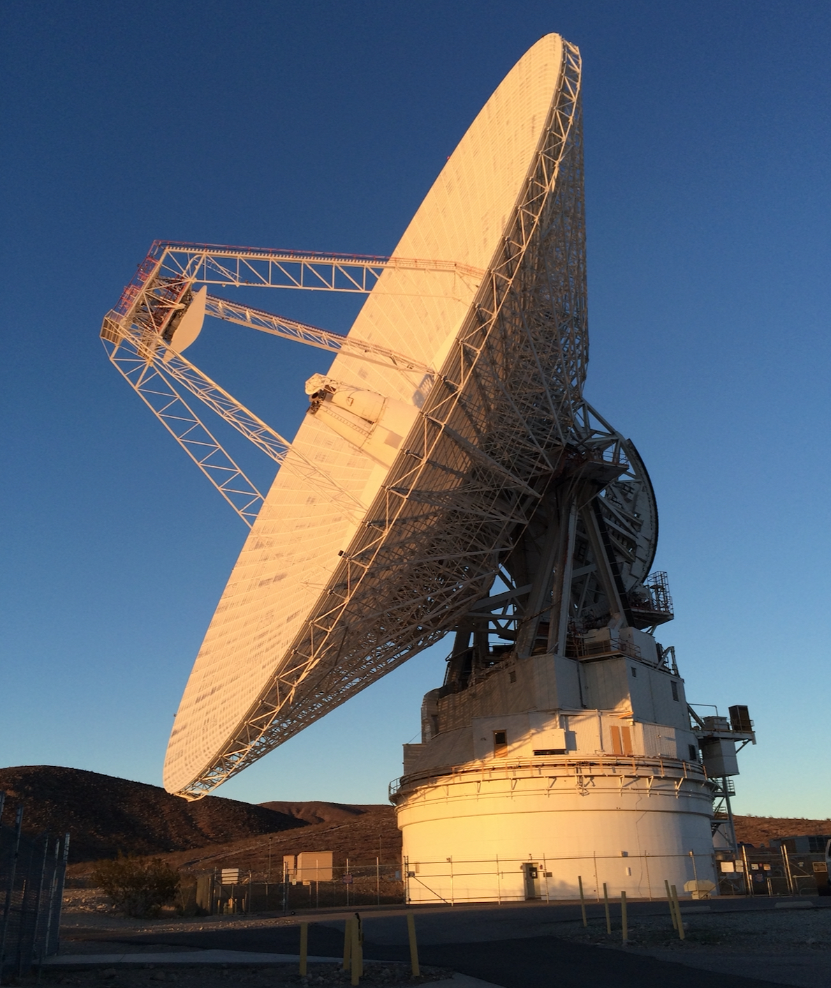
Goldstone
Diameter: 70 m
Transmitter power: 440 kW.
Fully steerable; can track north of -35 deg
(~79% of sky).
Transmitter frequency: 8560 MHz (λ = 3.5 cm)
Finest range resolution: 3.75 m
Recent Improvements:
New klystrons in 2020: more reliable!
Priority of radar observations is higher:
MUCH more time allocated!
Airspace coordination no longer necessary: More scheduling flexibility.
New software: Automatic, rapid NEA target identification (hourly).
More targets-of-opportunity: some within one day of discovery.
Monostatic observations now possible within one lunar distance.

Slide 3
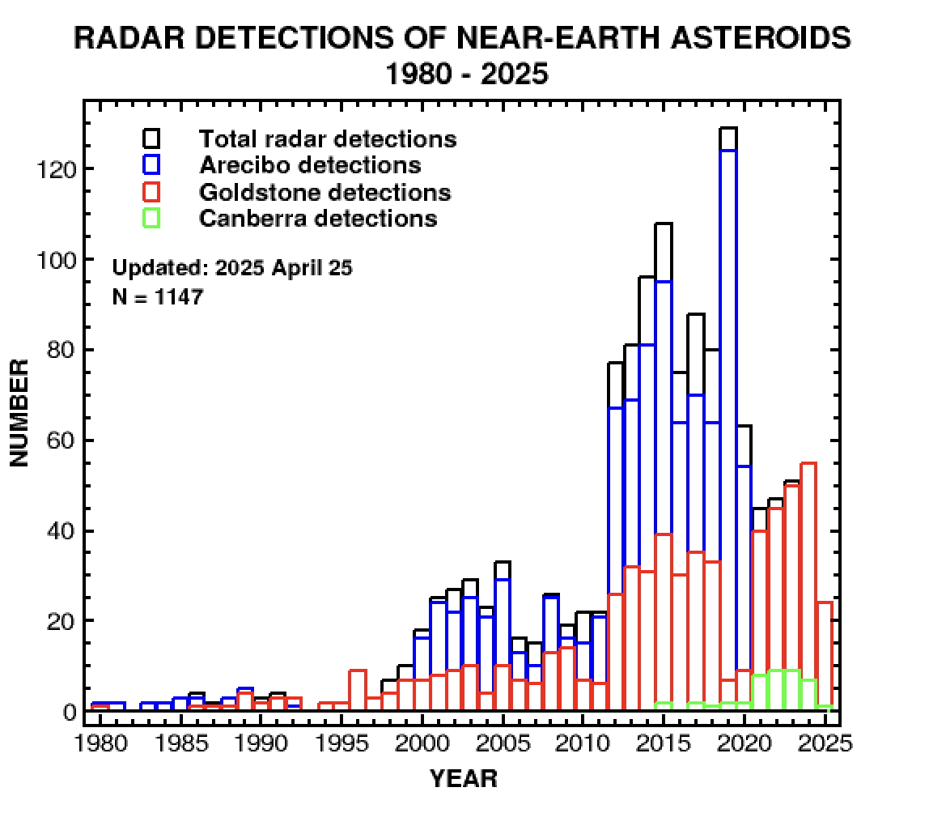
~ 5-fold increase in
Goldstone NEA
radar detections in
the last 15 years
NEAR-EARTH ASTEROID RADAR DETECTIONS
Year Goldstone Canberra > ATCA
2021 40 8 New Goldstone record
2022 45 9 New Goldstone record
2023 50 9 New Goldstone record
2024 55 7 New Goldstone record
2025 24 1
Last update: 2025 Apr 25

Slide 4
Goldstone NEA Observations Since 2020
Total radar detections 225
New detections 176
Potentially Hazardous 121
Targets-of-Opportunity 075
Binaries 18 Goldstone discoveries: 14
Triples 02
Contact Binaries 14 All discovered at Goldstone
In 2024, ~500 NEAs were detectable at Goldstone:
Detectable Observed
All sizes: ~500 55 11%
D > 020 m: ~170 48 28%
D > 140 m: ~032 31 97%
Last update: 2025 April 25

Slide 5
Asteroid Radar Observations Since 1968
Near-Earth Asteroids: 1147 3% of the population
Main-Belt Asteroids: 0138
Comets: 0023
Potentially Hazardous: 496 20% of all PHAs
44% of radar sample
Detected more than once: 136 13% of radar sample
NEAs Comets
Arecibo 858 18
Goldstone 533 08 31% since 2020
Both 242 0 6
Canberra 043 00
Last update: 2025 April 25

Slide 6
Radar Observations of NEA Subpopulations
Binary NEAs Observed 079 ~12% of NEAs > 0.15 km
Binary NEAs Discovered 057
Triples 005 All discovered by radar.
Four discovered at Goldstone.
Known Binary NEAs 101 (Some found by photometry)
NEA Contact Binaries: 061 All discovered by radar
All longer than ~100 meters
WISE Mission Targets: 487 42% of the radar sample
Yarkovsky Effect: 148 13% of the radar sample
Updated: 2025 Apr 25

Slide 7
Recent Highlights:
- Planetary Defense
- Angular, irregular objects
- Rounded objects
- Binaries
- Contact binaries

Slide 8
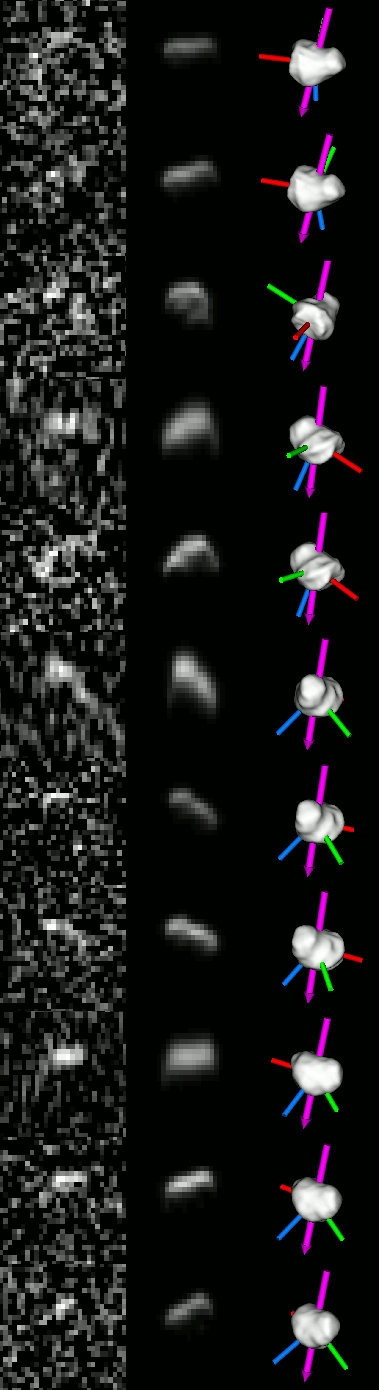
Planetary Defense: 99942 Apophis
International Asteroid Warning Network (IAWN) Campaign, 2021
Preliminary fits.
DATA FITS MODEL
Goldstone eliminated a low probability impact in 2068.
Major observing campaign planned in 2029.

Slide 9
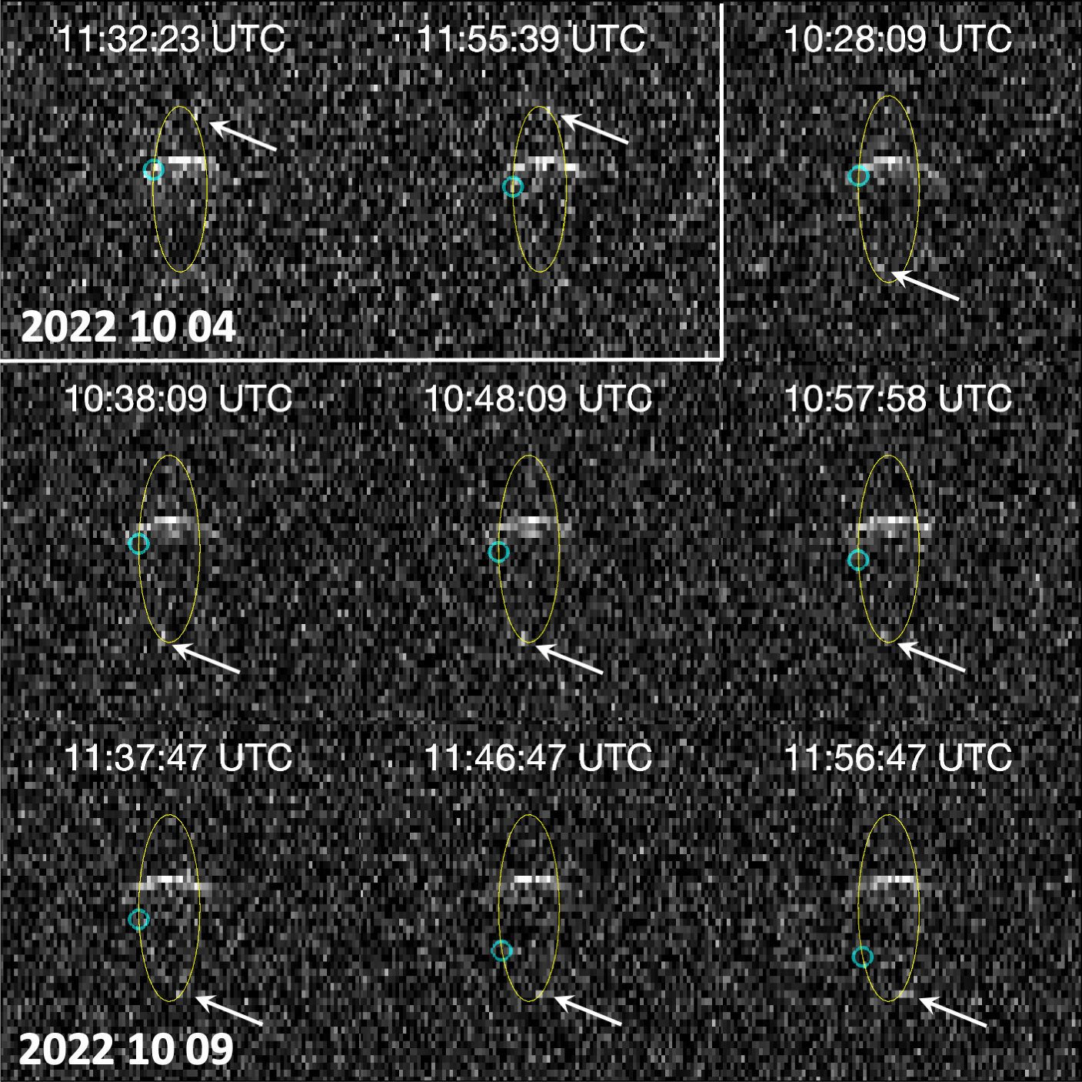


Planetary Defense: DART targets Didymos and Dimorphos
Goldstone detected the orbital period change
within 12 hours of the DART impact: -36 $±15 minutes$
Oct 4
Goldstone
monostatic
Observed
No-impact
Oct 9
Goldstone/ Green Bank
bistatic
Thomas et al. 2023, Naidu et al. 2024

Slide 10
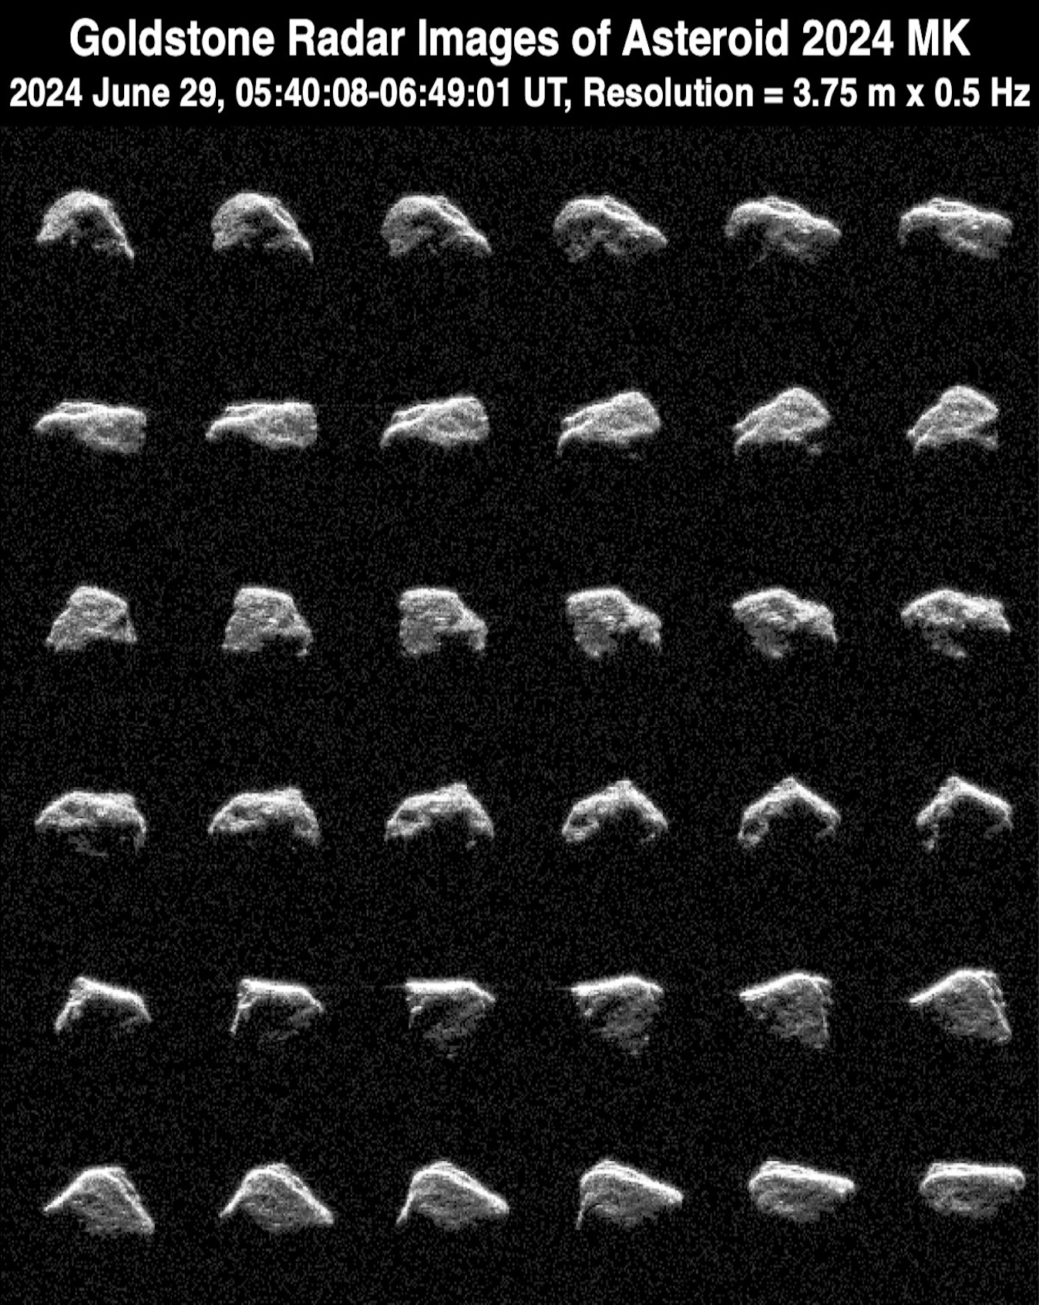
Angular Objects:
2024 MK
2024 June 29, 05:40-06:49 UT
Resolution: 3.75 m x 0.5 Hz
Range: 1 lunar distance
Long axis ~ 130 m
Non-principal axis rotation:
~30 minutes
Target-of-Opportunity

Slide 11
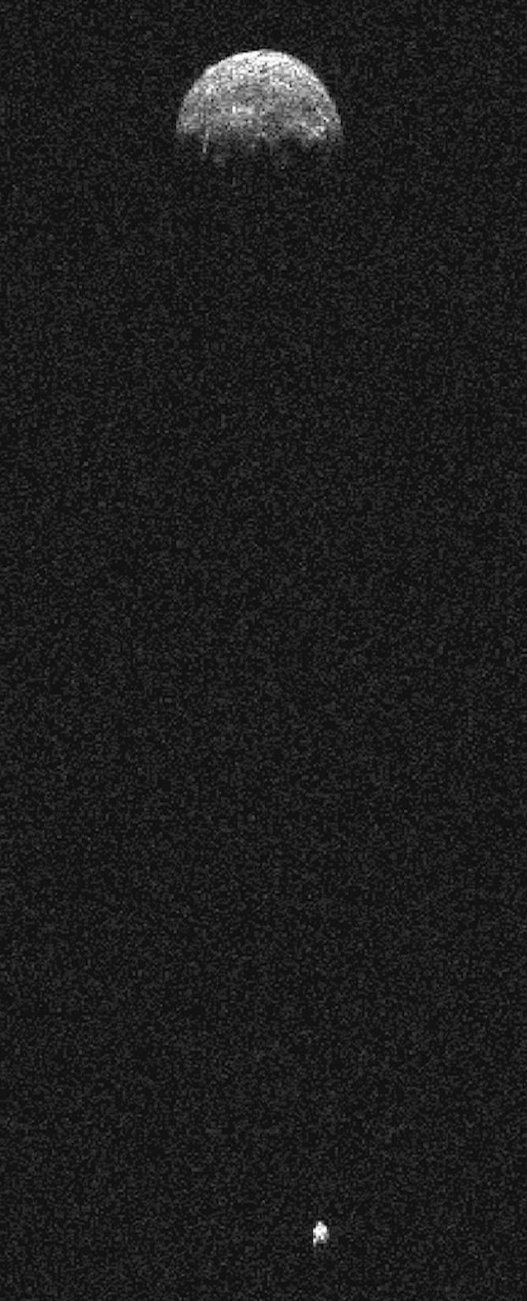
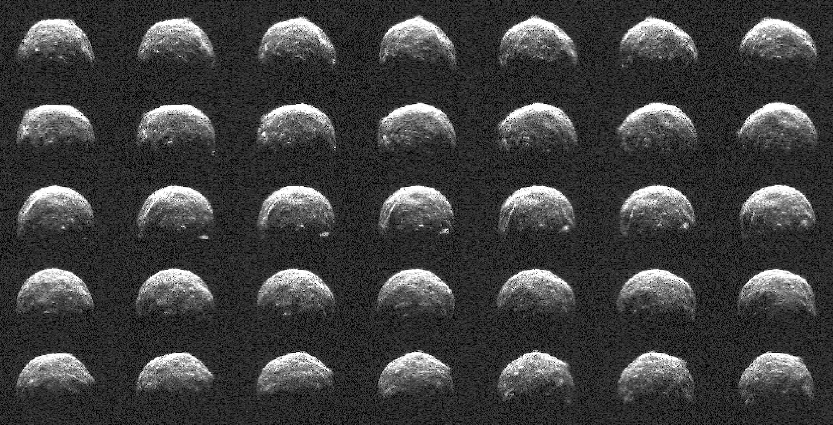
Rounded Objects and Binary Systems: (741081) 2005 LW3
2022 Nov 24, resolution = 3.75 m x 0.125 Hz
Secondary rotation is not synchronous.
PHA.

Slide 12
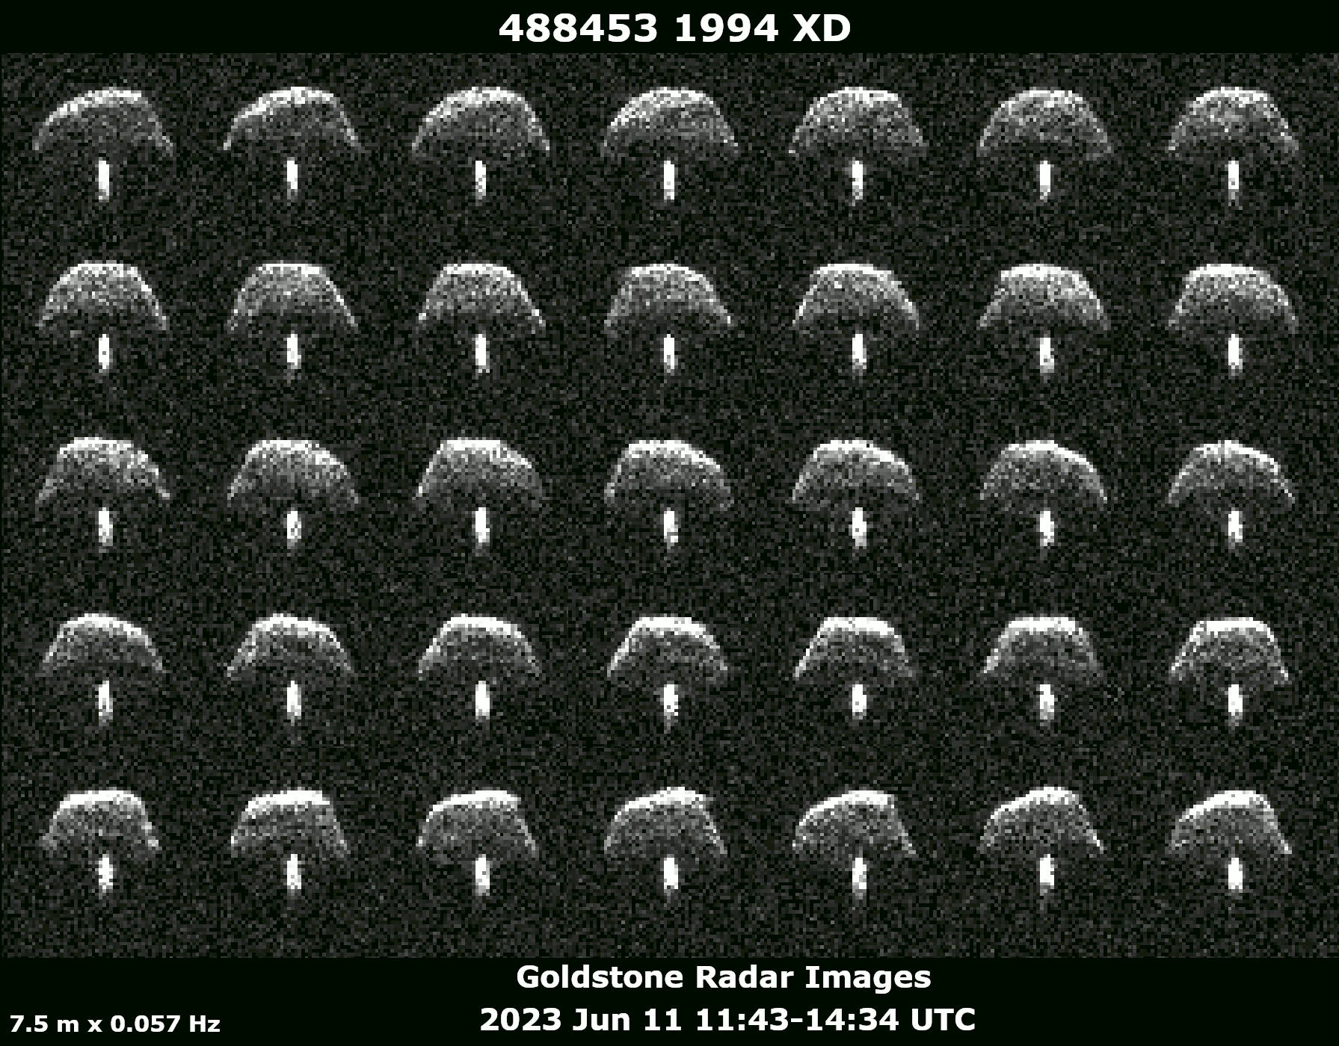
Binary Asteroid 1994 XD
High latitude view nearly perpendicular to the orbital plane
PHA

Slide 13
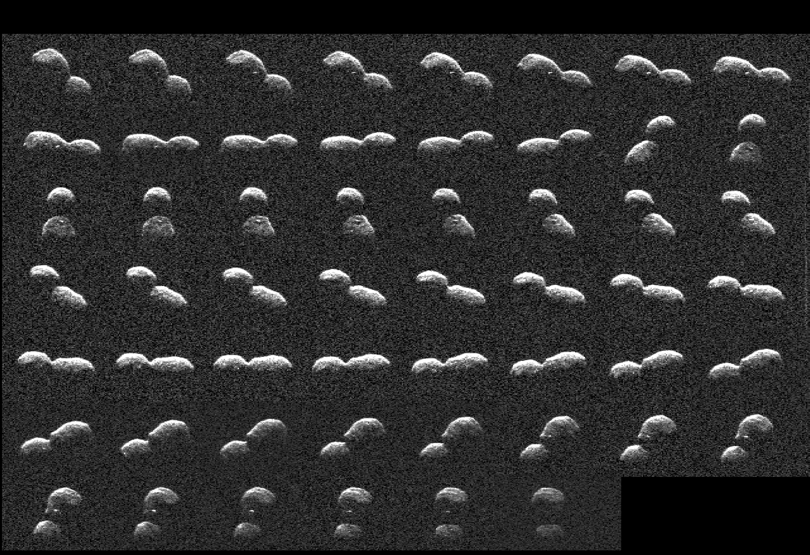
Contact Binary: 2024 ON
2024 September 16, Resolution = 3.75 m x 0.1 Hz, Target-of-opportunity, PHA

Slide 14
Outstanding Future NEA Radar Targets
Distance Diam. Goldstone
Asteroid Date (LD) (km) SNR/Day
2025 FA22 2025 Sep 18 2.2 0.16 1x10⁵ TORINO 1
2013 GM3 2026 Apr 14 0.66 0.02 3x10⁵
1997 NC1 2026 Jun 27 6.6 0.84 5x10⁴
1999 AN10 2027 Aug 07 1.1 0.8 2x10⁷
2001 WN5 2028 Jun 26 0.65 0.9 2x10⁷
2011 LJ19 2028 Jul 25 3.3 0.2 4x10⁴
1997 XF11 2028 Oct 26 2.4 1.2 3x10⁶
2023 GQ2 2028 Nov 16 4.0 0.35 3x10⁴
2006 SU49 2029 Jan 28 3.2 0.4 9x10⁴
Apophis 2029 Apr 13 0.1 0.34 3x10¹¹
2001 AV43 2029 Nov 11 0.65 0.05 3x10⁵
2010 DM56 2030 Sep 11 5.8 0.76 1x10⁴
2008 DB 2032 Aug 14 0.33 0.02 3x10⁵
2024 YR4 2032 Dec 22 0.67 0.05 3x10⁵
Strongest known SNRs by NEAs > 20 m in diameter that will approach
within 10 lunar distances from 2025-2032.
LD = one lunar distance (0.00257 au or 384,400 km)

Slide 15
Backup Slides

Slide 16
Goldstone Equipment Modernization
Offline from August 2026 - October 2028
Goals: Replace old equipment; some is >40 years old.
Extend the operational lifetime of the whole facility.
The radar will NOT become more sensitive. More reliable.
New 80 kW spacecraft communications klystron. Can act as a 2nd radar.
Highest resolution = 1.875 m.
Observations of dozens of weak targets will not happen.
But:
DSS-13/Green Bank and Canberra will still observe the strongest targets.
2028 April: Partial resumption of radar operations
2028 October: Resumption of regular operations
Full operations will resume 6 months before the 2029 Apophis flyby.
Extensive Apophis observations are planned to obtain detailed images, 3D models, observe spin state changes, and support OSIRIS-Apex.

Slide 17
2024 Goldstone NEA Radar Detections
N = 55 45 observed for the first time
Average H = 21.7 +- 4.1
TOO average H = 24.7 +- 2.8 N = 15
Faintest H = 30.4 2024 GJ2
Brightest H = 12.6 4954 Eric

Slide 18
Upcoming 2025 Goldstone Near-Earth Asteroid Targets
Month Asteroid Distance (au) 0SNR D (km)
May 612356 2002 JX8 0.019 01200 0.32
May 2011 HJ7 0.017 00590 0.11
May 154276 2002 SY50 0.070 00110 1.1
May 387746 2003 MH4 0.045 00120 0.37
May 390725 2003 HB 0.047 00130 0.29
Jun 2014 HQ124 0.072 00092 0.35 NPA rotator
Jun 424482 2008 DG5 0.023 02700 0.36
Jun 527715 2007 YQ56 0.077 00062 0.32
Jun 2003 AY2 0.036 00120 0.36
Jul 035107 1991 VH 0.078 00110 1.0 Binary
Aug 1997 QK1 0.020 03900 0.3
Aug 1998 SH2 0.021 00180 0.38
Aug 2021 PJ1 0.011 00200 0.022
Sep 2025 FA22 0.0055 120000 0.16
Sep 2009 FF 0.017 01900 0.14
Sep 152664 1998 FW4 0.026 01500 1.1 Contact Binary
Oct 434196 2003 HG2 0.045 00041 0.15
Nov 516155 2016 DP 0.032 00450 0.22
Nov 003361 Orpheus 0.038 00090 0.35
Nov 2007 VM184 0.033 00290 0.20
Dec 220839 2004 VA 0.096 00036 1.7
https://echo.jpl.nasa.gov/asteroids/goldstone_asteroid_schedule.html

Slide 19
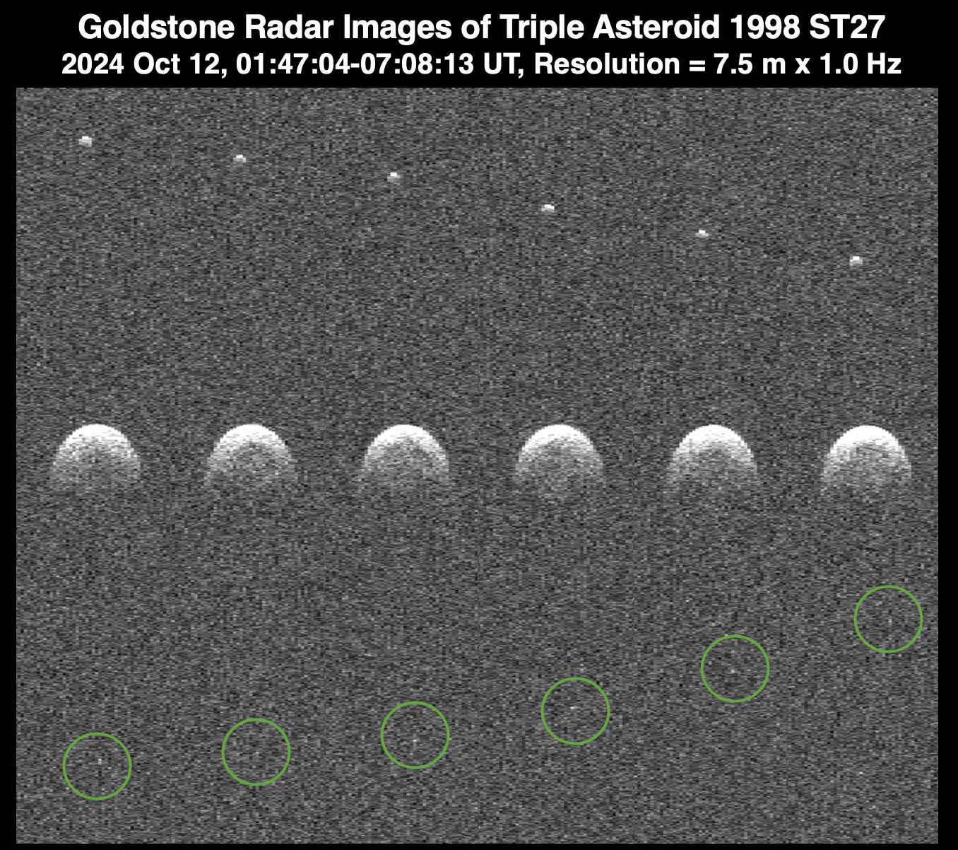
PHA

Slide 20
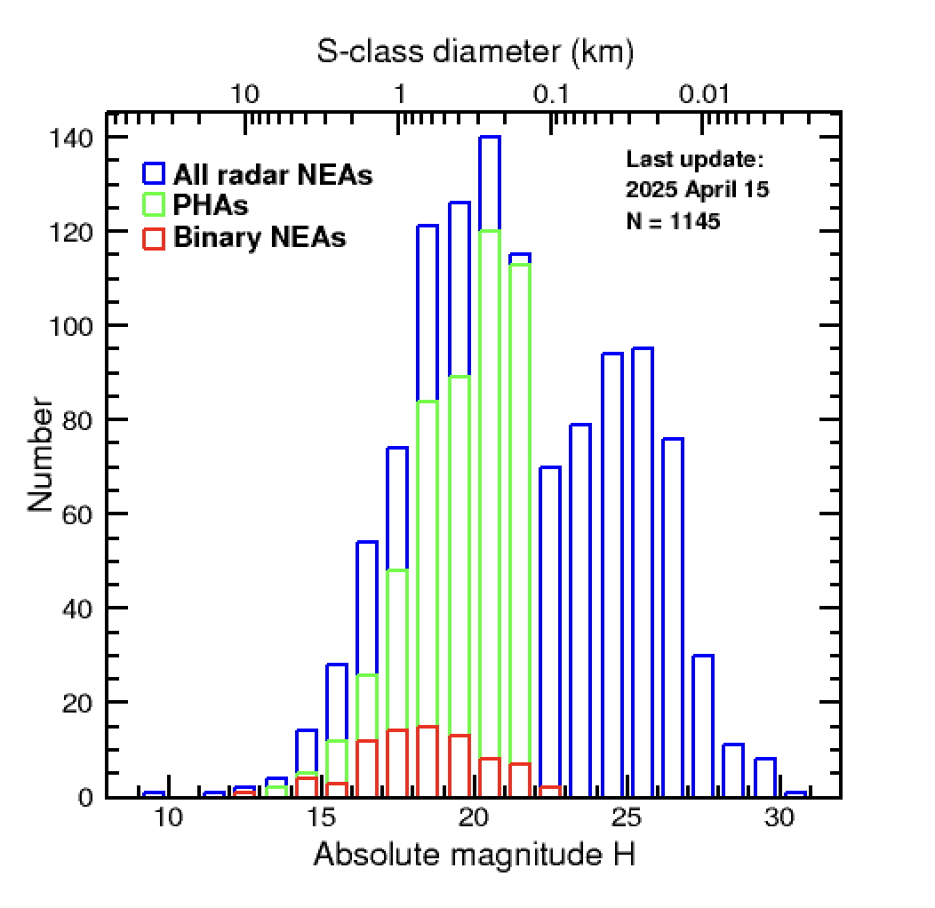
NEA Radar Absolute Magnitude Distribution

Slide 21
Near-Earth Object Mission Targets Observed by Radar
Upcoming Mission Targets:
65803 Didymos/Dimorphos Hera ESA 2027
3200 Phaethon Destiny+ JAXA 2028
99942 Apophis RAMSES ? ESA 2029
99942 Apophis OSIRIS-APEX NASA 2029
1998 KY26 Hayabusa2 JAXA 2031
Previous Mission Targets:
433 Eros NEAR-Shoemaker NASA
25143 Itokawa Hayabusa JAXA
Comet Hartley 2 EPOXI NASA
4179 Toutatis Chang’e 2 CNSA-China
162173 Ryugu Hayabusa2 JAXA
101955 Bennu OSIRIS-REx NASA
65803 Didymos/Dimorphos DART, LiciaCube NASA, ASI-Italy
Many asteroids become mission targets because radar observations
exist or are planned.
NEA mission targets not observed by radar: 98943 Torifune, 469219 Kamo'oalewa
Not included: NEA missions that failed (Odin, NEA Scout, Clementine, CONTOUR, Procyon, etc.) or main-belt missions (Dawn, Psyche).

Slide 22
Archiving Goldstone Data with the PDS
Raw data:
Clement Lee is leading this and has begun archiving it.
Processed Data:
Support Documents
Masterlog text files: Quick summaries of the observations.
PDFs: Echo power spectra and images.
CW data: csv files with xml headers
Delay-Doppler data: fits format.
The goal with processed data is to choose Doppler resolutions suitable for immediate work with the data.
Data are fully tagged.

