Slide 1
JWST As a Tool for Early Characterization of Potential Impactors
Andrew S. Rivkin, Cristina A. Thomas, Nancy L. Chabot, R. Terik Daly, Jessie L. Dotson, Lorien Wheeler, Bryan J. Holler, and Stefanie N. Milam

Slide 2
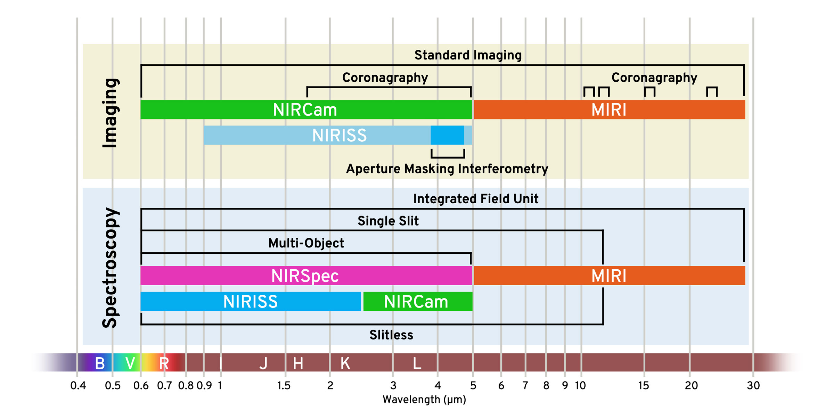
What are JWST’s capabilities?
6.5-m telescope at Sun-Earth L2
Instruments cover 0.6-28.3 µm:
NIRCam: 0.6-5 µm imaging (0.07” at 2 µm)
NIRSpec: 0.6-5 µm spectroscopy at a variety of spectral resolutions
MIRI: 5-27 µm imaging and spectroscopy at a variety of spectral resolutions
NIRISS: 0.8-5 µm imaging (0.11” per pixel) and spectroscopy
Extremely sensitive!
Can get wavelengths that are difficult/impossible to get from surface of Earth

Slide 3
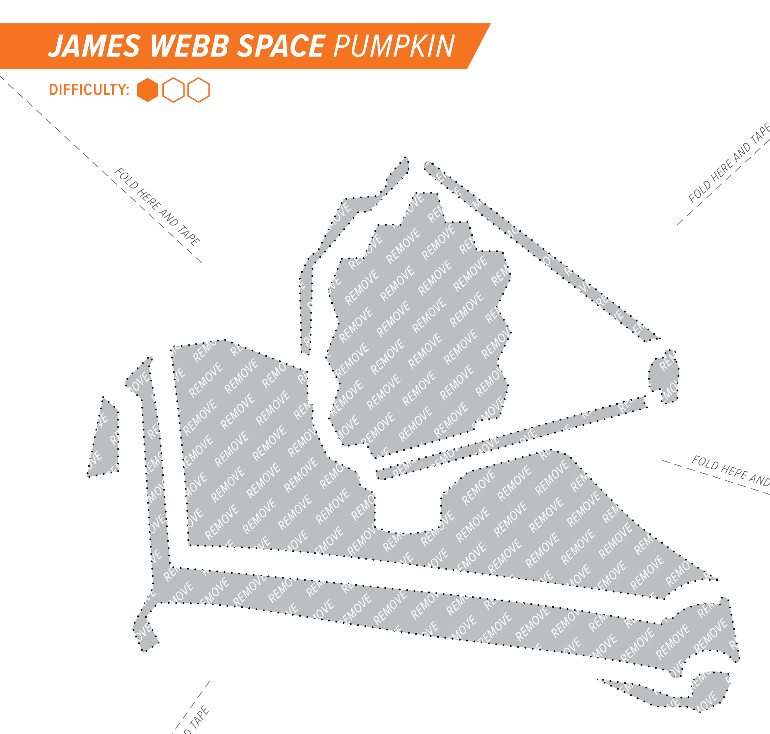
What are JWST’s limitations?
Field of regard: Can only observe objects between 65°-135° solar elongation
Large overheads: Time necessary for observations can amount to an additional 40% on top of integration time
Can’t point two instruments at same thing at same time
Some proposals might need to wrangle data rates and/or meteoroid avoidance zones
Very large oversubscription rate, so must make particularly good case to get time

Slide 4
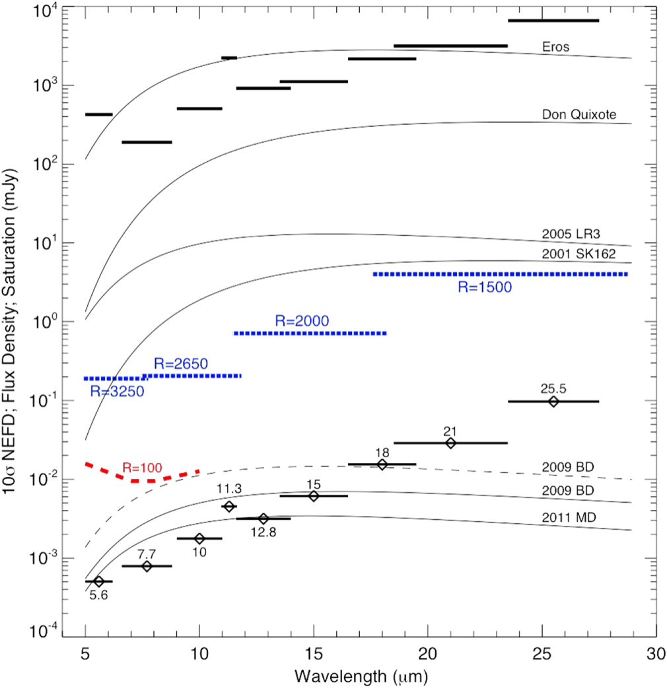
JWST as a Planetary Defense asset
1000 sec integration
JWST is an exceedingly capable, sensitive facility, and can make unique contributions to planetary defense in times of need
Can be scheduled for targets of opportunity with no overhead penalty with 2 week lead time, less lead time with additional overhead
Can greatly reduce size uncertainties and provide early, comprehensive characterization
See Thomas et al. (2016) in PASP for more details of using JWST for NEO observations
~5-m diameter objects
Thomas et al. (2016)

Slide 5
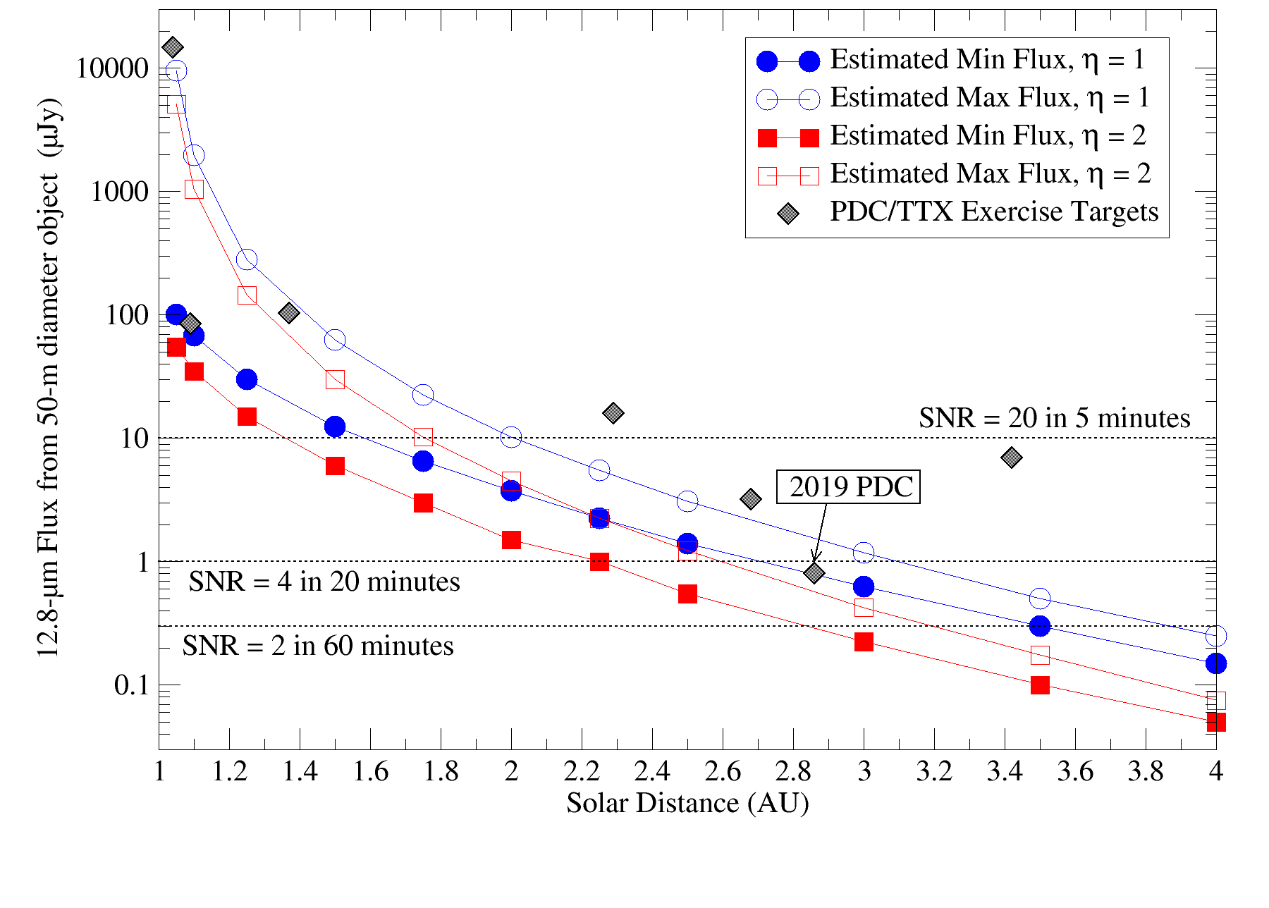
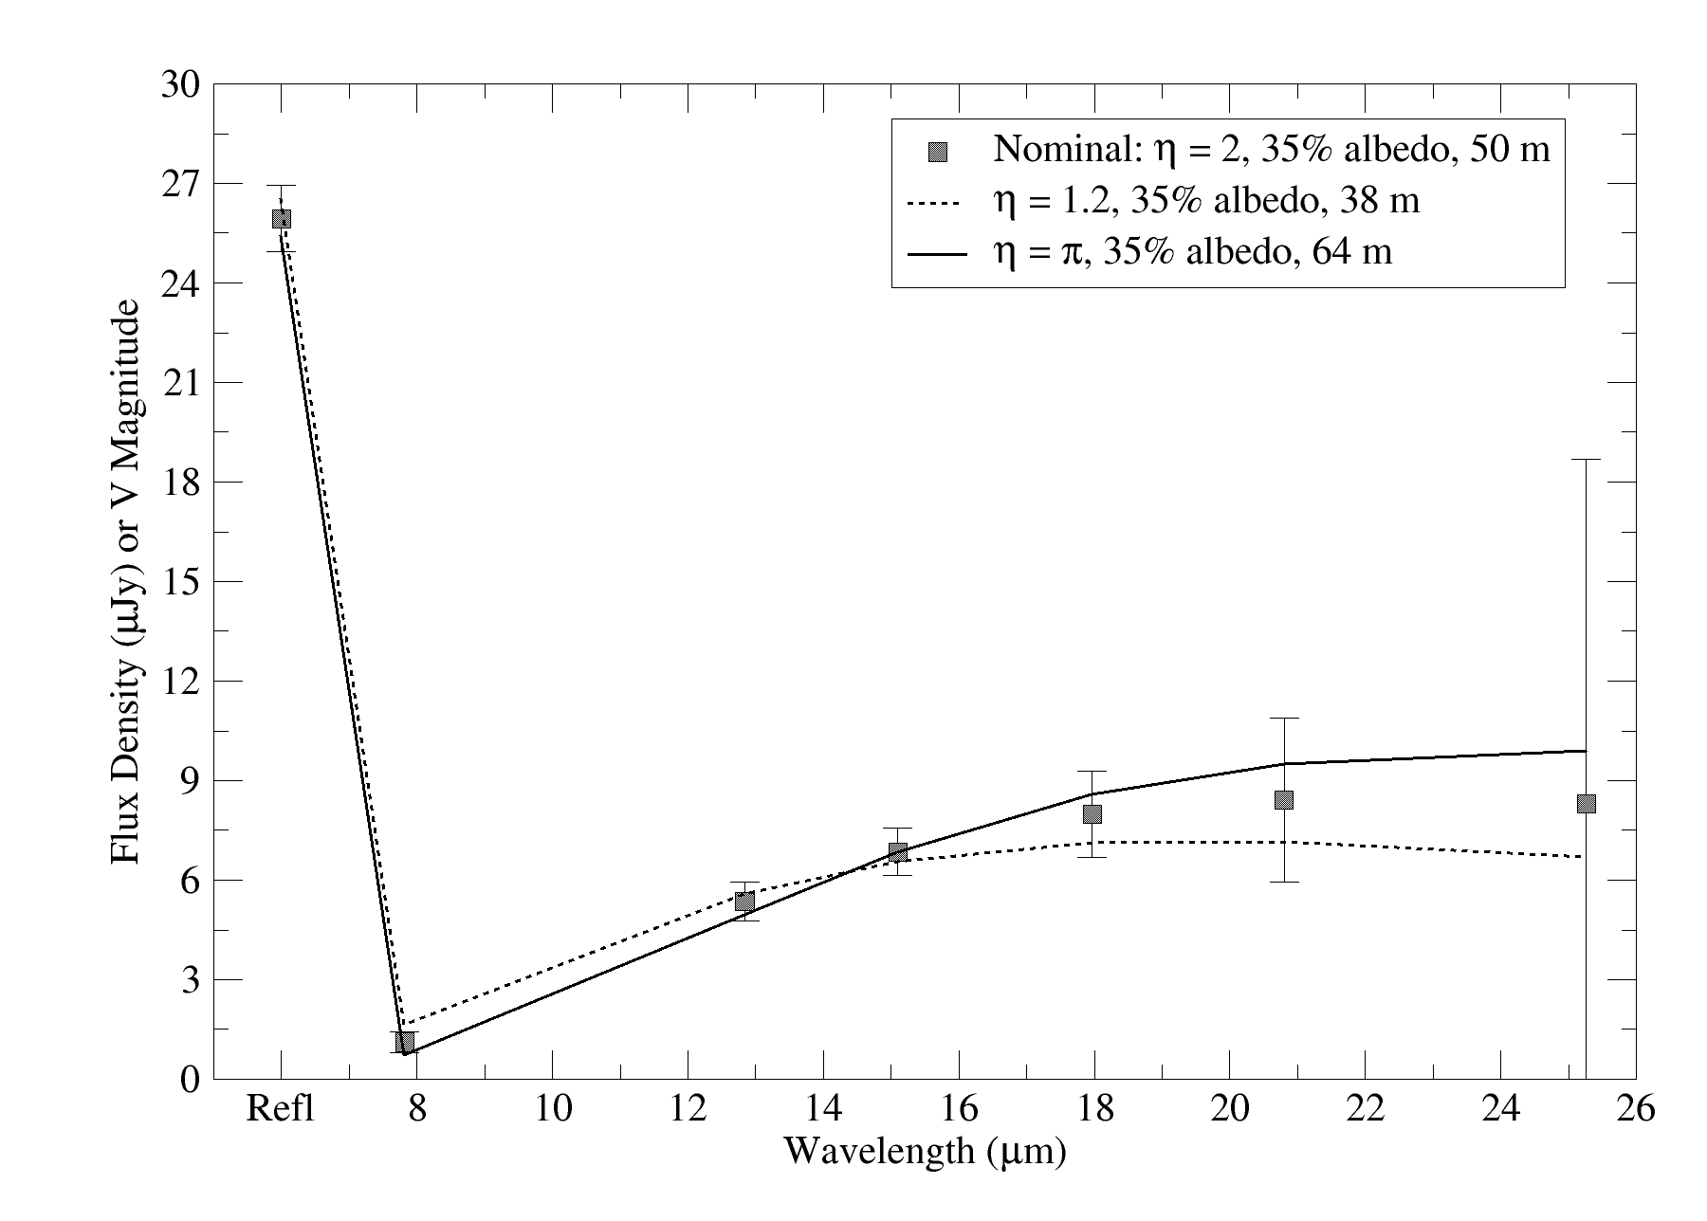
JWST vs. PDC/TTX exercise targets
Modeled the JWST observability of PDC/TTX exercise targets, using the actual launch date of JWST (December 2021) and impactor ephemerides from Horizons
Seven scenarios involved impacts after JWST was launched, all were observable by JWST before impact
The scenarios for the 2013/2014/2016 FEMA exercises, the 2019 PDC comet scenario, and the 2021 PDC scenario all involved impacts occurring before JWST was launched and so were not considered.
But if JWST had been in operation, they could also have been observed
Assumed 20 minute integrations per filter, representative thermal properties. Took SNR from JWST Exposure Time Calculator for modeled fluxes
SNR very high in almost all cases—2019 PDC fragment most difficult case. Observations in first window have SNR ~ 5, but better measurements available in second window, giving months of warning.

Slide 6
JWST vs. Recon Missions for PDC/TTX
Scenario Object | Exercise Discovery Date | Exercise Impact Date | Earliest JWST Observing Window | Exercise mission recon | Availability of JWST vs. mission data | Availability of JWST vs. impact date
2015 PDC (fragment) | 13 April 2015 | 3 September 2022 | 22 April- 8 June 2022 | None* | ∞ | ~3 months
2017 PDC | 6 March 2017 | 21 July 2027 | 26 Sep – Nov 14 2022 | 15 May 2020 | N/A | ~57 months
2019 PDC (intact, fragment) | 26 March 2019 | 29 April 2027 | 26 Aug – 14 Oct 2022 | 29 Dec 2021 | N/A | ~56 months
 |  |  | 14 Sep – 4 Nov 2025 | None | ∞ | ~19 months
2022 TTX | 11 February 2022 | 16 August 2022 | 11 March – 28 April 2022 | None, radar at T-6 days | ∞ | ~5 months
2023 PDC | 10 January 2023 | 22 October 2036 | 28 Nov 2033 – 25 Jan 2034 | 27 Nov 2025 | N/A | ~34 months
TTX 2024 | 4 October 2023 | 12 July 2038 | 4 Oct 2023-19 Feb 2024 | NET Jul 2027 | >44 months | ~175 months
2024 PDC25 | 5 Jun 2024 | 24 Apr 2041 | 5 Jun-3 Nov 2024 | 12 April 2028 | > 41 months | ~200 months

Slide 7
JWST vs. Recon Missions for PDC/TTX
Scenario Object | Exercise Discovery Date | Exercise Impact Date | Earliest JWST Observing Window | Exercise mission recon | Availability of JWST vs. mission data | Availability of JWST vs. impact date
2015 PDC (fragment) | 13 April 2015 | 3 September 2022 | 22 April- 8 June 2022 | None* | ∞ | ~3 months
2017 PDC | 6 March 2017 | 21 July 2027 | 26 Sep – Nov 14 2022 | 15 May 2020 | N/A | ~57 months
2019 PDC (intact, fragment) | 26 March 2019 | 29 April 2027 | 26 Aug – 14 Oct 2022 | 29 Dec 2021 | N/A | ~56 months
 |  |  | 14 Sep – 4 Nov 2025 | None | ∞ | ~19 months
2022 TTX | 11 February 2022 | 16 August 2022 | 11 March – 28 April 2022 | None, radar at T-6 days | ∞ | ~5 months
2023 PDC | 10 January 2023 | 22 October 2036 | 28 Nov 2033 – 25 Jan 2034 | 27 Nov 2025 | N/A | ~34 months
TTX 2024 | 4 October 2023 | 12 July 2038 | 4 Oct 2023-19 Feb 2024 | NET Jul 2027 | >44 months | ~175 months
2024 PDC25 | 5 Jun 2024 | 24 Apr 2041 | 5 Jun-3 Nov 2024 | 12 April 2028 | > 41 months | ~200 months

Slide 8


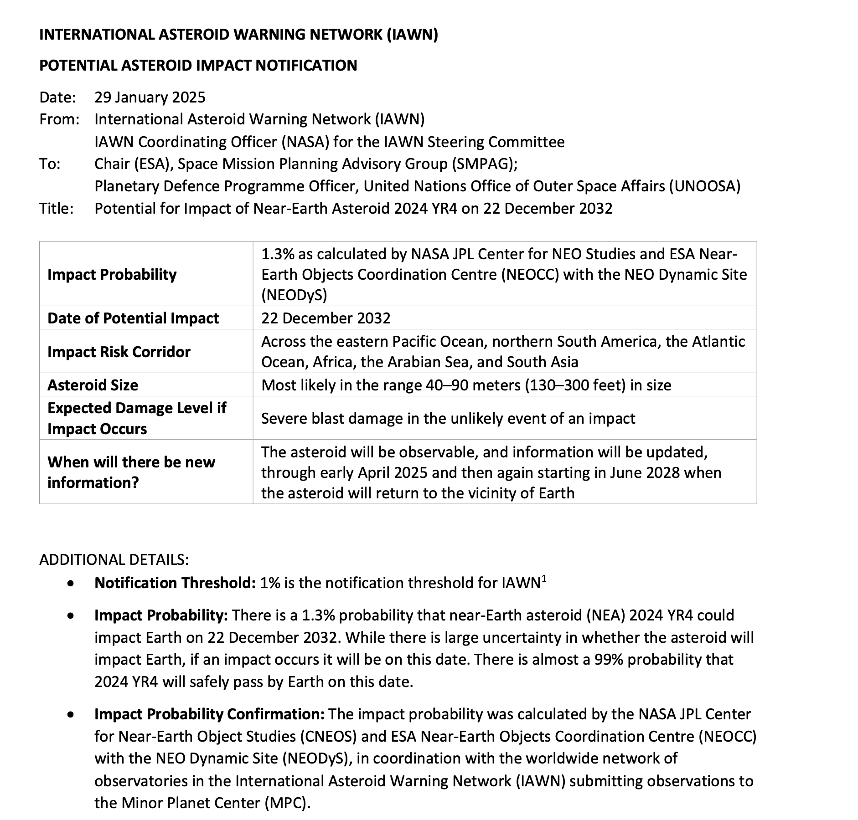
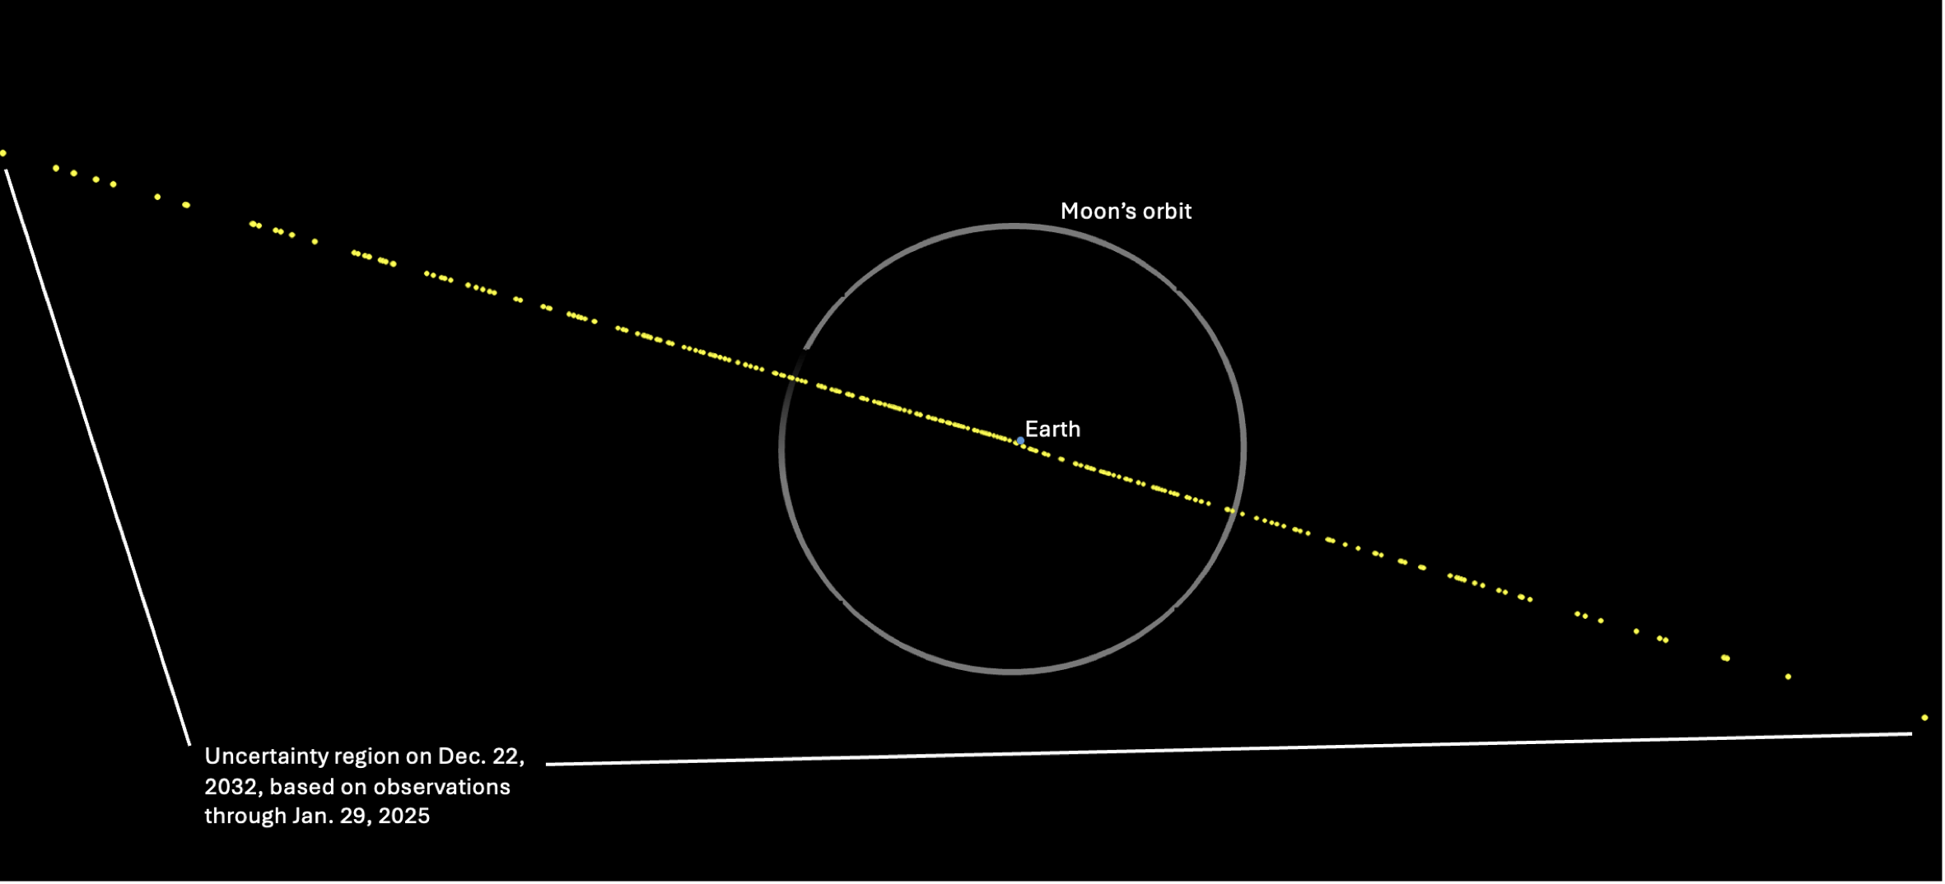
2024 YR4 Background
Discovered 27 December 2024
Possible 2032 impactor, with infrequent observing opportunities
Reached 1% probability of Earth impact, triggering memo from International Asteroid Warning Network
Estimated size range leads to > factor of 10 uncertainty in mass
Estimated size straddles 50-m diameter
Need JWST in order to do better!
2024 YR4 evolution of impact probability

Slide 9
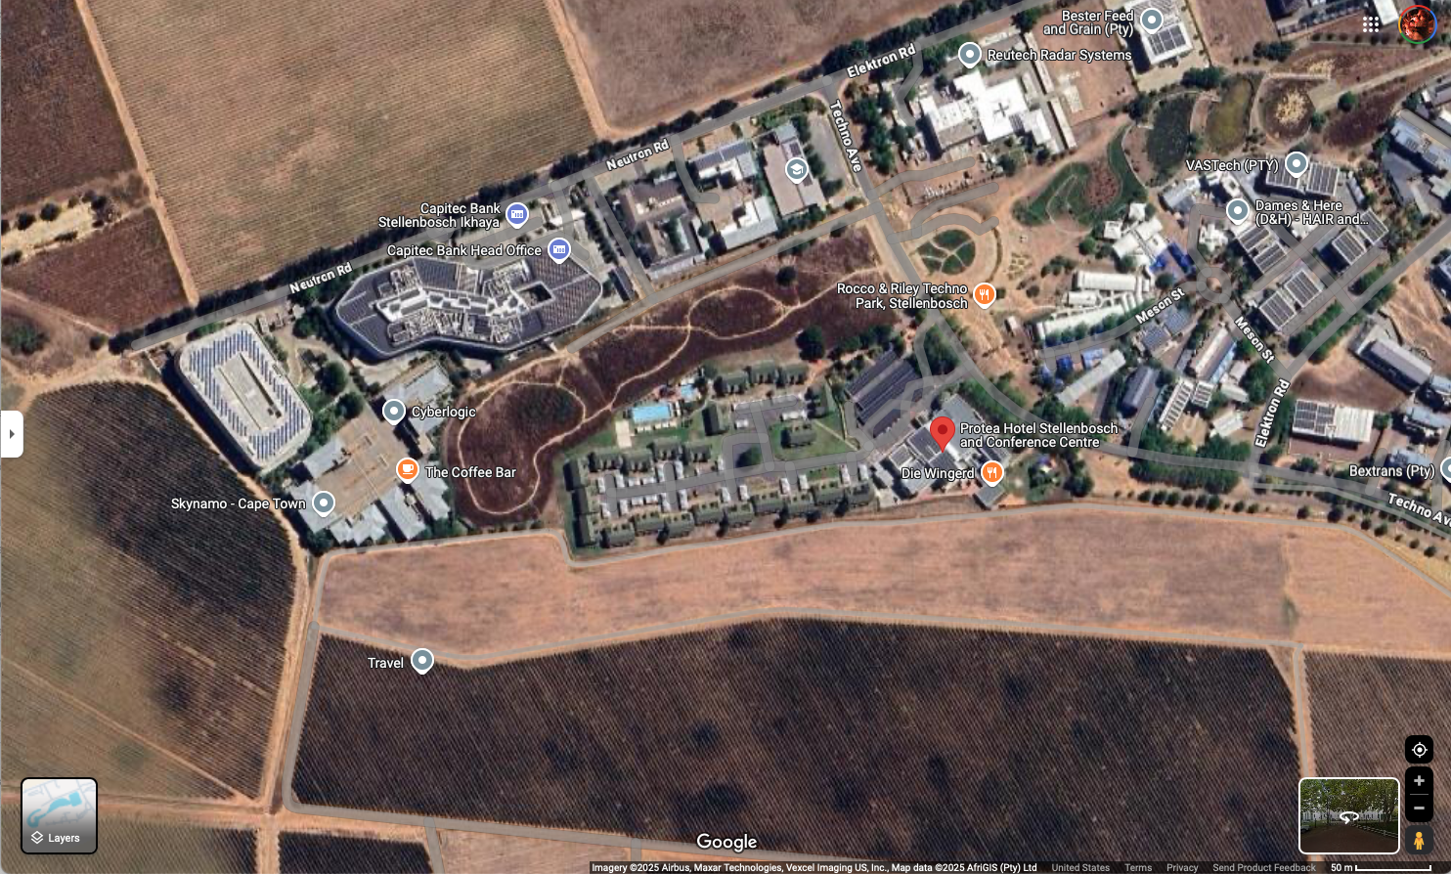

Slide 10
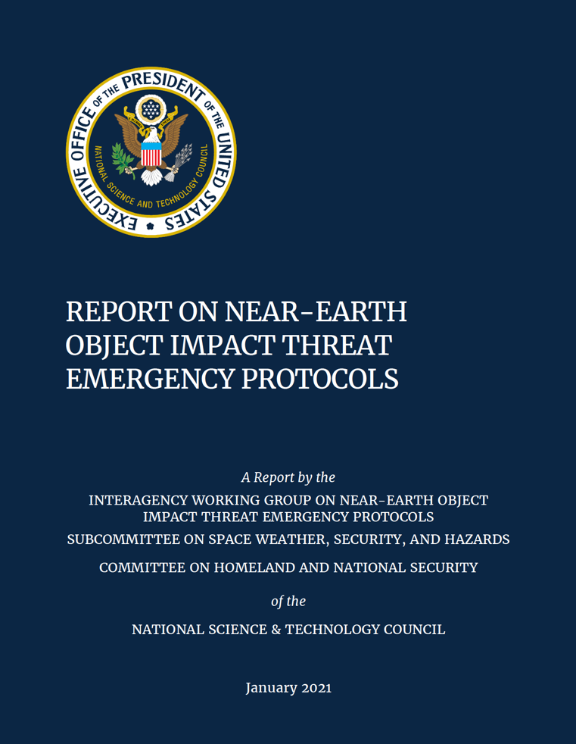
NITEP Benchmark for Recommending Space-Based Reconnaissance
Benchmark | 2024 YR4 | Met?*
Impact within 50 years | Date of potential impact: 12/22/32 | YES
Impact probability >1% | 3.1% (on 2/18/25) | YES
Object >50 meters in size* | 40 – 90 m (IAWN memo) | YES?
Sufficient time to conduct mission prior to predicted impact (>3 yrs) | ~ 8 years | YES

Slide 11
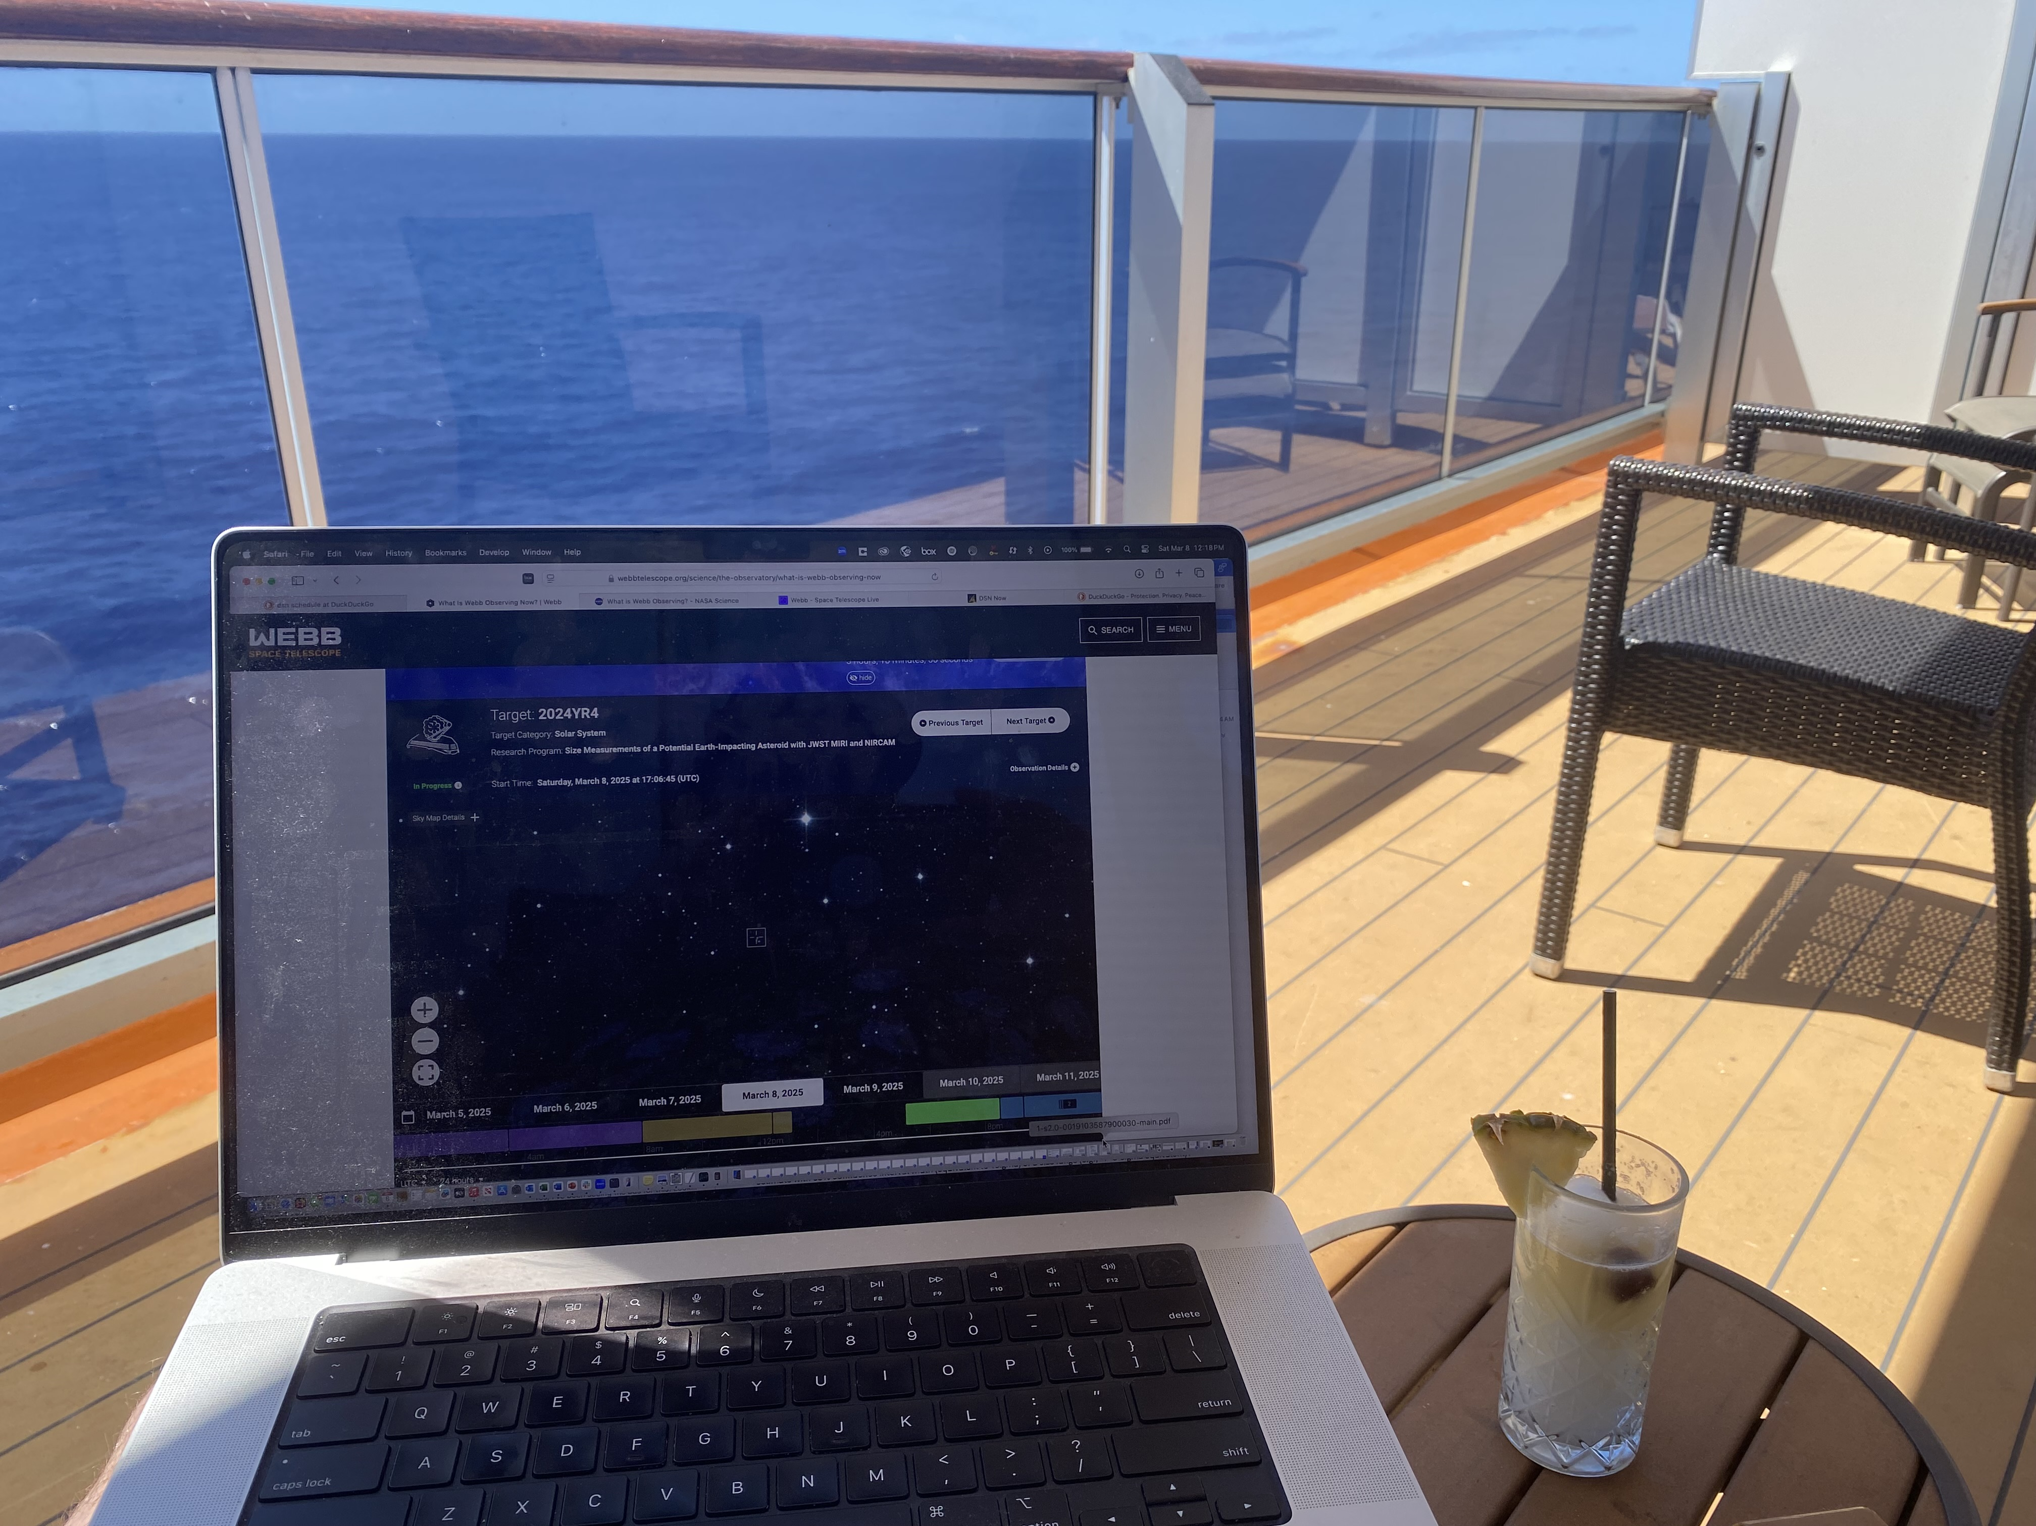
JWST Observations of 2024 YR4
Proposed for Director’s Discretionary Time for mid-IR and near-IR measurements of YR4 with JWST as the impact probability approached 1% in late January
Were able to take advantage of measurements by colleagues providing spin period (and likely composition) for observational design
Proposed most observing to occur in March, with follow-up in May to improve thermal modeling and provide additional positional measurements
Received ~4 hours of observing time (which was 100% of the request) as Program #92939.
YR4 entered JWST’s observing window on 8 March, observations were attempted that day
Monitoring setup for PI, somewhere between Florida and the Bahamas
2024 YR4 evolution of impact probability
Notes:
Task 7: is funded by SVI money.
Success criteria:
1- Meet with Sponsors XYZ.
2- Secure X amount of money for TTX-classified
Define things we can control, and set stretch goals that are out of control (winning money).
Success criteria for IAC and PDC:
Socialize with certain people – and purpose of the meetings: meeting with NASA folks – PDCO.
Who you met with and what valuable conversations could have for the next steps.

Slide 12
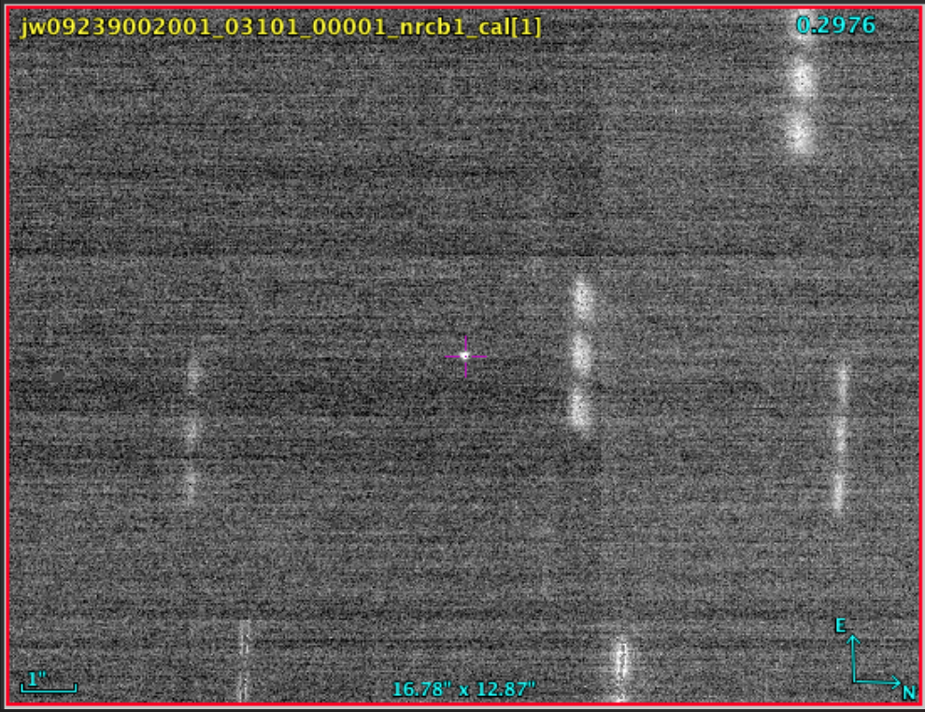
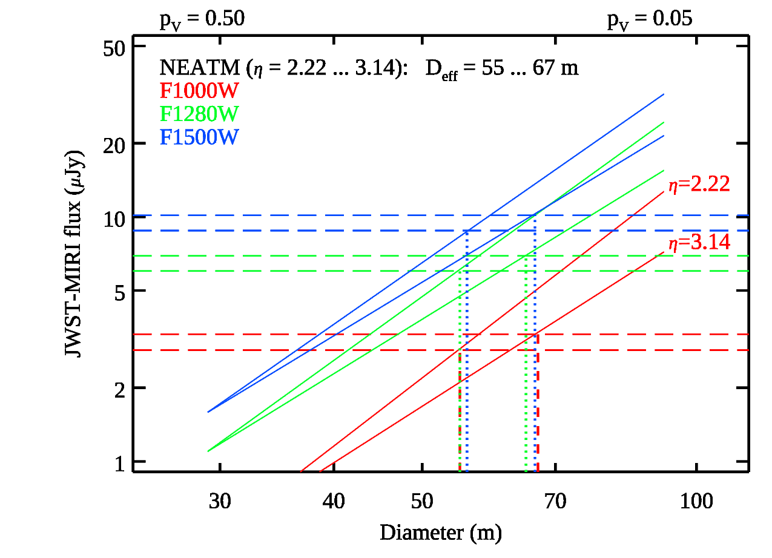
2024 YR4 results
8 March 2025
NIRCam images were successful with 1.5 and 3.2 µm filters
Covered entire rotation period
Lightcurve being extracted
26 March 2025
MIRI observations were unsuccessful on 8 March due to problems acquiring a guide star
MIRI rescheduled to 26 March, along with additional NIRCam data
Results:
SNR limited by calibration uncertainties, not brightness of target
2024 YR4 found to be 60 ± 7 m diameter, ~92% chance of being > 50 m
Thermal properties very unusual, perhaps in part due to being rapid spinner? Consistent with lack of dusty/sandy regolith
Publication
Memo submitted to International Asteroid Warning Network ~30 hours after data received on ground
Submitted to Research Notes of the AAS ~24 hours later
Submitting astrometry to Minor Planet Center to improve orbit
Team working on peer-reviewed papers
2024 YR4 evolution of impact probability
Notes:
Task 7: is funded by SVI money.
Success criteria:
1- Meet with Sponsors XYZ.
2- Secure X amount of money for TTX-classified
Define things we can control, and set stretch goals that are out of control (winning money).
Success criteria for IAC and PDC:
Socialize with certain people – and purpose of the meetings: meeting with NASA folks – PDCO.
Who you met with and what valuable conversations could have for the next steps.

Slide 14
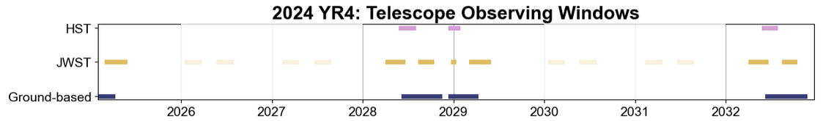
2024 YR4: Next Steps
Our last hours of Cycle 3 DDT time are coming up shortly
We expect the likelihood of a lunar impact in 2032 to remain ~3-4% after those observations
YR4 is a faint (V ~ 30) target in early 2026—possible if difficult from JWST, could establish whether it will hit the Moon or not
Ideally a program would be formally established setting a trigger for JWST to observe potential impactors
Working on paper describing how best to use JWST for planetary defense purposes
Positional measurements were a ”nice-to-have” for these observations, but may be a key JWST capability
Need to optimize dithers, timing to allow observations on particular star field backgrounds

Slide 15
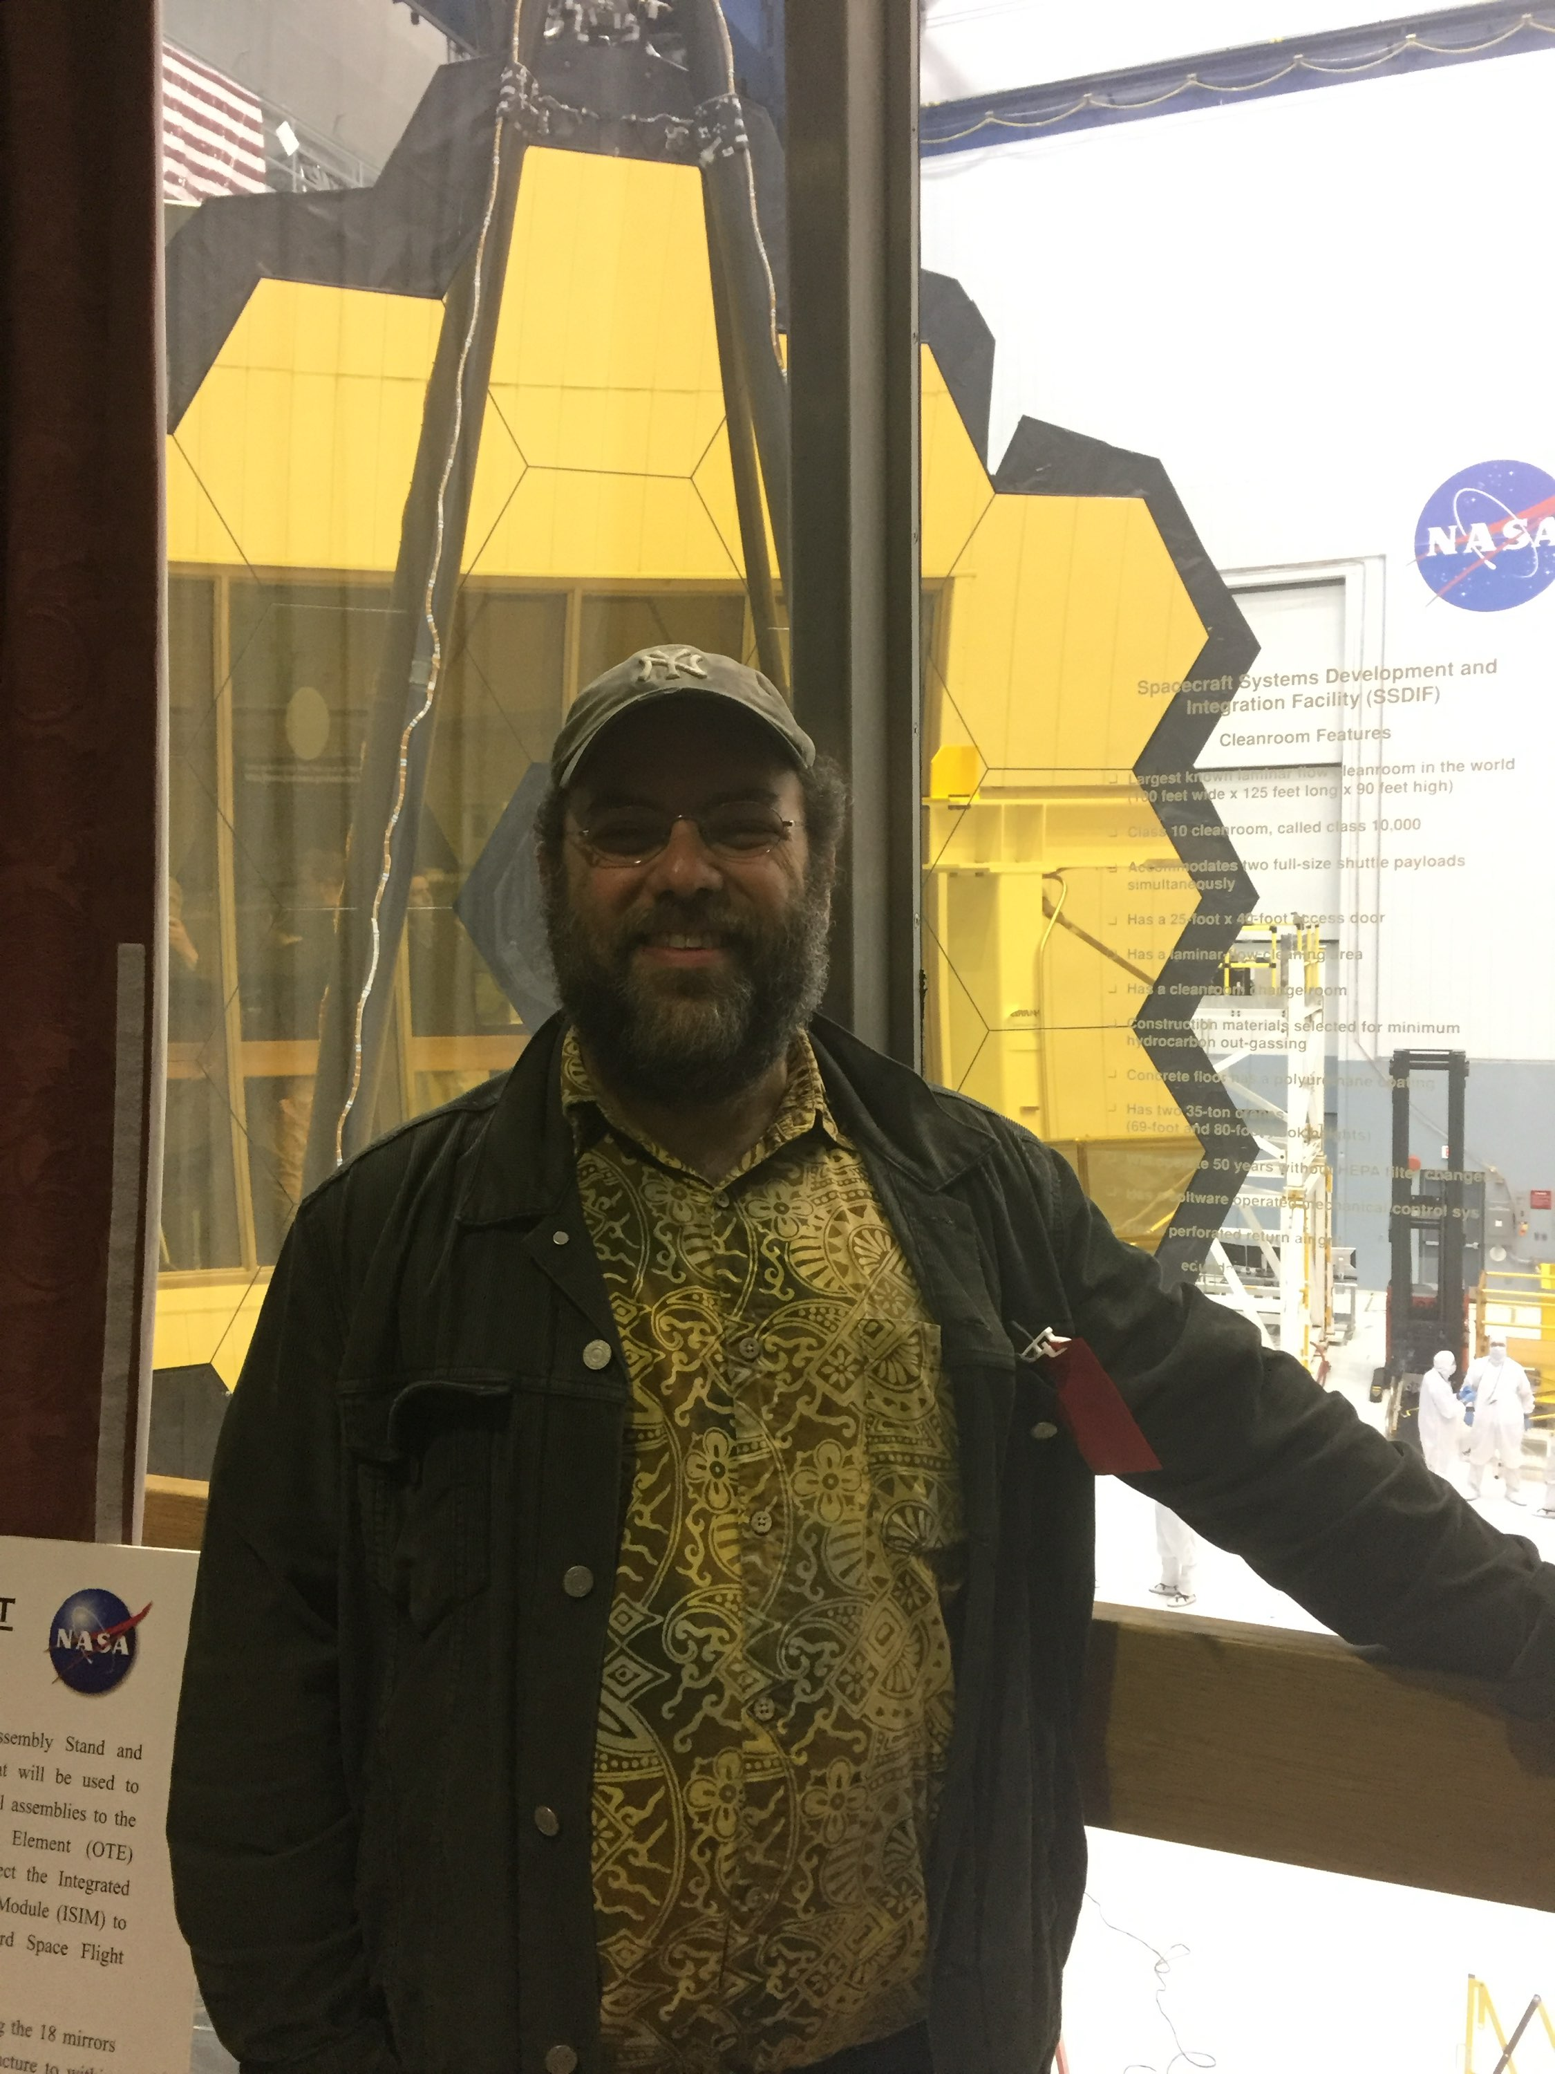
Conclusions
In scenario cases and the real-life case of 2024 YR4, JWST observations can quickly provide good size measurements or constraints for objects of interest
Still determining best ways to design astrometric observations for NEOs, but gained valuable experience with YR4
YR4 observations took advantage of complementary ground-based lightcurve and spectroscopic measurements
Won’t necessarily always be available
A nominal amount of JWST observing time (~10 hours or less) can do a tremendous amount of good in characterizing a potential impactor
Recommend the JWST stakeholders set a threshold trigger for use of JWST similar (in content or spirit) to the IAWN/SMPAG thresholds
Note that the trigger for JWST must be set at H < 26, because in most cases it will be the facility measuring the actual size
Estimate roughly ~1% chance of trigger occurring each year

Slide 16
Backups

Slide 17
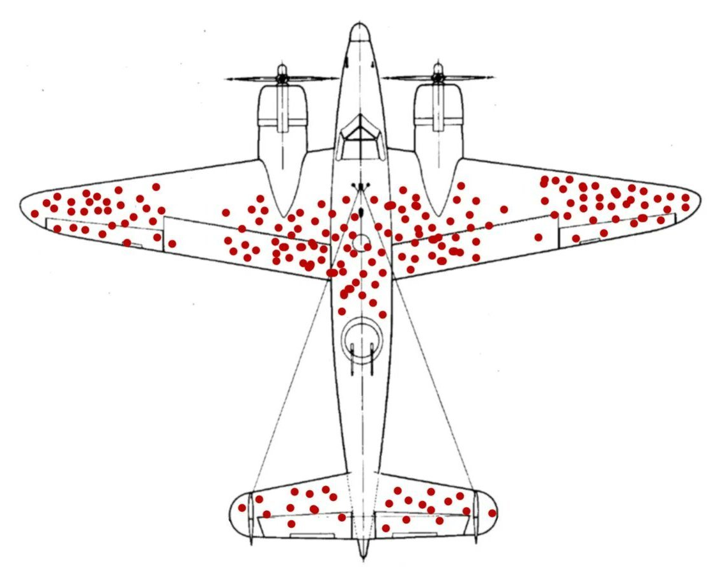
What is the JWST proposal process like?
Dual Anonymous
Planetary (non-exoplanet) proposals go to single TAC panel, available hours for each subdiscipline depends on proposal pressure
Proposals divided by time requested:
Large (>75 hours) go to separate TAC
Medium (25-75 hours) have separate pool of hours to start
Small (10-25) hours make up largest number of proposals; Very small (< 10 hours) only go to external reviewers
Proposals must go through “Astronomers’ Proposal Tool” (APT), with numbers vetted in the Exposure Time Calculator (ETC)
Both have a learning curve, but both are very flexible
This generates non-narrative parts of proposal
Proposal text covers science justification and technical justification
Proposals are reviewed on:
Importance to field
“Out of field” importance
Suitability for JWST
IYKYK

Slide 18
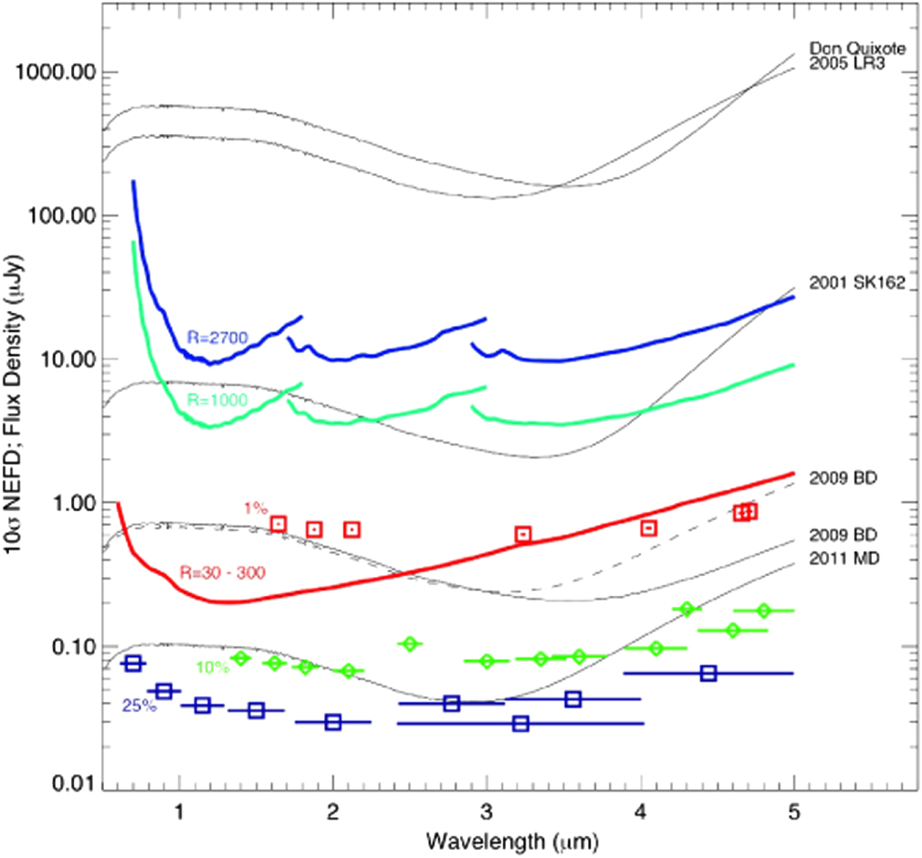
JWST as a Planetary Defense asset
1000 sec integration
Regardless of how JWST is/isn’t used for Apophis, should take its capabilities into account for PD purposes
Can be scheduled for targets of opportunity with no overhead penalty with 2 week lead time, less lead time with additional overhead
Can greatly reduce size uncertainties and provide early, comprehensive characterization
See Thomas et al. (2016) in PASP for more details of using JWST for NEO observations
~5-m diameter objects
Thomas et al. (2016)

Slide 19
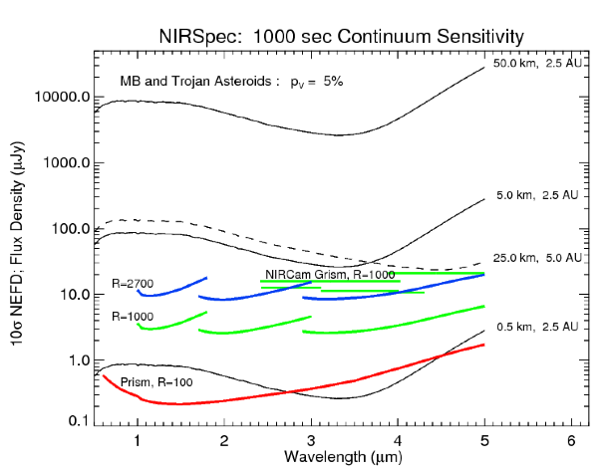
What are JWST’s capabilities?
6.5-m telescope at Sun-Earth L2
Instruments cover 0.6-28.3 µm:
NIRCam: 0.6-5 µm imaging (0.07” at 2 µm)
NIRSpec: 0.6-5 µm spectroscopy at a variety of spectral resolutions
MIRI: 5-27 µm imaging and spectroscopy at a variety of spectral resolutions
NIRISS: 0.8-5 µm imaging (0.11” per pixel) and spectroscopy
Extremely sensitive!
Can get wavelengths that are difficult/impossible to get from surface of Earth
Stars represent Apophis in March 2028

Slide 20
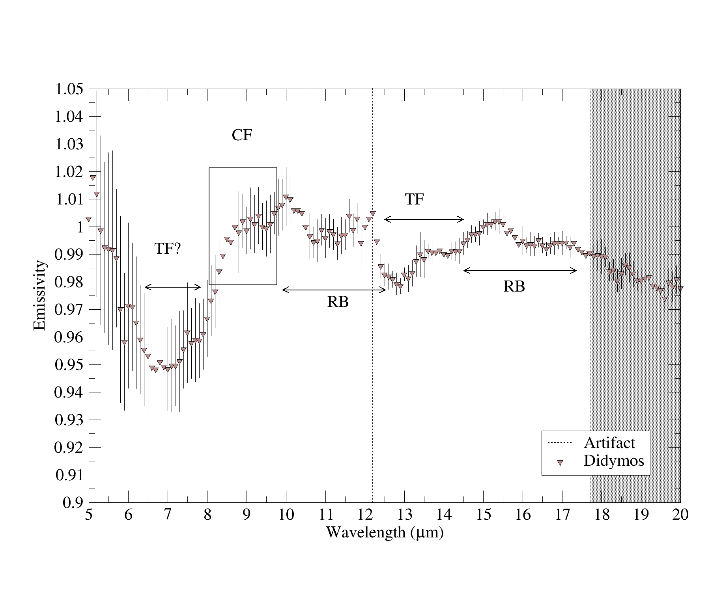
What are JWST’s capabilities?
6.5-m telescope at Sun-Earth L2
Instruments cover 0.6-28.3 µm:
NIRCam: 0.6-5 µm imaging (0.07” at 2 µm)
NIRSpec: 0.6-5 µm spectroscopy at a variety of spectral resolutions
MIRI: 5-27 µm imaging and spectroscopy at a variety of spectral resolutions
NIRISS: 0.8-5 µm imaging (0.11” per pixel) and spectroscopy
Extremely sensitive!
Can get wavelengths that are difficult/impossible to get from surface of Earth
Didymos with MIRI (Rivkin et al. 2023) ~11 minute integration. Similar to Apophis geometry in late February 2029

Slide 21
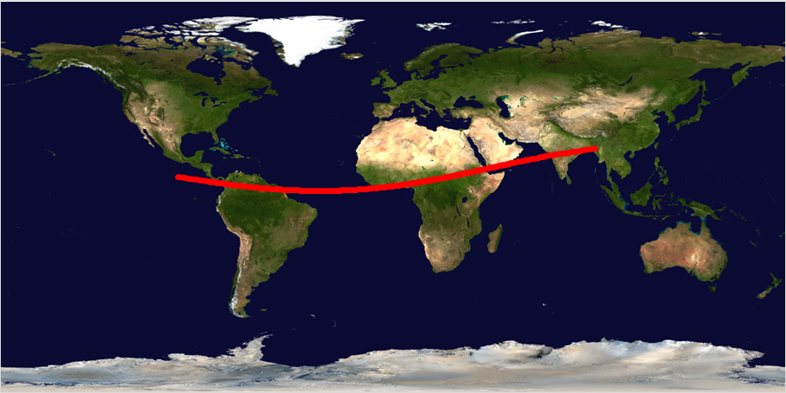
2024 YR4 – Impact Risk Corridor
Source: Sky & Telescope,
provided by German astronomer Daniel Bamberger [Northolt Branch Observatories]

Slide 22
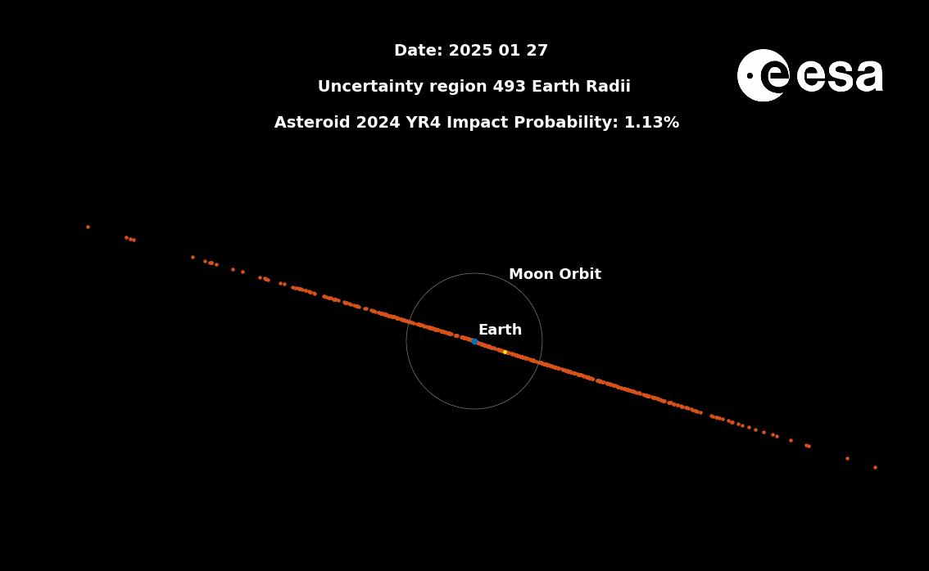
Evolution of 2024 YR4 Impact Probability
2024 YR4 evolution of impact probability

