Slide 1
Apophis Cratering and Deflection Experiment
Kevin J. Walsh & Viliam Klein (SwRI)
And
Ethan Kayser, Jeff Parker (Advanced Space)

Slide 2
Bottom line - up front
The presence of OSIRIS-APEX means that Apophis will be among the best studied asteroids
Its mass will be known to great precision
A highly capable spacecraft will be present as an observer

Slide 3
Bottom line - up front
The presence of OSIRIS-APEX means that Apophis will be among the best studied asteroids
Its mass will be known to great precision
A highly capable spacecraft will be present as an observer
An Apophis Cratering Experiment (ACE), launching in late 2029 or 2030 could achieve:
Large cratering experiment observed by an excellent observer (APEX)
Excellent momentum enhancement measurement

Slide 4
This is not DART – here is why
We are impacting a larger target – a rubble pile.
We are not hitting a satellite of a larger asteroid (its still uncertain how the satellites form and their structure relative to their primary)

Slide 5
This is not DART – here is why
We are impacting a larger target – a rubble pile.
We are not hitting a satellite of a larger asteroid (its still uncertain how the satellites form and their structure relative to their primary)
This is a cratering event.
DART likely re-shaped Dimorphos

Slide 6
This is not DART – here is why
We are impacting a larger target – a rubble pile.
We are not hitting a satellite of a larger asteroid (its still uncertain how the satellites form and their structure relative to their primary)
This is a cratering event.
DART likely re-shaped Dimorphos
This experiment is designed to have very precise pre-impact mass and shape of the target

Slide 7
This is not DART – here is why
We are impacting a larger target – a rubble pile.
We are not hitting a satellite of a larger asteroid (its still uncertain how the satellites form and their structure relative to their primary)
This is a cratering event.
DART likely re-shaped Dimorphos
This experiment is designed to have very precise pre-impact mass and shape of the target
Because APEX and RAMSES are there already – we have great observers to study the crater, its evolution and at a lower cost than a dedicated impact+observer mission

Slide 8
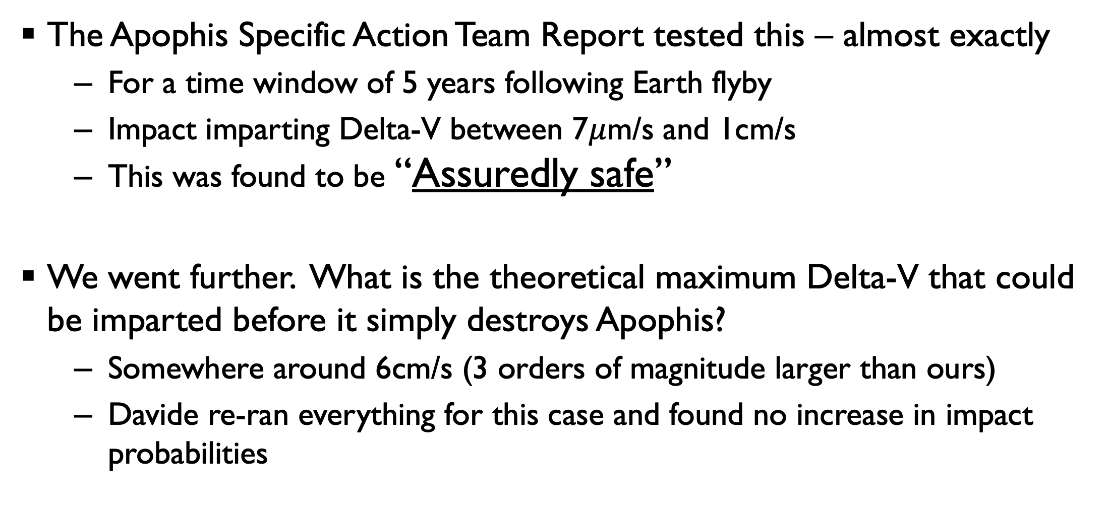
This will NOT increase Apophis impact risk
The Apophis Specific Action Team Report tested this – almost exactly
For a time window of 5 years following Earth flyby
Impact imparting Delta-V between 7$μ$m/s and 1cm/s
This was found to be “Assuredly safe”
We went further. What is the theoretical maximum Delta-V that could be imparted before it simply destroys Apophis?
Somewhere around 6cm/s (3 orders of magnitude larger than ours)
Davide re-ran everything for this case and found no increase in impact probabilities

Slide 9
Three big science objectives
Crater scaling relationships – essential for surface chronology
Rubble pile subsurface properties – looking meters deep
Momentum enhancement via impact – Planetary Defense concerns

Slide 10
Three big science objectives
Crater scaling relationships – essential for surface chronology
How does an S-type rubble pile respond to this higher energy impact?
Rubble subsurface properties – looking deeper than 1m
Are there differences in the near-subsurface between S- and C-type asteroids?
Momentum enhancement via impact – Planetary Defense concerns
Is the momentum enhancement the same for a simple cratering event (ACE) compared to a large, re-shaping event (DART)?
Does a large rubble pile (Apophis) respond the same way as a smaller satellite that likely formed in a different way (Dimorphos)

Slide 11
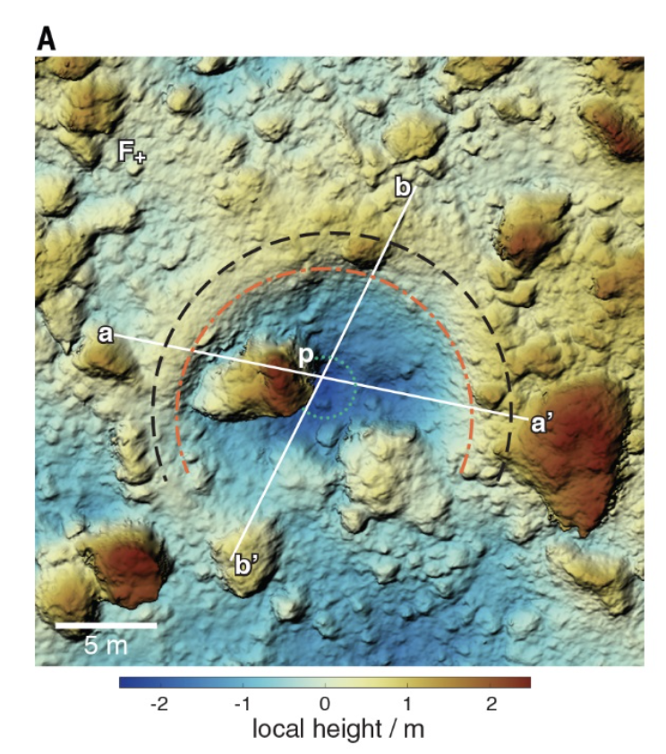
Requirements
Measureable* Delta-V ~0.01mm/s
A 65 kg impactor at 7km/s produces 0.01mm/s (with no enhancement)
Observable crater (which is certain with the impact energy to produce Delta-V)
20-50m diameter crater, 3-7.5m deep
SCI (JAXA) was 14m and 2m deep
OREx TAG event 8m and 70cm deep
The SCI artificial crater formed at NEA Ryugu as part of the Hayabusa2 mission. It used a 2kg impactor at 2km/s. See Arakawa et al. 2020.
*see Farnocchia et al. 2021 Fig 4
Notes:
35kg impactor

Slide 12
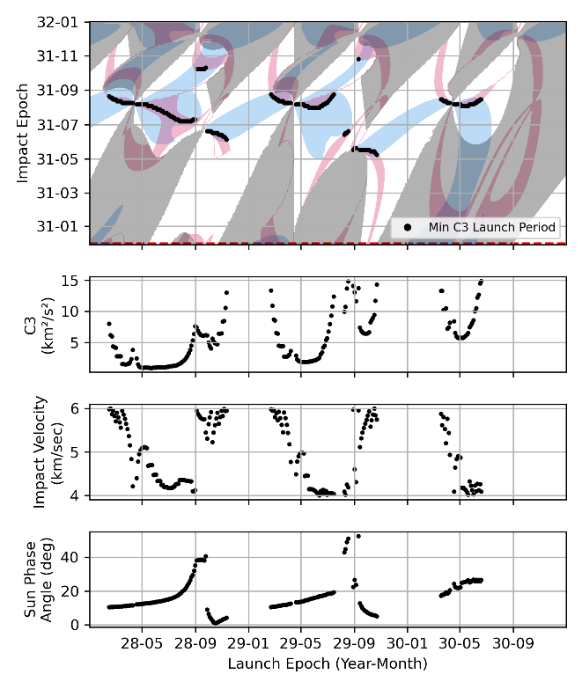
Launch windows and requirements
Advanced Space assisted in a first-order search for launch windows
Requirements:
Impact speed > 5km/s
Impact date after November 2030
Impact lighted side
Optimizations
Launch C₃
Launch date

Slide 13
Launch windows and requirements
Two good epochs
Launch Feb-April 2030 – impact December 2030 at 6-7km/s
Only 2-6 km2/s2 launch energy required
Launch Oct 2029-March 2030 – impact Jun-July 2031 at 8-11km/s
5-15 km2/s2 launch energy required

Slide 14
Avenues for optimizations
Numerous further avenues remain for optimizing and lowering launch energy
Utilizing JANUS for an impactor and additional flyby observer
Similar launch windows and requirements
Resonant encounters for “practice” runs
Numerous 1:1 resonant encounters in 2029-2030
Launch April-19-2029 with C3=2.71
1st encounter June-9-2030 at 4.59km/s
2nd encounter August-6-2031
3rd encounter October-2-2032

Slide 15
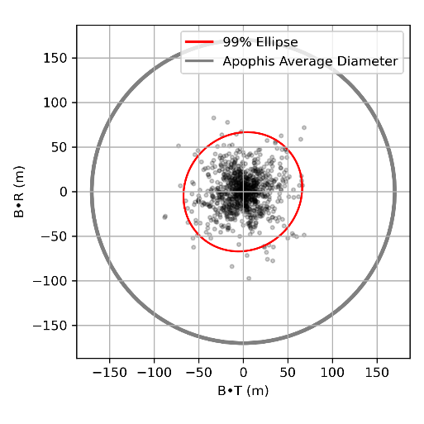
Targeting uncertainty
The extreme precision of the Apophis ephemerides is highly advantageous
Modeling Trajectory Course Maneuvers (TCM)
TCMs at 30,15,10, 5 days out and then a variable test for final TCM 1-24hrs
Repeated for various navigation errors and final TCM timing
Finds that for final TCM at 20hrs, navigation and velocity uncertainty 10cm and 10cm/s achieve impact 99%
Notes:
These preliminary results suggest that the navigation position uncertainty for the final-TCM must be less than 100 km to achieve an impact covariance ellipse smaller than Apophis’ average diameter, even with velocity uncertainty of 0.1 cm/s. With the best navigation case, 10 km and 10 cm/s, the 99% impact ellipse is smaller than Apophis’ average diameter when the final TCM is executed within 20 hours before impact. An impact ellipse with a diameter of <40 meters is achievable if the final TCM is executed just 1-hour prior to impact. While this simplified analysis sets preliminary bounds for the navigation and maneuver

Slide 16
Conclusions
ACE is not at odds with precursor mission concepts – this has different, but overlapping, science and Planetary Defense goals
And relies on/has synergy with APEX and RAMSES
ACE offers a long runway for development and launch!
launch opportunities in 2030
ACE could significantly advance cratering science and the understanding of momentum enhancement in a small and affordable mission

Slide 17
Chronology & surface ages
Using crater populations to estimate surface ages requires
Impact flux (how many things of different sizes will hit a surface)
Crater scaling (how big a crater each impactor will make)

Slide 18
Chronology & surface ages
Using crater populations to estimate surface ages requires
Impact flux (how many things of different sizes will hit a surface)
Crater scaling (how big a crater each impactor will make)
Particularly critical for km-sized rubble piles
For example: “Strength” based crater scaling predicts 100-1000Myr age of Bennu.
“Gravity” based crater scaling predicts <65Myr age.
“Armoring” due to surface boulders larger than impactors can alter things
SCI artificial impactor provides an anchor point at relatively small crater sizes
Here, we increase by nearly an order of magnitude in size and depth.

Slide 19
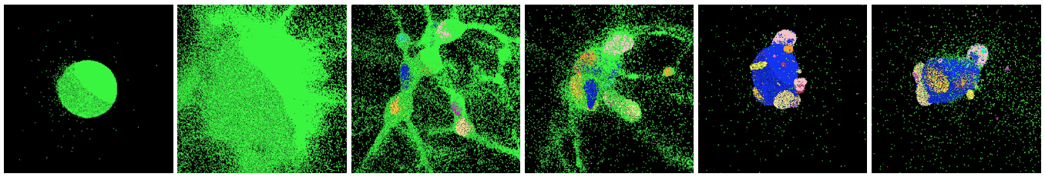
Apophis – rubble pile
Apophis is likely a “typical” rubble pile asteroid, reaccumulated from debris following the catastrophic disruption of a larger body in the Main Belt
Michel and Richardson 2013

Slide 20
Apophis – rubble pile
Apophis is likely a “typical” rubble pile asteroid, reaccumulated from debris following the catastrophic disruption of a larger body in the Main Belt
Many questions exist regarding the inside of rubble piles with implications for planetary defense and asteroid science in general
Stratification or layering of small particles at the near-surface
Internal density/porosity gradients
Existence and numbers of large, substantial, blocks

Slide 21
How deeply have we explored rubble piles?
Answer: about a meter (into C-types)
Small Carry-on Impactor (Hyb2) with a deployable camera observing
~14m diameter crater
TAG event for OSIRIS-REx released high-pressure gas into Bennu’s subsurface
~10m diameter crater
The SCI artificial crater formed at NEA Ryugu as part of the Hayabusa2 mission. It used a 2kg impactor at 2km/s. See Arakawa et al. 2020.

Slide 22
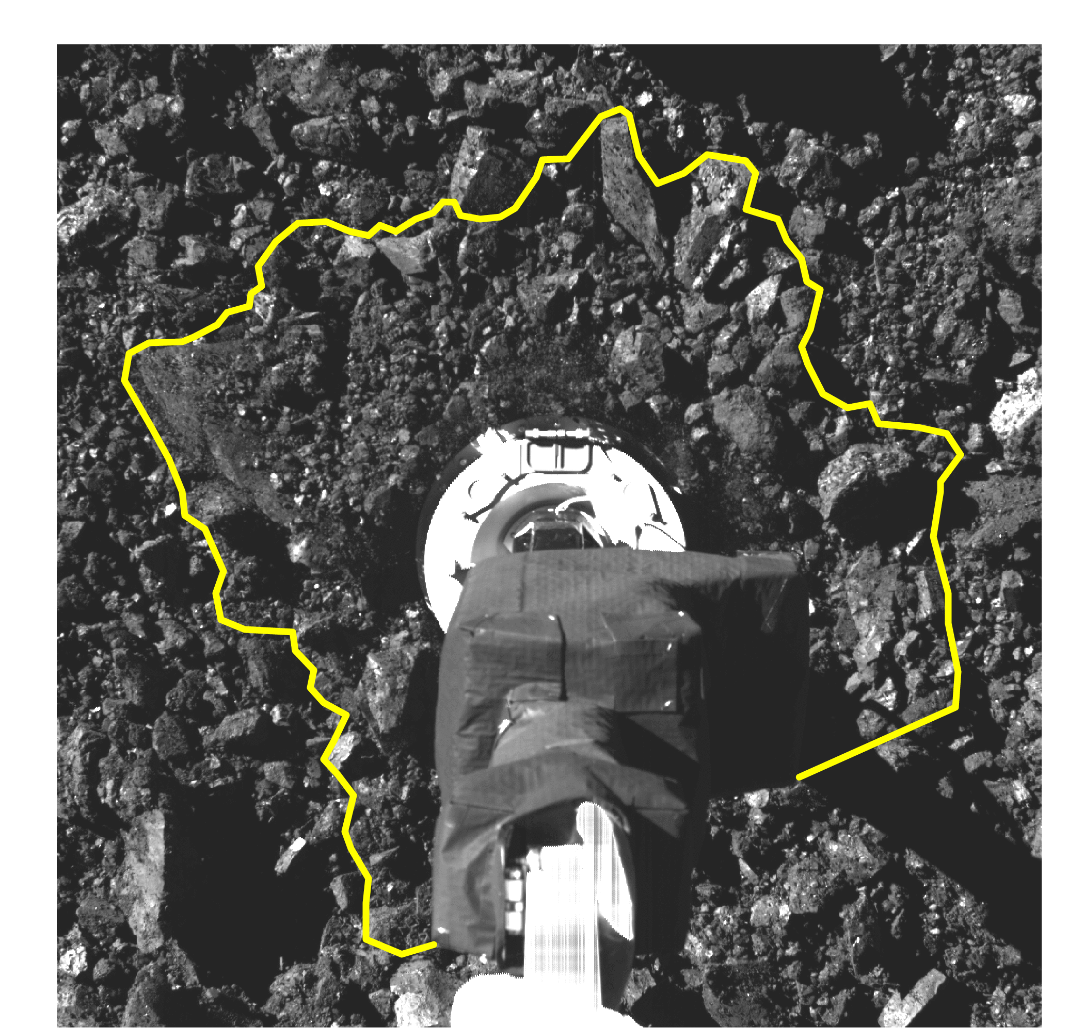
How deeply have we explored rubble piles?
Answer: about a meter (into C-types)
Small Carry-on Impactor (Hyb2) with a deployable camera observing
~14m diameter crater
TAG event for OSIRIS-REx released high-pressure gas into Bennu’s subsurface
~10m diameter crater
Near-subsurface (~1m) is super weak, and likely much more porous than the bulk body.
Both asteroids have suggestions of increasing strength with depth (Arakawa+2020, Daly+2022, Bierhaus+2022)
Walsh et al. 2022; Ballouz et al. 2021

Slide 23
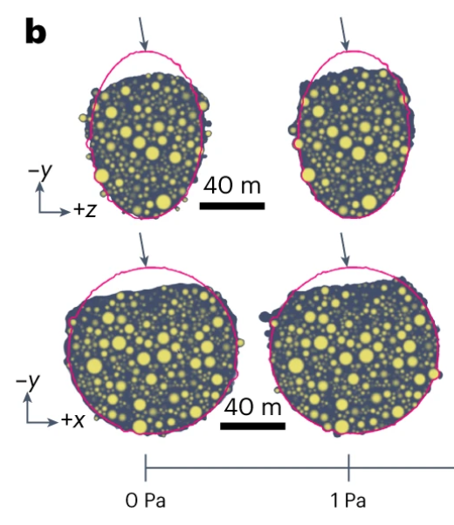
How deeply have we explored rubble piles?
Answer: about a meter (into C-types)
Small Carry-on Impactor (Hyb2) with a deployable camera observing
~14m diameter crater
TAG event for OSIRIS-REx released high-pressure gas into Bennu’s subsurface
~10m diameter crater
Re-shaped Dimorphos (S-type)
DART impact likely changed the global shape of Dimorphos! Hera will see…
Raducan+2024 find that DART likely re-shaped Dimoprhos, agreeing with lightcurve observations

Slide 24
Deflection experiment
OSIRIS-APEX is planning to measure the mass of Apophis to 1%
It also has the capability to detect change in velocity below 0.01mm/s
(0.004mm/s 1-sigma; Farnocchia et al. 2021)
This will be a cratering impact and not a re-shaping impact
Crater on order 50m.
Combined this is a very precise deflection experiment with before/after study of the target by a very capable observer

