Slide 1

RAMSES – Rapid Apophis Mission for SpacE Safety
P. Michel (CNRS, OCA), M. Lazzarin (Padova Univ.)
M. Küppers (ESA)
P. Martino (ESA)
Notes:
DO WE PUT NAMES ON THIS FIRST SLIDE OR NOT?

Slide 2
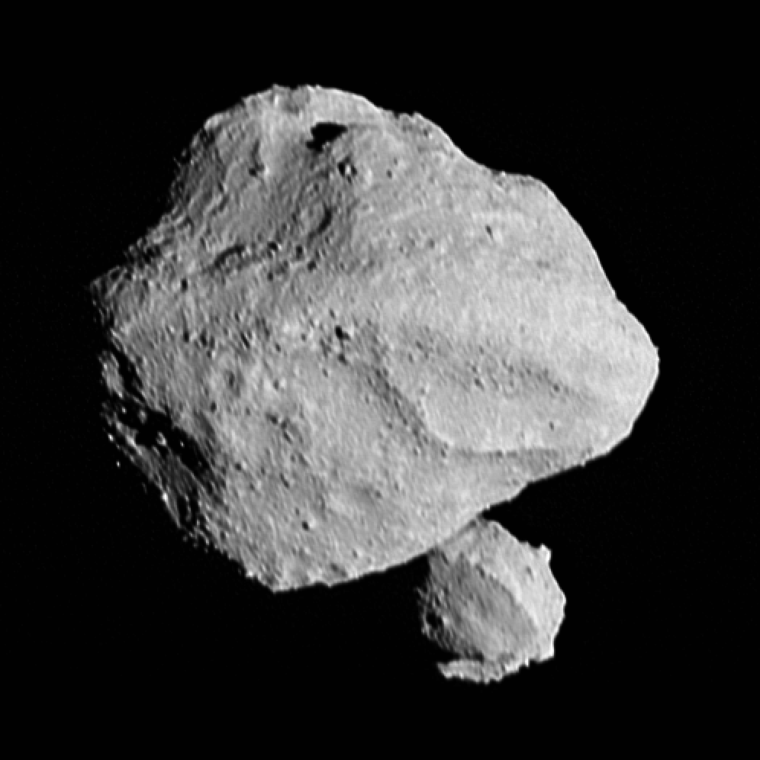
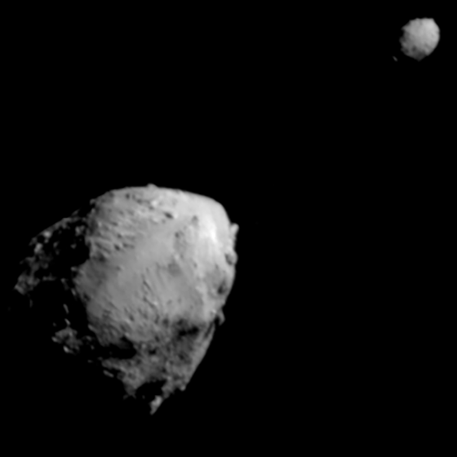
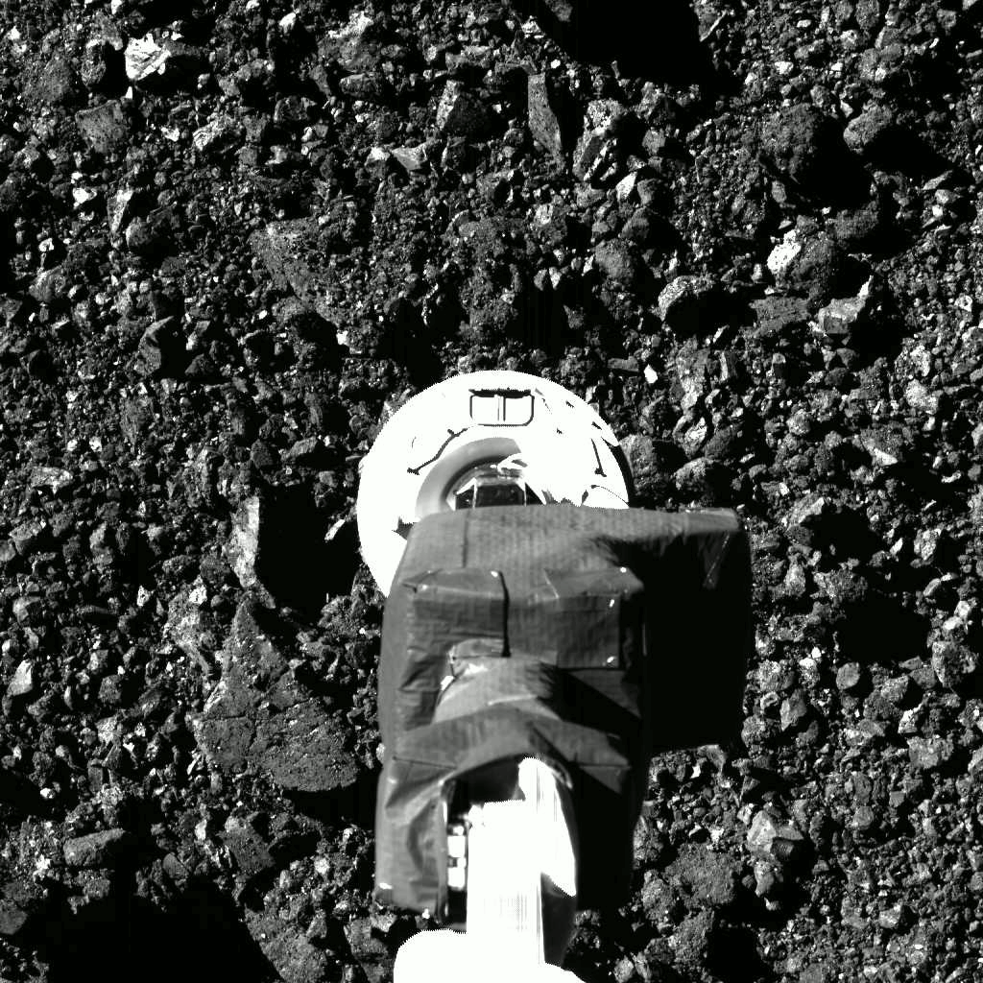
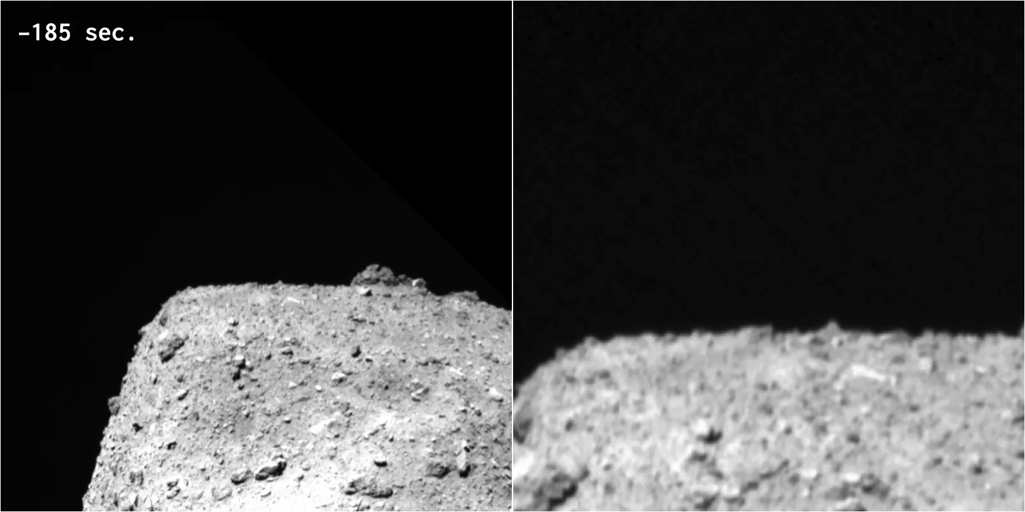
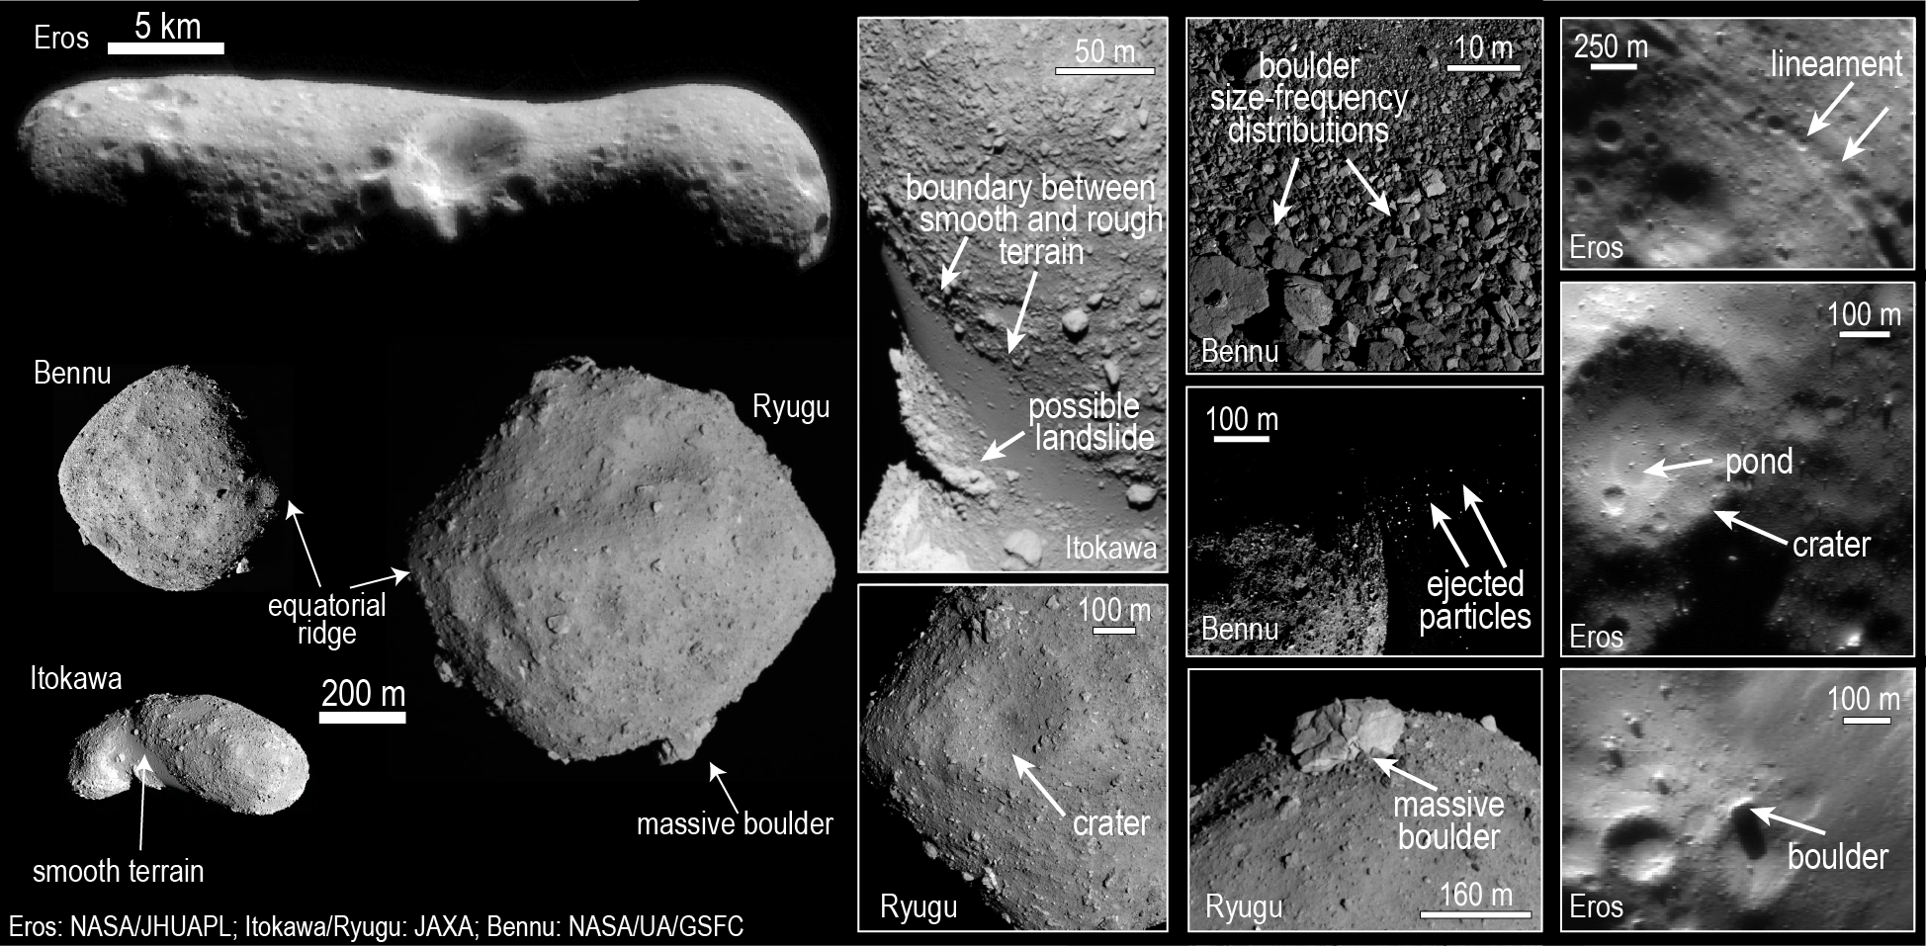


Slide 3
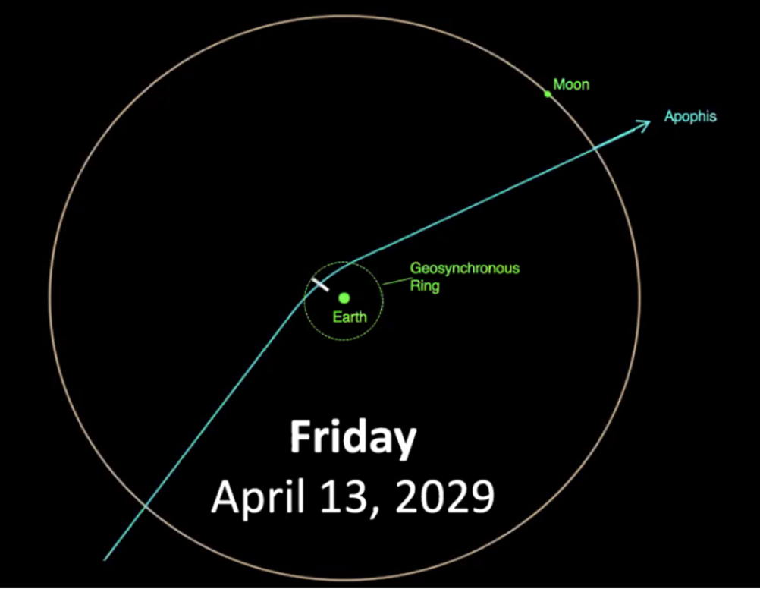
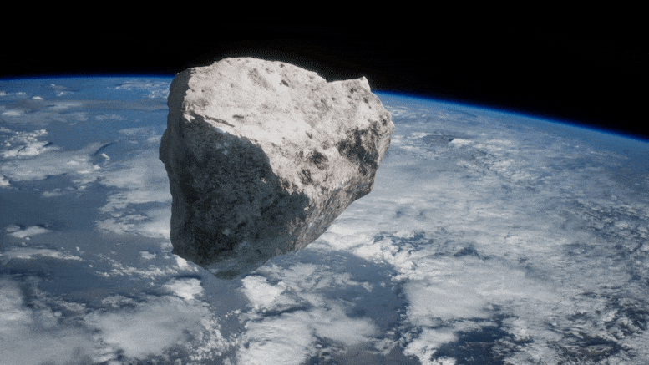
Apophis (D~340 meters)
In 2029, nature does the job for us: once-in-a-lifetime planetary defense opportunity to observe the response of an asteroid to a natural force!
2029 will be International Year of asteroid awareness and planetary defense (UN resolution)

Slide 4

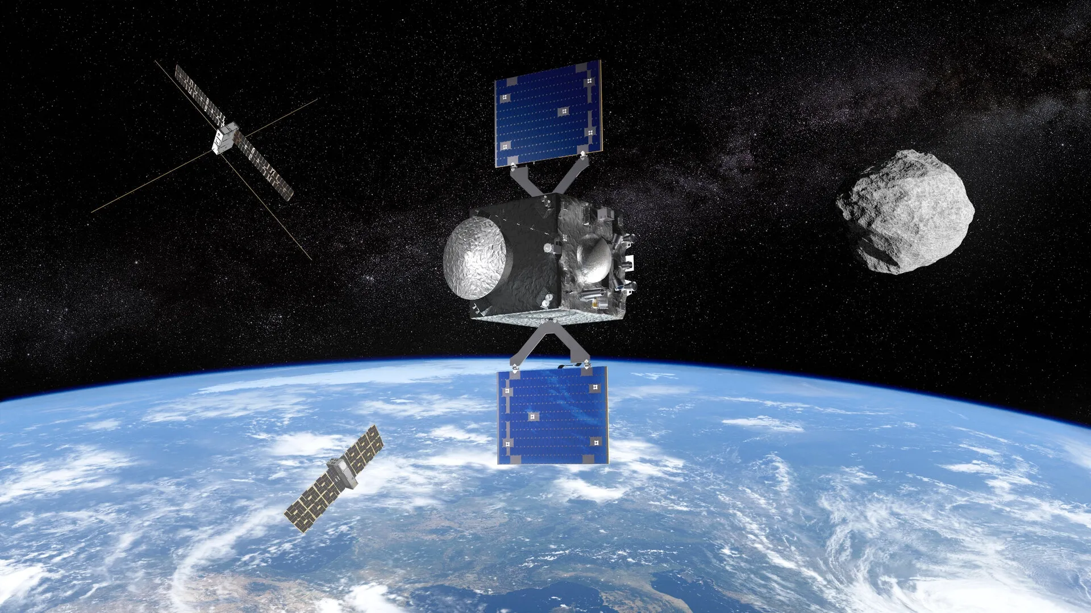
RAMSES: Mission objectives
RAMSES is ESA‘s candidate mission to rendezvous with Apophis prior to Earth encounter in 2029
High-level mission objectives
Characterize Apophis with high-resolution before (and after) the encounter:
Orbit (semimajor axis altered from 0.9 AU to >1AU)
Spin state and orientation (1% accuracy)
Shape and surface changes (10 cm resolutio needed)
Interior structure
Presence of dust <1mm
Interaction with solar wind and Earth’s magnetosphere
Mass, density and porosity (1% accuracy)
Monitor Apophis with high temporal resolution (1min) during the encounter (“live feed“)
Notes:
THIS COULD BE EVENTUALLY THE FIRST SLIDE.
THIS COULD BE SUBSTITUTED BY THE FOLLOWING THREE OR ARE THEY TOO LONG?

Slide 5
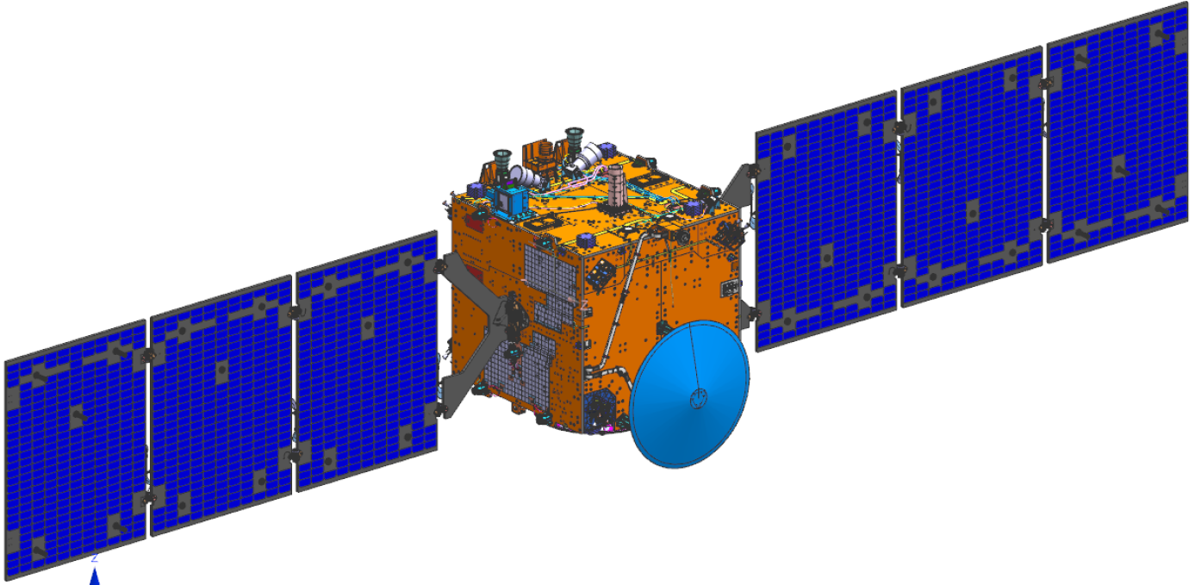
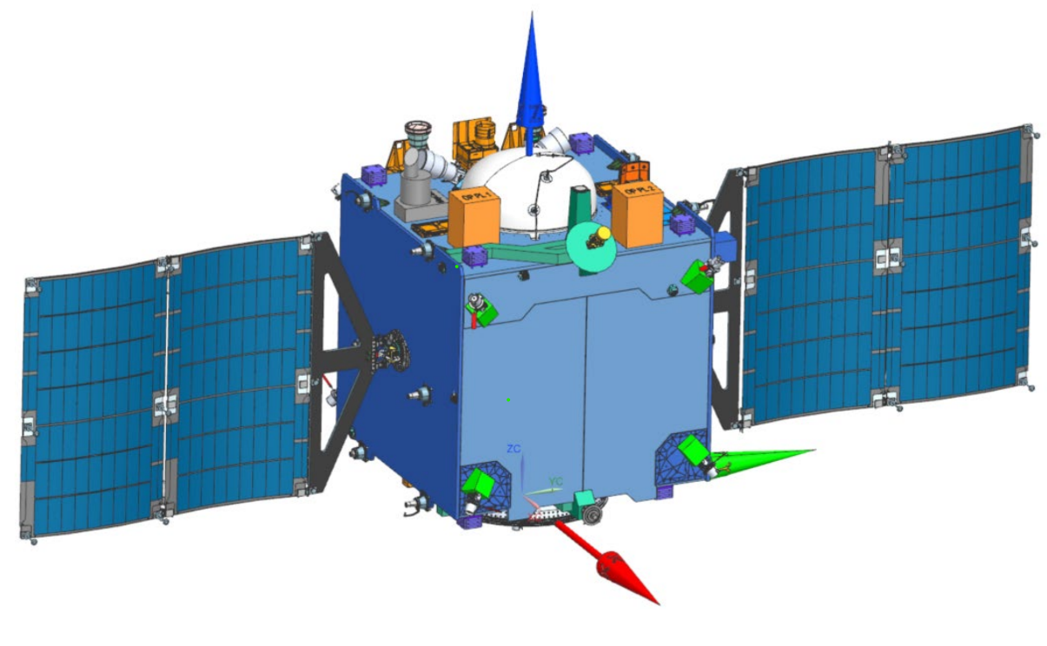
RAMSES Technical overview – Evolution w.r.t. Hera
Main adaptations | Phase 2: Consolidation / Early Implementation (2024-25)
System level | Partial Single String for lower mass, schedule and cost Reliability still >0.9 thanks to short mission (18 months)
Structure | Central Tube: attachment points shift Asteroid deck cutout
Power | SAW: NEC SAW Lighter PCDU (less units to “feed” due to single string)
Propulsion | Larger Tanks (331 l)
COMMS | MGAs or smaller dish

Slide 6

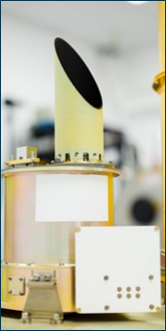
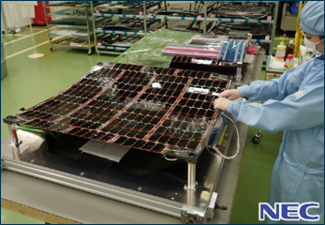
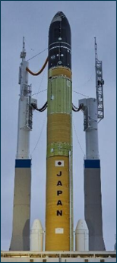




International Cooperation
JAXA
Thermal Infrared Camera
Lightweight Solar Array
H3 Launch service (TBC)
Synergy with DESTINY+
NASA
Synergy with OSIRIS-APEX
Notes:
DO WE HAVE ANY DISCUSSION WITH THE LAST TWO SPACE AGENCIES?

Slide 7
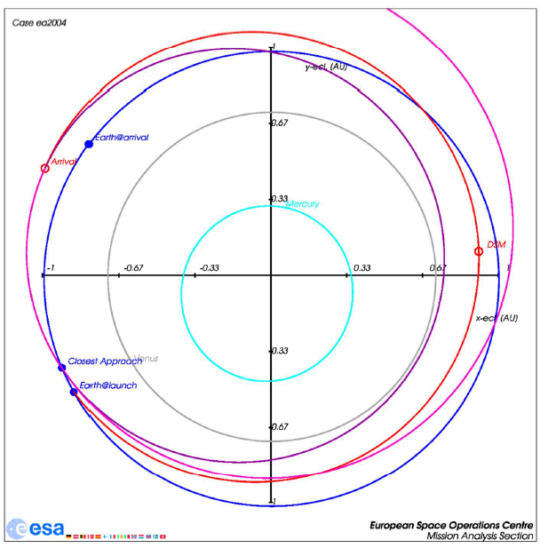
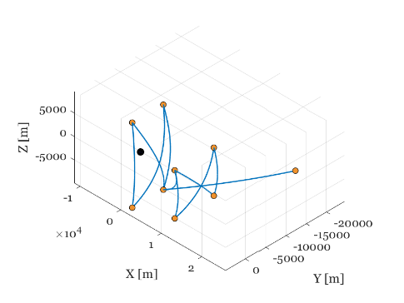
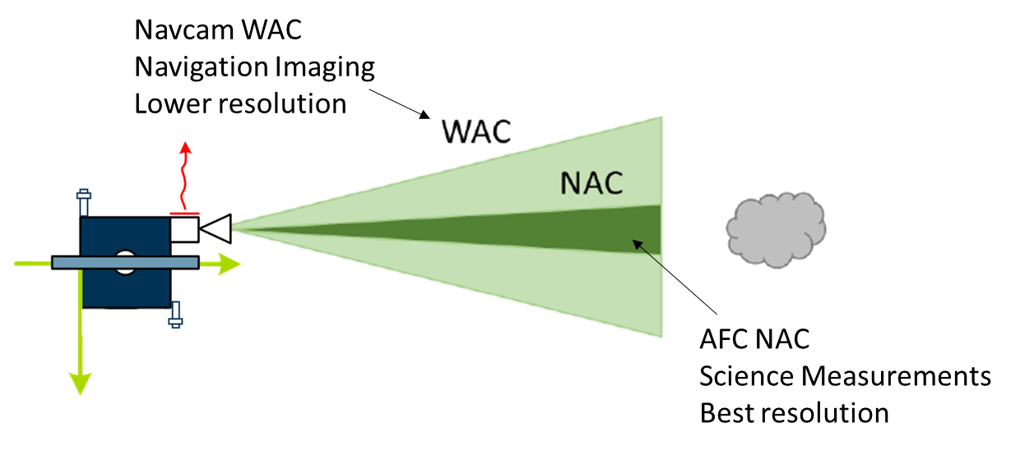
Mission Profile
RAMSES Mission Profile
Launch | Launch Vehicle | Ariane 6.2/Shared Ariane 6.4/Shared H3 (JAXA)
 | Launch Window | 20 April – 15 May 2028
Transfer | Duration | 10 months
 | Delta V | < 1590 m/s
 | Arrival at Apophis | February 2029
Close Proximity Operations | Insertion Manoeuvres | <20 days
 | Pre-encounter Phase (PRE) | 1 March – 11 April 2029 Passively safe hyperbolic arcs (20km) Hovering [50m box] in steps from 20 to 1 km
 | Close-encounter Phase (CEP) | 12-14 April 2029 Hovering at 5 km (Constant Sun phase angle)
 | Post-encounter Phase | Hyperbolic + hovering trajectories TBC
 | End of nominal Ops | August 2029
 | Experimental phase | Extended operations Autonomy experiments Controlled descent Commercial deep-space operations test bench ….
Notes:
WHO SPEACK ABOUT THE MISSION PROFILE?

Slide 8
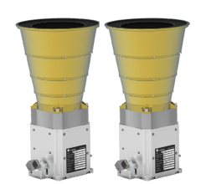
Mission Core and Opportunity Payloads
CORE payload suite: guarantees the achievements of the core mission objectives
2 X AFC cameras (used also for navigation)
Reuse of Hera AFC flight spare
Second AFC with complementary FoV
Radio Science/ISL
OPPORTUNITY Payload suite incl. 2 x 6U CubeSats
Selected for the mothercraft:
Thermal Infrared Imager (JAXA+BE) , Laser Altimeter (DE/IT) ,
Hamlet (hyperspectral with two channels 0.65-0.95 μm and 0.85-1.7 μm, IT),
CHANCES (high resolution camera in the visible range with colour filter, CH+FR),
RPS (RAMSES Plasma Spectromteter, Interaction of Asteroid with solar wind & Earth’s magnetosphere, DE)
Candidate Payload for the CubeSats
Cubesat 1: Vista (IT), Low frequency Radar (FR), Navcam (IT)
Cubesat 2: NAVCAM and if landing: Gravimeter(BE), Seismometer (FR), Magnetometer (DE)

Slide 9
Close Proximity Operations
Preliminary timeline
2 weeks (TBC) in ‘rectangular’ hyperbolic arcs (equivalent to ECP in HERA)
3-4-3-4 day arcs allowing for intermediate communication windows with MGA
2 weeks (TBC) in ‘bow-tie’ hyperbolic arcs (equivalent to DCP/COP in HERA)
3-4-3-4 day arcs allowing for intermediate communication windows with MGA
TBD if this is needed or directly start hovering
2 weeks (TBC) hovering at low distances (1km)
Some hovering stations to allow for simultaneous science & Earth communication
CEP: C/A +/-1 day
Hovering @ 5km relocating station for Post-CEP operations
Fast evolution of Sun-Apophis-Earth angle in this phase

Slide 10
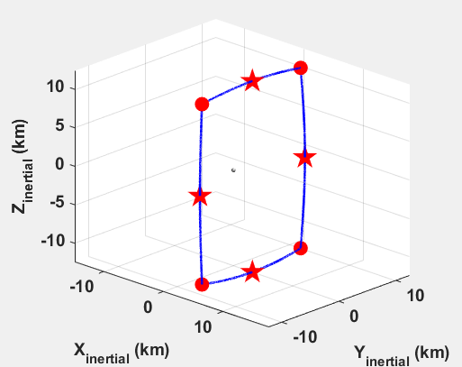
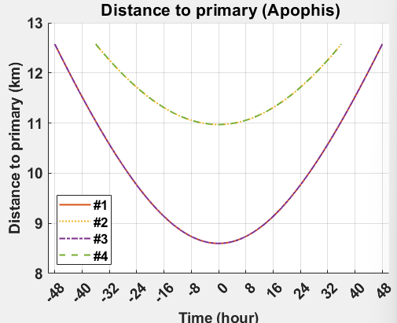
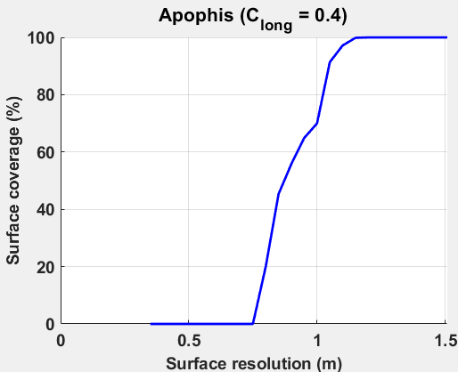
Rectangular Hyperbolic Arcs
Size chosen to maximise resolution over entire surface
Aimed at estimating the gravity parameter and refining the shape model to fine tune GNC algorithms for following phases.
Mapping assumes spherical shape & prime meridian aligned with Sun at each pericentre
Surface covered with resolution <1.2m
Coverage conservative due to assumption of prime meridian (Apophis spin period 30h)

Slide 11
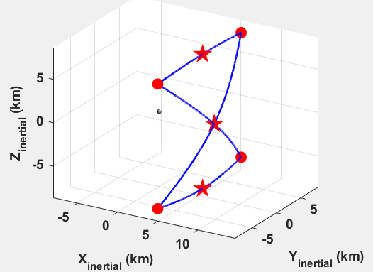
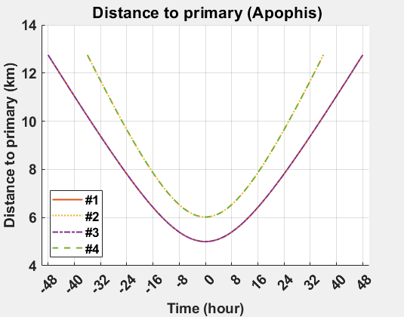
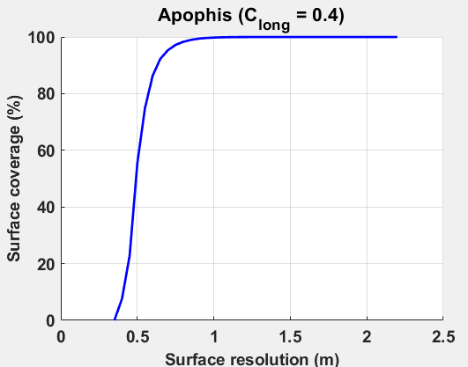
Bow-tie hyperbolic arcs
Full asteroid in FOV of NAC (500m diameter)
Max resolution only around pericentres
Max latitude ~61deg
Mapping assumes spherical shape & prime meridian aligned with Sun at each pericentre
Most surface covered with resolution <1m
Pole coverage for Apophis conservative due to slow rotation

Slide 12
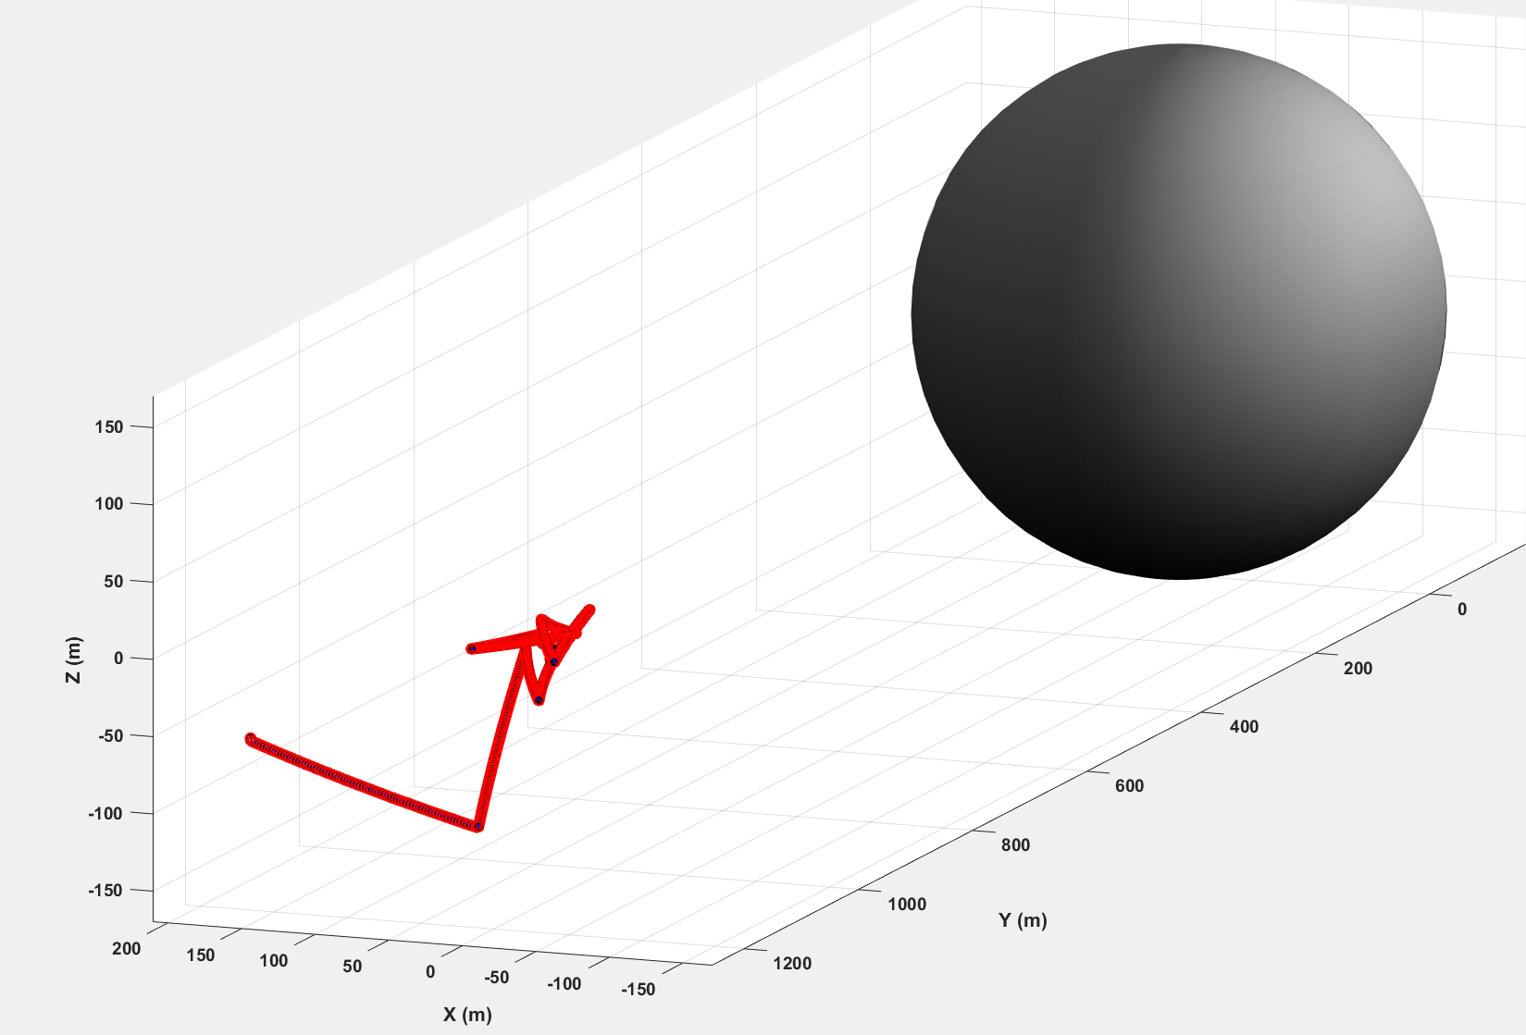
Hovering
Restricted Sun phase angle [15-75]deg
GNC requirements allow for simultaneous science & Earth communications with MGA
Hovering station can move to different latitudes (no MGA comms)
Transition via circular arcs (TBC)

Slide 13
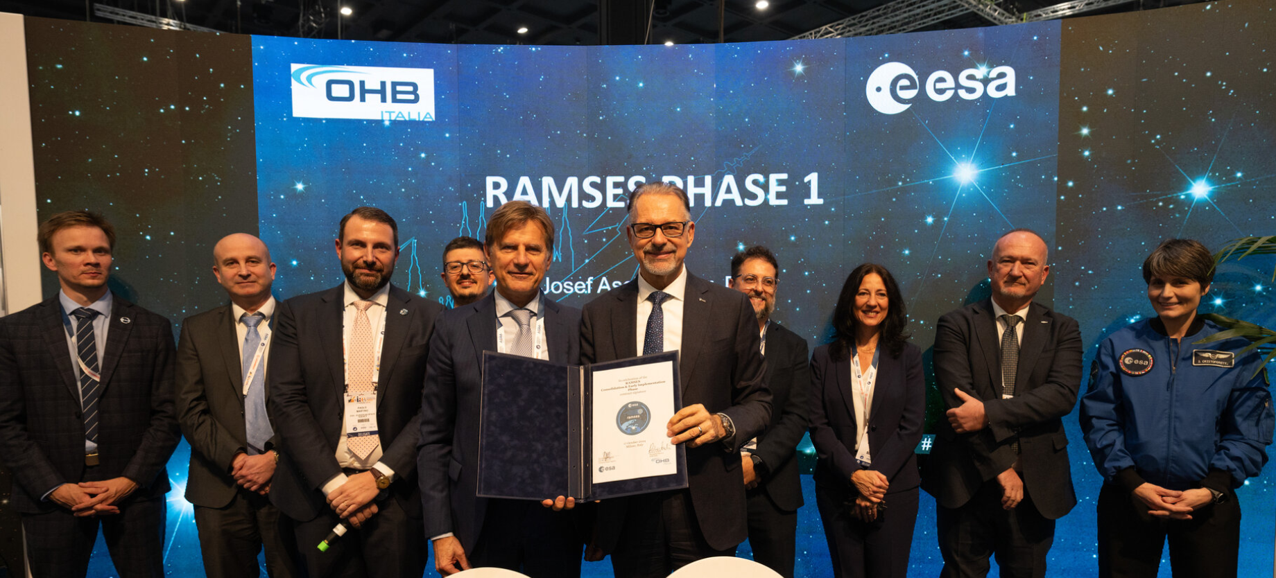
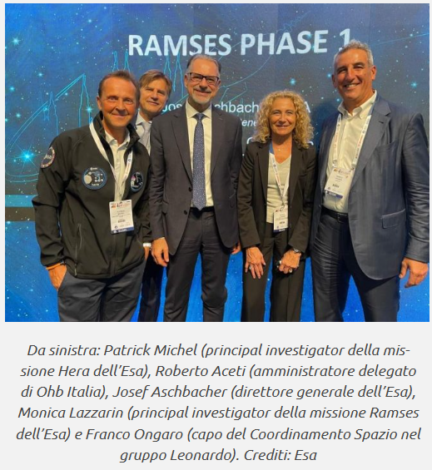
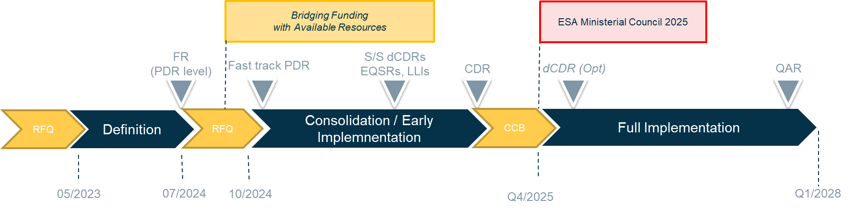
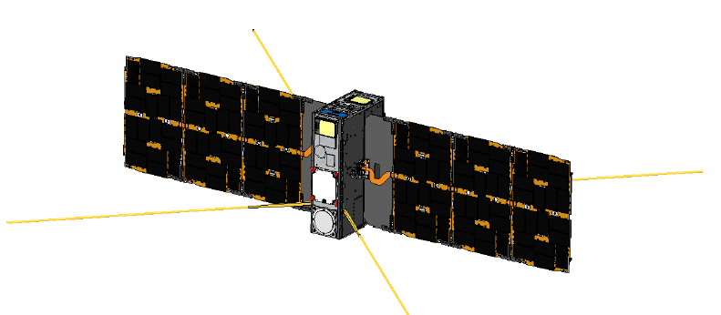
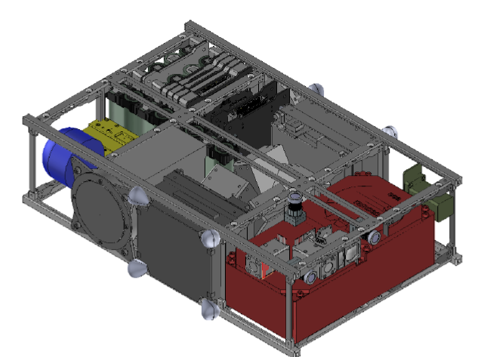
RAMSES Programmatic Status
Following programmatic authorization to make use of available program resources, preparatory promptly initiated (approx. 70 M€) to cover:
RAMSES [OHB-I with OHB, GMV and subcontractors]
Successful PDR in Q1 25, s/s level reviews and EQSRs ongoing
CubeSat 1 [Tyvak(IT) and subcontractors]
SRR ongoing
CubeSat 2 [EmXys(ES) with GomSpace(DK) and subcontractors]
SRR planned in May 2025

Slide 14
Master Schedule – Key Dates
PDR Successful: 25 Nov 24 – 16 Jan 25
CDR: Nov 25 - Feb 26 (across ESA Ministerial Conf. 2025)
Equipment Flight Model delivery: Feb-Sep 26
S/C Integration: up to Dec 2026
Functional tests: Jan – May 27
Environmental Test Campaign: Jun - Dec 2027
Qualification and Acceptance Review: Q1 2028
S/C shipment: end Mar 2028
Launch: Apr-May 2028
Hera reference
PDR Sep 20
CDR Jul 22
Prop Module assembly & Test: Mag 21 – Feb 22
Core module Integration: Jan –Jun 23
S/C mating Jun 23
Shipment to European Test Servicing: Aug 23
Environmental tests: 6 months (net)
Shipment to launch site: Aug 24

Slide 15
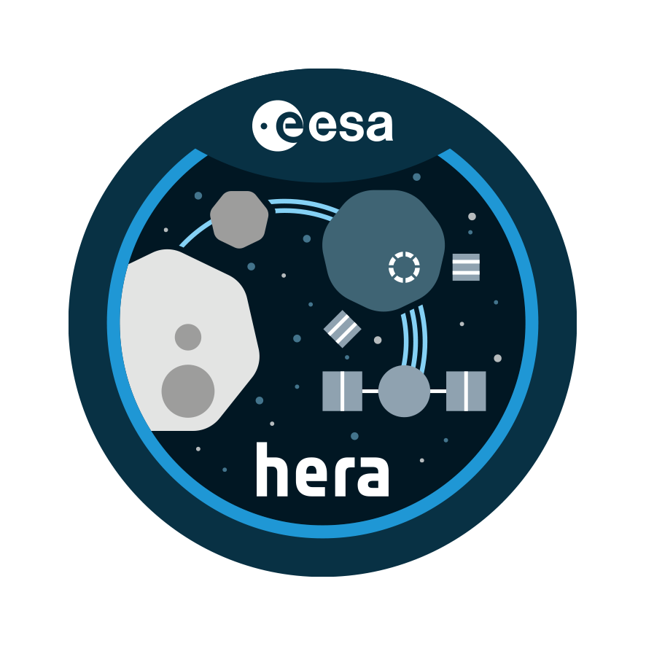

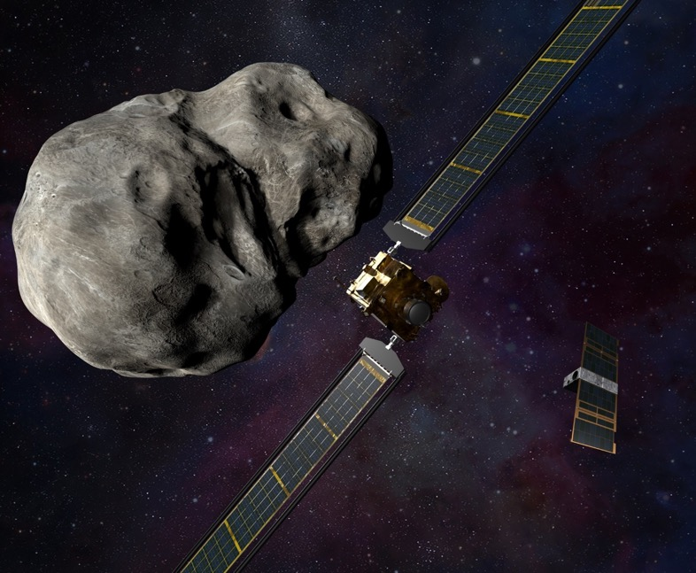
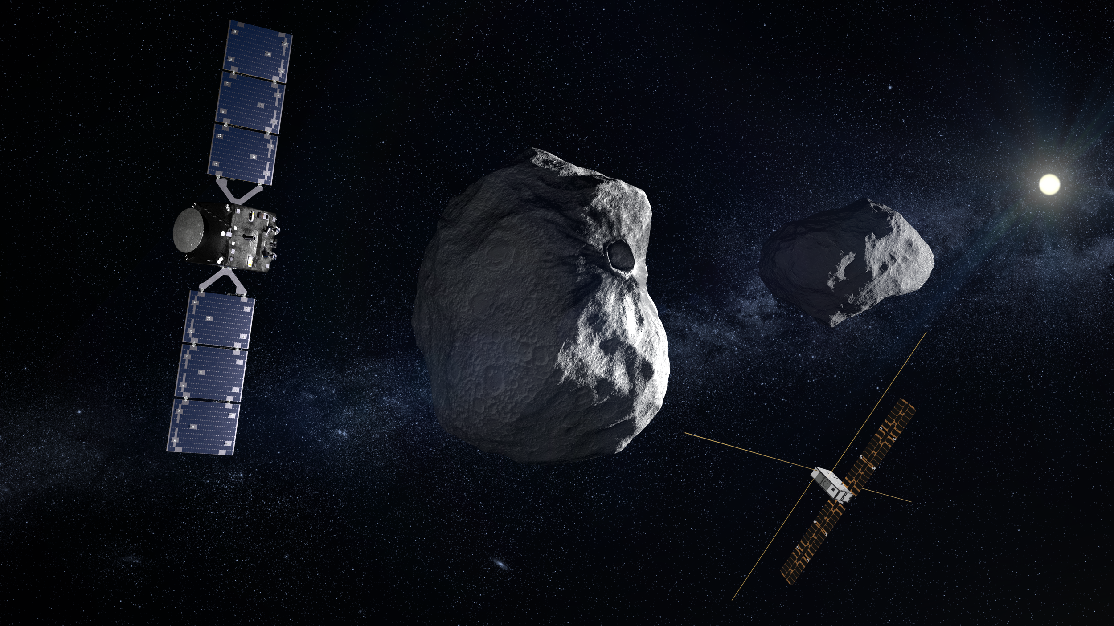




International Cooperation
at the heart of Planetary Defense
Other?

Slide 16

Conclusion
Fast development of RAMSES: demonstration of a rapid response planetary defense test
Multi-satellite approach combining a wide range of measurements (surface geology and composition, gravity, interior, seismic properties (first time), dust detection and analysis, plasma science)
Promizing synergies with other planned (OSIRIS-APEX) and possible missions
Contributions from JAXA as well as possible NASA support set the ground for yet another outstanding international collaboration.
A great return in terms of asteroid science and planetary defense following a very rare event
The expected attention from the media and the general public is unprecedented. Such high visibility represents a unique opportunity for public engagement and outreach, noting that 2029 will be the International Year of Asteroid Awareness and Planetary Defense.

Slide 17
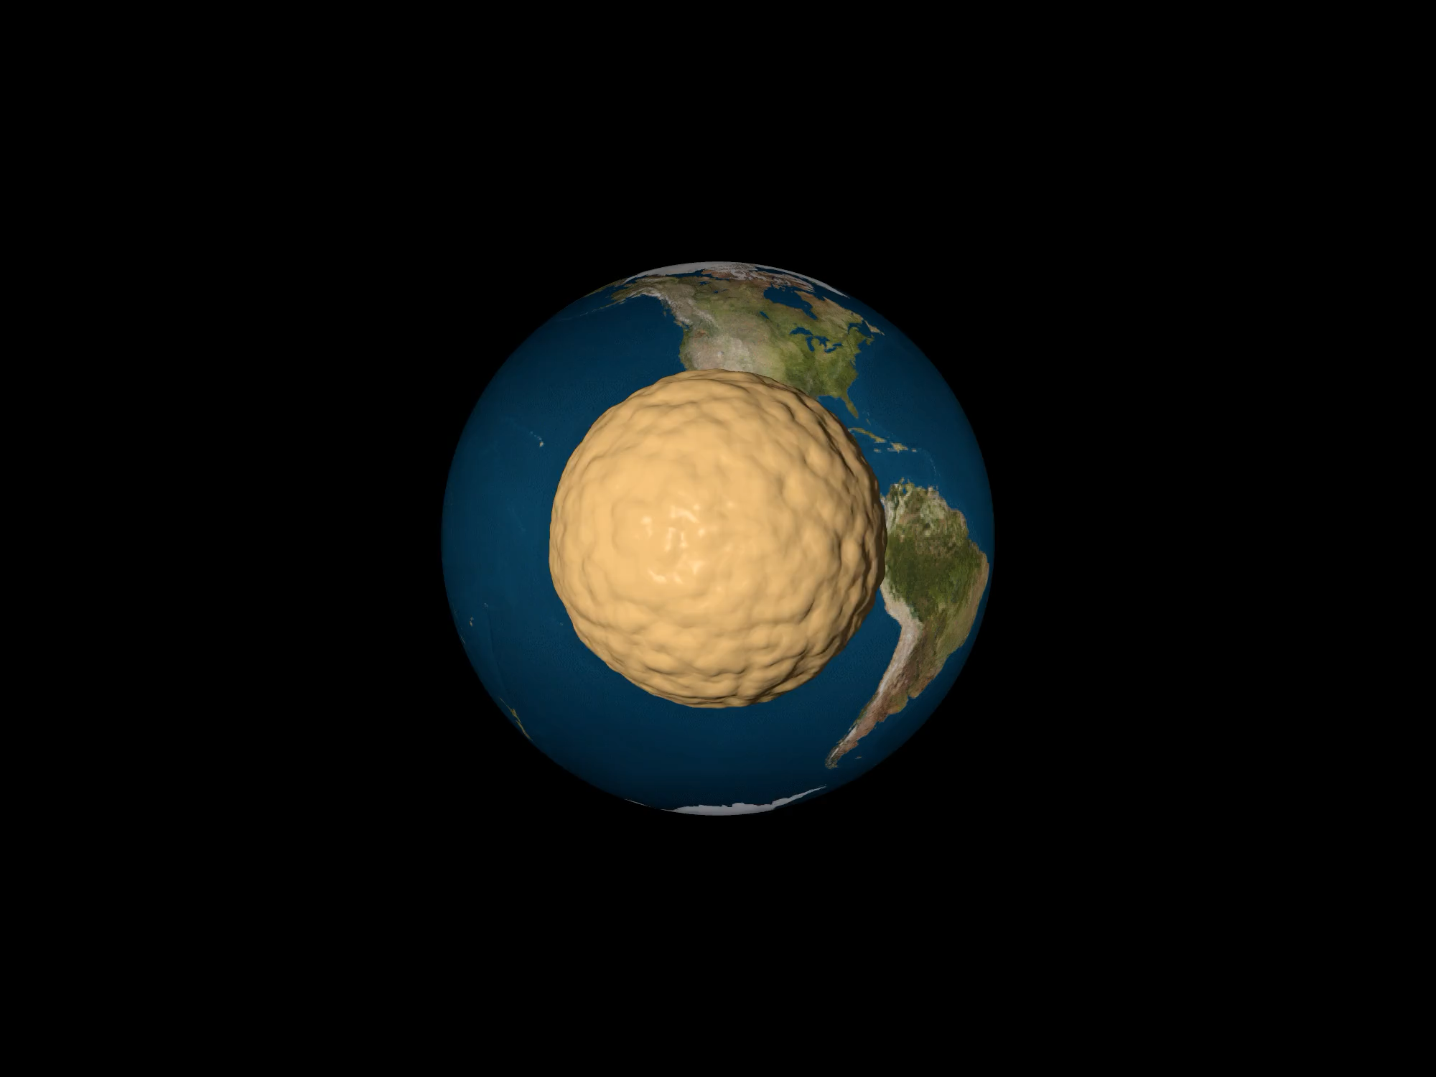
From Zhang & Michel 2020
Close approach of a cohesionless rubble pile at much closer distance than Apophis:
3 Earth’s raddii
(5.6 Earth’s raddii for Apophis)

Slide 18

Thank you

Slide 19
Payload contribution to mission objectives
Objective | Requirement | Prime instrument | Contributing instrument
Orbit | N/A (Reqs specified for other properties are sufficient) | AFC Radio Science | Transmitter/Landmark TIRI
Spin State and orientation | Orientation: 5 deg(TBD) Spin rate: 1% (primary) Spin rate: 10% (secondary) | AFC | Laser Altimeter (Landing) CubeSat
Shape and surface changes | Imaging resolution: 10 cm Image rate at CEP: 1 min | AFC | Laser Altimeter Hyperspectral imager TIR Imager
Interior structure | Global Goal: Few meters | Radio Science | Low Frequency Radar Seismometer
Dust | TBD | Cameras | Dust detector (VISTA) for < 1 mm
Cohesion | Global: OoM Local: Within factor of 2 | AFC | (Landing) CubeSat (Accelerometers, directmeasure)
Mass, density, porosity | 1% | Radio Science | TIR Imager (through thermal inertia) Low Frequency Radar (density / porosity) Landing CubeSat (in-situ local density and porosity)

